Slide 1
Sở Giáo Dục và Đào Tạo Bình Định
Trường THPT Xuân Diệu
Giáo viên: Trần Thị Minh Thủy
Lớp: 10A6
Môn: Tiếng Anh

Slide 2

Welcome to our class !

Slide 3

UNIT 3: SHOPPING
Lesson 2.1 – Vocabulary & Listening
Page 23

Slide 4




Lesson 2.1
Unit 3 Lesson 2.1
LESSSON OUTLINE
Consolidation

Slide 5

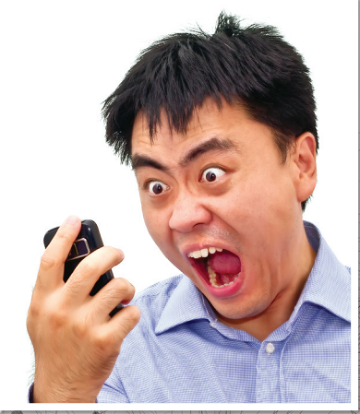
Unit 3 Lesson 2.1
Work in pairs.
What do you do when the phones
you have just bought don’t work?
I will take it to the store that I bought it

Slide 6


Unit 3 Lesson 2.1

Slide 7


Unit 3 Lesson 2.1
- crash /kræʃ/ (v) (máy tính) gặp sự cố
- disconnect /ˌdɪskəˈnekt/ (v) ngừng kết nối
- overheat /ˌoʊvərˈhiːt/ (v) trở nên quá nóng
- receipt /rɪˈsiːt/ (n) hoá đơn
- repair /rɪˈper/ (v) sửa chữa
- restart /riːˈstɑːrt/ (v) khởi động lại
- warranty /ˈwɔːrənti/ (n) bảo hành

Slide 8
Unit 3 Lesson 2.1
Extra Practice
WB, page 16
a. Fill in the missing letters.
1. r e __ __ __ r
2. __ v __ __ __ e __ _
3. __ __ s t __ __ __
4. __ e c __ __ __ __
5. __ a __ __ a __ __ __
6. __ r __ __ __
7. __ __ s __ o __ __ __ __ __
p a i
o e r h a t
r e a r t
r e i p t
w r r n t y
c a s h
d i c n n e c t
Notes:
Taken from TA 10 i-Learn Smart World WB, page 2

Slide 9
Unit 3 Lesson 2.1
a. Match the underlined words to the definitions. Listen and repeat.
disconnect overheat receipt warranty restart repair crash
disconnect
1. _________ – break a connection between two things
2. _________ – suddenly stop working
3. _________ – become too hot
4. _________ – turn off and on
5. _________ – a paper showing what you bought, when you bought it, and how much it cost
6. _________ – fix something
7. _________ – a written promise from a company to fix or replace a broken product
crash
overheat
restart
receipt
repair
warranty
Notes:
Please, click on each phrase to hear the sound

Slide 10
Unit 3 Lesson 2.1
Extra Practice
WB, page 16
Now, Fill in the blanks with the correct forms of the words in Task a.
disconnect overheat receipt warranty restart repair crash
crashes
1. Save your document. If the computer ___________________, you will be able to open it again.
2. My new laptop came with a three-year ____________________. If there's a problem, the store will fix it for free.
3. The fan switches on, so the computer doesn't ________________.
4. My phone stopped working. I'll have to ask the store to ______________________ it.
warranty
overheat
repair
Notes:
Taken from TA 10 i-Learn Smart World WB, page 2

Slide 11
Unit 3 Lesson 2.1
Extra Practice
WB, page 16
Extra Practice
WB, page 16
Now, Fill in the blanks with the correct forms of the words in Task a.
disconnect overheat receipt warranty restart repair crash
disconnect
5. Your phone battery is full. I'll ______________________ the charger for you.
6. So, the phone is 199 dollars, and you gave me two hundred dollars. Here's a dollar change and your _______________.
7. If the computer crashes, turn it off and then on again to ______________________ it.
receipt
restart
Notes:
Taken from TA 10 i-Learn Smart World WB, page 2

Slide 12
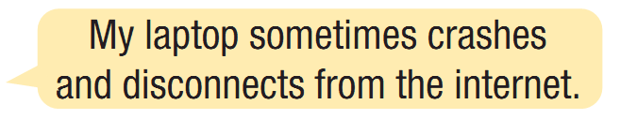
Unit 3 Lesson 2.1
b. In pairs:
Talk about what problems you've had with your devices by using the new words you have just learnt.

Slide 13



Slide 14

Unit 3 Lesson 2.1
While-Listening
a. Listen to Jess talking to the manager of an electronics store. Why is she at the store?
She wants to get her money back.
Her laptop needs repairing.
✓

Slide 15
Unit 3 Lesson 2.1
Pre-Listening
b. Now, listen and complete the form.
What are you going to do?
→ Listen and complete the form
What are some key words in the question?
→ Customer name, Phone number, Item, Problem, Warranty, Note

Slide 16
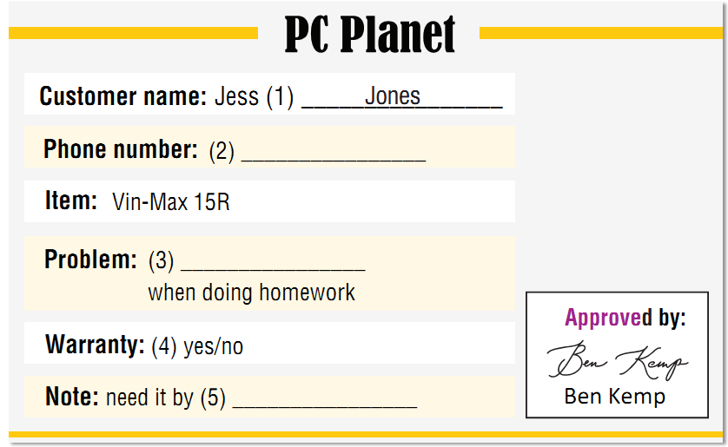
Unit 3 Lesson 2.1
While-Listening
What kind of word is needed?
numbers
a noun / gerund
Yes or No
a day / a date

Slide 17
Unit 3 Lesson 2.1
While-Listening
b. Now, listen and complete the form.
077-274-7641
overheats
Thursday

Slide 18
Unit 3 Lesson 2.1
Audio Scripts
Matt: Hi, welcome to PC Planet. How can I help?
Jess: Good morning, I'd like to speak to the manager, please.
Matt: Of course, one moment please.
Ben: Hi, I'm Ben. I'm the manager. How can I help today?
Jess: Hello, Ben. I have a problem with my laptop.
I bought it from here a few months ago.
Ben: OK, what's the problem?
Jess: It overheats when I do my homework. Like yesterday,
when I tried to save my essay, it became really hot
and crashed.
Ben: Sorry about that. We probably need to repair it. Can I
take your name, please?
Jess: Yes, it's Jess Jones. That's J-E-S-S J-O-N-E-S.

Slide 19
Unit 3 Lesson 2.1
Ben: OK. And can I take your phone number?
Jess: 077-274-7641.
Ben: And the problem is it overheats when you do your
homework, right? Anything else?
Jess: No, just that.
Ben: OK. Do you have your receipt?
Jess: Erm...yes. Here it is.
Ben: OK, it's still under warranty. We can repair it for free.
Jess: Great.
Ben: Thank you, Jess. We'll call you when your laptop is
ready. Probably on Thursday or Friday, OK?
Jess: Could you finish it by Thursday? I need to finish my
essay for Friday.
Ben: OK, I think we can finish it by then.
Jess: Great, thanks.
Audio Scripts

Slide 20
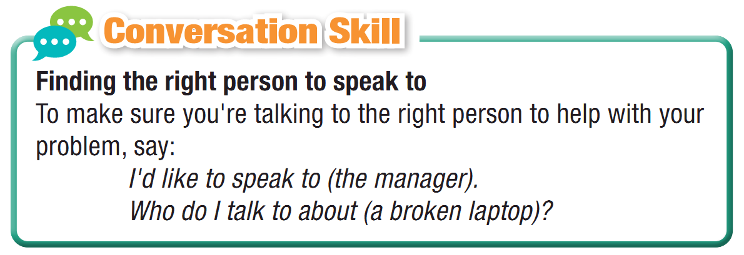
Unit 3 Lesson 2.1
Post - Listening
Read the Conversation Skill box and listen to Task b. audio again. Circle the phrase in the Conversation Skill box that you hear.

Slide 21
Post - Listening
d. Listen and repeat.

Slide 22

Unit 3 Lesson 2.1
Post - Listening
e. In pairs:
What would you do if you bought an expensive phone or laptop and it broke the next day?
How would you feel?
I would feel disappointed because ……

Slide 23

Consolidation

Slide 24
Unit 3 Lesson 2.1
Write a paragraph about your experience of shopping online. (100-120 words)

Slide 25
Unit 3 Lesson 2.1
Consolidation
Today’s lesson
Vocabulary: complaints
Listening: for specific information
Speaking: starting a friendly conversation asking and answering about the problems of the items

Slide 26
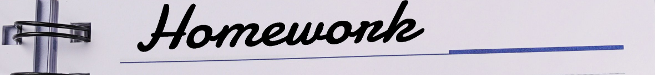
Unit 3 Lesson 2.1
Make sentences about complaints.
Do the exercises in WB on page 16.
Do the exercises in Tiếng Anh 10 i-Learn Smart World Notebook on page 16.
Prepare the next lesson - Grammar on page 24 in SB.
Play consolidation games in Tiếng Anh 10 i-Learn Smart World DHA App on www.eduhome.com.vn

Slide 27

Have a nice day!

