Slide 1
Sở Giáo Dục và Đào Tạo Bình Định Trường THPT Xuân Diệu Giáo viên: Võ Mỹ Thư Lớp : 11A10 Môn: Tiếng Anh

Slide 2
WATCH A VIDEO
ANSWER

Slide 4
UNIT9: EDUCATION IN THE FUTURE
Lesson 3.2: Writing and speaking
Teacher: Vo My Thu
Class: 11A10

Slide 5
CONTENTS
1
Warm-up
4
consolidation
2
writing
5
wrap-up
3
speaking

Slide 6
WRITING
Read Ben’s essay (p. 98) again and underline the problems and solutions
Ben’s Dream Jobs:
The needs:______
Solutions: __________

Slide 7
Read Ben's essay again and underline the needs and solutions.
I have always wanted to be an animator. I have researched it and known how to do it. However, I don't think many teenagers know how to get their dream jobs. Let me tell you about mine and how I am going to get it. I hope this will help other people to get their own dream jobs.
The first thing I need is a university degree in computer animation. This degree tells people I know how to use animation programs. It will teach me how to use the software to create amazing pictures. All animators need this. Another thing I need is to have great communicative skills because I will have to be able to take feedback well. Finally, I need to get work experience working for different companies to know more about the industry.
I have decided to study animation at the School of Visual Arts in New York to get my degree. I am going to ask my friends for feedback on my drawings and discuss changes with them to improve my communication skills. I am going to find work experience over the holidays while I am at university to get experience.
These are the three most important things I think I need to do to get my dream job. Hopefully, after reading this, you can start to plan for your dream job.

Slide 8
OUTLINE
Dream job - an animator
Body 1: | Body 2:
Need 1: a university degree | Solution 1 (where): study animation at the School of Visual Arts in New York
Need 2: communicative skills | Solution 2 (How): ask my friends for feedback on my drawings and discuss changes
Need 3: work experience | Solution 3 (How): find work experience over the holidays
Ex: These are the three most important things I think I need to do to get my dream job. Hopefully, after reading this, you can start to plan for your dream job.
1. Introduction
- Introduce the topic and problem
2. Body:
2 paragraphs about problems and solutions.
3. Conclusion:
summarize the information & make an action statement

Slide 9
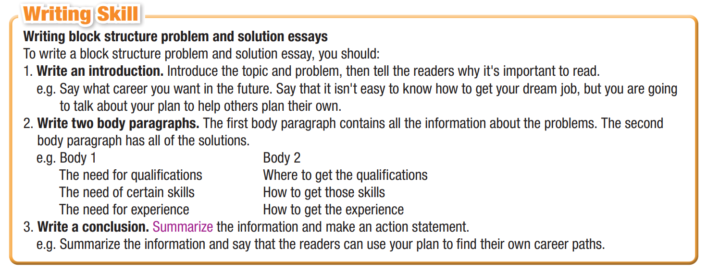
Task a
Read about writing a block structure problem and solution essay.

Slide 10
YOUR DREAM JOB
DEGREE
SKILLS
EXPERIENCE
Here are three most important things you need to get a job

Slide 11
Match the problems with the solutions. Use the block structure problem and solution essay model to help you.
Task b
I need a degree in social
science.
1. I will ask my dad if his company needs some help.
5
2. I will take a public speaking class.
B. I am not good at math.
3
C. I get nervous when I give a presentation.
3. I will get a math tutor after school.
2
D. I need work experience.
1
4. I will join the soccer team and practice with them a lot.
E. I need to have good teamworking skills.
4
5. I will attend the University of Fordcester.

Slide 12
Task b
Complete the table with your three most important needs and reasons why, then add solutions.
English teacher
communicative skills
All teachers need this
study English Teaching at Quy Nhon University
a university degree
take a public speaking class
teach me how to be a great teacher
not as good at speaking and listening
improve my fluency in English
practise speaking English with friends or foreigners on social platforms

Slide 13
Your dream job
you can do it
Write an essay (150–180) for your school newspaper about your dream job. Talk about the three most important things you need and how you will get them.

Slide 14
English teacher
a university degree
communicative skills
my fluency in English

Slide 15
Complete the essay with given ideas:
I have always wanted to be an English teacher. I have researched it and know how to do it. However, I don't think many teenagers know how to get their dream jobs. Let me tell you about mine and how I am going to get it. Maybe it will help you.
The first thing I need is ______________________________. It will_____________________ _______________________________. Another thing I need is________________________. ___________________________________________________________. Finally, I need to _______________________________.____________________________________________
I have decided to __________________________________________. I am also going to _________________________________________. I plan/intend to__________________ ___________________________________________________________________________.
These are the three most important things I think I need to do to get my dream job. Hopefully, after reading this, you can start to plan for your dream job.

Slide 16
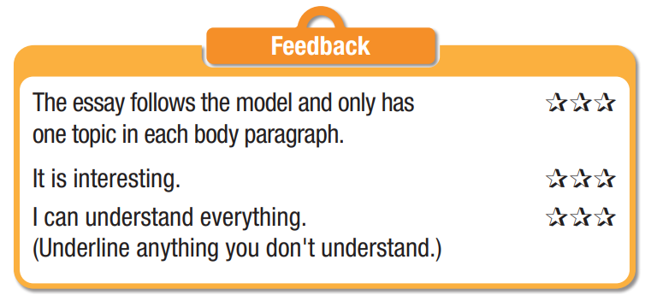
Peer check
Exchange your writing with your partner for checking the following points:

Slide 17
MODEL:
I have always wanted to be an English teacher. I have researched it and know how to do it. However, I don't think many teenagers know how to get their dream jobs. Let me tell you about mine and how I am going to get it. Maybe it will help you.
The first thing I need is a university degree in English Teaching. It will teach me how to be a great teacher. Another thing I need is great communcative skills and patience. All teachers need this. Finally, I need to improve my fluency in English. I am good at reading and writing, but I am not as good at speaking and listening.
I have decided to study English Teaching at Quy Nhon University to get my degree. I am also going to take a public speaking class next summer to improve my communicative skills. I am going to practise speaking English with friends or foreigners on social platforms daily to improve my English fluency.
These are the three most important things I think I need to do to get my dream job. Hopefully, after reading this, you can start to plan for your dream job.

Slide 18
SPEAKING

Slide 19
Task a
With a partner, discuss your dream jobs. Say what degree, skills and experience you need, and how to get them.
I want to be an English teacher.
I need a university degree.
I plan to study at a university near my hometown.

Slide 20
SPEAKING
- Choose a card having the need on it
- Talk about why you need it for your job and how can you get it.
- The class will guess the name of the job

Slide 21
My Dream job
a degree in English Teaching
It will teach me how to teach children in a right way with suitable methods. Therefore, I plan to study at Quy Nhon university to get my degree.
ENGLISH TEACHER

Slide 22
My dream jobs
These are things you need:
A university degree in nursing
communicative skills
good physical health
be creative and updated

Slide 23
CONSOLIDATION

Slide 24
WRAP-UP

Slide 25
Today’s lesson
Writing:
Write a block structure problem and solution essay about a dream job.
Speaking:
Talking about how to get a dream job.

Slide 26
Homework
Do the exercises on page 55 WB.
Prepare the next lesson (page 100 SB)
Play the consolidation games on www.eduhome.com.vn

