Slide 2
Unit
4
Asean and Viet Nam
Unit
FAMILY LIFE
LESSON 3
READING
ASEAN news

Slide 3
WARM-UP
Labelling game

Slide 4
WARM-UP
Students work in 4 groups
There are some news headlines and some categories: Sport, Laws, Education, etc…
Raise your hands to get turns and choose the correct category for the headlines.

Slide 5
Choose the correct category for the headline.
1
Economy
Food
Politics
Sport

Slide 6
Choose the correct category for the headline.
2
Economy
Food
Law
Sport

Slide 7
Choose the correct category for the headline.
3
Economy
Food
Politics
Sport

Slide 8
Put the news headlines in the correct category
4
Economy
Education
Politics
Sport

Slide 9
Choose the correct category for the headline.
5
Economy
Food
Politics
Sport

Slide 10
Choose the correct category for the headline.
6
Economy
Education
Politics
Laws

Slide 11
PRE-READING
1
Work in pairs. Discuss the following questions.

Slide 12
PRE-READING
relation (n)
/rɪˈleɪʃən/
the connection between people, groups, organizations, or countries

Slide 13
PRE-READING
eye-opening (adj)
/ˈaɪˌəʊpənɪŋ/
surprising, and teaching you new facts about life, people, etc.

Slide 14
PRE-READING
represent (v)
/ˌreprɪˈzent/
to speak, act, or be present officially for another person or people

Slide 15
PRE-READING
live stream (n)
/ˈlaɪvstriːm/
a broadcast of the video and sound of an event over the internet as it happens

Slide 16
Form | Pronunciation | Meaning
1. relation (n) | /rɪˈleɪʃən/ | the connection between people, groups, organizations, or countries
2. eye-opening (adj) | /ˈaɪˌəʊpənɪŋ/ | surprising, and teaching you new facts about life, people, etc.
3. represent (v) | /ˌreprɪˈzent/ | to speak, act, or be present officially for another person or people
4. live stream (n) | /ˈlaɪvstriːm/ | a broadcast of the video and sound of an event over the internet as it happens

Slide 17
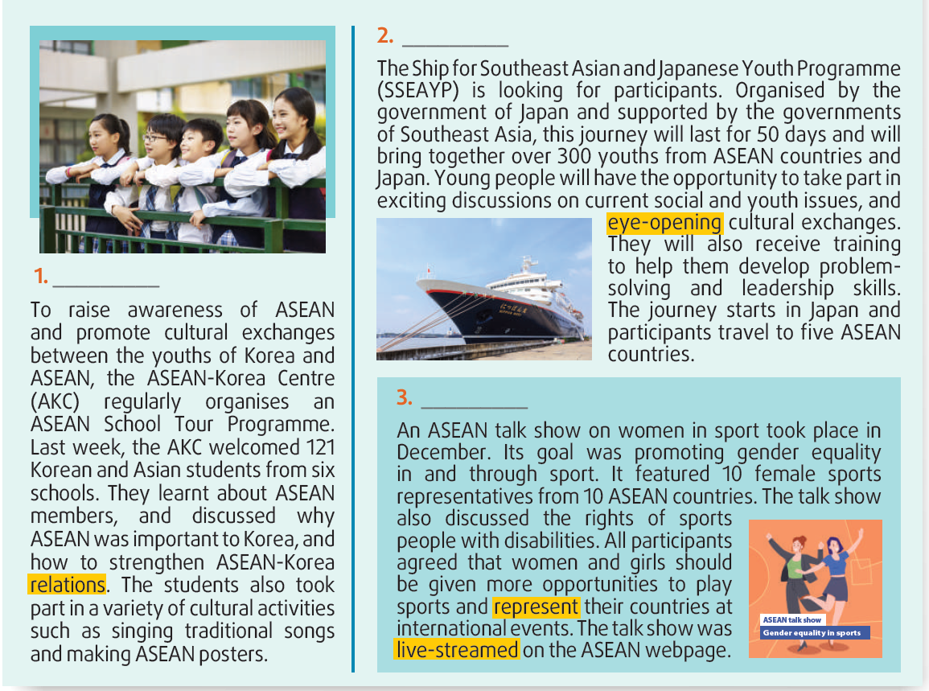
WHILE-READING
2
Read the news items and choose the most suitable headline for each one.
A
D
C
Answer key:
1. D 2. A 3. C

Slide 18
WHILE-READING
3
Read the news items again and match the highlighted words with their meanings.

Slide 19
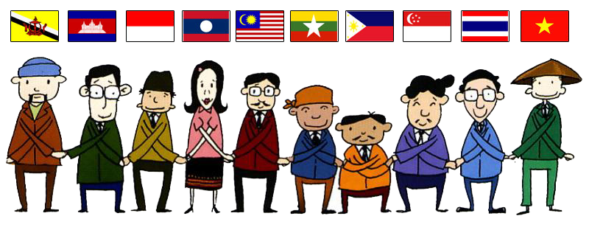
WHILE-READING
4
Read the news items again and answer each question below with no more than FOUR words and/or a number.
1. 121 (students)
2. 50 days
3. current social issues
4. (in) December
5. (on) the ASEAN webpage
ANSWER KEY

Slide 20
POST-READING
5
Work in groups. Discuss the following questions.

Slide 21
CONSOLIDATION
2
Homework
Do exercises in the workbook.
Prepare for Lesson 4 - Unit 4.

Slide 22
Website: hoclieu.vn
Fanpage: facebook.com/www.tienganhglobalsuccess.vn

