Slide 2
Unit
1
A long and healthy life
Unit
FAMILY LIFE
LESSON 3
READING
How to live a long and healthy life

Slide 3
WARM-UP
CROSSWORD
Work in groups.
Take turns to choose a word.
If you get the correct answer ➔ 1 point.
- If the answer is wrong or you don’t have the answer ➔ the chance is for other groups.
After 6 words you can answer the key word ➔ 5 points
If the key word is incorrect ➔ you are out of the game.

Slide 4
WARM-UP
1
H | E | A | R | T
2
D | I | E | T
KEY WORD: (11 letters)
A way of living that helps you enjoy more aspects of your life.
3
W | A | T | E | R
4
I | L | L | N | E | S | S
5
S | T | R | E | N | G | T | H
6
C | H | I | P | S
7
P | H | Y | S | I | C | A | L
8
C | A | L | O | R | I | E | S
9
E | X | A | M | I | N | E
10
S | U | F | F | E | R
11
V | E | G | E | T | A | B | L | E

Slide 5
WARM-UP
Question 1
heart
Eating too much fat can cause _______ diseases.

Slide 6
WARM-UP
Question 2
Go on a ______ means to begin a specific nutritional plan in an attempt to lose weight or achieve some other health benefits.
diet

Slide 7
WARM-UP
Question 3
A clear liquid that has no color or taste when it is pure.
→ water

Slide 8
WARM-UP
Question 4
A disease or period of sickness affecting the body or mind.
→ illness

Slide 9
WARM-UP
Question 5
The noun of ‘strong’
→ strength

Slide 10
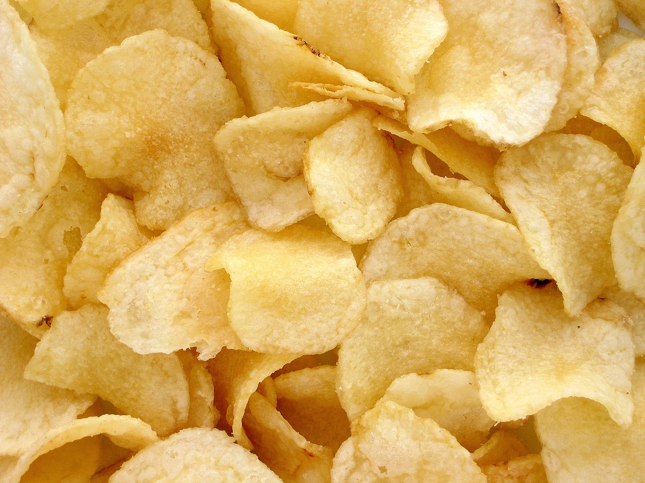
WARM-UP
Question 6
What is it?
→ chips

Slide 11
WARM-UP
Question 7
The subject P.E stands for __________ Education.
Physical

Slide 12
WARM-UP
Question 8
Doing exercises can burn out many __________.
calories

Slide 13
WARM-UP
Question 9
To look at or consider a person or thing carefully to discover something about them.
→ examine

Slide 14
WARM-UP
Question 10
Do you _________ from any allergies?
suffer

Slide 15
WARM-UP
Question 11
Eating enough _____________ and fruits is good for your digestive system.
vegetable

Slide 16
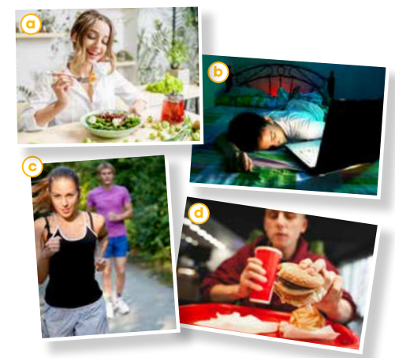
PRE-READING
1
Work in pairs. Look at the photos and discuss the questions.
Which photos show healthy habits?
Which ones show unhealthy habits?

Slide 17
PRE-READING
life expectancy (n)
/ˈlaɪf ɪkspektənsi/
the number of years that a person is likely to live

Slide 18
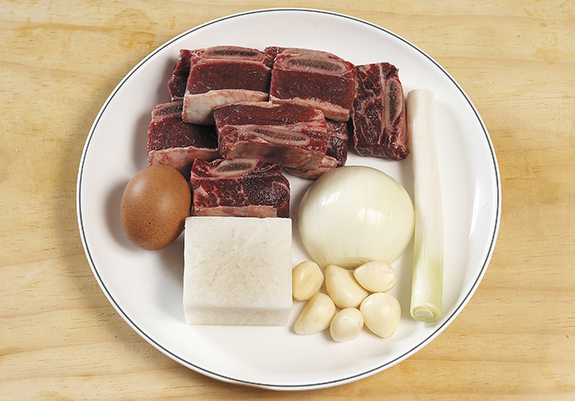
PRE-READING
ingredient (n)
/ɪnˈɡriːdiənt/
one of the things from which something is made, especially one of the foods that are used together to make a particular dish

Slide 19
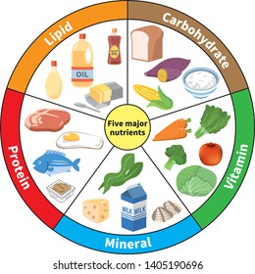
PRE-READING
nutrient (n)
/ˈnjuːtriənt/
a substance that is needed to keep a living thing alive and to help it to grow

Slide 20
PRE-READING
(to) give off
/ɡɪv ɒf/
to produce something such as a smell, heat, light, etc.

Slide 21
PRE-READING
repetitive (adj)
/rɪˈpetətɪv/
repeated many time

Slide 22
PRE-READING
Form | Pronunciation | Meaning | Vietnamese equivalent
1. life expectancy (n) | /ˈlaɪf ɪkspektənsi/ | the number of years that a person is likely to live | tuổi thọ
2. ingredient (n) | /ɪnˈɡriːdiənt/ | one of the things from which something is made, especially one of the foods that are used together to make a particular dish | nguyên liệu
3. nutrient (n) | /ˈnjuːtriənt/ | a substance that is needed to keep a living thing alive and to help it to grow | chất dinh dưỡng
4. (to) give off | /ɡɪv ɒf/ | to produce something such as a smell, heat, light, etc. | phát ra, tỏa ra
5. repetitive (adj) | /rɪˈpetətɪv/ | repeated many time | lặp đi lặp lại

Slide 23
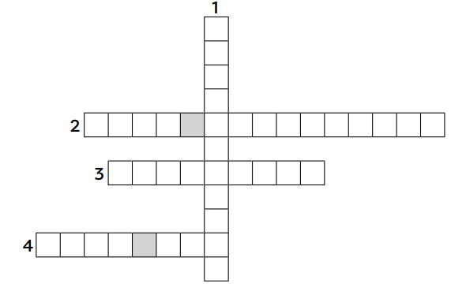
WHILE-READING
2
Read the article. Solve the crossword with words and phrases from it.
I
N
G
R
L
I
F
E
E
X
P
E
C
T
A
N
C
Y
D
N
U
T
R
I
E
N
T
S
E
N
W
O
R
K
O
U
T
S

Slide 24
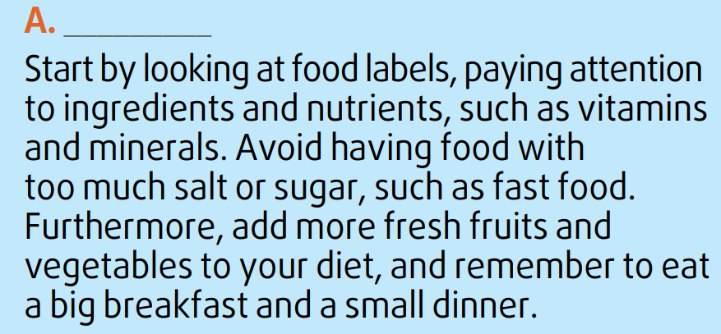
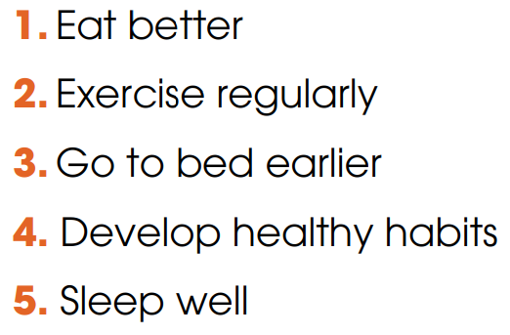
WHILE-READING
3
Read the article again. Match the section (A-C) with the heading (1-5) below. There are TWO extra headings.
1. Eat better

Slide 25
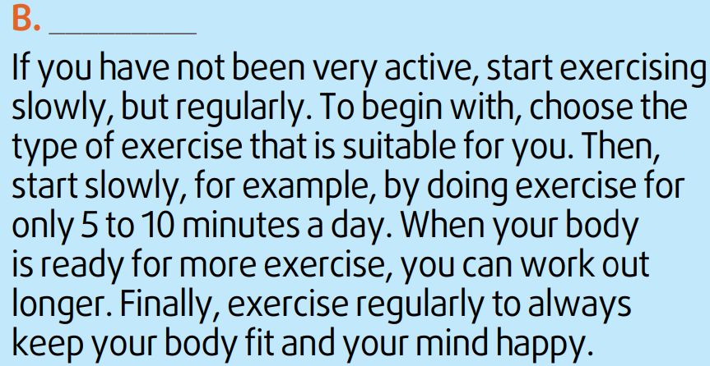
WHILE-READING
3
Read the article again. Match the section (A-C) with the heading (1-5) below. There are TWO extra headings.
2. Exercise regularly

Slide 26
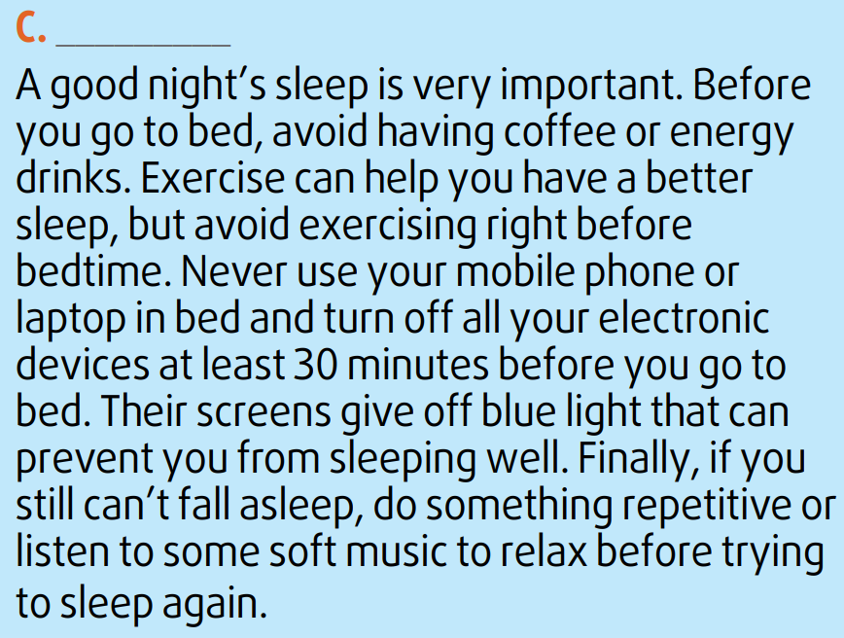
WHILE-READING
3
Read the article again. Match the section (A-C) with the heading (1-5) below. There are TWO extra headings.
5. Sleep well

Slide 27
WHILE-READING
4
Read the article again. Complete the diagrams with information from the text. Use no more than two words for each gap.
Study food labels
Avoid too much salt or sugar
Add fresh fruits and vegetables
Eat a big (1) __________
A
breakfast
Choose
(2) ________ exercise
Start slowly
Work out longer
Exercise
(3) __________
B
suitable
regularly
Before bed:
Avoid having coffee or (4) _____________________
Turn off (5) _________________
Unable to sleep: do something repetitive or listen to music
C
energy drinks / exercising
electronic devices

Slide 28
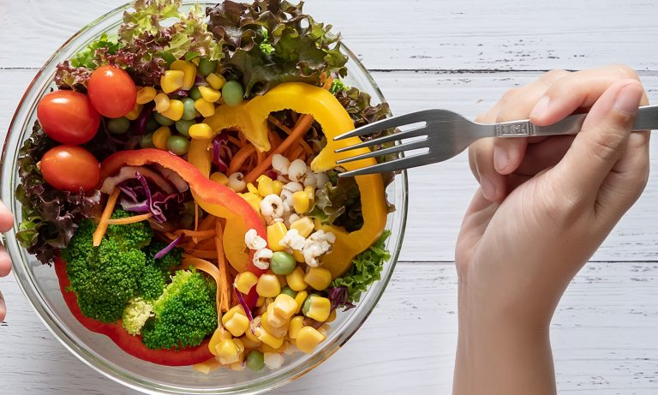
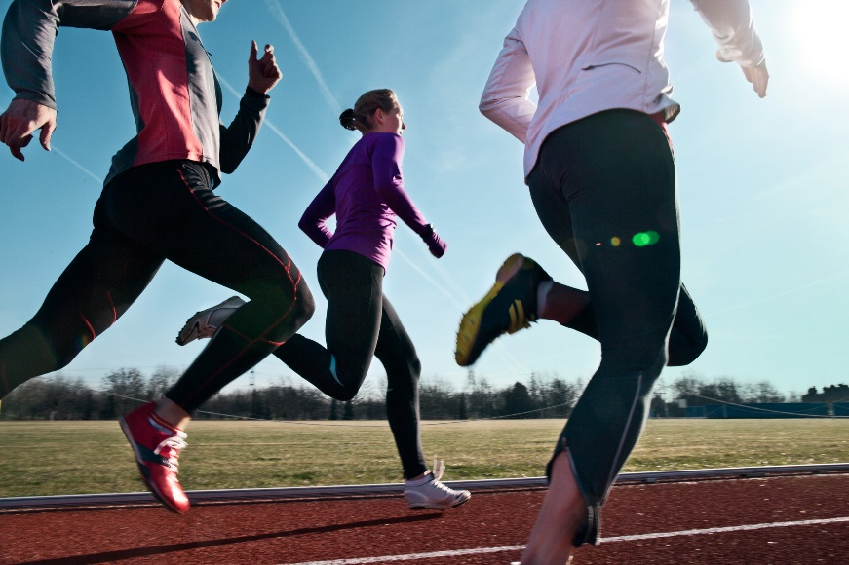
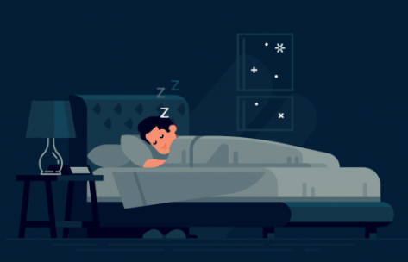
POST-READING
5
Discussion
Do you find the advice in the article useful?
Have you tried following any of the suggestions above?

Slide 29
CONSOLIDATION
2
Homework
Do exercises in the workbook.
Prepare for Lesson 4 - Unit 1.

Slide 30
Website: hoclieu.vn
Fanpage: facebook.com/www.tienganhglobalsuccess.vn

