Slide 2
Unit
10
1
Unit
FAMILY LIFE
ECOTOURISM
LESSON 3
READING
Ecotour brochures

Slide 3
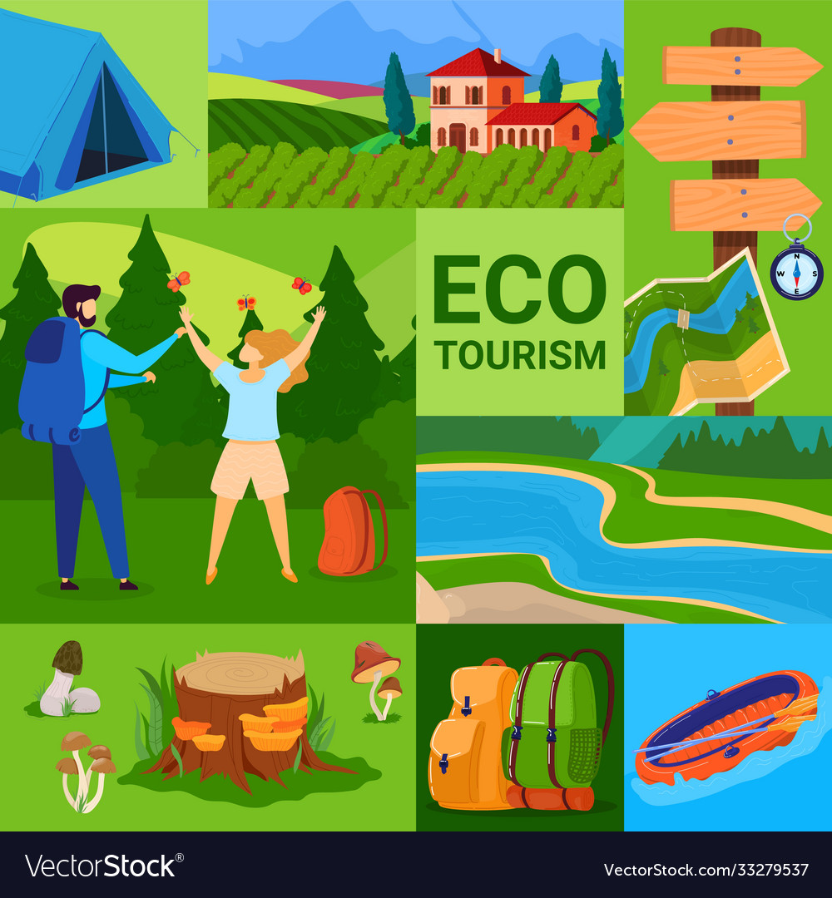
NAME THE TOURS

Slide 4
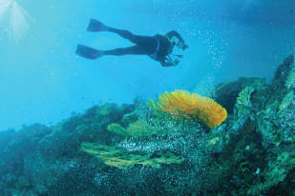
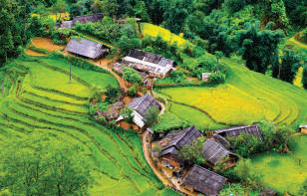
WARM-UP
Reef Tour
Trekking Tour

Slide 5
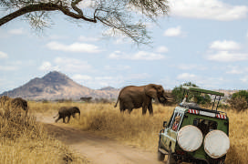
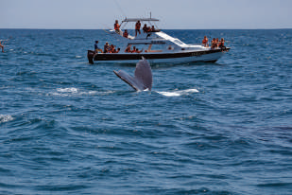
WARM-UP
National Park Tour
Whale-watching Tour

Slide 6
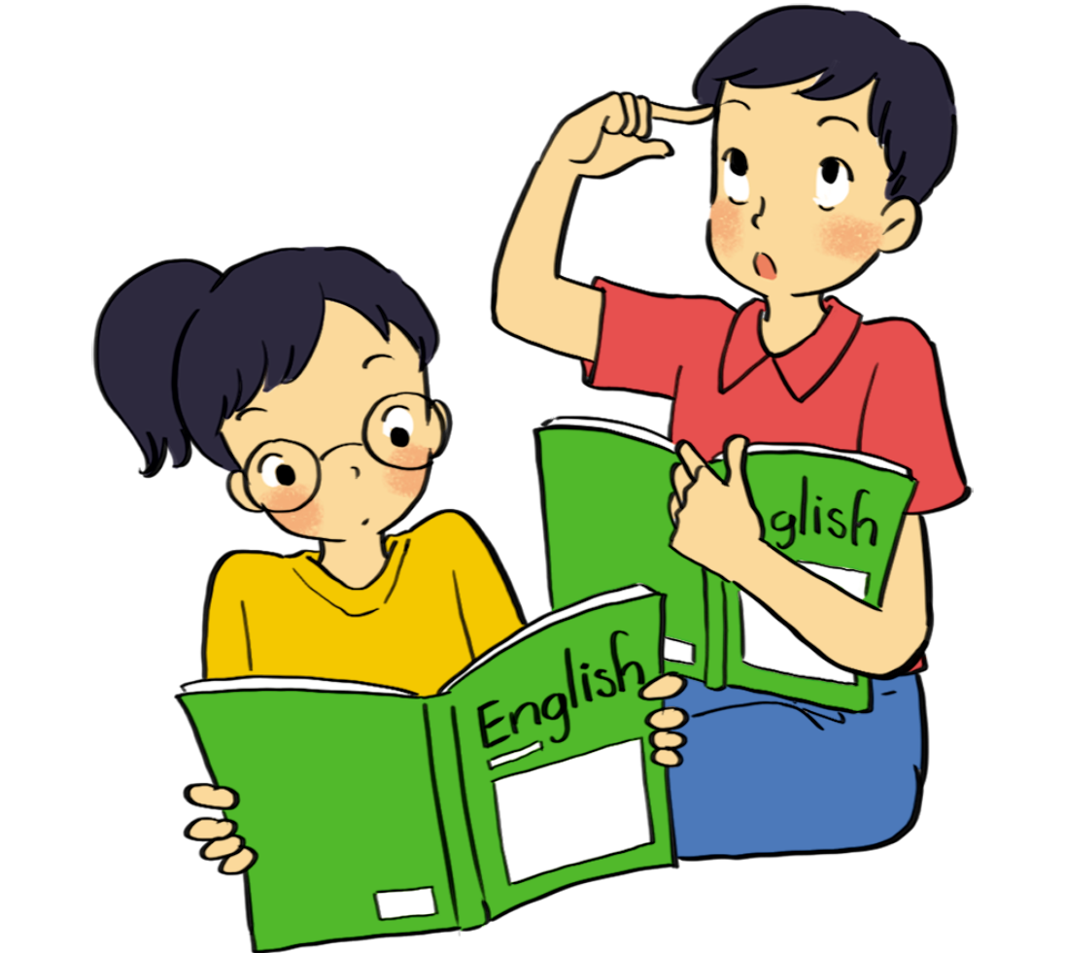
PRE-READING
1
Work in pairs. Answer these questions.
1. Have you ever been on an ecotour? 2. Look at the photos in task 2. What do you think tourists do on these tours?

Slide 7
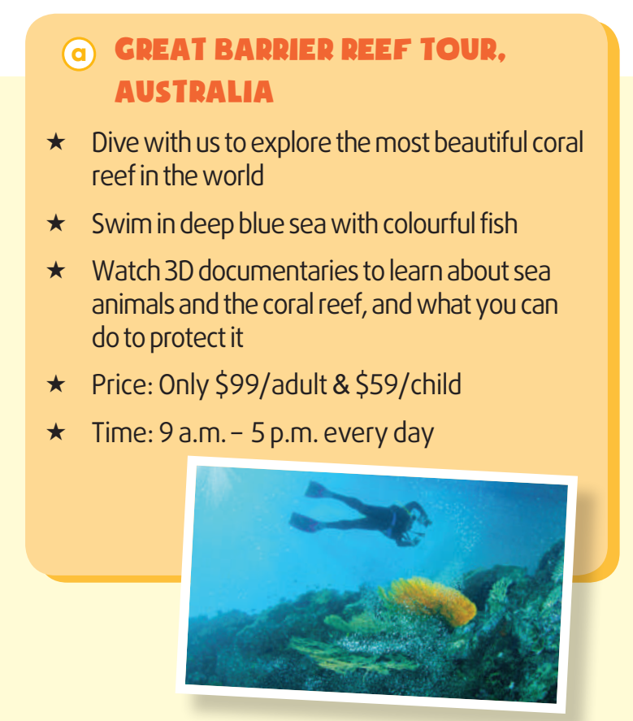
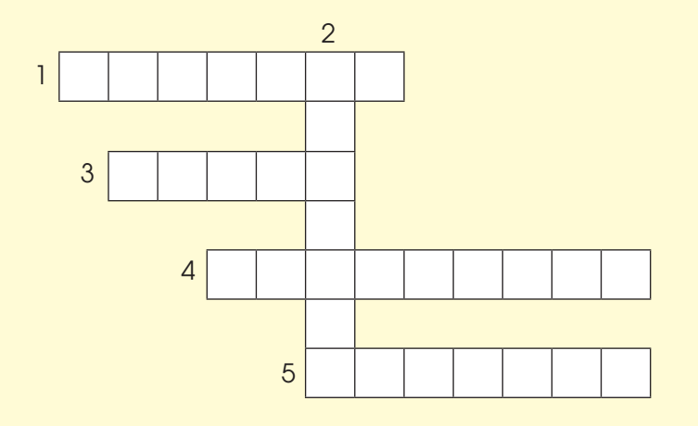
WHILE-READING
2
Read the brochures below. Then work in pairs to solve the crossword using words from the brochures.
ACROSS 1. (v) to keep something safe from damage or harm

Slide 8
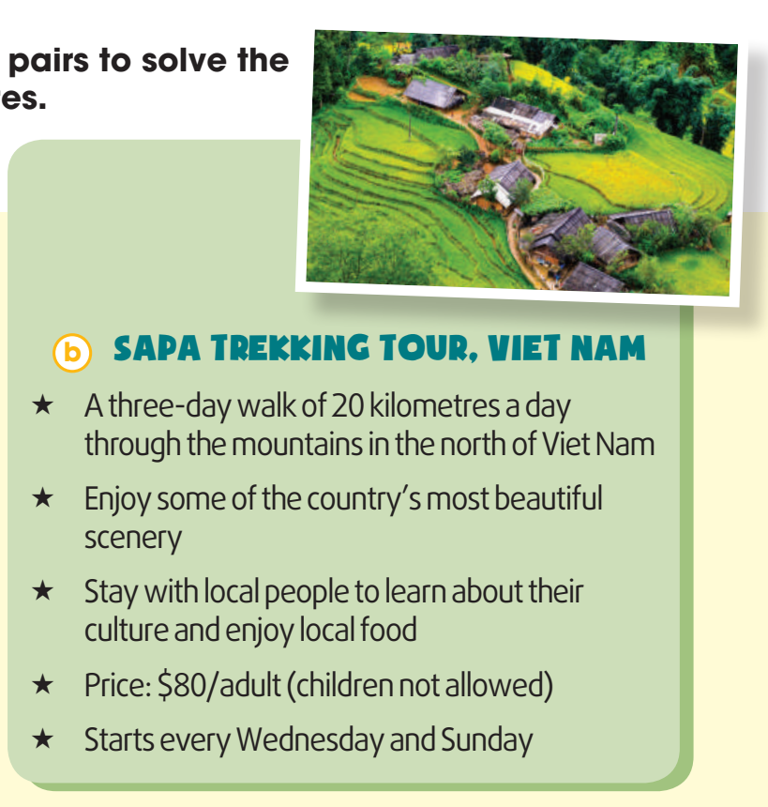
WHILE-READING
2
Read the brochures below. Then work in pairs to solve the crossword using words from the brochures.
DOWN 2. (n) the way of life of a group of people or countries

Slide 9
WHILE-READING
2
Read the brochures below. Then work in pairs to solve the crossword using words from the brochures.
ACROSS 3. (adj) connected with the place you are living

Slide 10
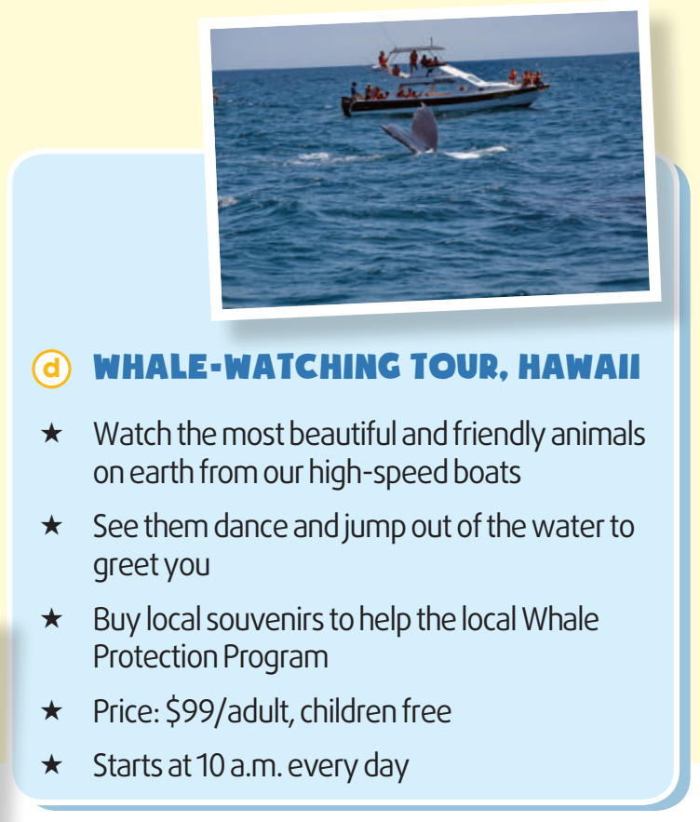
WHILE-READING
2
Read the brochures below. Then work in pairs to solve the crossword using words from the brochures.
ACROSS 4. (n) things you buy or keep to remind yourself of a place or holiday

Slide 11
WHILE-READING
2
Read the brochures below. Then work in pairs to solve the crossword using words from the brochures.
ACROSS 5. (v) to find more about a place (Brochures a and c)

Slide 12
WHILE-READING
3
Which tour does each statement below talk about? Write a, b, c or d.
1. You can buy arts and crafts to help protect the environment. _________ 2. You can learn how to help protect wildlife. _________ 3. This tour is not suitable for families with children. _________ 4. This tour offers educational videos about the environment. _________
d
c
b
a

Slide 13
POST-READING
4
Work in groups. Think of new ideas for making one of the tours better for the environment.

Slide 14
POST-READING
4
Work in groups. Think of new ideas for making one of the tours better for the environment.
Suggested answer:
A. If they ban swimming with fish, the Great Barrier Reef will be better protected. Tourists should not be allowed to dive very close to the coral reefs.

Slide 15
POST-READING
4
Work in groups. Think of new ideas for making one of the tours better for the environment.
Suggested answer:
B. Tourists should always follow the walking paths and trails on the Sa Pa Trekking Tour. The local people with whom the tourists stay should only use local ingredients. If they only use local ingredients, their carbon footprint will be lower.

Slide 16
POST-READING
4
Work in groups. Think of new ideas for making one of the tours better for the environment.
Suggested answer:
D. The boats on the Whale-watching Tour should not get too close to the whales or make too much noise. If the boats are environmentally friendly, they will not harm the whales or their habitats. This is because environmentally-friendly boats use less fuel and oil, make small waves and are quiet.

Slide 17
CONSOLIDATION
2
Homework
Prepare for the next lesson: Unit 10 – Speaking
2.Do exercises in the workbook

Slide 18
Website: hoclieu.vn
Fanpage: facebook.com/tienganhglobalsuccess.vn/

