Slide 2
Unit
9
1
Unit
FAMILY LIFE
Protecting The Environment
LESSON 3
READING
Environmental problems

Slide 3
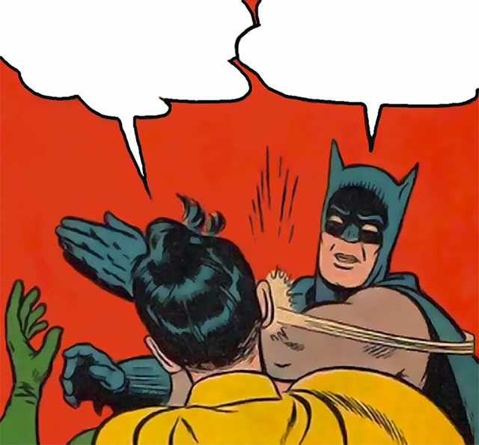
Game: Slap the board
Unit

Slide 4
GAME: SLAP THE BOARD
- There are 12 pictures of environmental issues on the board.
- Teacher will say the name of one environmental issue and students have to slap their hands on the appropriate picture.

Slide 5
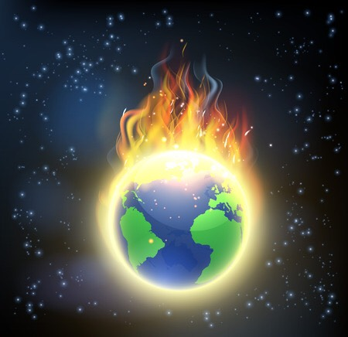
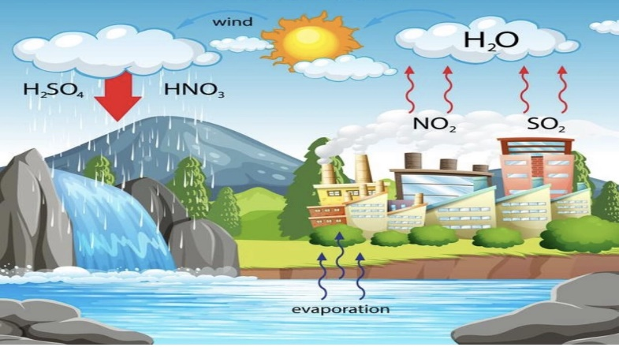
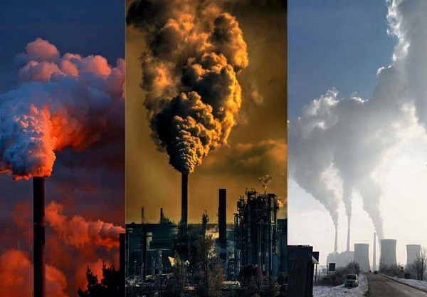
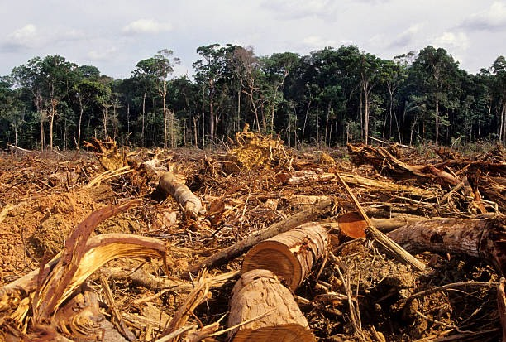
SLAP THE BOARD
1
2
3
4

Slide 6
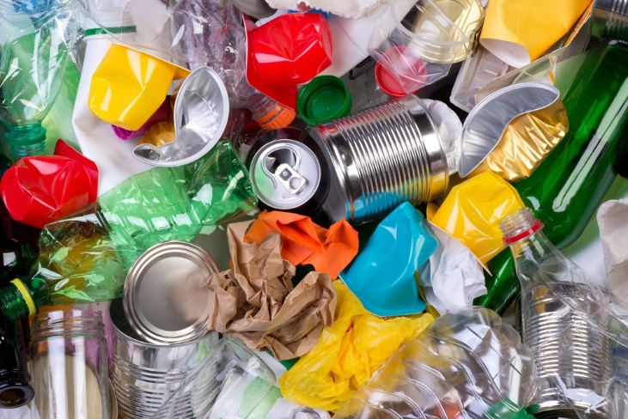
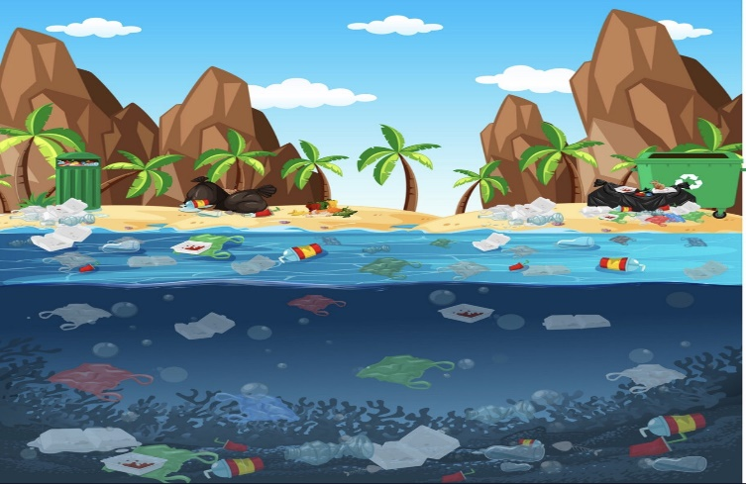
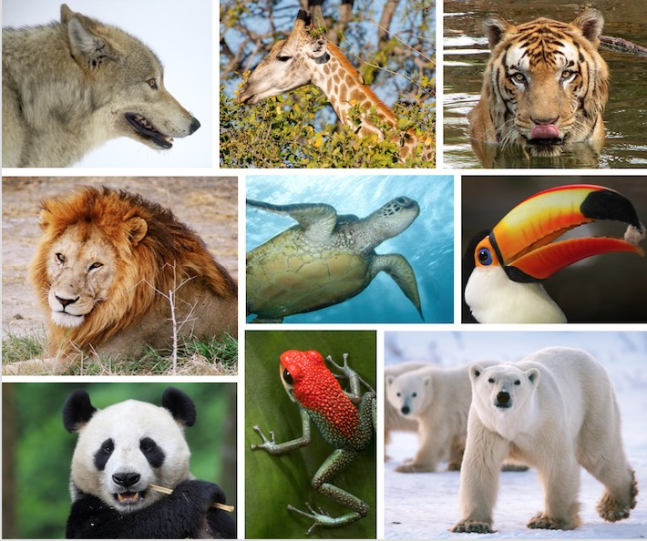
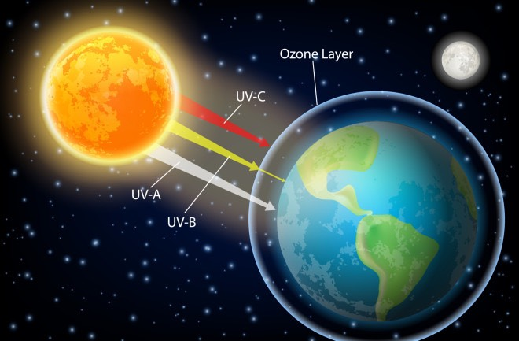
SLAP THE BOARD
5
6
7
8

Slide 7
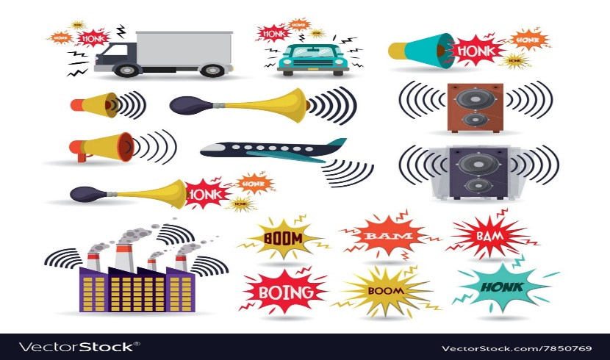
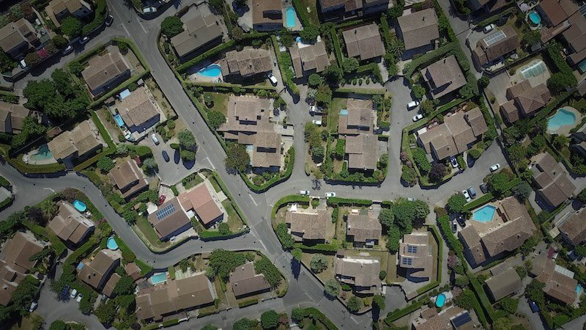
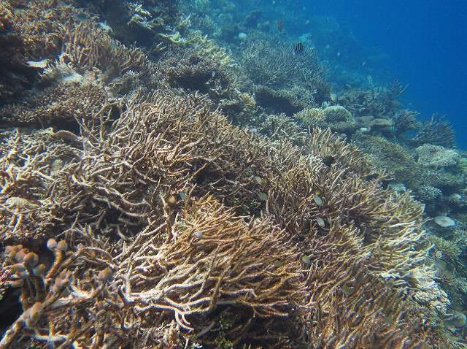
SLAP THE BOARD
9
10
11
12

Slide 8
SLAP THE BOARD GAME
1. Global warming | 2. Acid rain
3. Air pollution | 4. Deforestation
5. Rubbish | 6. Water pollution
7. Endangered animals | 8. Ozone layer depletion
9. Noise pollution | 10. Urban sprawl
11. Pesticide | 12. Ocean acidification

Slide 9
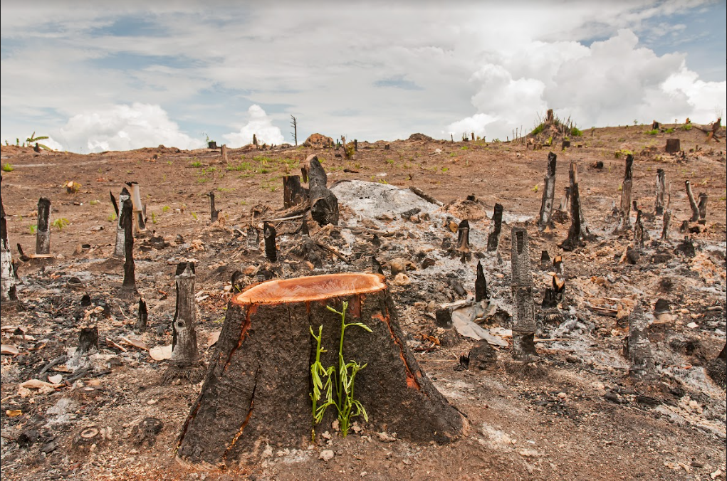
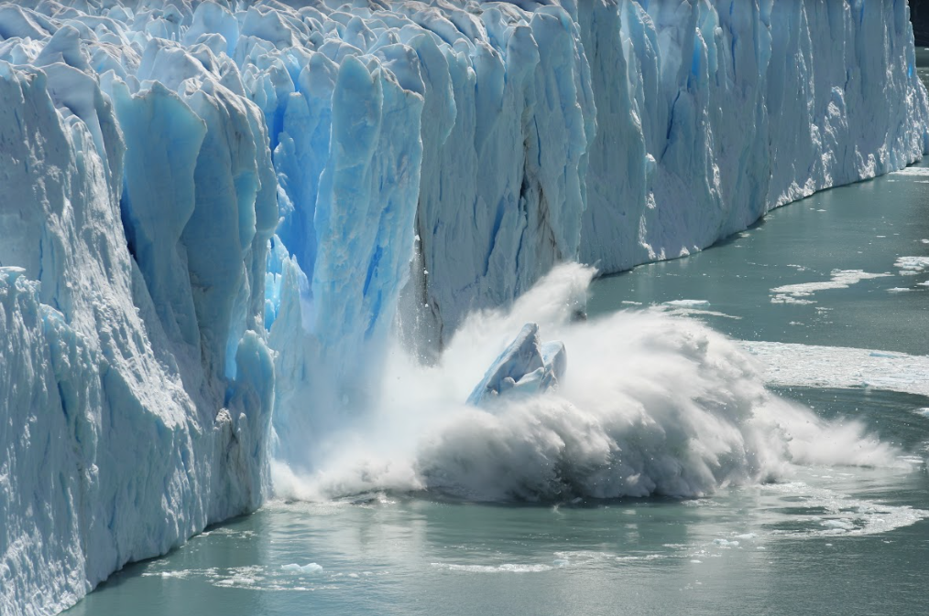
PRE-READING
1
Look at the pictures and answer the question:
What environmental problems do you see in the pictures?
a. Cutting of forests
b. Global warming/ Ice melting

Slide 10
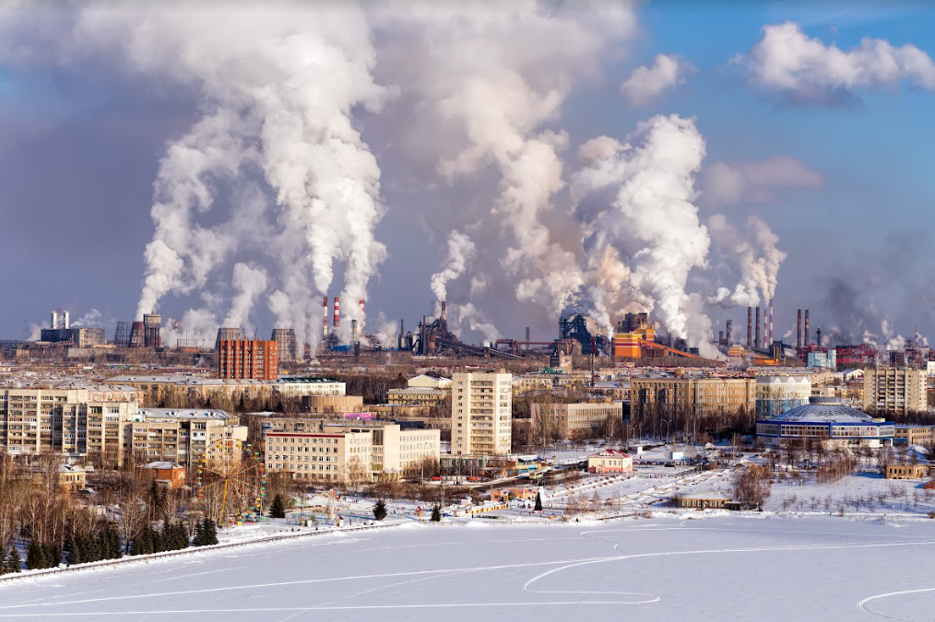
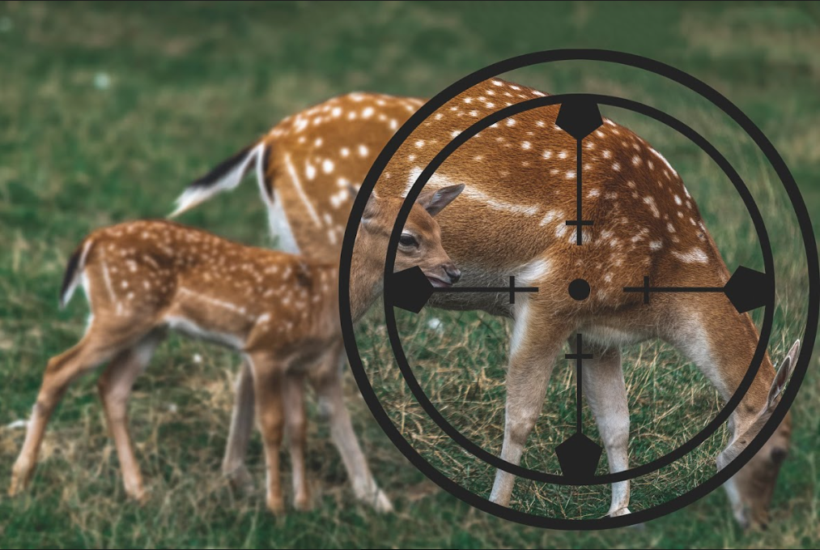
PRE-READING
1
Look at the pictures and answer the question:
What environmental problems do you see in the pictures?
c. Air pollution
d. Endangered animals

Slide 11
WHILE-READING
2
Read the text and choose the best title for it.
1
a. Environmental problems: What are they?
b. Environmental protection: How important is it?
c. Environmental solutions: How practical are they?

Slide 12
WHILE-READING
3
Read the text again and decide which paragraph contains the following information.
Information | Paragraph
1. an example of harmful substances in the air and water | C
2. one of the reasons for destroying wildlife habitats | B
3. an increase in the level of the world’s oceans | A
4. an effect of illegal hunting on the ecosystem | D

Slide 13
WHILE-READING
PRACTICE
4
Complete the sentences with information from the text. Use no more than TWO words for each answer.
1. Global warming can cause extreme ______________ such as floods or heatwaves.
2. The natural ___________ of many animals can be destroyed in the process of cutting down forests.
3. One of the main causes of air pollution is ___________ produced by machines and factories.
4. When many animals disappear, this damages the natural balance of ___________.
weather events
habitats
waste gases
ecosystem

Slide 14
POST-READING
PRACTICE
5
Discuss the question.
Which of the problems mentioned in the text do you think is the most serious in Viet Nam?
1. Global warming
2. Cutting of forests
3. Air pollution
4. Endangered animals
Each group prepares a 3-minute talk on the question.

Slide 15
POST-READING
PRACTICE
Two group leaders take turns giving their talks to the whole class.

Slide 16
CONSOLIDATION
2
Homework
Do exercises in the workbook

Slide 17
Website: hoclieu.vn
Fanpage: facebook.com/tienganhglobalsuccess.vn/

