Slide 2
Unit
9
1
Unit
FAMILY LIFE
Protecting the environment
LESSON 7
COMMUNICATION AND CULTURE/ CLIL

Slide 3
Video watching
In this video, Paul says sorry for making Noelia fall over. Watch the video and:
- Complete the conversation with the correct information.
- Listen and repeat at the end of the clip.
Notes:
Video link: https://learnenglish.britishcouncil.org/skills/speaking/pre-intermediate-a2/apologising

Slide 4
Video watching
Paul: Noelia! I am so (1) ! Are you OK?
Noelia: I think so. That was lucky.
Paul: I'm (2) sorry! I didn't see you!
Noelia: That's (3) . I shouldn't have been running.
Paul: No, no, I should have been (4) .
Noelia: And they teach you (5) inside at school!
Paul: Still, it was my (6) and I'm sorry.
Noelia: I'm sorry (7) . It was both of us. Honestly, (8) .I'm fine. Don't (9) about it. Hey, I saved the laptop though!
Bob: Yeah, I'll be there in …
Noelia: Oh no!
Bob: Uh oh!
Paul: Ahhhh …
sorry
really
all right
paying attention
not to run
fault
too
it's fine
worry

Slide 5
EVERYDAY ENGLISH
1
Listen and complete the conversations with the expressions in the box. Then practise them in pairs.
Never mind
I’d like to apologise for
That’s all right
I’m sorry to
1
Mai: (1) ________ submitting my assignment late. I‘m sorry, but my laptop was broken.
Mr Ha: (2) ________. Next time you should finish it earlier and have a back-up copy in case you have any technical problems.
B
C
2
Nam: (3) ________ keep you waiting for so long. The talk was longer than expected.
Mai: (4) ________. We still have enough time for dinner before the show.
D
A

Slide 6
EVERYDAY ENGLISH
PRACTICE
2
Work in pairs. Make similar conversations making and responding to apologies. Use the expressions below to help you
Useful expressions
Making apologies | Responding to apologies
(I hope you’ll) excuse me for… | Don’t mention it.
Sorry for … I am sorry to … | Never mind.
I’d like to apologise for … | That’s all right.
Please accept my apology for… | Don’t worry about it.

Slide 7
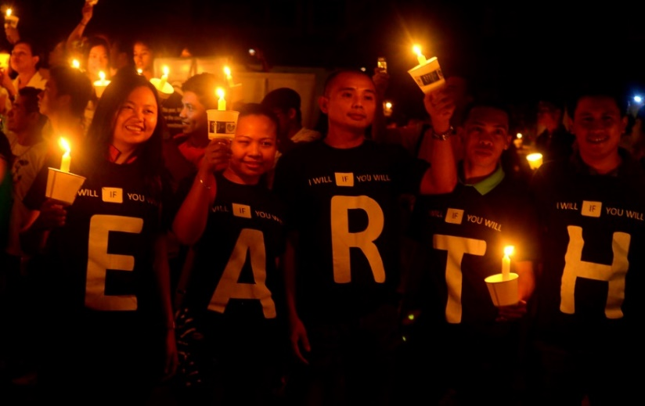
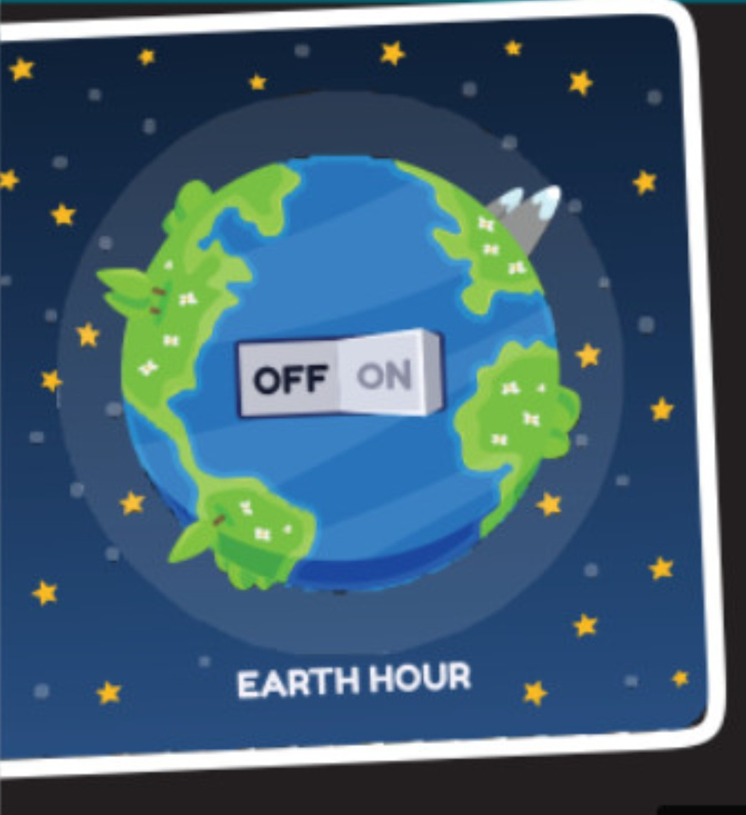
CLIL
PRACTICE
1
Look at the pictures and answer the question:
What do you know about Earth Hour?

Slide 8
CLIL
2
Read the text and complete each blank about Earth Hour with ONE word.
EARTH HOUR
Organised by | World Wide Fund for Nature
Held from | 8.30 p.m. – 9.30 p.m. on the last (1)………………….of March.
Started in | Sydney, Australia, in 2007
Aims | - to show the public (2)………….....for protecting the environment and saving the planet - to draw attention to (3)……..........change and global energy issues - to promote green (4) ………………worldwide
First held in Viet Nam in | (5) ……………….with a variety of activities nationwide.
Saturday
support
climate
activities
2009

Slide 9
CLIL
3
Watch a video about Earth Hour. Work in pairs. Discuss the following questions.
1. Do you want to take part in this lights-out event in Viet Nam? Why or why not?
2. If you have a chance to take part in the event, what would you do?
Notes:
https://www.youtube.com/watch?v=mDM1piwvGCQ&t=24s

Slide 10
EXTRA ACTIVITY
TALK ABOUT EARTH HOUR
2

Slide 11
CONSOLIDATION
2
Homework
Do exercises in the workbook.

Slide 12
Website: hoclieu.vn
Fanpage: facebook.com/tienganhglobalsuccess.vn/

