Slide 1


to

Slide 2
Watching a video and answer the questions
M
What is this video about?
The time social networks appeared.
T
X
T
F

Slide 3


Slide 4

Watching a video and answer the questions
M
What is this video about?
The time social networks appeared.
T
X
T
F

Slide 5
Keys
1. This video talks about History of The Internet

Slide 6
Keys
1969 : ARPANET founded
1974 : designed Telenet
1981 : TCP/TP
1982 : TCP/IP protocol suite formalized and WAN installed in Europe.
1983 : MILNET split off from ARPANET
1984 : First implementations of DNS
1985 : sympolics.COM domain name registered
1986 : Mordern Email Routing System
1987 : UUNET founded
1989 : PSINet founded, allows commercial traffic
1990 : WWW is availble to the public.
1994 : Yahoo was created
1995 : Amazon.com online retailer and eBay online auction and shopping
1998 : Google Search and Internet Corporation for Assigned Names and Numbers (ICANN)
2000 : Dot-com bubble bursts
2003 : Wordpress is launched
2004 : Facebook social networking site
2005 : YouTube video sharing
2006 : Twitter microblogging
2014 : HTTP

Slide 7


5
Unit
Inventions
Period : Lesson 2: Language

Slide 8
A. PRONUNCIATION
Stress in three-syllable nouns
GREEN

Slide 9


1. Listen and pay attention to the stressed syllable in each word
computer
Invention
holiday
century

Slide 10
Tips:
Most three-syllable nouns are stressed on the first syllable.
Ex: 'century 'holiday 'energy
Nouns ending in “-tion”, “-sion” or “-al” generally have the stress on the syllable before these suffixes.
Ex: con'sumption de'nial in'vention

Slide 11
PLAY GAME: WHICH TEAM IS FASTER ?
Divide the class into two teams.
Choose questions in Package A or B and answer the question correctly as fast as possible.
- The team with the shorter time win.
A
B
Game Rules

Slide 12

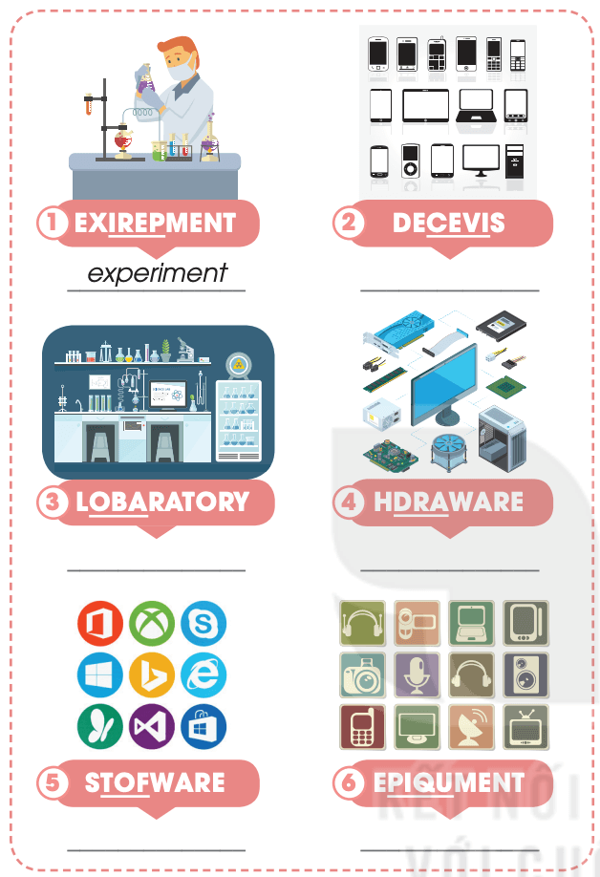
B.
Unscramble the underlined letters in these words.

Slide 13

VOCABULARY
1
Unscramble the words.
EXPERIMENT

Slide 14
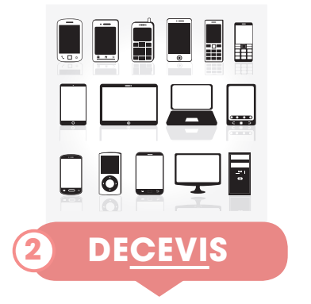
VOCABULARY
2
Unscramble the words.
DEVICES

Slide 15

VOCABULARY
3
Unscramble the words.
LABORATORY

Slide 16

VOCABULARY
4
Unscramble the words.
HARDWARE

Slide 17

VOCABULARY
5
Unscramble the words.
SOFTWARE

Slide 18

VOCABULARY
6
Unscramble the words.
EQUIPMENT

Slide 19
VOCABULARY
experiment | /ɪkˈsperɪmənt/ | a scientific test that is done in order to study what happens and to gain new knowledge
device | /dɪˈvaɪs/ | an object or a piece of equipment that has been designed to do a particular job
laboratory | /ləˈbɒrətri/ | a room or building used for scientific research, experiments, testing, etc.
hardware | /ˈhɑːdweə(r)/ | the machines and electronic parts in a computer or other electronic system
software | /ˈsɒftweə(r)/ | the programs used by a computer for doing particular jobs
equipment | /ɪˈkwɪpmənt/ | the things that are needed for a particular purpose or activity

Slide 20

C. GRAMMAR
GREEN

Slide 21
Put the words in the correct order to make correct sentences.
lived / We / here / since/ have / 2000.
→
2. has / He / just/ eaten / breakfast.
→

Slide 22


Slide 23
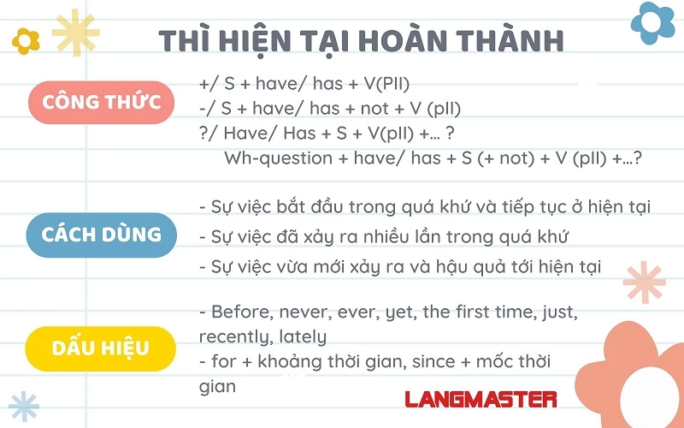

The present perfect tense
Form
Usage
Adv

Slide 24


Gifts for teachers
Game Rules

Slide 25








Game Rules
Kind flowers
Flowers have good points
Divide the class into two teams.
- Choose a flower and answers the question correctly for 10 points.
- The other team has the right answer correctly for 5 points.
- Take turns choosing flowers.
- The team with the higher score win.
gratitude flowers
hardworking flowers
obedient flowers
polite flowers

Slide 26


Flowers have good points
Kind flowers
gratitude flowers
obedient flowers
hardworking flowers
polite flowers
Notes:
Click vào hoa để tới câu hỏi. Tại slide câu hỏi, click vào hoa để quay về
Click vào nền hoặc nhấn enter để ra hình ảnh các bạn nhỏ tặng quà cô ngày 20/11
Click vào hình 4 bạn nhỏ để tới bài học

Slide 27


Question 1
They ………a suitable solution to the problem.
A. have just found
B. just found
C. has just found
Notes:
CLICK VÀO A B C ĐỂ RA ĐÁP ÁN ĐÚNG SAI

Slide 28
Question 2
Since people ………the first computer, they ………. many more interesting inventions.
A. invented / have created
B. have created/ invented
C. invented/ has created

Slide 29
The woman in very angry because her son ………. his smart phone.
Question 3
A. lost
B. has lost
C. have lost

Slide 30
Question 4
Supply the correct form of verb.
We (learn)……………..English for 9 years.
have learnt

Slide 31
Find a mistake in this sentence.
Question 5
My school just has installed TVs in the classrooms.
just has installed

Slide 32
Find a mistake in this sentence.
I have taught here for 2021.
Question 6

Slide 33
2. Gerunds and to-infinitives

Slide 34
Some verbs followed by V-ing or To-infinitive or both
afford, love, agree, ask, hate, enjoy, want, finish, mind, suggest, avoid, can’t help, plan, hope, learn, allow, decide, remember, stop , postpone, should , practice, consider , like , may
V - ing | To - infinitives | Both

Slide 35
Suggested answers
V-ing | To – infinitives | Both
enjoy | afford | love
finish | agree | hate
mind | ask | like
suggest | want
avoid | plan
can’t help | hope
postpone | learn
practice | allow
consider | decide

Slide 36
Some verbs followed by V-ing
admit | delay | keep | quit | understand
advise | deny | mind | recommend
avoid | discuss | miss | report
can’t help | enjoy | postpone | risk
consider | finish | practice | suggest
Ex: We enjoy playing football.

Slide 37
Some verbs followed by To-infinitive
afford | choose | hope | prepare | want
agree | decide | learn | promise | wish
arrange | expect | manage | refuse | would like
ask | fail | need | seem | would love
help | plan | threaten
Ex: We decide to go to the movie theater.

Slide 38


PLAY GAME
Nhạc nền
RESCUE THE FARM

Slide 39









1. Many children enjoy…….modern devices nowadays.
use
to use
to using
using
Khi đến mỗi Slide, thầy cô
nhấp chuột trái 1 lần hoặc
phím mũi tên qua phải thì câu hỏi và đáp án sẽ tự xuất hiện.
Sau khi HS đưa ra đáp án qua Camera, thầy cô nhấp vào đáp án đúng để xác nhận đáp án.
Để chuyển sang câu hỏi tiếp theo, thầy cô nhấp phím mũi tên qua phải 2 lần hoặc
nhấp chuột trái 2 lần.

Slide 40
2. I decide ………..computer science at university
to study
to studies
studying
to studying
Khi đến mỗi Slide, thầy cô
nhấp chuột trái 1 lần hoặc
phím mũi tên qua phải thì câu hỏi và đáp án sẽ tự xuất hiện.
Sau khi HS đưa ra đáp án qua Camera, thầy cô nhấp vào đáp án đúng để xác nhận đáp án.
Để chuyển sang câu hỏi tiếp theo, thầy cô nhấp phím mũi tên qua phải 2 lần hoặc
nhấp chuột trái 2 lần.

Slide 41
3. …………language games on the smartphone is fun.
Plays
Playing
To playing
To plays
Khi đến mỗi Slide, thầy cô
nhấp chuột trái 1 lần hoặc
phím mũi tên qua phải thì câu hỏi và đáp án sẽ tự xuất hiện.
Sau khi HS đưa ra đáp án qua Camera, thầy cô nhấp vào đáp án đúng để xác nhận đáp án.
Để chuyển sang câu hỏi tiếp theo, thầy cô nhấp phím mũi tên qua phải 2 lần hoặc
nhấp chuột trái 2 lần.

Slide 42
4. It is very convenient …….with a smartphone.
study
studies
to study
studying
Khi đến mỗi Slide, thầy cô
nhấp chuột trái 1 lần hoặc
phím mũi tên qua phải thì câu hỏi và đáp án sẽ tự xuất hiện.
Sau khi HS đưa ra đáp án qua Camera, thầy cô nhấp vào đáp án đúng để xác nhận đáp án.
Để chuyển sang câu hỏi tiếp theo, thầy cô nhấp phím mũi tên qua phải 2 lần hoặc
nhấp chuột trái 2 lần.

Slide 43

THANK YOU RESCUED US!

Slide 44




Thank You

