Slide 1
Unit 2
A multicultural world
LESSON 8
LOOKING BACK AND PROJECT

Slide 2
WARM-UP
Game: Lucky number
- Work in 2 teams.
- There are 7 numbers, 2 of which are lucky ones.
- If you choose a lucky number ➔ one point without answering the question.
- If you choose the other numbers ➔ one student of a group picks up a piece of paper and sees the word on it.
- This student has to use words or actions to describe it (without saying the word directly)
- Other Ss try to guess the words. One point for a correct answer.
- The group with the most points is the winner.

Slide 3
WARM-UP
WARM-UP
Answer the question in each puzzle.
1
2
3
4
5
6
7

Slide 4
WARM-UP
WARM-UP
Number 1
originate
BACK

Slide 5
WARM-UP
WARM-UP
Number 2
trend
BACK

Slide 6
WARM-UP
WARM-UP
Number 3
identity
BACK

Slide 7
WARM-UP
WARM-UP
Number 4
cuisine
BACK

Slide 8
WARM-UP
WARM-UP
Number 5
booth
BACK

Slide 9

WARM-UP
WARM-UP
Question 6
BACK

Slide 10
WARM-UP
WARM-UP
Question 7
BACK

Slide 11
LOOKING BACK
Pronunciation
1
Read the following sentences and write the words containing the /ɔɪ/, /aɪ/, and /aʊ/ sounds in the correct column. Then listen and check. Practise saying the sentences in pairs.
 | /ɔɪ/ | /aɪ/ | /aʊ/
1. Seeing my K-pop idols appear at the booth, I started shouting their names loudly.
2. Mike really enjoyed his life in the USA despite experiencing culture shock.
3. The Korean food festival offers a wide choice of spicy dishes.
4. They haven’t announced the final applicants for the culture exchange programme.
shouted, loudly
my, idols
Mike, life, desipte
enjoyed
wide, spicy
choice
final
announced

Slide 12
LOOKING BACK
Vocabulary
2
Choose the correct word to complete each of the sentences.
1. Studying abroad is a growing trend / event in many Asian countries.
2. It is believed that Thailand’s Songkran celebrations origin / originate from a Buddhist story.
3. It’s important to preserve a country’s national fame / identity through its culture.
4. Italian cuisine / culture is popular because it is delicious and healthy.

Slide 13
LOOKING BACK
Grammar
3
Choose the best answer A, B, C, or D.
Many secondary school students dream of studying abroad because they think it is a wonderful opportunity. However, while studying in (1) _______ foreign country such as (2) _______ US, students may experience culture shock. One of the best ways to deal with culture shock is to research
(3) _______ local culture in advance.
1. A. a B. an C. ∅ D. the
2. A. an B. the C. one D. a
3. A. the B. a C. many D. ∅

Slide 14
LOOKING BACK
Grammar
3
Choose the best answer A, B, C, or D.
For example, if you’re attending (4) _______ UK university, reading about British culture can be helpful. This will help you understand how to interact with local people. You’ll also be prepared to deal with any differences between (5) _______ two cultures. Making friends with other students, joining clubs, or attending social events at the university is another way to overcome culture shock.
4. A. an B. ∅ C. the D. a
5. A. ∅ B. the C. both D. an

Slide 15
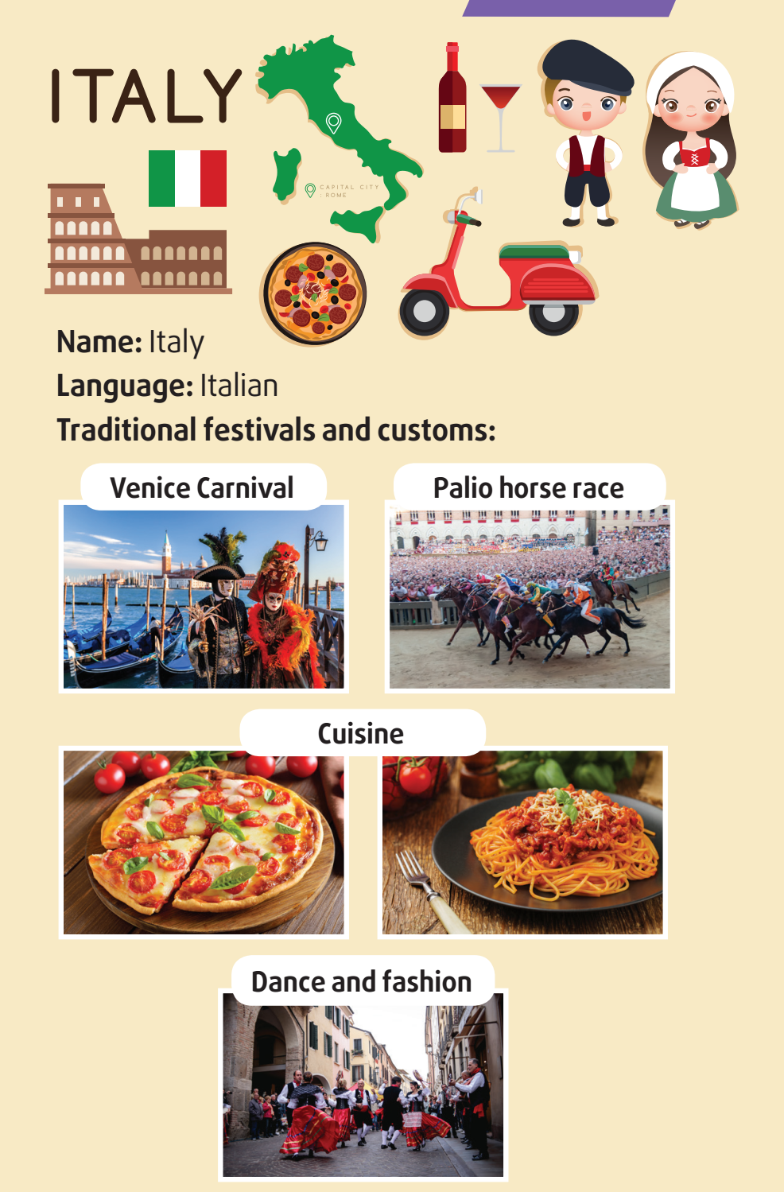
PROJECT
INTRODUCE A CULTURE
Work in groups. Choose a country and do some research on its culture. give a group presentation. It can include some of the following information:
• Name of the country
• Language(s) spoken
• Traditional festivals and customs
• Music, dance, and fashion
• Cuisine

Slide 16
CONSOLIDATION
1
Wrap-up
What have you learnt today?
- Review the vocabulary and grammar of Unit 2;
- Apply vocabulary and grammar into practice through a project.

Slide 17
CONSOLIDATION
2
Homework
- Do exercises in the workbook.
- Prepare for the next lesson – Unit 3.

