Slide 1
Unit 2
A multicultural world
LESSON I
GETTING STARTED
At the International Cultural Festival

Slide 2
WARM-UP
Game: What is this?

Slide 3
WARM-UP
Rules
- Work in two teams.
- There are 6 pictures of 6 signature dishes of Viet Nam, Japan and Korea.
- Only one student from each group sees a picture.
- Use your own words to describe the food.
- Others guess the name of the food.
+ If the answer is correct ➔ one point for your team.
+ If the answer is incorrect ➔ the chance to answer is transferred to the other team.
+ The team having more points is the winner of the game.

Slide 4
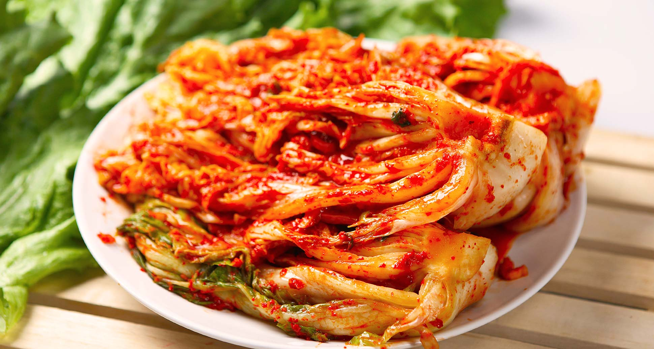
WARM-UP
kimchi

Slide 5
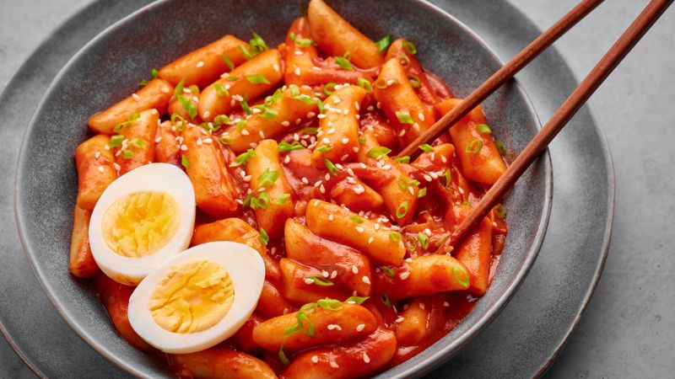
WARM-UP
tteokbokki – spicy rice cakes

Slide 6
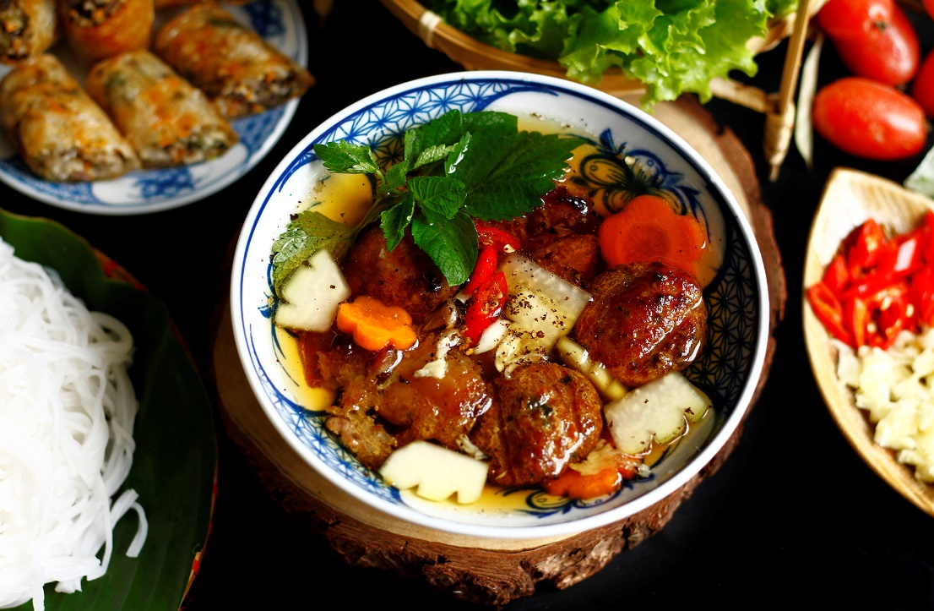
WARM-UP
bun cha – grilled pork meatballs with noodles

Slide 7
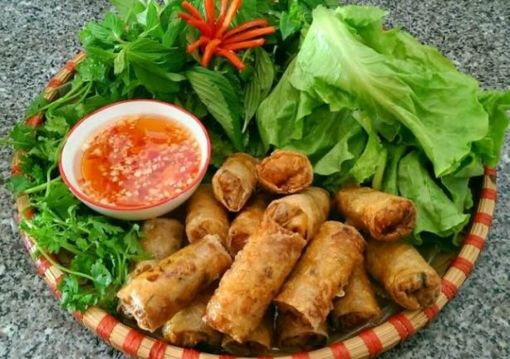
WARM-UP
spring rolls

Slide 8
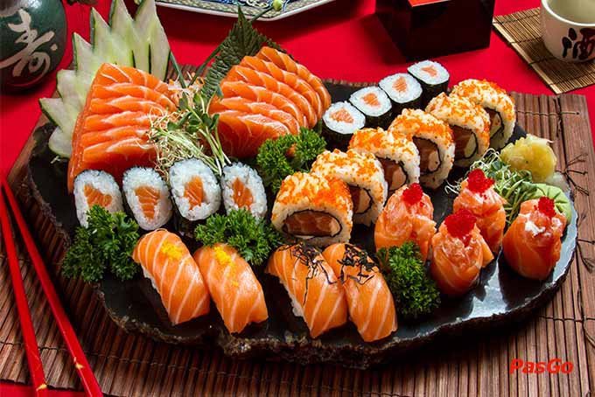
WARM-UP
sushi

Slide 9
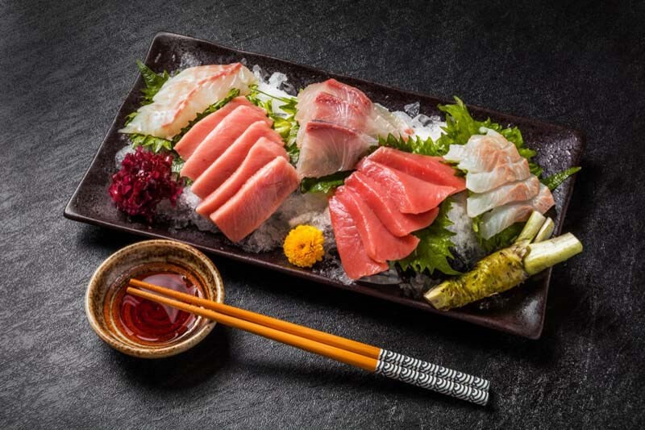
WARM-UP
sashimi

Slide 10
PRESENTATION
cultural diversity (n)
/ˈkʌltʃərəl daɪˈvɜːsəti/
the quality of diverse or different cultures

Slide 11
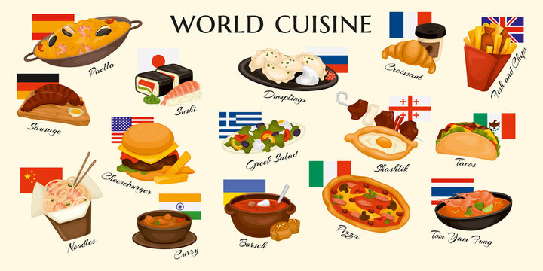
PRESENTATION
cuisine (n)
/kwɪˈziːn/
a style of cooking

Slide 12
PRESENTATION
autograph (n)
/ˈɔːtəɡrɑːf/
a signature (= your name written by yourself), especially of a famous person

Slide 13
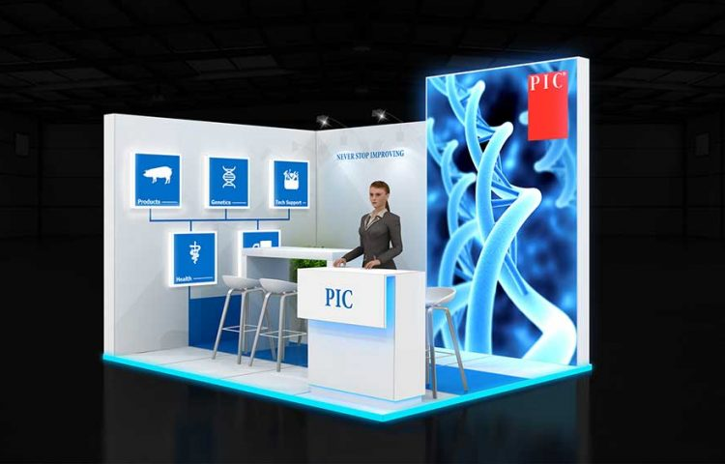
PRESENTATION
booth (n)
/buːð/
a small space like a box that a person can go into

Slide 14
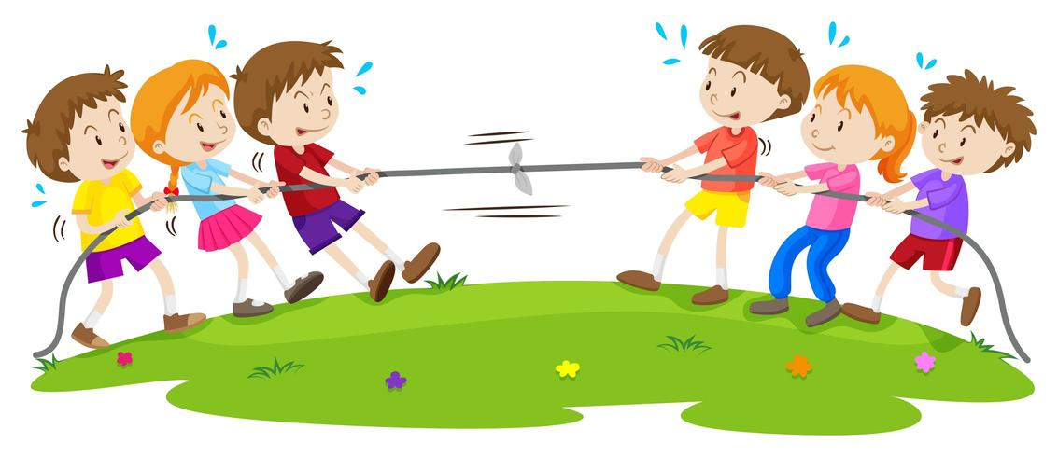
PRESENTATION
tug of war (n)
/ˌtʌɡ əv ˈwɔːr/
a type of sport in which two teams show their strength by pulling against each other at the opposite ends of a rope, and each team tries to pull the other over a line on the ground

Slide 15
PRESENTATION
Form | Pronunciation | Meaning | Vietnamese equivalent
1. cultural diversity (n) | /ˈkʌltʃərəl daɪˈvɜːsəti/ | the quality of diverse or different cultures | sự đa dạng văn hoá
2. cuisine (n) | /kwɪˈziːn/ | a style of cooking | ẩm thực
3. autograph (n) | /ˈɔːtəɡrɑːf/ | a signature (= your name written by yourself), especially of a famous person | chữ kí
4. booth (n) | /buːð/ | a small space like a box that a person can go into | gian hàng
5. tug of war (n) | /ˌtʌɡ əv ˈwɔːr/ | a type of sport in which two teams show their strength by pulling against each other at the opposite ends of a rope, and each team tries to pull the other over a line on the ground | kéo co

Slide 16
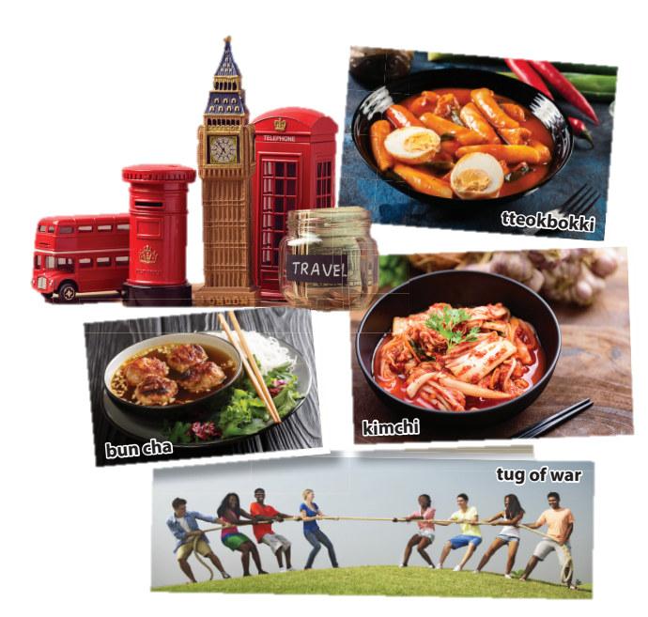
PRACTICE
1
Listen and read.
1. What can you see in the first photo?
2. What does the second picture show?
3. Where can you buy those souvenirs?
4. Who are the speakers?
a bowl of kimchi, bun cha, rice cake
some teenagers playing tug-of-war
England
Nam, Mai and Linda

Slide 17
PRACTICE
2
Read the conversation again and complete the table. Use no more than THREE words for each blank.
Country | Food to try | Things to do or buy
Japan | (1) _________
Korea | kimchi, tteokbokki | meet a K-pop (2) ___________ ________________
Britain | (3) ____________ | buy souvenirs
Viet Nam | spring rolls, (4) _________ | play games (tug of war, bamboo dancing)
sushi
group / singers
and get autographs
fish and chips
bun cha

Slide 18
PRACTICE
3
Find words and a phrase in 1 that have the same or similar meaning to the following words and phrases.
1. variety
2. a style of cooking
3. tasty
4. interesting places
diversity
cuisine
delicious
attractions

Slide 19
PRACTICE
4
Complete the sentences based on the conversation. use the correct article (a, an, the) or ∅ (no article).
1. Nam took Mai and Linda to _____ International Cultural Festival in Ha Noi.
2. Tasting food from different countries is a way to learn about _____ cultural diversity.
3. Nam tells his friends that ____ famous K-pop group will be at the Korean booth.
4. The Vietnamese booth is ____ open booth, and is very big.
the
∅
a
an

Slide 20
PRODUCTION
Design a poster to introduce the International Cultural Festival

Slide 21
CONSOLIDATION
1
Wrap-up
What have you learnt today?
Some lexical items the topic A multicultural world
Reading for specific information
The article

Slide 22
CONSOLIDATION
2
Homework
Do exercises in the workbook.
Prepare for the project in Lesson 8.

