Slide 1
Unit 1
Life stories we admire
LESSON 8
LOOKING BACK AND PROJECT

Slide 2
WARM-UP
WARM-UP
Lucky number
1
2
3
4
5
6
7

Slide 3
WARM-UP
WARM-UP
Number 1
determination
BACK

Slide 4
WARM-UP
WARM-UP
Number 2
animation
BACK

Slide 5
WARM-UP
WARM-UP
Number 3
genius
BACK

Slide 6
WARM-UP
WARM-UP
Number 4
adopt
BACK

Slide 7
WARM-UP
WARM-UP
Number 5
drop out
BACK

Slide 8
WARM-UP
WARM-UP
Question 6
BACK

Slide 9
LOOKING BACK
Underline the words that contain the /eɪ/ sound and circle the ones with the /əʊ/ sound in the sentences below.
LOOKING BACK
1. Cleopatra VII, a queen of ancient Egypt, was famous for her beauty.
2. I love Disney animated films like Snow White and the Seven Dwarfs and The Little Mermaid.
3. Vo Thi Sau attacked some French soldiers when she was only 14.
4. Steve Jobs passed away when he was only 56 years old.

Slide 10
LOOKING BACK
Replace each underlined word or phrase with one word you have learnt in this unit.
1. Uncle Ho gave all his love and energy to the country and people of Viet Nam.
2. Although Albert Einstein lost interest in school as a child, he became known as a very intelligent person.
➔ devoted
➔ genius

Slide 11
LOOKING BACK
Replace each underlined word or phrase with one word you have learnt in this unit.
3. Steve Jobs was respected for his successes in computer technology.
4. My grandfather regretted not going to college when he was young.
➔ admired
➔ achievements
➔ attending

Slide 12
LOOKING BACK
Circle the mistake in each sentence. Then correct it.
1. When I was looking for some books in the library, I
was finding an interesting biography about General Vo
Nguyen Giap.
2. At the age of 16, Walt Disney was dropping out of
school because he wanted to join the army.
➔ found
➔ dropped

Slide 13
LOOKING BACK
Circle the mistake in each sentence. Then correct it.
3. Vo Thi Sau was caught while she tried to attack
some French soldiers.
4. While the famous author read from his biography,
everyone was listening and taking notes.
➔ was trying
➔ was reading

Slide 14
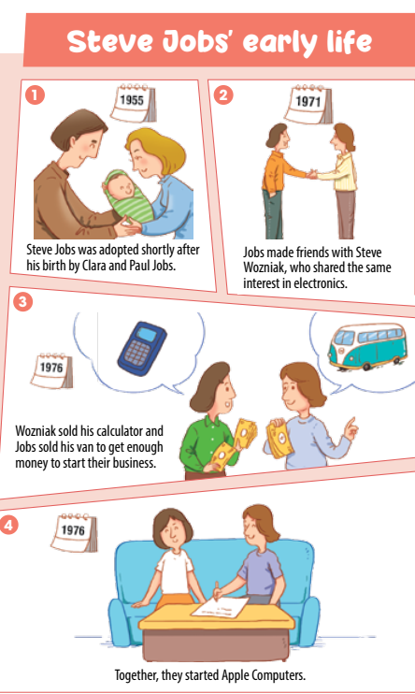
PROJECT
VISUAL STORIES
- Who is your story about?
- What are the key events in
his/her life?
- What are his/her achievements?
- What do you think of his/her life
and achievements?

Slide 15
CONSOLIDATION
1
Wrap-up
What have you learnt today?
Review the vocabulary and grammar of Unit 1;
Apply vocabulary and grammar into practice through a project.

Slide 16
CONSOLIDATION
2
Homework
Do exercises in the workbook.
Prepare for the next lesson – Unit 2.

