Slide 1
Unit
1
A long and healthy life
Unit
FAMILY LIFE
LESSON 8
LOOKING BACK AND PROJECT

Slide 2
WARM-UP
LUCKY NUMBER
- Work in 2 teams
- There are 7 numbers, 2 of which are lucky ones
- Choose a lucky number ➔ 1 point without answering
- Other numbers ➔ Pick a piece of paper
- Use words or actions to describe the word (without saying it directly)
- Guess the word correctly ➔ 1 point
- The group with the most points is the winner.

Slide 3
WARM-UP
Choose a number!
1
2
3
4
5
6
7

Slide 4
WARM-UP

Slide 5
WARM-UP
Pick a word and explain it to your friends.

Slide 6
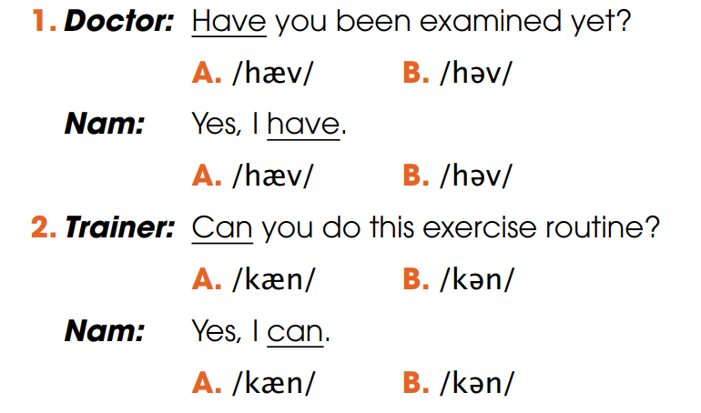
LOOKING BACK
1
Circle the common pronunciation of the underlined auxiliary verbs. Then listen and check. Practise saying the conversations in pairs

Slide 7
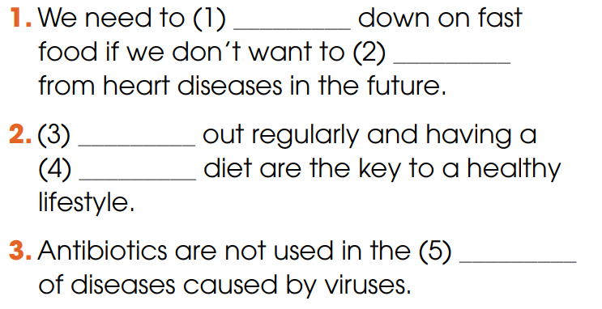
LOOKING BACK
2
Fill in each gap with ONE word. Use the words you have learnt in this unit.
cut
suffer
Working
balanced
treatment

Slide 8
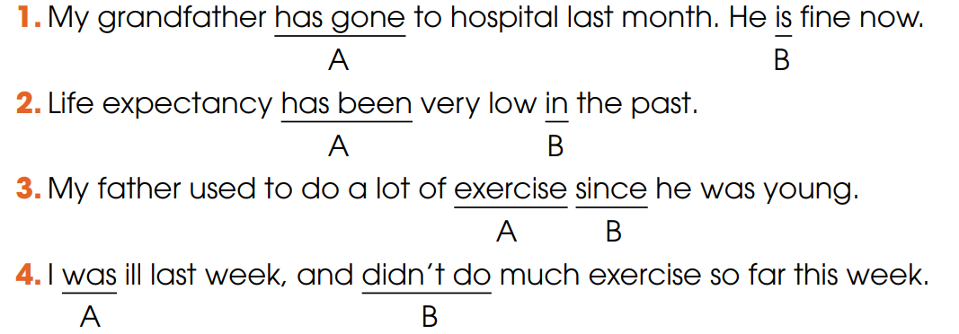
LOOKING BACK
3
Circle the underline part that is incorrect in each of the following sentence. Then correct it.
➔ went
➔ was
➔ when
➔ haven’t done

Slide 9
PROJECT
HEALTHY HABITS POSTERS

Slide 10
CONSOLIDATION
1
Wrap-up
What have you learnt today?
- Review the pronunciation, vocabulary and grammar of Unit 1;
- Apply what you have learnt (vocabulary and grammar) into practice through a project.

Slide 11
CONSOLIDATION
2
Homework
Do exercises in the workbook.
Prepare for Unit 2.

