Slide 1
Unit
1
A long and healthy life
Unit
FAMILY LIFE
LESSON 5
LISTENING
Food and health

Slide 2
WARM-UP
KAHOOT!
- Use your electronic devices to scan the QR code or enter the game pin to join the game.
- The whole class complete to answer the questions.
- After the game, Ss with the highest point is the winner.
Notes:
Link: https://create.kahoot.it/details/af7bb445-6028-430f-8ba9-a8adef37264d

Slide 3
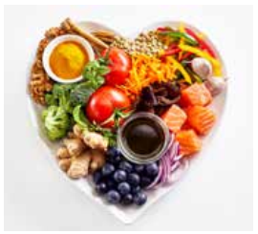
PRE-LISTENING
What is a balanced diet?
A diet that contains different kinds of foods in appropriate amounts to give our body the nutrients it needs

Slide 4
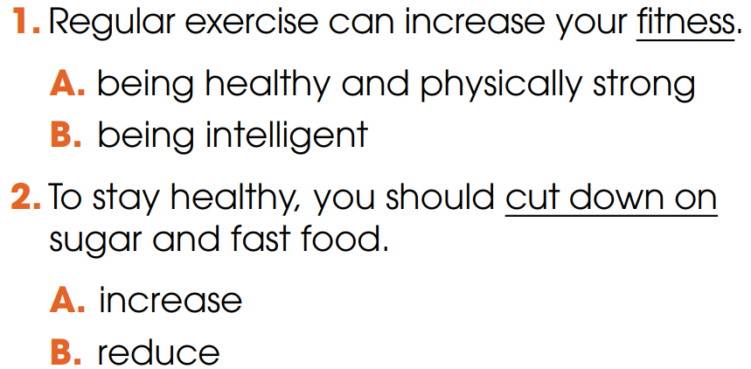
PRE-LISTENING
1
Choose the correct meaning of the underlined word and phrase

Slide 5
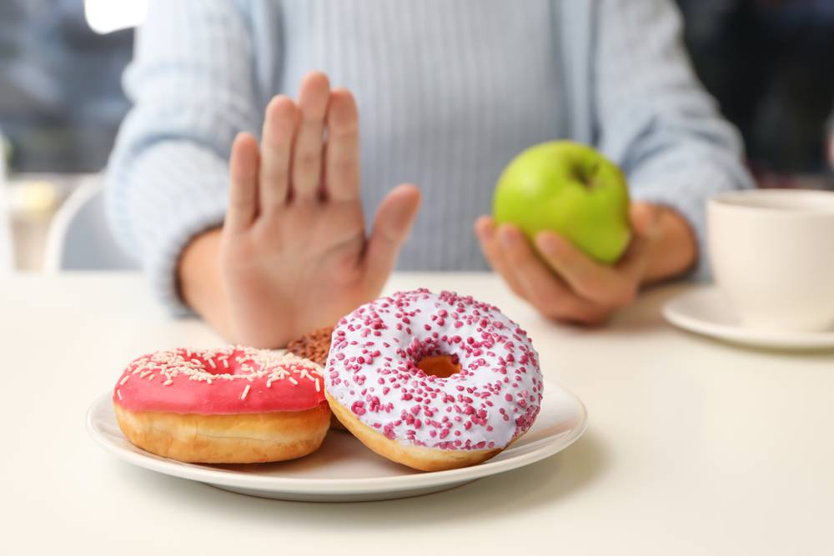
PRE-LISTENING
cut down on
/kʌt daʊn ɒn /
to reduce the size, amount or number of something
E.g. I will show you 5 tips to cut down on sugar.

Slide 6
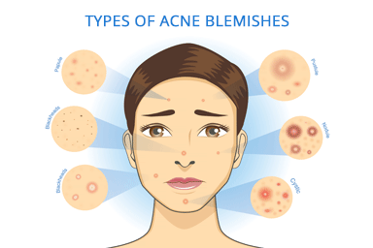
PRE-LISTENING
acne (n)
/ˈækni/
a skin condition, common among young people, that produces many pimples (= spots), especially on the face and neck

Slide 7
PRE-LISTENING
skincare (n)
/ˈskɪnkeə(r)/
the use of creams and special products to look after your skin

Slide 8
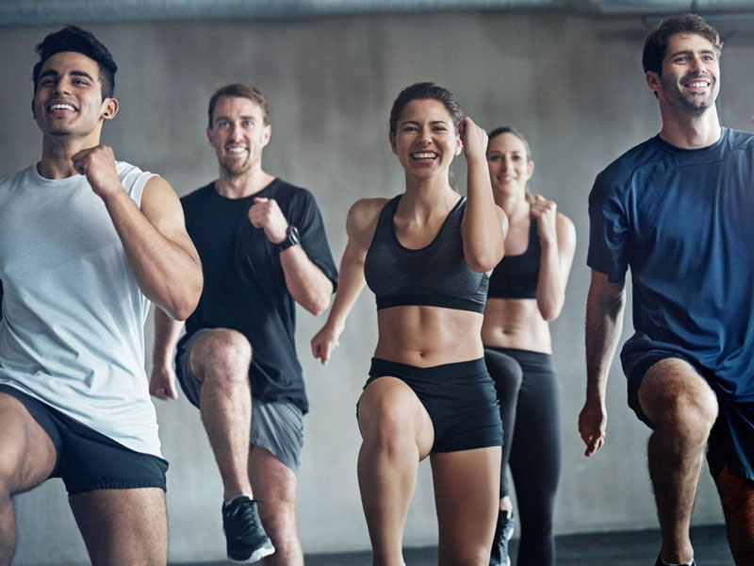
PRE-LISTENING
fitness (n)
/ˈfɪtnəs/
the state of being physically healthy and strong

Slide 9
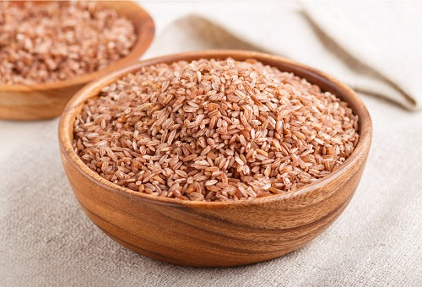
PRE-LISTENING
brown rice (n)
/ˌbraʊn ˈraɪs/
rice that is light brown because it has not had all of its outside part removed

Slide 10
PRE-LISTENING
Form | Pronunciation | Meaning
1. cut down on | /kʌt daʊn ɒn / | to reduce the size, amount or number of something
2. acne (n) | /ˈækni/ | a skin condition, common among young people, that produces many pimples (= spots), especially on the face and neck
3. skincare (n) | /ˈskɪnkeə(r)/ | the use of creams and special products to look after your skin
4. fitness (n) | /ˈfɪtnəs/ | the state of being physically healthy and strong
5. brown rice (n) | /ˌbraʊn ˈraɪs/ | ​rice that is light brown because it has not had all of its outside part removed

Slide 11
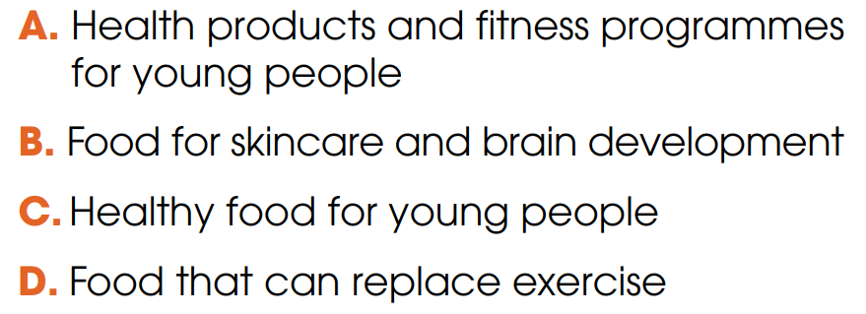
WHILE-LISTENING
2
Listen to a TV chat show about teen health. Circle the topic of the show.

Slide 12
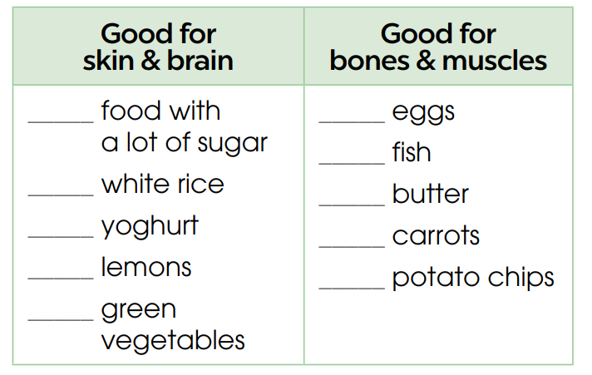
WHILE-LISTENING
3
Listen again and tick the food which is recommended in the talk.

Slide 13
WHILE-LISTENING
4
Listen again and complete the sentences. Use ONE word for each answer.
sugar
concentrate
stronger
exercise

Slide 14
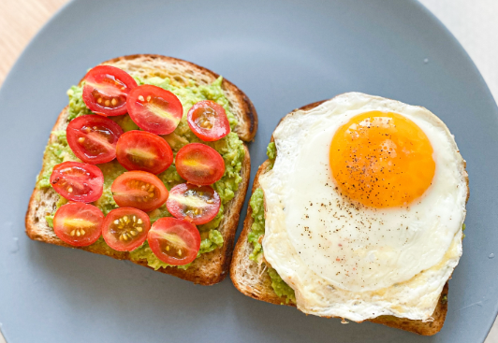
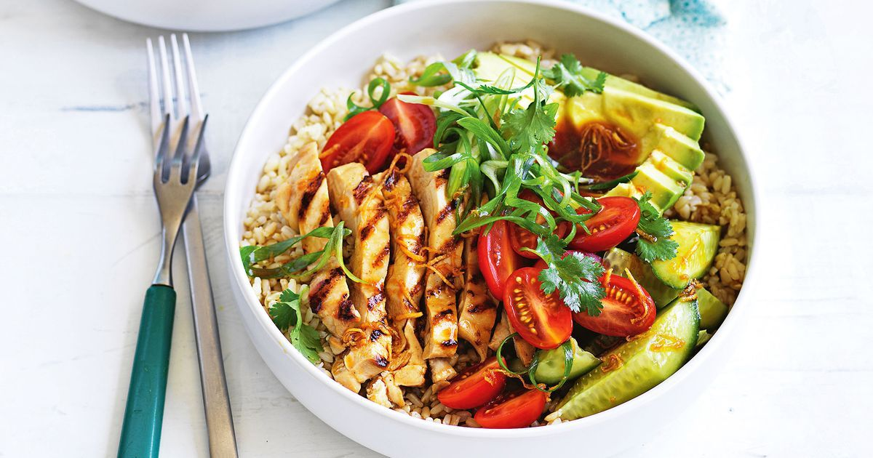
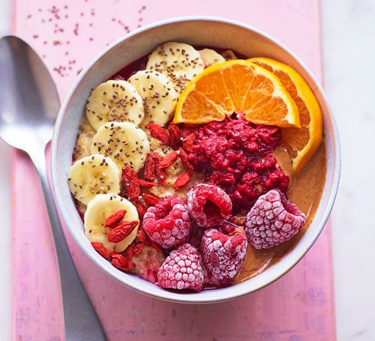
POST-LISTENING
5
Work in groups. Make a healthy meal plan for one day and explain why you have selected the food.

Slide 15
CONSOLIDATION
1
Wrap-up
What have you learnt today?
Healthy food for teenagers
Listening for main ideas and specific information

Slide 16
CONSOLIDATION
2
Homework
Do exercises in the workbook.
Prepare for Lesson 6 - Unit 1.

