Slide 1
Unit
1
A long and healthy life
Unit
FAMILY LIFE
LESSON 4
SPEAKING
Giving instructions for an exercise routine

Slide 2

WARM-UP
WATCH A VIDEO

Slide 3
WARM-UP
Can you remember any instructions in the video???
turn around
clap your hands
stretch it out
jump
shake
stomp your feet

Slide 4


PRE-SPEAKING
slightly (adv)
/ˈslaɪtli/
a little
E.g. Are you worried?’ ‘Only slightly.’

Slide 5
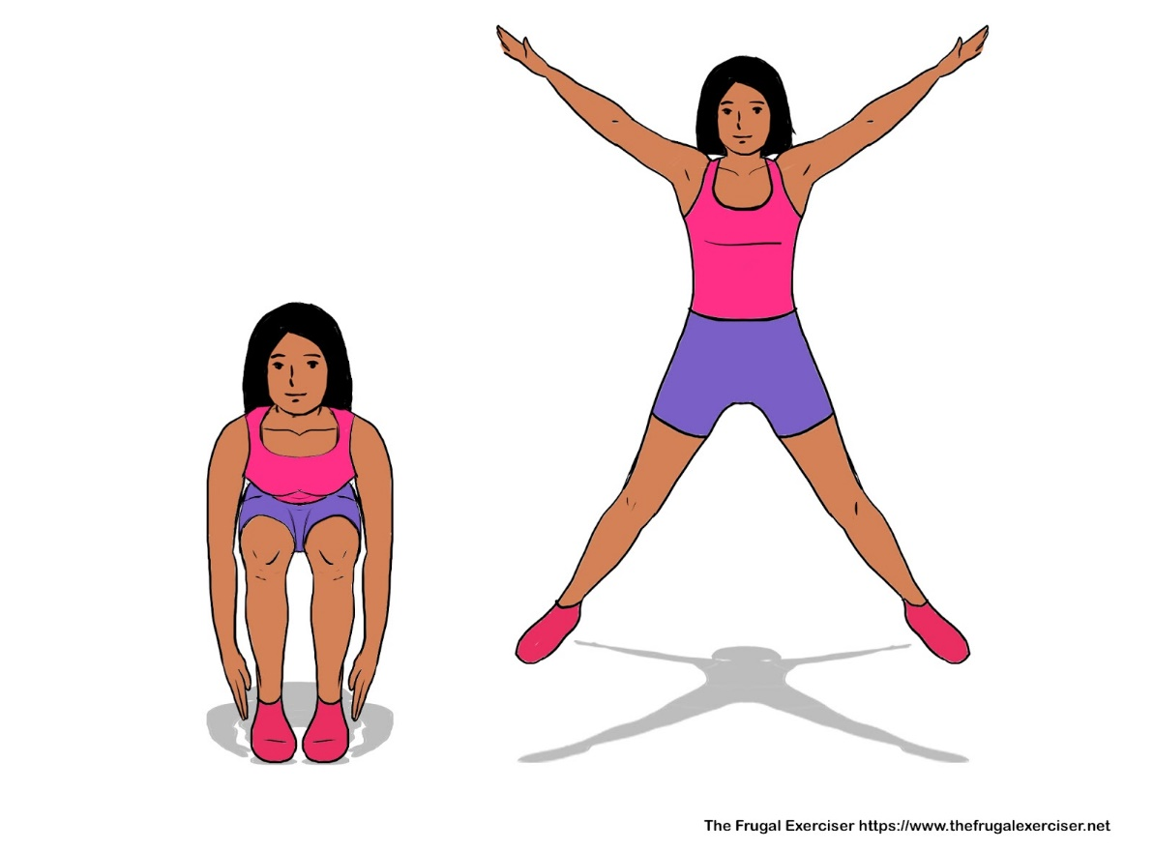
PRE-SPEAKING
star jump (n)
/stɑː(r) dʒʌmp/
an exercise in which you stand with your legs together and your arms at your sides and jump to a position with your legs apart and your arms spread out

Slide 6
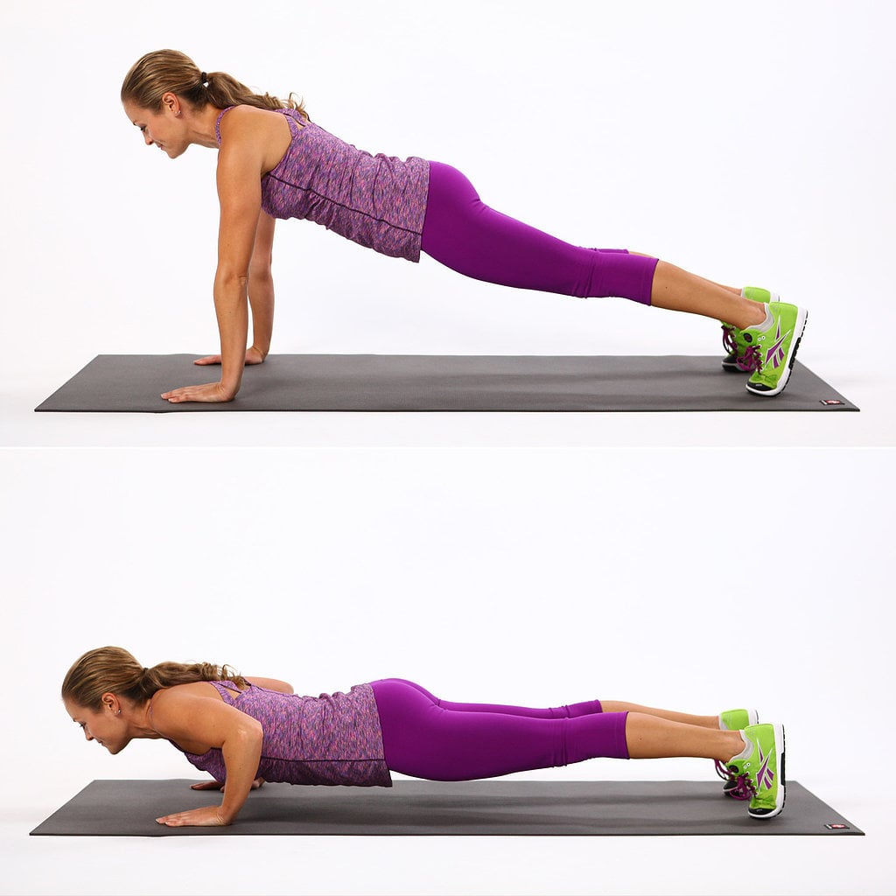
PRE-SPEAKING
press-up
/ˈpres ʌp/
an exercise in which you lie on your stomach and raise your body off the ground by pressing down on your hands until your arms are straight

Slide 7

PRE-SPEAKING
(to) squat
/skwɒt/
to sit on your heels with your knees bent up close to your body

Slide 8
PRE-SPEAKING
Form | Pronunciation | Meaning
1. slightly (adv) | /ˈslaɪtli/ | a little
2. star jump (n) | /stɑː(r) dʒʌmp/ | an exercise in which you stand with your legs together and your arms at your sides and jump to a position with your legs apart and your arms spread out
3. press-up (n) | /ˈpres ʌp/ | an exercise in which you lie on your stomach and raise your body off the ground by pressing down on your hands until your arms are straight
4. (to) squat | /skwɒt/ | to sit on your heels with your knees bent up close to your body

Slide 9
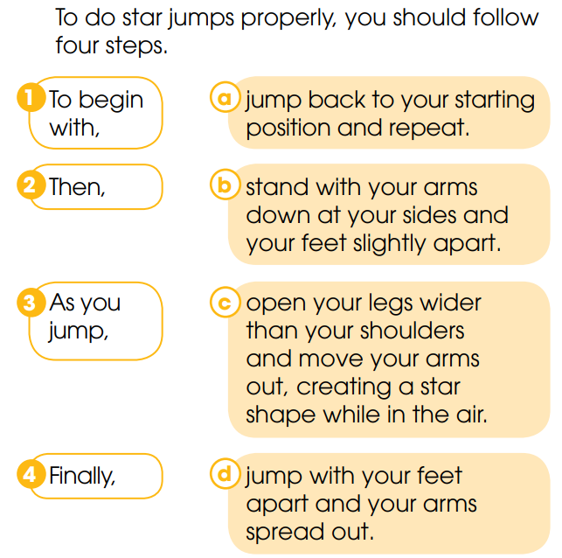
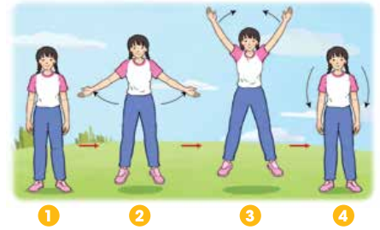
PRE-SPEAKING
1
Look at the diagram. Match the two parts of each sentence to complete the instruction.

Slide 10
PRE-SPEAKING
Tips to give instructions:
Fill in the blanks with a suitable word:
1. Start by _______________ the process.
2. Sequencing the steps, using ___________ words or phrases (i.g: first, second, next, finally …)
3. Give ___________ direction at a time.
introducing
linking
one

Slide 11
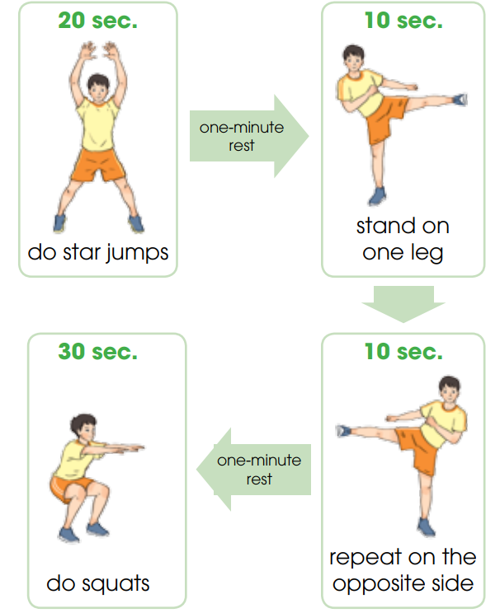
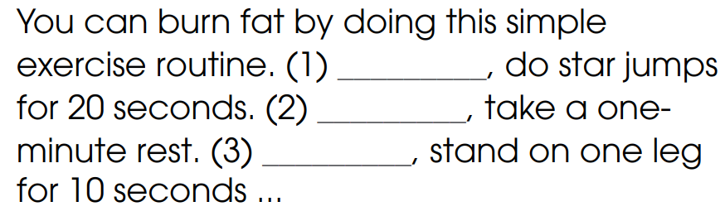
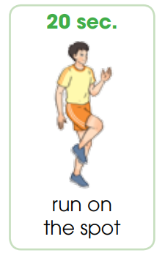

WHILE-SPEAKING
2
Look at the How to burn fat exercise. Fill in the blanks with one word to complete the first part of the instructions
First
Second
Next/Then

Slide 12
WHILE-SPEAKING
3
Work in pairs. Practice giving instructions for the rest of the exerice routine

Slide 13
WHILE-SPEAKING
4
Take turns demonstarting the exercise routine and giving instructions to the rest of your group so that they can do the exercise with you.

Slide 14

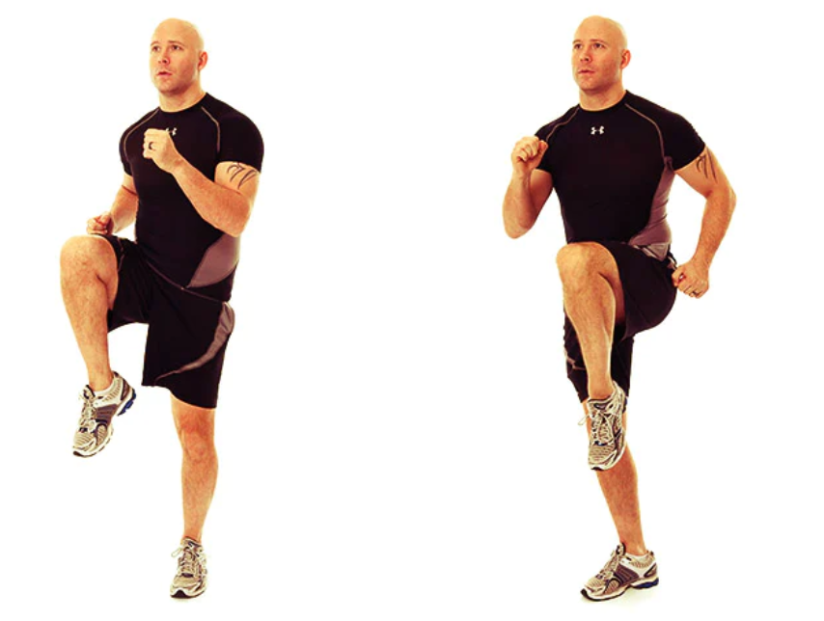

POST-SPEAKING
FURTHER PRACTICE
- Work in pairs and come up with instructions for another exercise routine. (e.g: Warm-up exercise in the P.E lesson)
- Demonstrate your routine in front of the class and give instructions.

Slide 15
CONSOLIDATION
1
Wrap-up
What have you learnt today?
How to give instructions for an exercise routine
Vocabulary to talk about an exercise routine

Slide 16
CONSOLIDATION
2
Homework
Do exercises in the workbook.
Prepare for Lesson 5 - Unit 1.

