Slide 1

Unit
1
A long and healthy life
Unit
FAMILY LIFE
Back to school
LESSON I
GETTING STARTED
A healthy lifestyle
11A4

Slide 2
WARM-UP
CATEGORIZING GAME
Work in 4 groups.
Each group is given pieces of paper about healthy and unhealthy lifestyle.
Classify them to correct columns.
The first team to complete the task correctly is the winner.
Go to the board and show the answers.

Slide 3
WARM-UP
Get enough good sleep
Eat fruits and vegetables
Stay up late
Eat too much sodium
Drink enough water
Have excessive screen time
Eat fast food
Have a balanced diet
Eat late in the evening
Overuse painkillers and sedatives
Get regular exercise
Avoid tobacco and drugs

Slide 4


WARM-UP
HEALTHY LIFESTYLE
UNHEALTHY LIFESTYLE
Eat fruits and vegetables
Stay up late
Drink enough water
Eat too much sodium
Get regular exercise
Eat fast food
Have a balanced diet
Eat late in the evening
Get enough good sleep
Overuse painkillers and sedatives
Avoid tobacco and drugs
Have excessive screen time

Slide 5
Unit
1
A long and healthy life
Unit
FAMILY LIFE
LESSON I
GETTING STARTED
A healthy lifestyle

Slide 6





PRESENTATION
New Words

Slide 7
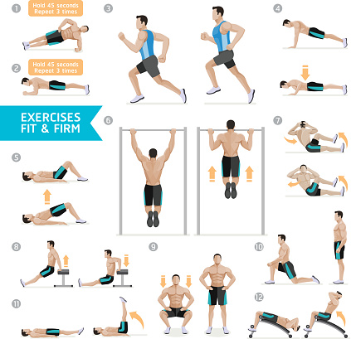

PRESENTATION
(to) work out
/wɜːk aʊt/
to exercise in order to improve the
strength or appearance of your body

Slide 8

PRESENTATION
(be) full of
/fʊl əv/
containing a lot of something
E.g: You're always so full of energy.

Slide 9
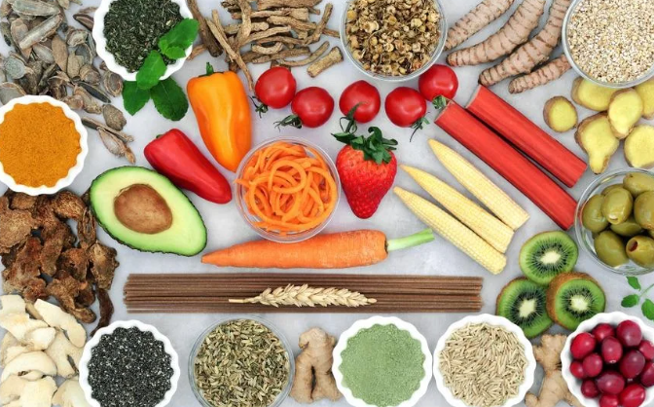
PRESENTATION
diet (n)
/ˈdaɪət/
the food and drink usually eaten or
drunk by a person or group

Slide 10
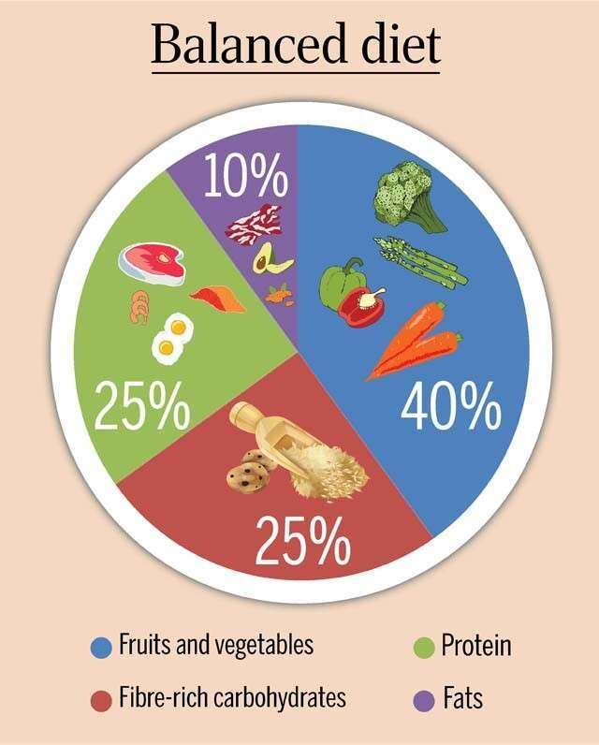
PRESENTATION
balanced (adj)
/ˈbælənst/
A balanced diet is a combination of the correct types and amounts of food

Slide 11
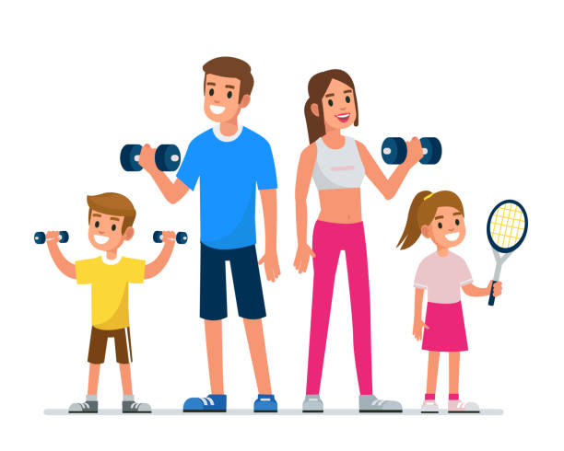
PRESENTATION
fit (adj)
/fɪt/
healthy and strong, especially as a result of exercise

Slide 12
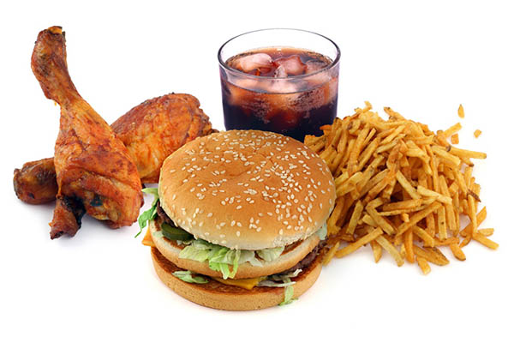
PRESENTATION
Fast food (n)
/ˌfɑːst ˈfuːd/
hot food, such as hamburgers and chips, that is served very quickly and can be taken away to be eaten in the street

Slide 13

PRESENTATION
Give up (v.phr)
/gɪv ʌp/
to stop trying to do something

Slide 14
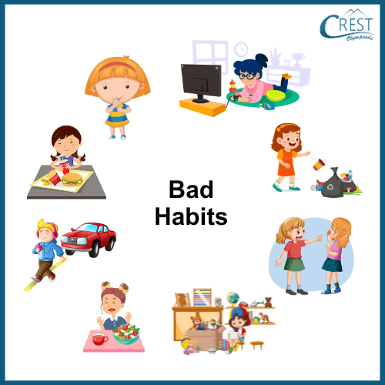
PRESENTATION
habit (n)
/ ˈhæb.ɪt/
a thing that you do often and almost without thinking, especially something that is hard to stop doing

Slide 15

PRESENTATION
Burger(n)
/bɜːɡə(r)/

Slide 16
PRESENTATION
Life lesson(n)
/laɪf ˈles.ən/
a situation in which you learn something useful about how to live your life

Slide 17
PRESENTATION
Form | Pronunciation | Meaning | Vietnamese equivalent
1. (to) work out | /wɜːk aʊt/ | to exercise in order to improve the strength or appearance of your body | Tập luyện
2. (be) full of (adj) | /fʊl əv/ | containing a lot of something | Tràn đầy
3. diet (n) | /ˈdaɪ.ət/ | the food and drink usually eaten or drunk by a person or group | Chế độ ăn uống
4. balanced (adj) | /ˈbælənst/ | A balanced diet is a combination of the correct types and amounts of food. | Cân bằng
5. fit (adj) | /fɪt/ | healthy and strong, especially as a result of exercise | Cân đối

Slide 18
PRESENTATION
Form | Pronunciation | Meaning | Vietnamese equivalent
6. Fast food(n) | /fɑːst fuːd/ | hot food, such as hamburgers and chips, that is served very quickly and can be taken away to be eaten in the street | Thức ăn nhanh
7. Give up (v.phr) | /gɪv ʌp/ | to stop trying to do something | Từ bỏ
8. habit (n) | / ˈhæb.ɪt/ | a thing that you do often and almost without thinking, especially something that is hard to stop doing | Thói quen
9. Burger(n) | /bɜːɡə(r) / |  | Bánh mì kẹp thịt
10. Life lesson(n) | /laɪf ˈles.ən/ | a situation in which you learn something useful about how to live your life | Bài học cuộc sống

Slide 19

PRESENTATION
1
Listen and read.

Slide 20
PRESENTATION
1
Listen and read.
Mark: Hi, Nam!
Nam: Hi, Mark! Long time no see. How are you?
Mark: I'm fine, thanks, but you look so fit and healthy! Have you started working out again?
Nam: Yes, I have. I've also stopped eating fast food and given up bad habits, such as staying up late.
Mark: I can't believe it! I thought you can't live without burgers and chips!
Nam: I know. I ate a lot of fast food, but now I prefer fresh fruits and vegetables.
Mark: So what happened?
Nam: Well, it was my grandfather. I visited him during my last summer holiday and have learnt a lot of important life lessons from him.
Mark: Really?
Nam: Yes. He's a wonderful person. He has just had his 90th birthday, but he’s still full of energy!
Mark: Amazing! How does he stay so active?
Nam: Well, he does exercise every morning, goes to bed early, and eats a lot of vegetables. We spent a lot of time together cooking, working in his garden, and walking in the parks. I've learnt from him that taking regular exercise and eating a balanced diet are the key to a long and healthy life.

Slide 21
PRACTICE
2
Read the conversation again and decide whether the following statements are true (T) or false (F).
 | T | F
1. Nam has always had healthy habits.
2. He has learnt the importance of exercise and healthy food.
3. Nam’s grandfather goes to sleep early, exercises everyday and eats healthily.
✓
✓
✓

Slide 22
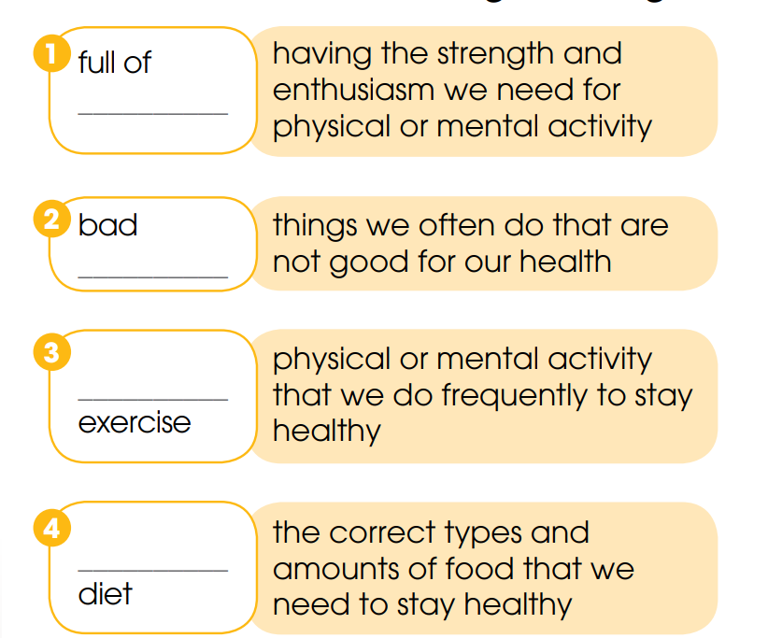
PRACTICE
3
Fill in the blanks to make phrases from Task 1 with the following meanings.
energy
habits
regular
balanced

Slide 23
PRACTICE
4
Complete the text based on the conversation in Task 1. Use the correct forms of the verbs in brackets.
In the past, Nam (1. eat) _______ fast food and often stayed up late. But he (2. start) ____________ eating healthy food and (3. give) ____________ up bad habits. He has changed his lifestyle since he (4. visit) _________ his grandfather, who (5. just celebrate) ___________________ his 90th birthday.
ate
has started
(has) given
visited
has just celebrated

Slide 24

PRODUCTION
Role-play
- Ss work in groups of 4.
- In each group, one student plays the role of grandpa who is in his 90s and still very strong and healthy. Others are grandchildren.
- Grandpa gives advice on how to be healthy.
- 3 minutes to prepare for the role-play.
- 2 minutes for a performance.

Slide 25
CONSOLIDATION
1
Wrap-up
What have you learnt today?
Some lexical items about healthy lifestyle
Reading for specific information
Past simple and Present perfect tense

Slide 26
CONSOLIDATION
2
Homework
Do exercises in the workbook.
Write a short paragraph about how to keep fit and stay healthy.
Prepare materials for the project in Lesson 8.

Slide 27
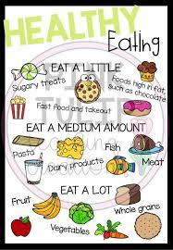
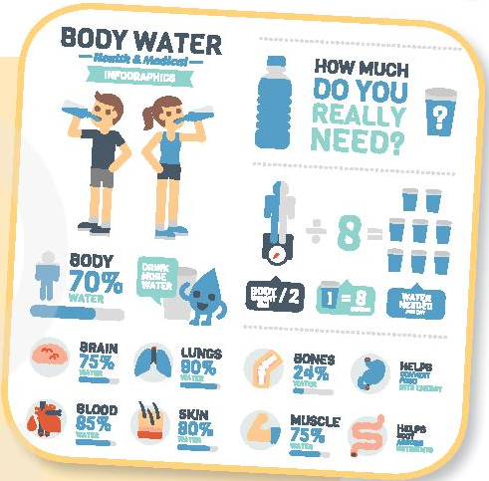
CONSOLIDATION
2
Homework

