Slide 1
TUY PHUOC 2 HIGH SCHOOL
TEACHER: NGUYEN THI BICH CHI
CLASS: 11A1
SCHOOL YEAR: 2024 - 2025

Slide 2

Unit 2: Generation Gap
Lesson 2.1: Vocabulary & Reading
Pages: 18 & 19

Slide 3
Lesson Outline
Warm-up
Vocabulary
Reading
Consolidation
Wrap-up

Slide 4

WARM UP

Slide 5

Work in pairs
Look at the picture and answer the questions:
1. What's the problem in the picture?
2. What are some other reasons for arguments between parents and teenagers?

Slide 6
Suggested answer:
In the picture, the boy is playing games too much and the mother is not happy with this.
teenagers don’t study hard at school, don’t help parents with housework, watch TV too much, spend too much time on their mobile phones, do don’t their homework.

Slide 7

Vocabulary

Slide 8
Match the words with the correct definitions.
1. Influence
2. Behavior
3. Respect
4. Ignore
5. Curfew
6. Permission
7. Privacy
a. how someone acts
b. pay no attention to something
c. the effect that somebody or something has on the way someone thinks or acts
d. the state of being alone and not watched by other people
e. act in a way that shows you are aware of someone's rights, wishes, etc.
f. a time when children must be home in the evening
g. the right to do something that is given to you by someone else

Slide 9
Match the words with the correct definitions.
1. Influence
2. Behavior
3. Respect
4. Ignore
5. Curfew
6. Permission
7. Privacy
a. how someone acts
b. pay no attention to something
c. the effect that somebody or something has on the way someone thinks or acts
d. the state of being alone and not watched by other people
e. act in a way that shows you are aware of someone's rights, wishes, etc.
f. a time when children must be home in the evening
g. the right to do something that is given to you by someone else

Slide 10

Listen and repeat.
influence (n) /ˈɪnfluəns/
behavior (n) /bɪˈheɪvjə/
respect (v) /rɪˈspekt/
ignore (v) /ɪgˈnɔːr//
curfew (n) /ˈkɜːfjuː/
permission (n) /pərˈmɪʃn/ => permit (v)
privacy (n) /ˈpraɪvəsi/

Slide 11
Listen and repeat.
influence (n) /ˈɪnfluəns/ sự ảnh hưởng
behavior (n) /bɪˈheɪvjə/ hành vi
respect (v) /rɪˈspekt/ tôn trọng
ignore (v) /ɪgˈnɔːr// làm ngơ, bỏ qua
curfew (n) /ˈkɜːfjuː/ giờ giới nghiêm
permission (n) /pərˈmɪʃn/ sự cho phép => permit (v)
privacy (n) /ˈpraɪvəsi/ sự riêng tư

Slide 12
Task a
Read the words and definitions, then fill in the blanks.
Influence, behavior, respect, ignore, curfew, permission, privacy
1. When working in teams, you should ________ other people's opinions and not make decisions on your own.
2. I need to get my mom's ____________ when I want to go out with my friends.
3. Sarah has a 9:30 p.m. ________. She has to be home before that.
respect
permission
curfew

Slide 13
Influence, behavior, respect, ignore, curfew, permission, privacy
4. As children get older, they want to have more ________ and stop sharing everything with their parents.
5. Tom's ___________ has become quite strange. He doesn't talk much and always stays in his room.
6. Why did you ________ my messages? I sent you so many, and you
never replied!
7. Movies can be a bad _________ on children. Parents should know what their children are watching.
privacy
behavior
ignore
influence

Slide 14
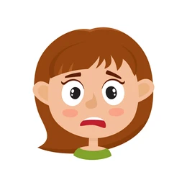

Task a
In pairs: What behavior is not accepted in your family?
When do you have to ask for permission from your parents?
I can't ignore my parents' messages.
I can’t go out without asking for permission.

Slide 15

Reading

Slide 16
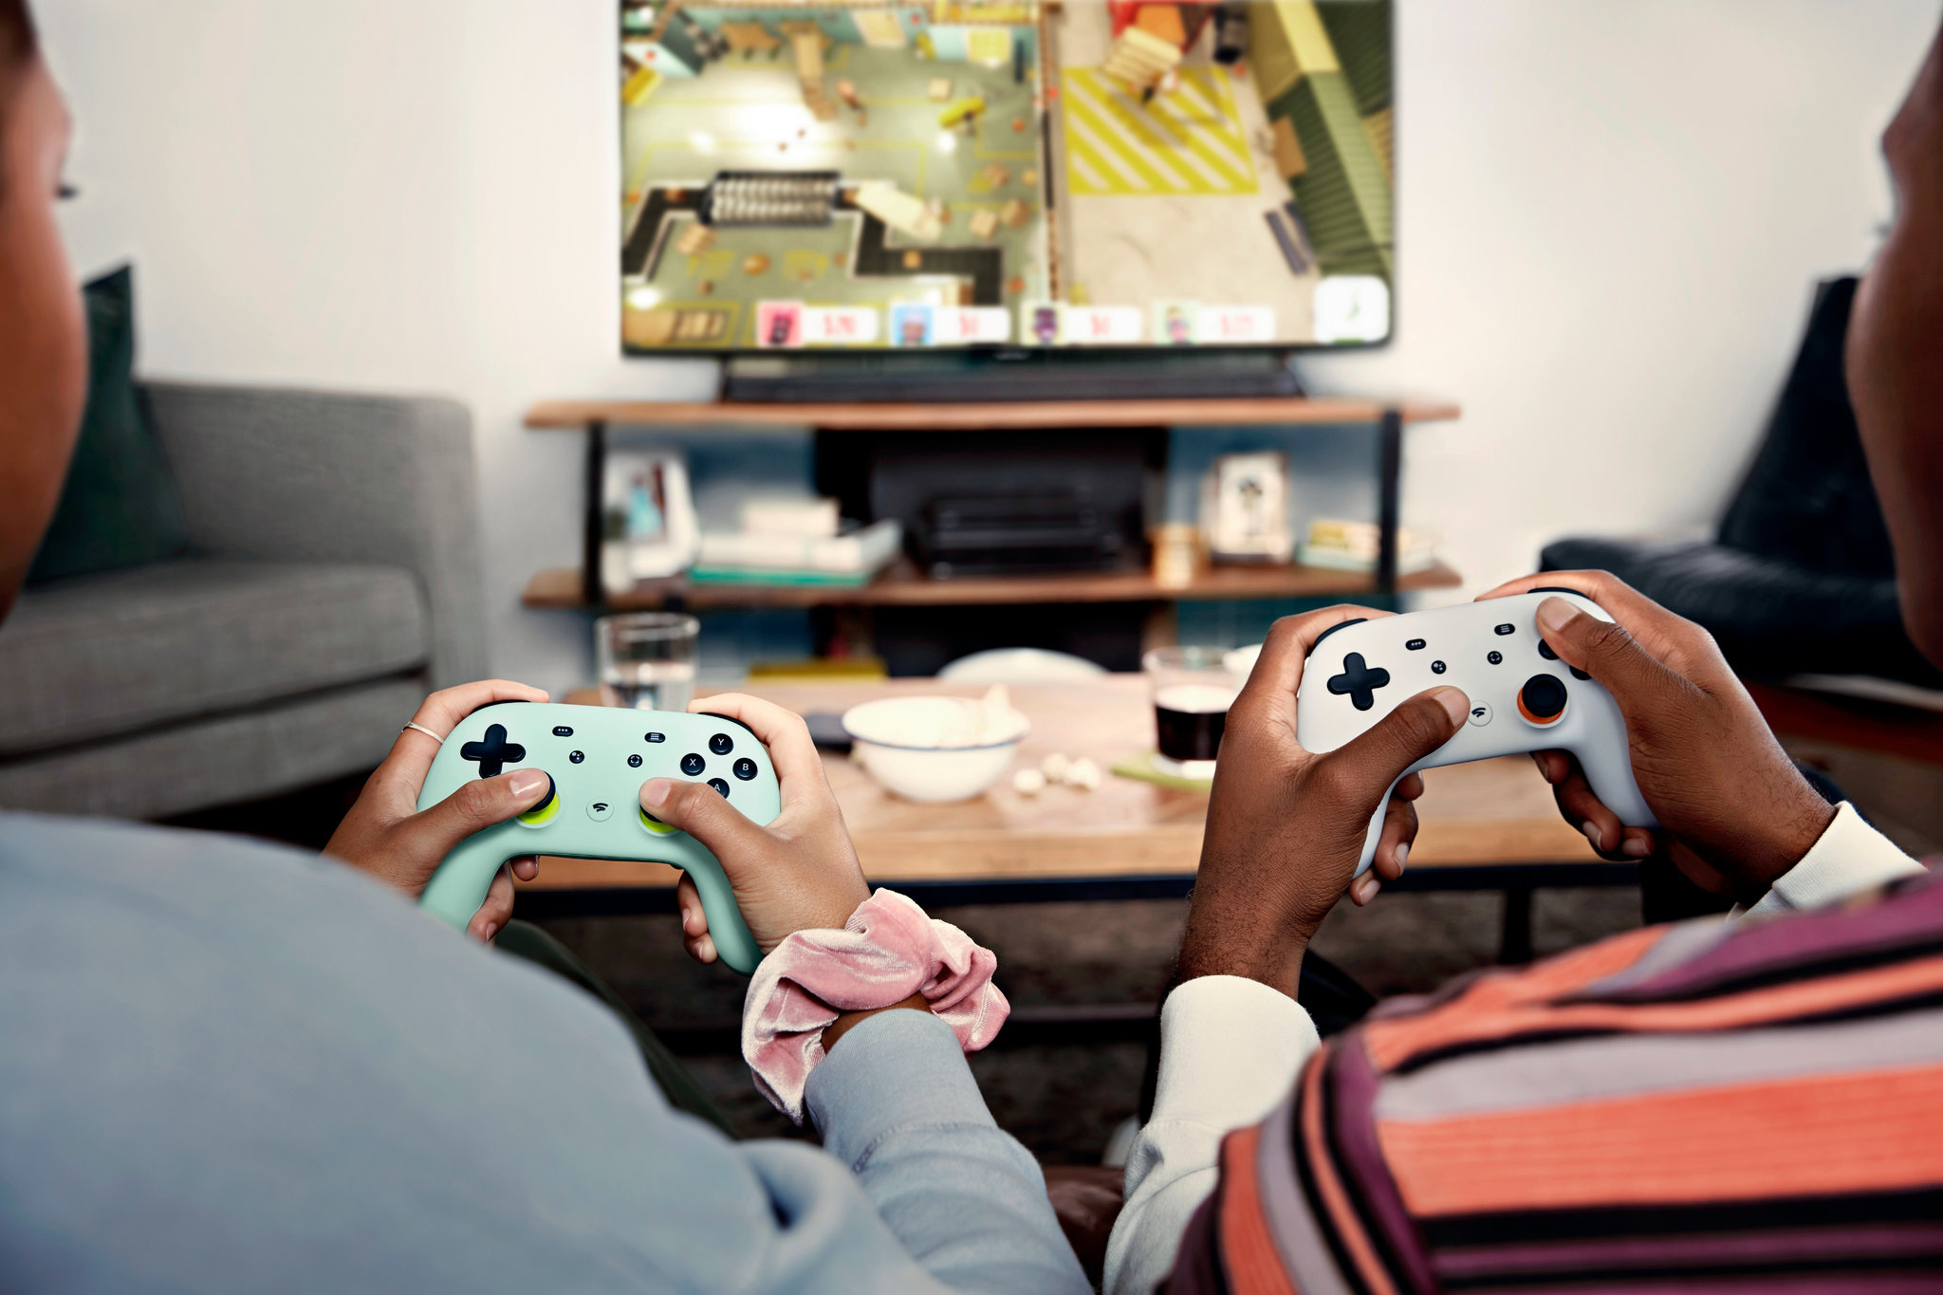

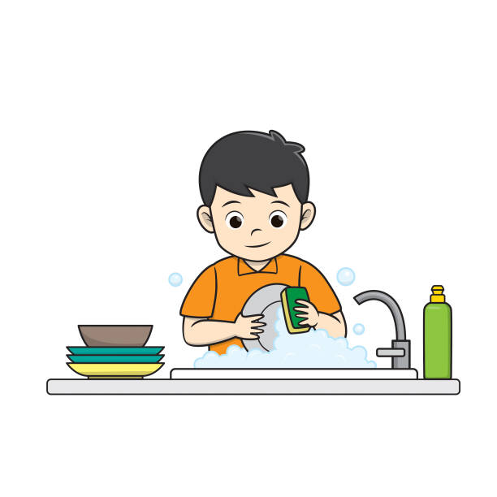
Work in pairs: List the problems you usually have with your parents.
Playing games
Doing housework
Studying
Choosing friends
Spending money

Slide 17
New words
argument (n) /ˈɑːɡ.jə.mənt/ => argue /ˈɑːɡ.juː/ (v)
several (det) /ˈsev.ər.əl/
diary (v) /ˈdaɪə.ri/
focus (v) /ˈfəʊ.kəs/
appearance (n) /əˈpɪə.rəns/

Slide 18
New words
argument (n) /ˈɑːɡ.jə.mənt/ sự tranh cãi => argue /ˈɑːɡ.juː/ (v)
several (det) /ˈsev.ər.əl/ một vài
diary (n) /ˈdaɪə.ri/ nhật kí
focus (v) /ˈfəʊ.kəs/ tập trung = pay attention to
appearance (n) /əˈpɪə.rəns/ ngoại hình

Slide 19
Task a
Guess the answer to the following question.
Which of the following is NOT mentioned as a problem between Donna and her daughter?
how her daughter spends money
her daughter's musical taste
her daughter's grades

Slide 20
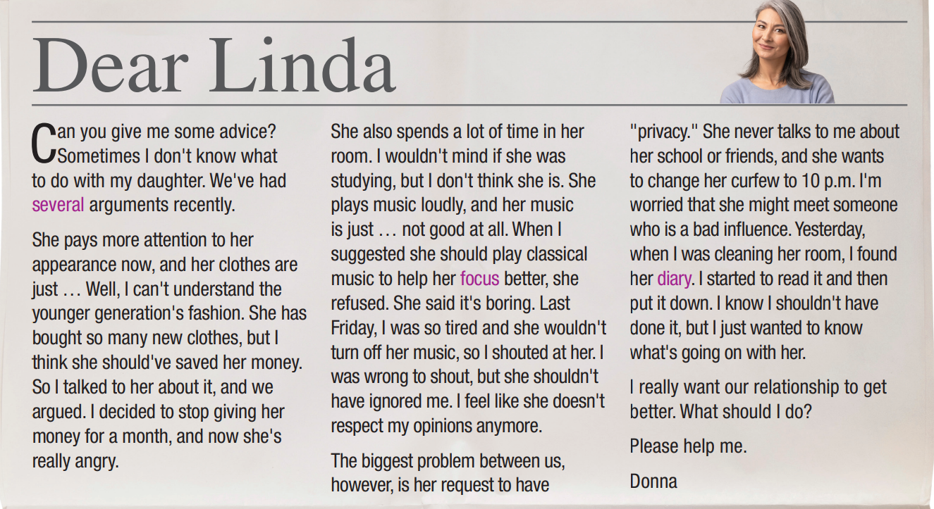
c. her daughter's grades
Read and check.

Slide 21
Task b
Read and underline the key words.
1. Donna thinks her daughter spent too much money on clothes.
2. Donna's daughter likes to listen to classical music.
3. Donna often argues with her daughter about her friends.
4. Donna didn't give her daughter permission to go home late.
5. Donna regrets reading her daughter's diary.

Slide 22
Read and write True, False, or Doesn't say.
1. Donna thinks her daughter spent too much money on clothes.
T
She pays more attention to her appearance now, and her clothes are just … Well, I can't understand the younger generation's fashion. She has bought so many new clothes, but I think she should've saved her money. So I talked to her about it, and we argued. I decided to stop giving her money for a month, and now she's really angry.

Slide 23
2. Donna's daughter likes to listen to classical music.
F
She also spends a lot of time in her room. I wouldn't mind if she was studying, but I don't think she is. She plays music loudly, and her music is just … not good at all. When I suggested she should play classical music to help her focus better, she refused. She said it's boring. Last Friday, I was so tired and she wouldn't turn off her music, so I shouted at her. I was wrong to shout, but she shouldn't have ignored me. I feel like she doesn't respect my opinions anymore.

Slide 24
3. Donna often argues with her daughter about her friends.
4. Donna didn't give her daughter permission to go home late.
5. Donna regrets reading her daughter's diary.
DS
DS
T
The biggest problem between us, however, is her request to have "privacy." She never talks to me about her school or friends, and she wants to change her curfew to 10 p.m. I'm worried that she might meet someone who is a bad influence. Yesterday, when I was cleaning her room, I found her diary. I started to read it and then put it down. I know I shouldn't have done it, but I just wanted to know what's going on with her.

Slide 25
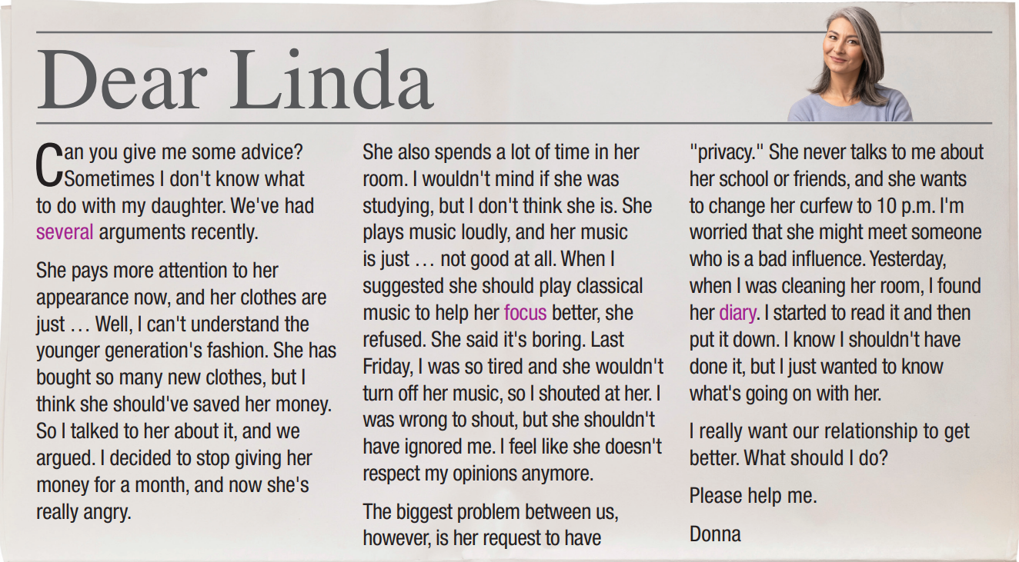
Task c
Listen and read.

Slide 26

Task d
In pairs: What do you think Donna should do? Why?
I think Donna should spend more time with her daughter and talk with her like a friend so that she can know her hobbies as well as problems and give useful advice.

Slide 27

CONSOLIDATION

Slide 28
Write four sentences about problems you usually have with your parents, using the new words in the lesson
For example:
My parents usually complain about my behaviors. I rarely ask for permission when I want to go out. I feel uncomfortable when my parents don’t respect my privacy. They always go into my room without knocking the door.

Slide 29

WRAP-UP

Slide 30

Today’s lesson
Vocabularies
Influence
Behavior
Respect
Ignore
Curfew
Permission
Privacy

Slide 31
Today’s lesson
Reading:
- Understanding instructions
Skimming and scanning for general and specific information
Speaking:
- Talking about generation gap

Slide 32
Homework
Learn by hearts vocabularies and make sentences using them.
Do the exercises on page 10 WB.
Prepare the next lesson (pages 19 & 20 SB)
Play the consolidation games on www.eduhome.com.vn

Slide 33

Lesson 3
Stay positive and have a nice day!

