Slide 1
TUY PHUOC 2 HIGH SCHOOL
TEACHER: NGUYEN THI BICH CHI
CLASS: 11A1
SCHOOL YEAR: 2024 - 2025

Slide 2

Unit 2: Generation Gap
Lesson 2.3: Pronunciation & Speaking
Pages: 20 & 21

Slide 3
Lesson Outline
Warm-up
Pronunciation
Speaking
Consolidation
Wrap-up

Slide 4

WARM UP
GUESSING
GAME

Slide 5
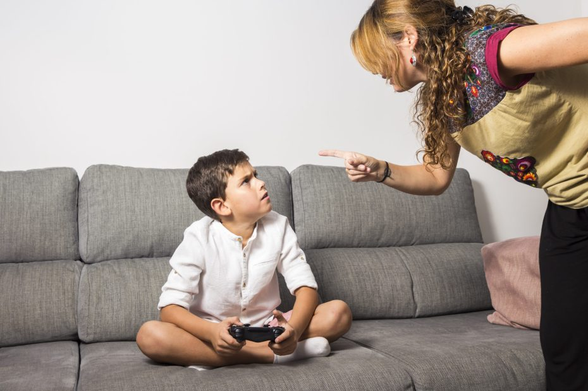

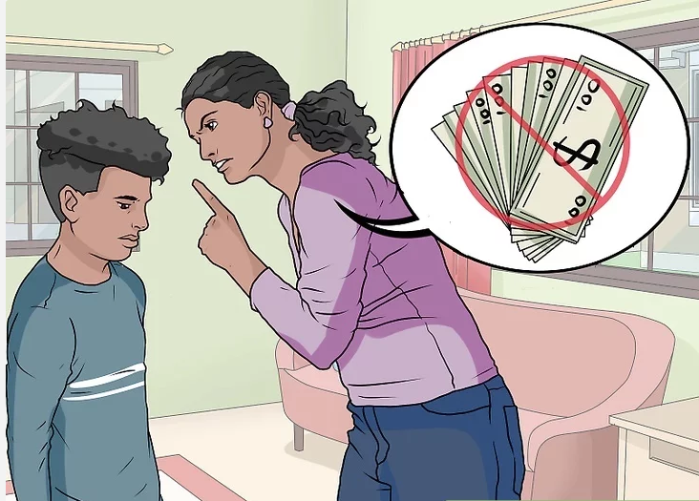
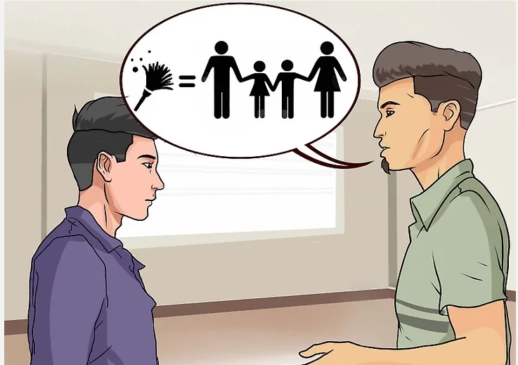
Look at the pictures and give words/ phrases related to these pictures.
1
2
Playing games
Study
Spend money
Do housework
3
4
I should’ve studied harder.

Slide 6

Presentation

Slide 7

Listen to the questions and notice the sound changes of the underlined word.
You should've called your mom.
He should've studied for the exam.
After a consonant, '… have …' is often contracted to ('ve)
and is pronounced /əv/.
'… should have …' is written '… should've …' and sounds like /'ʃʊdəv/.

Slide 8
Listen and repeat.
You should've called your mom.
He should've studied for the exam.

Slide 9
Task c
Listen and cross out the sentence with the wrong sound changes.
He should've left earlier.
I should've checked my phone more often.
Task d
Read the sentences with the correct
sound changes to a partner.

Slide 10

Practice

Slide 11
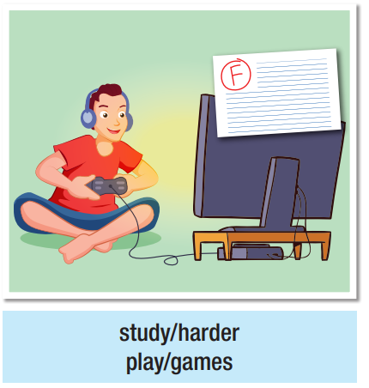
Take turns asking what the people should have done differently. Use the prompts to say what they should've and shouldn't have done.
Task a
What should he have
done differently?
He should've studied harder.
He shouldn't have played games.

Slide 12
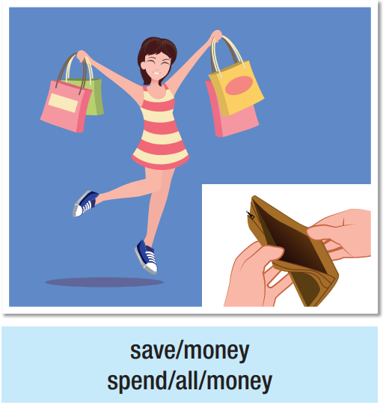
What should she have
done differently?
She should’ve saved money.
She shouldn't have spent all money.

Slide 13
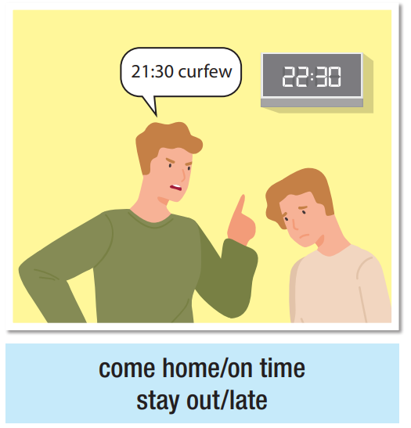
What should he have
done differently?
He should’ve come home on time. He shouldn't have stayed out late.

Slide 14
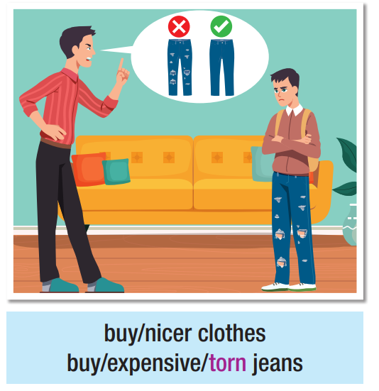
What should he have
done differently?
He should’ve bought nicer clothes. He shouldn't have bought expensive torn jeans.

Slide 15
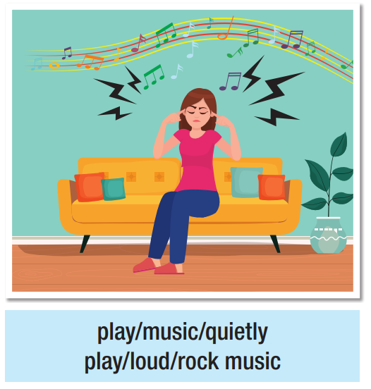
What should she have
done differently?
She should’ve played music quietly. She shouldn't have played loud rock music.

Slide 16
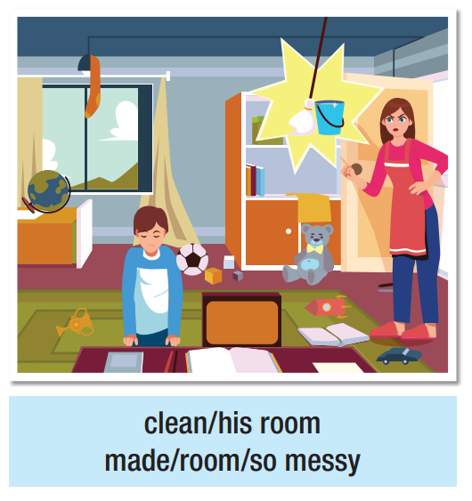
What should he have
done differently?
He should’ve cleaned his room. He shouldn't have made his room so messy.

Slide 17
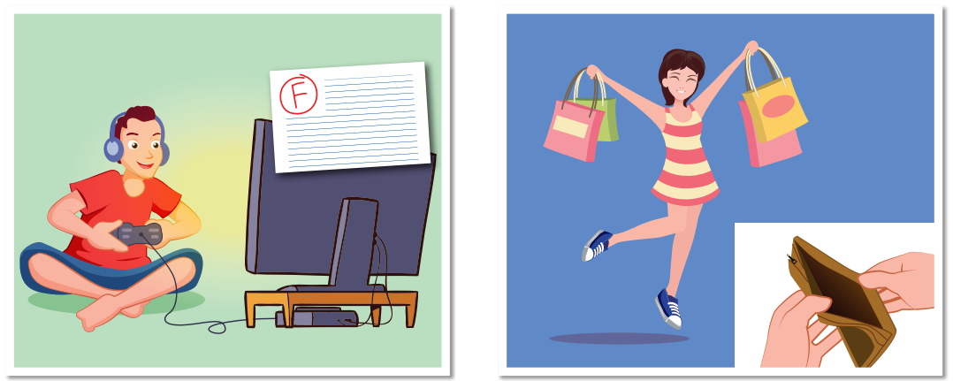
Task b
Discuss what can be done to avoid these situations.
He should make a habit of studying before playing.
She should make a plan to spend money better.

Slide 18
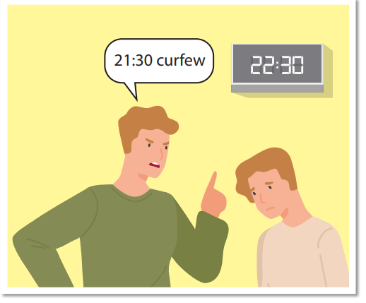
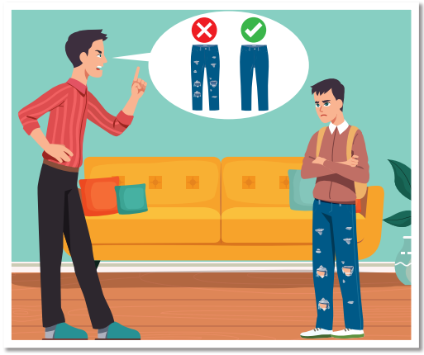
He should make a habit of coming home early.
He shouldn’t buy expensive clothes.

Slide 19
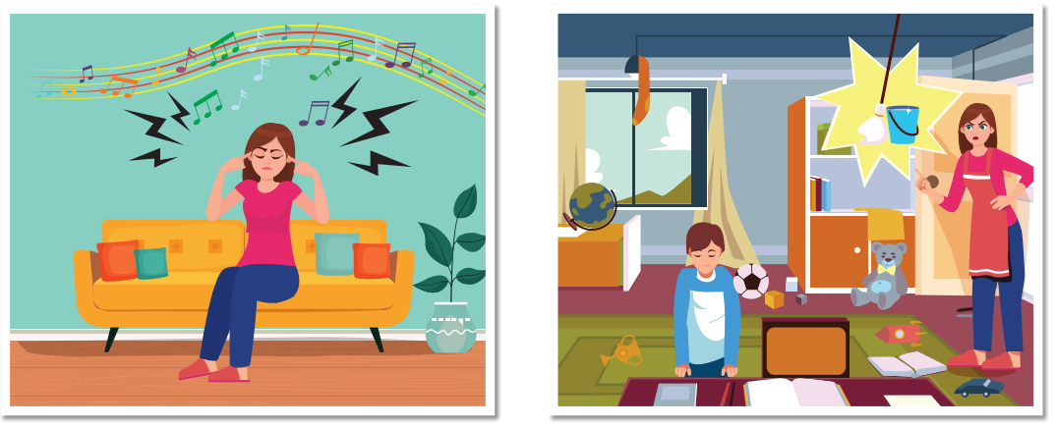
She should make a habit of playing music with low volume.
He should make a habit of tidying his room regularly.

Slide 20

Speaking

Slide 21
FAMILY ARGUMENTS: WHAT THEY SHOULD'VE DONE
In pairs: Read the situation and discuss what the people should have done differently. Then, think of a solution for each situation.
A: What should Tom have done differently?
B: Tom shouldn't have ignored his dad's advice.
A: Yes, but his dad should've explained why he didn't like Tom's friend.
B: That's right. I think in the future, Tom should …
Tom got in trouble for hanging out with a friend
his dad doesn't like. But Tom's dad never told him
why he didn't like his friend.

Slide 22
A: What should Mary have done differently?
B: Mary should have worn the clothes her mom bought.
A: Yes, but her mom should have asked her what kind of clothes she likes.
B: That’s right. I think in the future Mary should …
Mary's mom bought clothes for her. Mary doesn't like the clothes and never wears them. Her mom is angry.

Slide 23
A: What should Jane have done differently?
B: Jane should have told her dad before going to see a movie.
A: Yes, and she should have answered her dad’s phone calls.
B: That’s right. I think in the future Jane should …
Jane went to see a movie without telling her dad.
She broke her curfew and didn't answer her dad's phone calls. He was very angry

Slide 24
A: What should John’s mom have done differently?
B: John’s mom shouldn’t have come into his bedroom without knocking.
A: Yes, but John should have told his mom why he doesn’t like that.
B: That’s right. I think in the future John should …
John's mom wanted to check on him. She came
into his bedroom without knocking, and John was not happy.

Slide 25
Production

Slide 26
Work in pairs
Which of the above situations have you been in? What did you and your parents do? Why?
I have been in the second situation. I told my mom that I didn’t like those clothes. Therefore, she let me choose my favorite items whenever we go shopping for clothes.

Slide 27

CONSOLIDATION

Slide 28
Write four sentences about the problems you have with your parents and suggest solutions for them.
For example:
My parents are angry when I go out without asking for permission. I think I should make a habit of asking for permission before going out.
I feel uncomfortable when my parents go into my room without knocking the door. I think I should talk with them about how I feel about that and tell them that I sometimes need privacy.

Slide 29

WRAP-UP

Slide 30
Today’s lesson
Pronunciation:
- Pronunciation of “should have”
Speaking:
- Talking about family problems and solutions

Slide 31
Homework
Practice talking about family problems and solutions, using should or should have
Prepare the next lesson (pages 22 & 23 SB)
Play the consolidation games on www.eduhome.com.vn

Slide 32

Lesson 3
Stay positive and have a nice day!

