Slide 1
TUY PHUOC 2 HIGH SCHOOL
TEACHER: NGUYEN THI BICH CHI
CLASS: 11A1
SCHOOL YEAR: 2024 - 2025

Slide 2

Unit 2: Generation Gap
Lesson 2.2: Grammar
Page: 19 & 20

Slide 3
Lesson Outline
Warm-up
Grammar
Consolidation
Wrap-up

Slide 4

WARM UP

Slide 5
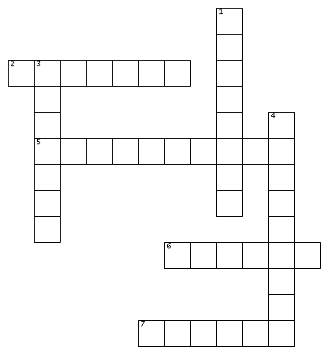
ACROSS
2. the state of being alone and not watched by other people
5. the right to do something that is given to you by someone else
6. a time when children must be home in the evening
7. pay no attention to something
DOWN
1. how someone acts
3. act in a way that shows you are aware of someone's rights, wishes, etc.
4. the effect that somebody or something has on the way someone thinks or acts
B
E
P
R
I
V
A
C
Y
H
E
A
S
V
I
P
E
R
M
I
S
S
I
O
N
E
O
F
C
R
L
T
U
C
U
R
F
E
W
N
C
I
G
N
O
R
E

Slide 6

Presentation

Slide 7
PERFECT MODAL : SHOULD HAVE
Look at the sentences and underline the main verbs.
I should have listened to you.
I shouldn't have eaten so much for dinner.
You shouldn't have gone to the party.
You should have drunk more water before bed.
Complete the formation
S + should/shouldn’t + have +
V-ed / V3

Slide 8
* USAGE: PERFECT MODAL : SHOULD HAVE
Look at the sentences and answer the question below.
Ex: I should have listened to you.
→ Did I listen to you?
NO
=> Circle the correct word to complete the rule.
We can use Perfect Modals to describe past/present situations that happened/didn’t happen.

Slide 9
* USAGE: PERFECT MODAL : SHOULD HAVE
Look at the sentences and answer the question below.
Ex: I shouldn't have eaten so much for dinner.
→ Did I eat a lot for dinner?
→ How did I feel about that?
yes
regretful
=> Complete the rule with the correct word.
regret
We can use Perfect Modals should have to show ………..

Slide 10
* USAGE: PERFECT MODAL : SHOULD HAVE
Look at the sentences and answer the question below.
Ex: You shouldn't have gone to the party.
→ Did you go to the party?
→ Was it right to do that?
yes
no
Complete the rule with the correct word.
We can use Perfect Modal should have to say someone else’s actions were …………..
wrong

Slide 11
* USAGE: PERFECT MODAL : SHOULD HAVE
Look at the sentence and answer the questions below.
Ex: You should have drunk more water before bed.
→ Did you drink enough water before bed?
→ How did I feel about that?
NO
annoyed
=> Complete the rule with the correct word.
Using should have with pronoun you can come across as ………………… between friends.
annoying

Slide 12
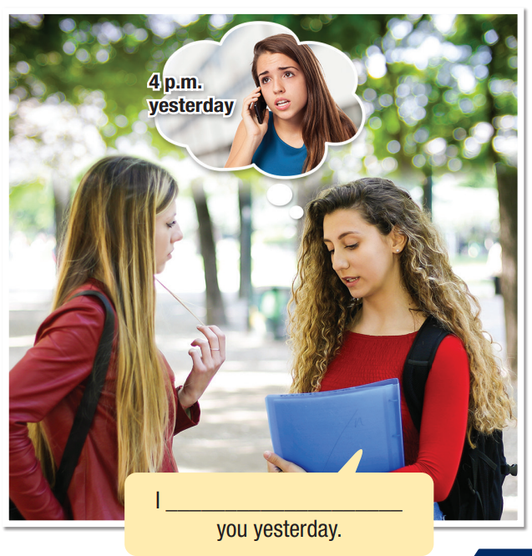

Task a
Look at the picture. What do you think the girl are saying?
Task b
Listen and check your ideas.
Task c
Listen and repeat.
should have called

Slide 13

Practice

Slide 14
Task a
Fill in the blanks with a perfect modal and the correct verb form.
1. I ____________________ (should not/ignore) my mom's advice. I got into trouble because I didn't listen.
2. I'm sorry. I __________________ (should/call) and told you I was going to be late.
3. Lucy ____________________ (should not/break) her curfew. Her dad was very angry last night.
shouldn’t have ignored
should have called
shouldn’t have broken

Slide 15
4. My brother __________________ (should/help) me do some chores. I had to clean the kitchen, did the dishes and laundry, and he was free!
5. They _____________________ (should not/go out) without their mom's permission.
6. What (should/I/say) ________________ to make her feel better?
7. I ________________ (should/ask) if I could stay out late.
8. She ____________________ (should/respect) your privacy.
should have helped
shouldn’t have gone out
should I have said
should have asked
should have respected

Slide 16
Task a
Circle should've or shouldn't have.
1. He should've/shouldn't have respected your privacy and knocked first.
2. John should've/shouldn't have spoken to Mom like that. His behavior could be a bad influence on our little brother.
3. I should've/shouldn't have saved some money. Those shoes were really nice, but I couldn't afford them.
4. He failed the exam, and now his mom is angry. He should've/shouldn't have studied harder instead of playing games all day.

Slide 17
5. I should've/shouldn't have said that to you. I was angry, and I didn't mean it.
6. I should've/shouldn't have checked my phone more often. My dad called me so many times, and he was very worried.
7. I should've/shouldn't have used your phone without your permission. I'm sorry.
8. They should've/shouldn't have made her wait for so long. That wasn't very nice of them.

Slide 18
Further practice Exercise b, WB p. 11
Unscramble the sentences.
more./respected/my/I/parents/should’ve
2. shouldn't/out/I/last/stayed/so/have/night./late
3. told/you/when/to./room/You/your/I/should've/cleaned
4. You/going/should've/knocked/in./before
5. should've/He/his/before/going/out./homework/finished
I should've respected my parents more.
I shouldn't have stayed out so late last night.
You should've cleaned your room when I told you to.
You should've knocked before going in.
He should've finished his homework before going out.

Slide 19

Production

Slide 20

In pairs: Talk about three regrets you have had at school.
I got a bad score. I shouldn't have waited until the night before to write my essay.
I didn't understand the physics lesson. I should've asked my teacher for help.

Slide 21

CONSOLIDATION

Slide 22
Write two sentences about things you should have done and two sentences about things you shouldn't have done.
For example:
I should have helped my mom with housework more.
I shouldn’t have played computer games too much.

Slide 23

WRAP-UP

Slide 24
Today’s lesson
Grammar
Perfect modal: should have
Speaking
Talking about regret.

Slide 25
Homework
Learn by heart the grammar structure and make sentences using it.
Do the exercises on page 11 WB.
Prepare the next lesson (pages 20 & 21 SB).
Play the consolidation games on www.eduhome.com.vn

Slide 26

Lesson 3
Stay positive and have a nice day!

