Slide 1
TUY PHUOC 2 HIGH SCHOOL
TEACHER: BUI THI THANH HOA
CLASS: 12A2
SCHOOL YEAR: 2024 - 2025

Slide 2

Unit 1: Life Stories
Lesson 3.2: Writing & Speaking
Pages: 13 & 14

Slide 3
Lesson Outline
Warm-up
Writing
Speaking
Consolidation
Wrap-up

Slide 4

By the end of this lesson, students will be able to…
- practice using time expressions (writing skill)
- practice talking about inspiring people’s stories.
- practice writing a biography about someone.

Slide 5
WARM-UP (5ms)
Gameshow:
Costume competition
The winner is the one to get more “likes”

Slide 6

WRITING

Slide 7
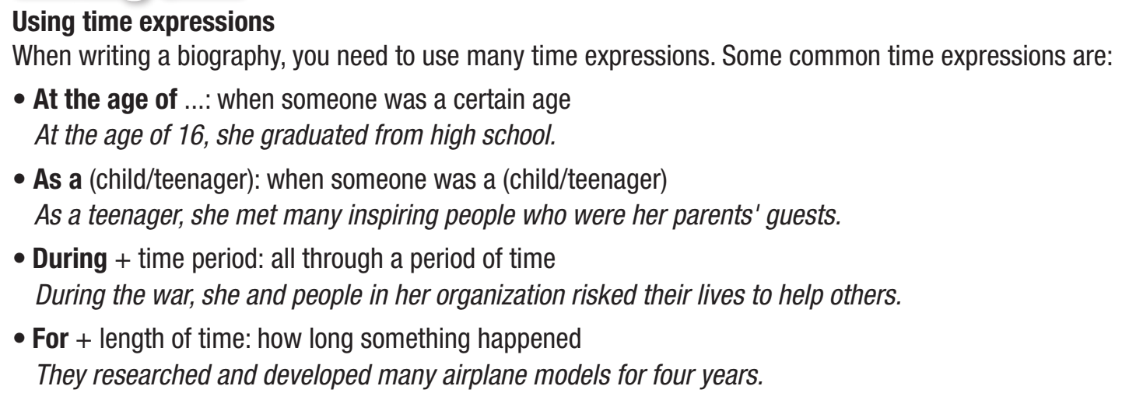
a. Read about using time expressions, then read the biography about Nellie Bly again and circle the time expressions that were used. (5 ms)

Slide 8
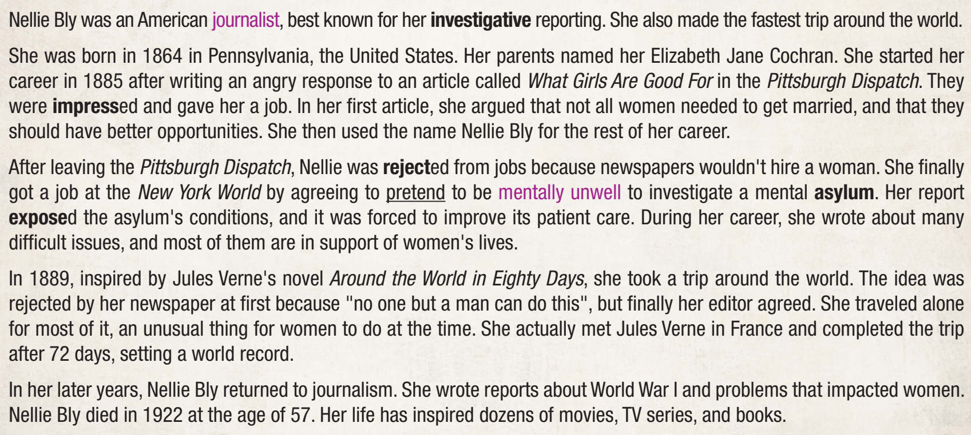

Slide 9
b. Fill in the blanks with at the age of, as a, during, or for. (3ms)
1. She learned how to play the piano ______________ four.
2. _______ his teenage years, he learned how to paint with various great painters of the time.
3. He spent most of his free time exploring the country ______ boy.
4. ____ over 20 years, he fought for the freedom of his country.
at the age of
During
as a
For

Slide 10
SPEAKING

Slide 11
a. You're working on a project about inspiring people. In pairs: Student B, p 122 . Student A, you want to find out about Yvonne Young Clark. Ask Student B questions and complete the notes below. (5ms)

Slide 12
Yvonne Young Clark (known as Y.Y.) – "The First Lady of Engineering“
Early life:
• ____________: was born in Houston, Texas, the USA
• loved _______________________ as a child
• __________________: attended Howard University
• only woman in her class and the first woman to earn a degree in mechanical engineering
Yvonne Young
building and fixing things
From 1947 to 1951

Slide 13
Career and achievements:
• struggled to find jobs because of her skin color and gender
• ________: got married and moved to Tennessee at the age of 25
• worked as ___________________ at Tennessee State University for the next 55 years
• first female member of her department
• worked for ________ during her summer breaks
• contributed to the development of the engine of the rocket Saturn V and the box used to bring moon samples back
In 1955
an engineer professor
NASA

Slide 14
Death and influence:
• received many awards for her contributions
• _____________: died at the age of ________
• A scholarship in her name was established at Tennessee State University
Yvonne Young
89

Slide 15
b. Swap roles and repeat. Student A, answer Student B’s questions about Nguyễn Ngọc Ký. (7ms)

Slide 16
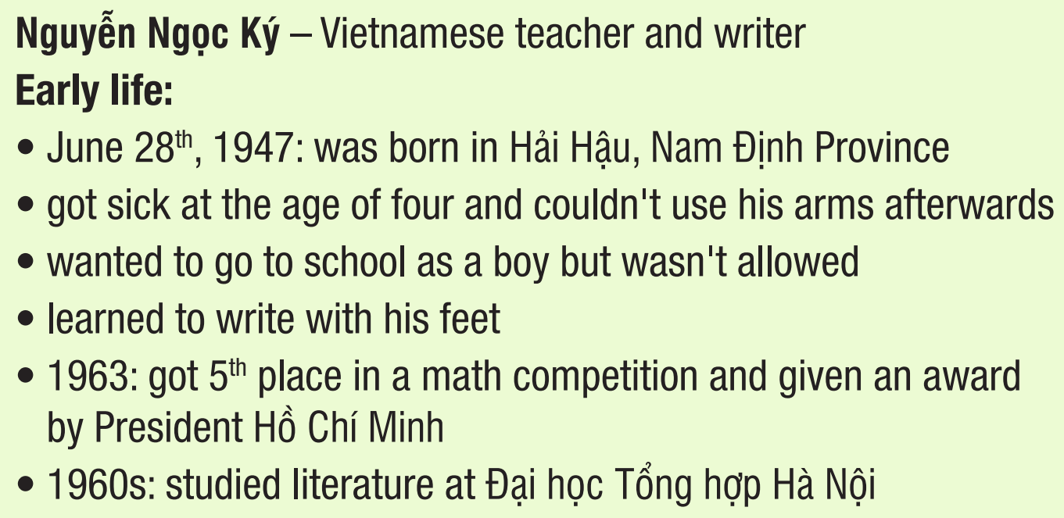

Slide 17
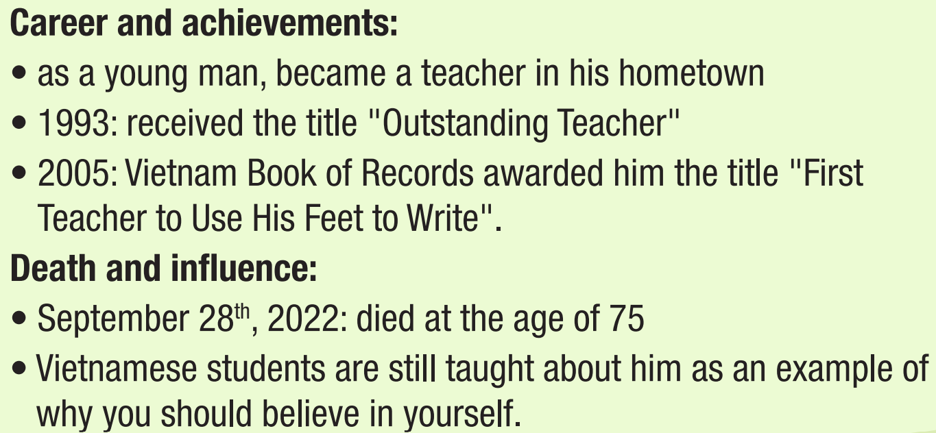

Slide 18
Useful English
a. Read the biography about Nellie Bly again. In which paragraph do you see the following phrases? Write the paragraph numbers (1–5) on the lines. (5ms)
Talking about interests:
_____ He showed an interest in ...
_____ She developed an interest for ...

Slide 19
Talking about career:
_____ She started (her career) ...
_____ He worked as/for ...
_____ She contributed to ...
2

Slide 20
Talking about achievements:
_____ She was best known for ...
_____ He was considered ...
_____ He was remembered as ...
1

Slide 21
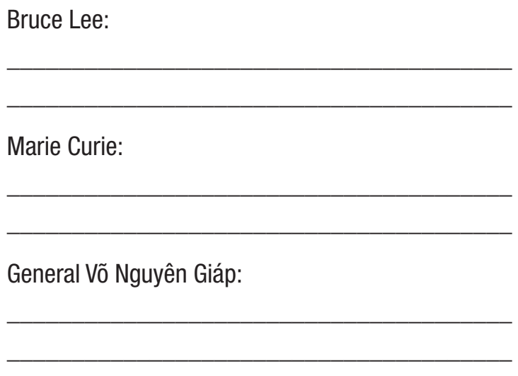
Useful English
Sample answers:
b. Use the information in the Listening and the Useful Language box to write sentences for their biographies. (4ms)
Bruce Lee was best known for his martial arts and movies.
Marie Curie was remembered as the first woman to win the Nobel Prize.
Võ Nguyên Giáp was considered one of the greatest leaders of Vietnam.

Slide 22
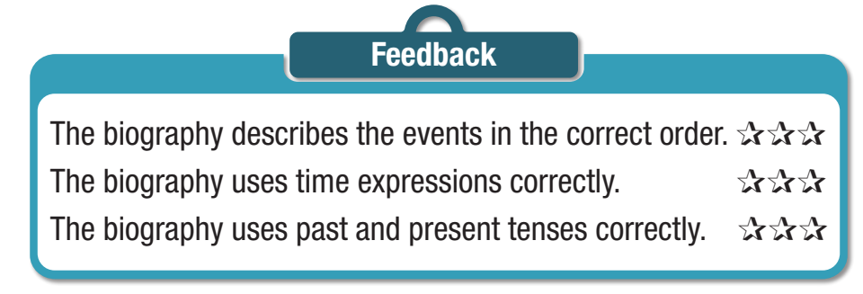
Let’s write
Now, write a biography about Yvonne Young Clark or Nguyễn Ngọc Ký. Use the Writing Skill box, the reading model, and your speaking notes to help you. Write 180–200 words. (7)

Slide 23
Suggested answer:
Yvonne Young Clark (known as Y.Y.) was remembered as "The First Lady of Engineering". She was the first woman to do many things throughout her life.
Y.Y. was born in 1929 in Houston, Texas. As a child, she loved building and fixing things. She attended Howard University from 1947 to 1951 and was the only woman in her class.
She was the first woman to earn a degree in mechanical engineering there. She struggled to find jobs after graduation because of her
skin color and gender.

Slide 24
In 1955, she got married and moved to Tennessee. She worked as an engineering professor at the Tennessee State University for the next 55 years. She was the first female member of her department.
She worked for NASA during her summer breaks. At NASA, she contributed to the development of the engine of the rocket Saturn V and the box used to bring moon samples back to Earth. She received many awards for her contributions. Y.Y. died at the age of 89, in 2019. A scholarship in her name was established at Tennessee State University.

Slide 25
Nguyễn Ngọc Ký is a famous Vietnamese teacher and writer. He was born in June 28th, 1947 in Hải Hậu, Nam Định Province. He got sick at the age of four and couldn't use his arms afterwards. As a boy, he wanted to go to school, but he wasn't allowed. He then learned how to write with his feet.
He was a hardworking and very good student. In 1963, he got 5th place in a math competition and was given an award by President Hồ Chí Minh. He went to Đại học Tổng hợp Hà Nội and studied literature during the 1960s.

Slide 26
As a young man, he became a teacher. He went back to his hometown and taught there. He got many awards during his career as a teacher. He received the title "Outstanding Teacher" in 1993, and in 2005, Vietnam Book of Records awarded him the title “First Teacher to Use His Feet to Write”.
Nguyễn Ngọc Ký died on September 28th, 2022, at the age of 75. Vietnamese students are still taught about him as an example of why you should believe in yourself.

Slide 27

WRAP-UP (3ms)

Slide 28
Today’s lesson
Writing
practice using time expressions
Practice writing a biography of someone that you know.
Speaking:
talk about inspiring people’s stories.

Slide 29
Homework
Practice writing skills using time expressions
Do the exercises on page 7 WB.
Prepare the next lesson (Unit 2 – Vocab & Reading, pages 15 & 16 SB)
Play the consolidation games on www.eduhome.com.vn

Slide 30

Lesson 3
Stay positive and have a nice day!

