Slide 1
TUY PHUOC 2 HIGH SCHOOL
TEACHER: BUI THI THANH HOA
CLASS: 12A2
SCHOOL YEAR: 2024 - 2025

Slide 2

Unit 1: Life Stories
Lesson 1.1: Vocab & Reading
Pages: 4 & 5

Slide 3
Lesson Outline
Warm-up
Vocabulary
Reading
Consolidation
Wrap-up

Slide 4
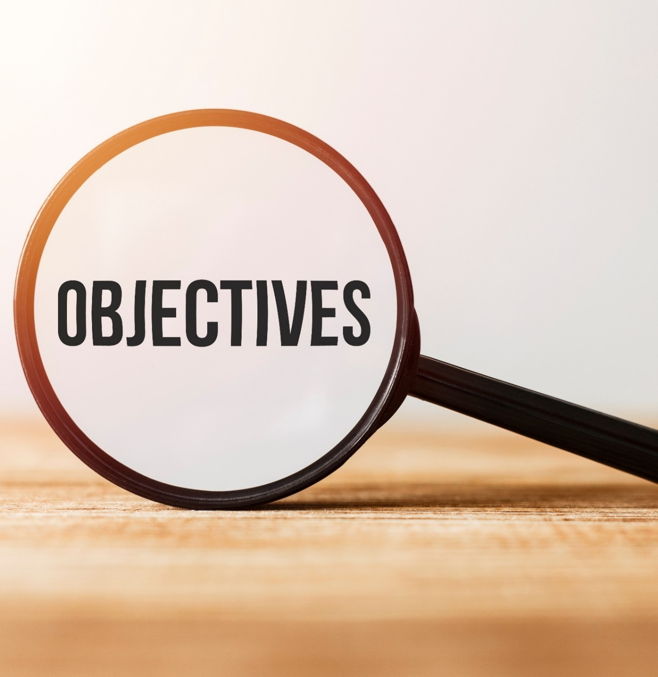
By the end of this lesson, students will be able to…
- Learn and use vocabulary related to Life Stories.
- practice reading for gist and specific information.

Slide 5
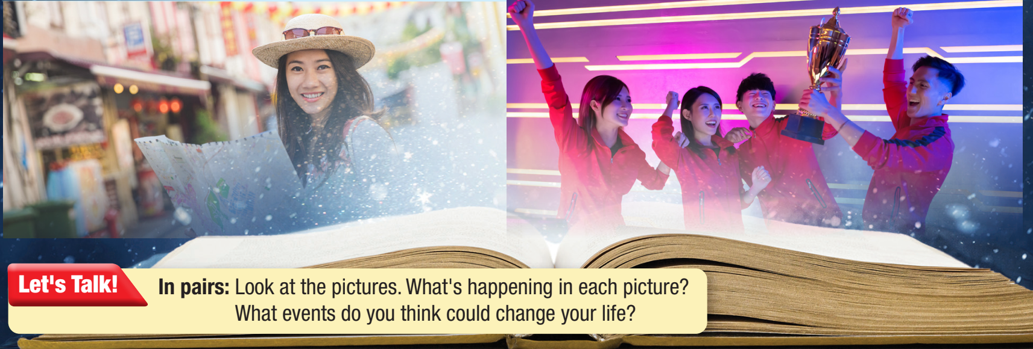
WARM-UP

Slide 6

Suggested answers
1. moving to a new house, travelling to a new place, getting a gift, winning a competition
2. getting a pet, welcoming a new member to the family, moving to a new school, meeting a new friend, starting work, learning how to drive

Slide 7



Slide 8
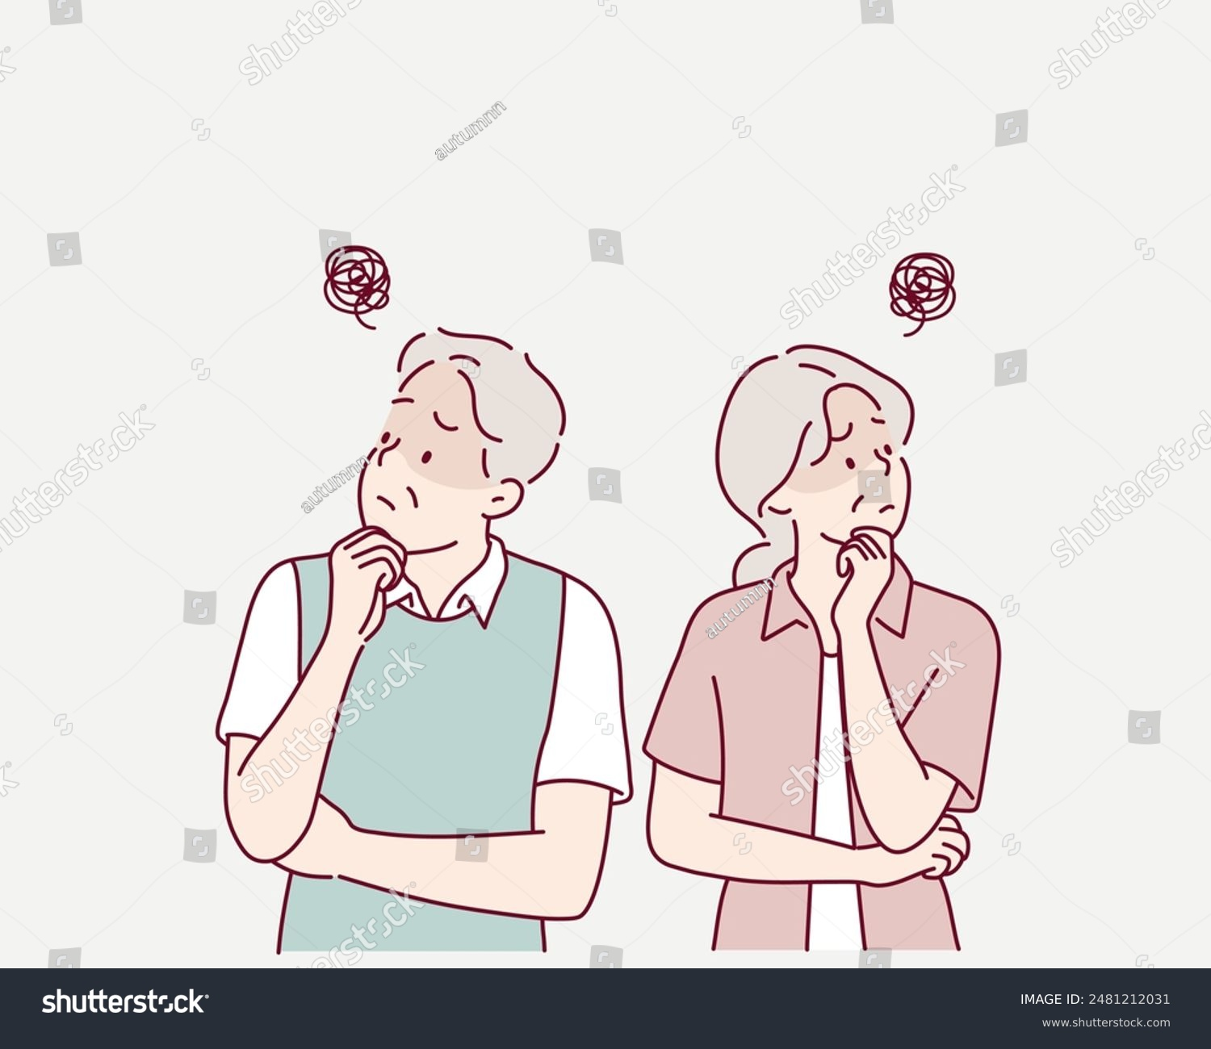
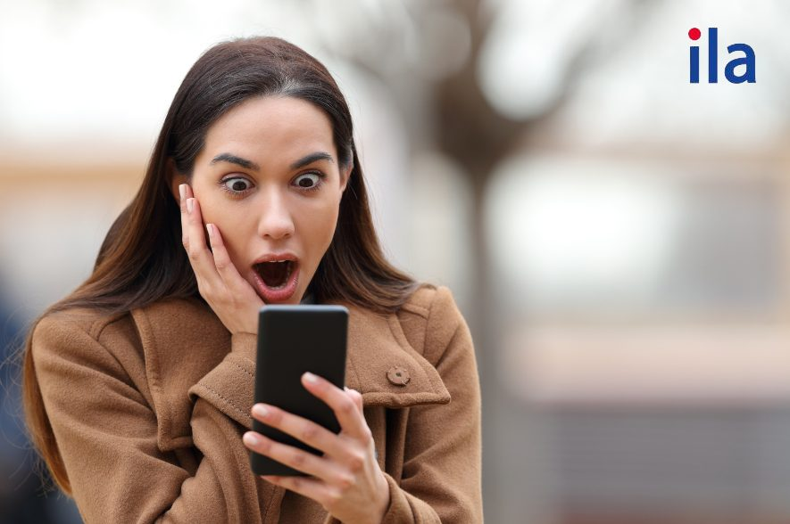
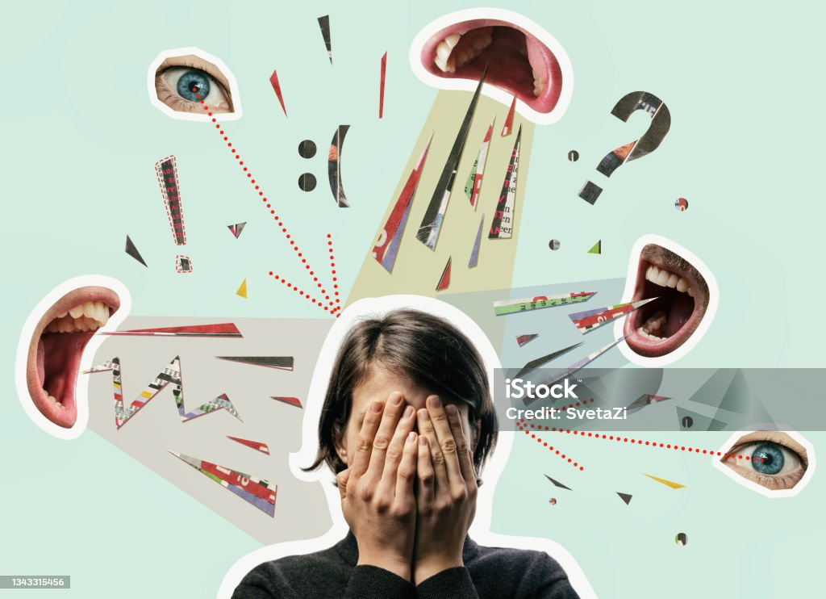
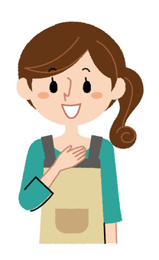
I. New words
1. Amazed (a)
2. Anxious (a)
3. Embarrassed (a)
4. Depressed (a)
= very sad and without hope
5. Grateful (a)
= thankful
6. Relieved (a)

Slide 9
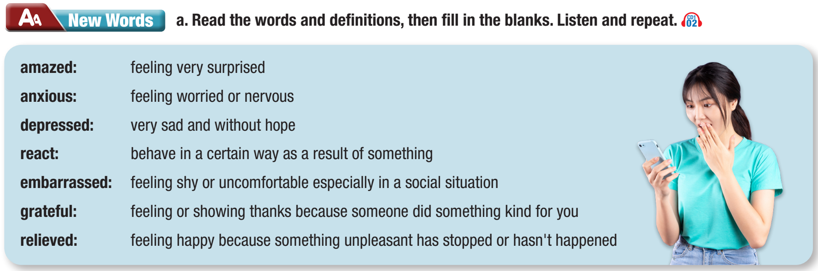

Slide 10

1. I couldn't believe how good my scores on my exams were. I was totally _______________.
2. My parents have worked hard to give me a good life. I'm so _______________ to them for all they do.
3. I studied hard for the exam, so I didn't feel _______________ about it at all. Actually, I was looking forward to it.
amazed
grateful
anxious

Slide 11
4. I always felt closest to my grandmother. When she passed away last year, I felt really _______________.
5. I was so _______________ when I found out that my mistake didn't cause much damage.
6. I often feel _______________ if I answer a question in class and get it wrong. It makes me so uncomfortable.
7. I think that even if someone is not nice, you should _______________ with kindness.
depressed
relieved
embarrassed
react

Slide 12
Listen and repeat. Click on each phrase to hear the sound.
amazed (adj) /əˈmeɪzd/ kinh ngạc
anxious (adj) /ˈæŋkʃəs/ lo lắng
depressed (adj) /dɪˈprest/ buồn rầu, chán nản
grateful (adj) /ˈɡreɪtfəl/ biết ơn
react (v) /riˈækt/ phản ứng
relieved (adj) /rɪˈliːvd/ cảm thấy nhẹ nhõm
embarrassed (adj) /ɪmˈberəst/ xấu hổ
Notes:
GV click vào từng cụm nghe âm thanh

Slide 13
Listen and repeat. Practice saying them with a partner.
amazed (adj) /əˈmeɪzd/ kinh ngạc
Hai hoat động trong slide 11 và 12 dung chung slide 12
anxious (adj) /ˈæŋkʃəs/ lo lắng
depressed (adj) /dɪˈprest/ buồn rầu, chán nản
grateful (adj) /ˈɡreɪtfəl/ biết ơn
react (v) /riˈækt/ phản ứng
relieved (adj) /rɪˈliːvd/ cảm thấy nhẹ nhõm
embarrassed (adj) /ɪmˈberəst/ xấu hổ
Notes:
GV click vào từng cụm nghe âm thanh

Slide 14
Work in pairs. Look, say and write the English words.
/əˈmeɪzd/ kinh ngạc _____________
/ˈæŋkʃəs/ lo lắng _____________
/dɪˈprest/ buồn rầu, chán nản _____________
/ˈɡreɪtfəl/ biết ơn _____________
/riˈækt/ phản ứng _____________
/rɪˈliːvd/ cảm thấy nhẹ nhõm _____________
/ɪmˈberəst/ xấu hổ _____________
Notes:
GV click vào từng cụm nghe âm thanh

Slide 15

amazed
depressed
embarrassed
grateful
anxious

Slide 16
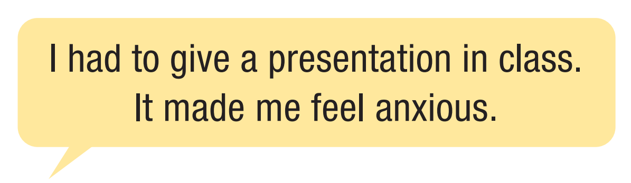


Slide 17


Slide 18
Pre - reading
Read Lisa's blog about visiting Italy. What event impacted her the most? Choose the correct answer.
learning about Italian history
seeing the Colosseum
going on the tour without her phone

Slide 19
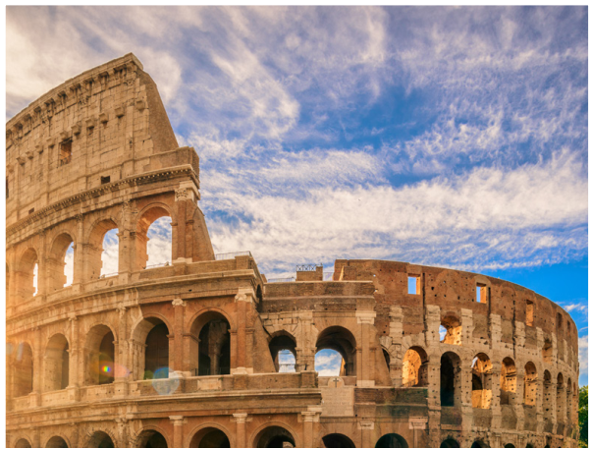
While - reading
Skim the text. Underline the key words. Choose the best title.
A LIFE-CHANGING TRIP
Lisa Smith
Hi, everyone! Today, I want to tell you all about something that had a big impact on me. It happened two years ago on a trip to Rome, Italy with my family and my best friend.

Slide 20
While - reading
Skim the text. Underline the key words. Choose the best title.
On the first day, we were outside the hotel, and our tour guide was explaining the itinerary. While everyone else was listening, my friend and I were busy taking selfies. Then, my dad came over and asked what we thought about the planned bus tour. We were embarrassed because we didn't listen at all. My dad was really upset. He said we would enjoy the trip more if we didn’t spend all day on our phones. Then, he asked us to give him our phones for the rest of the day. I felt so embarrassed in front of my friend, but we didn’t have a choice.

Slide 21
At first, I didn't know what to do on the bus. It was a nice day with perfect weather, and all around me were beautiful, old buildings. Suddenly, I didn't miss my phone. Later that morning, we stopped at a huge ancient stadium called the Colosseum. The guide told us it was almost 2,000 years old. He said that sometimes they would even fill it with water and put ships in it to recreate famous sea battles. It was so cool!
I'm grateful that my dad took my phone away that day. Now when I travel, I'm not always looking at my phone. I enjoy the sights in front of me with my eyes first, and only take photos later. So, everyone, don't live your life on your phones. There's a beautiful world out there for you to see.
➔ going on a tour without her phone

Slide 22
Pre - reading
Read Lisa's blog about visiting Italy. What event impacted her the most? Choose the correct answer.
learning about Italian history
seeing the Colosseum
going on the tour without her phone

Slide 23
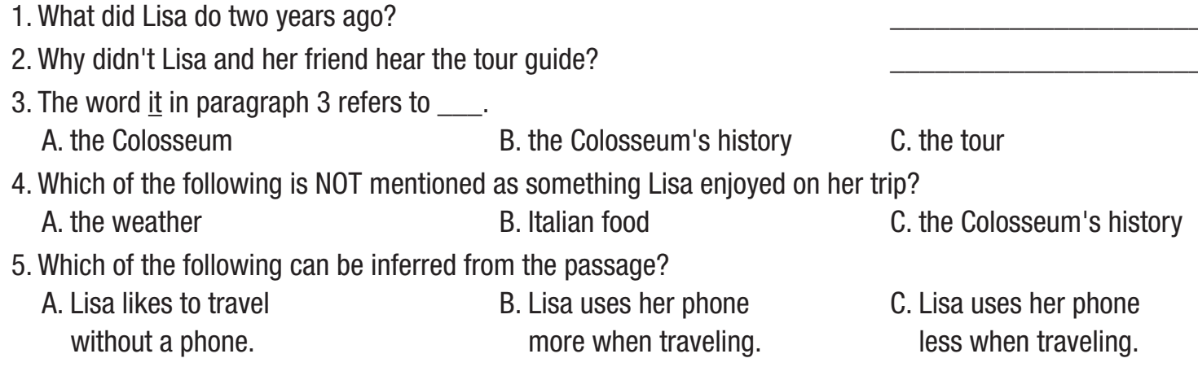
Pre - reading
Now, read the questions and underline the key words.

Slide 24
Pre - reading
Now, read the questions and underline the key words.
What did Lisa do two years ago?
Why didn't Lisa and her friend hear the tour guide?
The word it in paragraph 3 refers to ___.
A. the Colosseum B. the Colosseum's history C. the tour

Slide 25
4. Which of the following is NOT mentioned as something Lisa enjoyed on her trip?
A. the weather B. Italian food C. the Colosseum’s history
5. Which of the following can be inferred from the passage?
Lisa likes to travel without a phone.
Lisa uses her phone more when traveling.
Lisa uses her phone less when traveling.

Slide 26
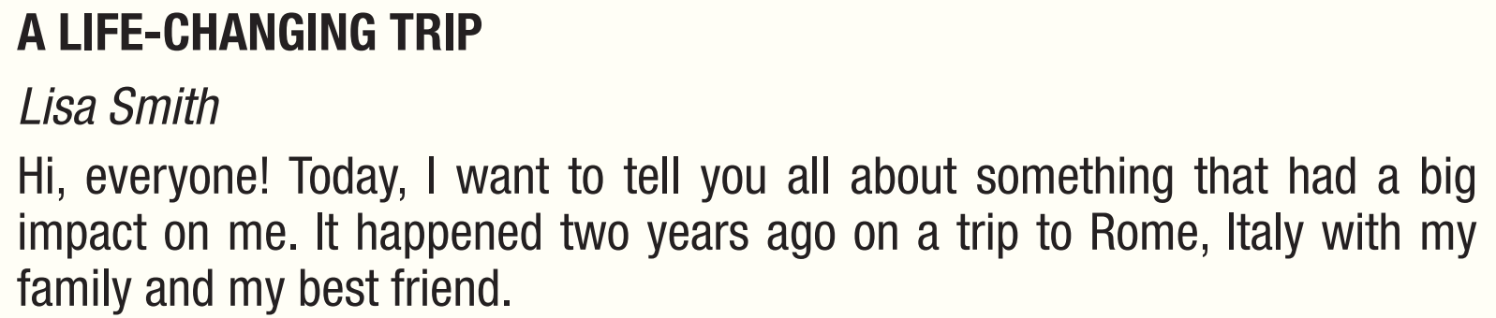
While - reading
Now, read.
Scan the text. Answer the questions.
She took a trip to Rome, Italy
1. What did Lisa do two years ago? _________________________

Slide 27
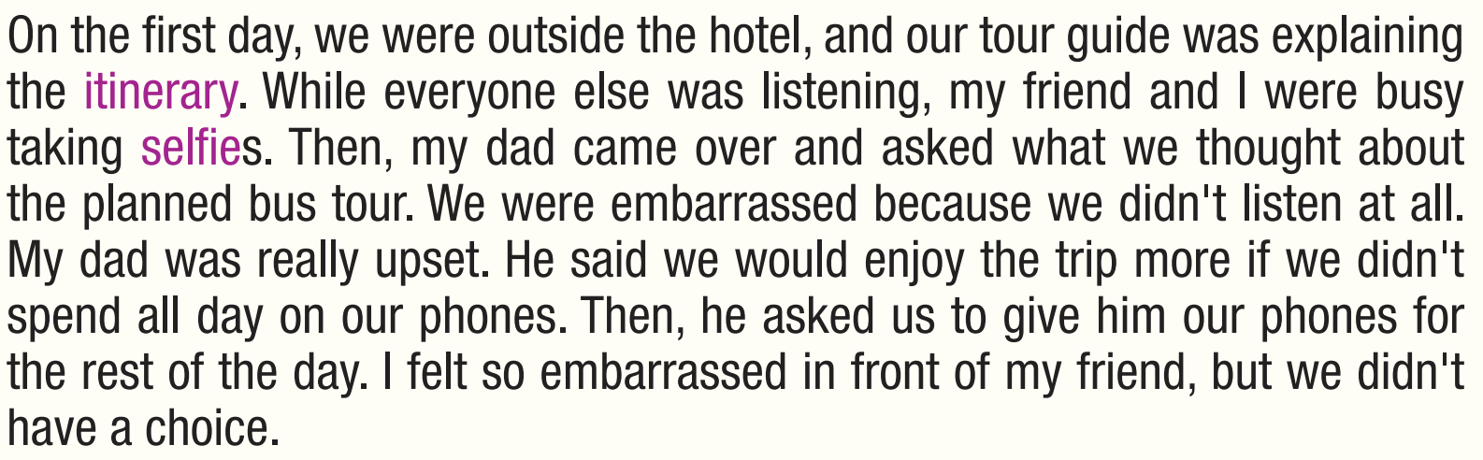
While - reading
Now, read.
Scan the text. Answer the questions.
2. Why didn't Lisa and her friend hear the tour guide? _________________________
They were taking selfies.

Slide 28
While - reading
Now, read.
Scan the text. Answer the questions.
3. The word it in paragraph 3 refers to _____________.
A. the Colosseum B. the Colosseum's history C. the tour
At first, I didn't know what to do on the bus. It was a nice day with perfect weather, and all around me were beautiful, old buildings. Suddenly, I didn't miss my phone. Later that morning, we stopped at a huge ancient stadium called the Colosseum. The guide told us it was almost 2,000 years old. He said that sometimes they would even fill it with water and put ships in it to recreate famous sea battles. It was so cool!

Slide 29
While - reading
Scan the text. Answer the questions.
4. Which of the following is NOT mentioned as something Lisa enjoyed on her trip?
A. the weather B. Italian food C. the Colosseum's history
At first, I didn't know what to do on the bus. It was a nice day with perfect weather, and all around me were beautiful, old buildings. Suddenly, I didn't miss my phone. Later that morning, we stopped at a huge ancient stadium called the Colosseum. The guide told us it was almost 2,000 years old. He said that sometimes they would even fill it with water and put ships in it to recreate famous sea battles. It was so cool!

Slide 30
While - reading
Scan the text. Answer the questions.
5. Which of the following can be inferred from the passage?
A. Lisa likes to travel without a phone.
B. Lisa uses her phone more when traveling.
C. Lisa uses her phone less when traveling.
I'm grateful that my dad took my phone away that day. Now when I travel, I'm not always looking at my phone. I enjoy the sights in front of me with my eyes first, and only take photos later. So, everyone, don't live your life on your phones. There's a beautiful world out there for you to see.

Slide 31
Ask and answer the questions with a partner.
Post - reading

Slide 32
Read the text again and decide if the statements are True or False.
Extra Practice
Lisa and her friend were inside the hotel when the tour guide was explaining the itinerary.
Lisa and her friend were embarrassed because they didn’t listen to what Lisa’s dad was saying.
The guide said that the Colosseum was nearly 2,000 years old.
Lisa felt good that her dad didn’t take her phone that day.
T F
T F
T F
T F

Slide 33
Read the questions and underline the key words.
Extra Practice
Lisa and her friend were inside the hotel when the tour guide was explaining the itinerary.
Lisa and her friend were embarrassed because they didn’t listen to what Lisa’s dad was saying.
The guide said that the Colosseum was nearly 2,000 years old.
Lisa felt good that her dad didn’t take her phone that day.
T F
T F
T F
T F

Slide 34
Read the text to find the answers
Extra Practice
Lisa and her friend were inside the hotel when the tour guide was explaining the itinerary.
T F
On the first day, we were outside the hotel, and our tour guide was explaining the itinerary. While everyone else was listening, my friend and I were busy taking selfies. Then, my dad came over and asked what we thought about the planned bus tour. We were embarrassed because we didn't listen at all. My dad was really upset. He said we would enjoy the trip more if we didn’t spend all day on our phones. Then, he asked us to give him our phones for the rest of the day. I felt so embarrassed in front of my friend, but we didn’t have a choice.

Slide 35
Read the text to find the answers
Extra Practice
2. Lisa and her friend were embarrassed because they didn’t listen to what Lisa’s dad was saying.
T F
On the first day, we were outside the hotel, and our tour guide was explaining the itinerary. While everyone else was listening, my friend and I were busy taking selfies. Then, my dad came over and asked what we thought about the planned bus tour. We were embarrassed because we didn't listen at all. My dad was really upset. He said we would enjoy the trip more if we didn’t spend all day on our phones. Then, he asked us to give him our phones for the rest of the day. I felt so embarrassed in front of my friend, but we didn’t have a choice.

Slide 36
Read the text to find the answers
Extra Practice
3. The guide said that the Colosseum was nearly 2,000 years old.
T F
At first, I didn't know what to do on the bus. It was a nice day with perfect weather, and all around me were beautiful, old buildings. Suddenly, I didn't miss my phone. Later that morning, we stopped at a huge ancient stadium called the Colosseum. The guide told us it was almost 2,000 years old. He said that sometimes they would even fill it with water and put ships in it to recreate famous sea battles. It was so cool!

Slide 37
Read the text to find the answers.
Extra Practice
4. Lisa felt good that her dad didn’t take her phone that day.
T F
I'm grateful that my dad took my phone away that day. Now when I travel, I'm not always looking at my phone. I enjoy the sights in front of me with my eyes first, and only take photos later. So, everyone, don't live your life on your phones. There's a beautiful world out there for you to see.

Slide 38

Post - reading
Work in pairs
Think of a trip you went on. What happened, and how did you feel?
It happened 2 years ago on a trip to Bangalore, India.
Our flight was delayed without any announcement, I was so upset.

Slide 39
Post - reading
Work in pairs
Think of a trip you went on. What happened, and how did you feel? Talk in 45 seconds.
It happened 2 years ago on a trip to Bangalore, India. I went there with my friends and we intended to stay there for 5 days. We planned carefully before the trip but something happened. First, our flight was delayed without any announcement, I was so upset. Second, the hotel said that our booking was canceled, so we had to look for another hotel. Luckily, our new hotel was close to the center and the services were good ….

Slide 40
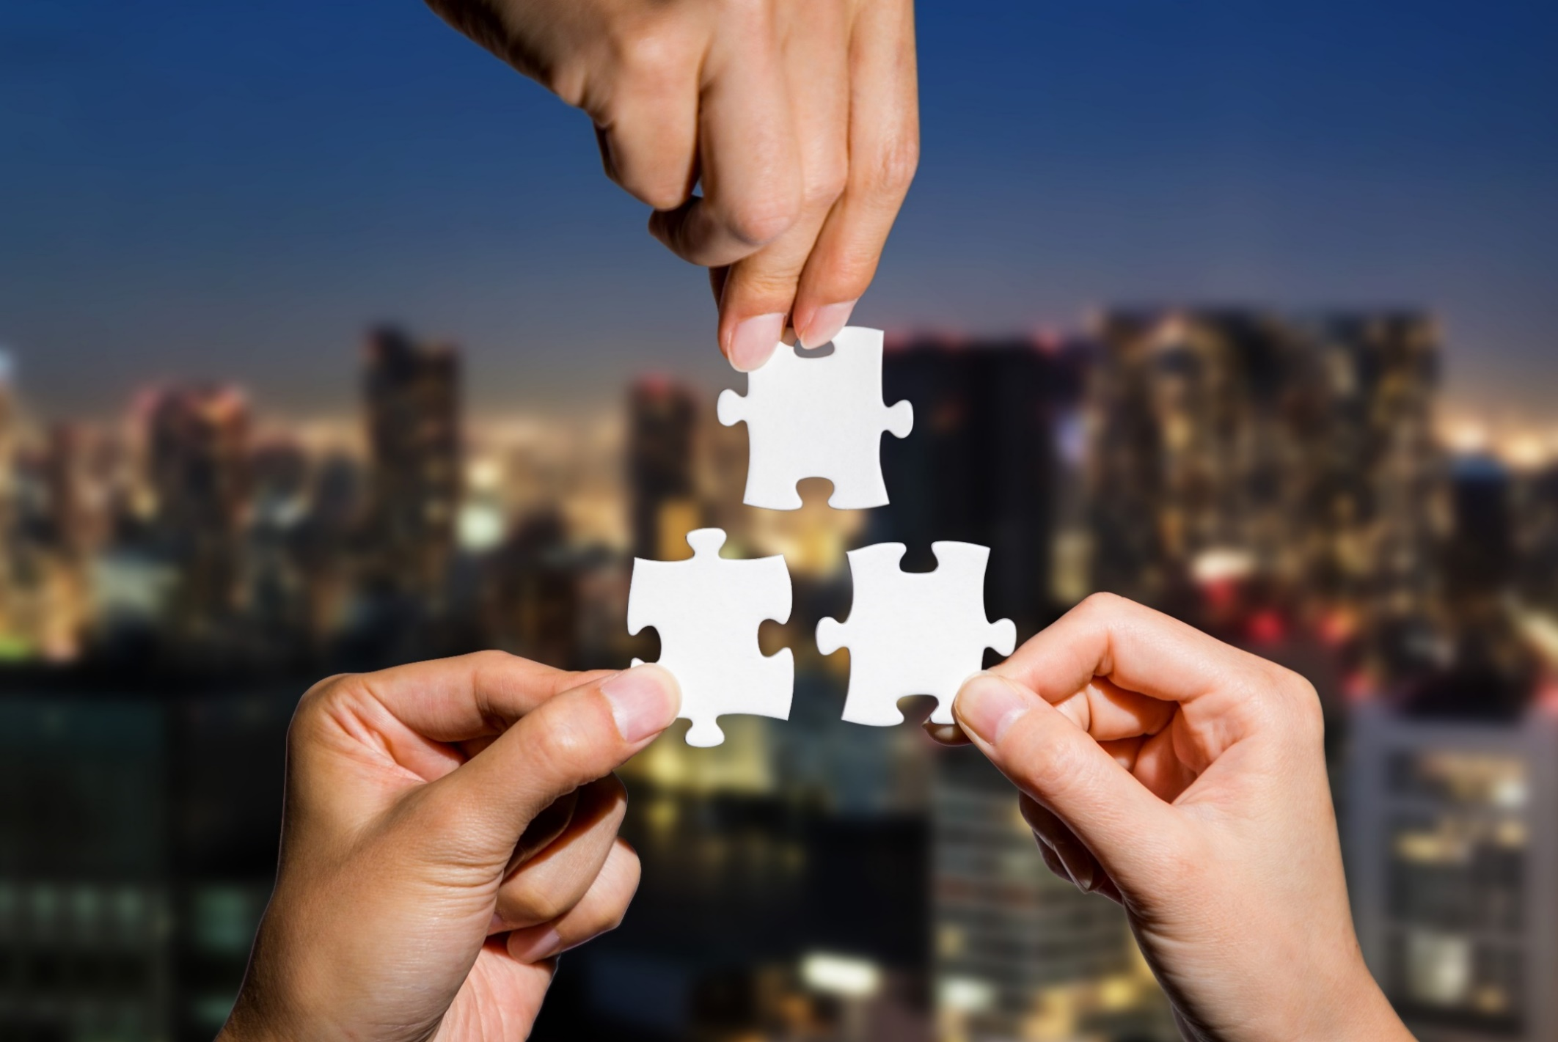
CONSOLIDATION

Slide 41

WRAP-UP

Slide 42
Today’s lesson
Vocabularies
amazed
depressed
embarrassed
relieved
react
grateful
anxious

Slide 43
Today’s lesson
Reading:
- Practice reading for gist and specific information.
Speaking:
- Talking about your experience about your trip.

Slide 44
Homework
Learn by hearts vocabularies and make sentences using them.
Do the exercises on pages 2 & 3 WB.
Prepare the next lesson (Grammar pages 5 & 6 SB)
Play the consolidation games on www.eduhome.com.vn

Slide 45
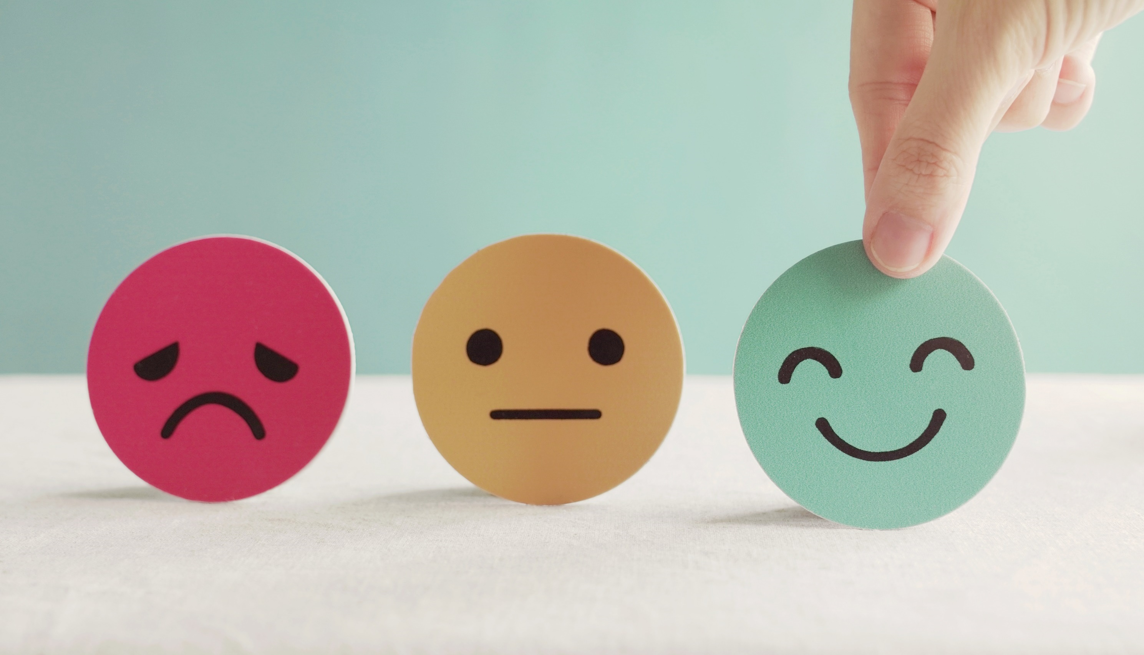
Lesson 3
Stay positive and have a nice day!

