Slide 1
TUY PHUOC 2 HIGH SCHOOL
TEACHER : HUYNH THI KIM VUI
CLASS 12 A4
SCHOOL YEAR :2024-2025

Slide 2

WARM-UP

Slide 3


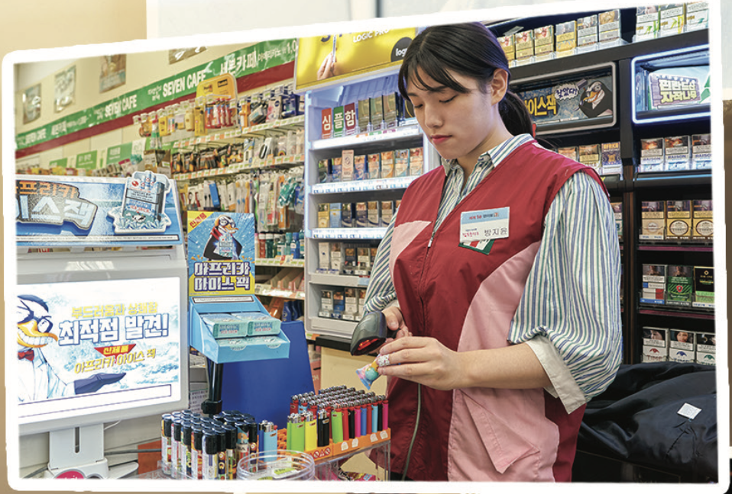

In pairs: Look at the pictures. What jobs are shown? What are some good and bad things about these jobs?

Slide 4
Suggested answers
Good things: develop communication and problem-solving skills, foster teamwork, flexible work hours
Bad things: deal with irate or high demanding customers, repetitive tasks, high stress levels
Call center operator

Slide 5
Suggested answers
Good things: be able to work flexible hours, develop communication, time management and multi-tasking skills
Bad things: have to work shifts, experience high stress levels, low wages
Sales assistant
Notes:
sales assistant. Good things: work with a team, meet lots of people every day. Bad things: have to stand a lot, low salary.

Slide 6
Suggested answers
Good things: get to meet people of different cultures, be able to develop communication skills, etc.,
Bad things: irregular work hours, repetitive tasks, deal with difficult guests, etc.,
Receptionist

Slide 7

Unit 3: World of Work
Lesson 3.1: Listening & Reading
Pages: 34 & 35

Slide 8



Slide 9






I/Pre-listening
a. Listen to David and Cassie talking about what they want to do in the future. Which things do they talk about?
 | getting an apprenticeship
 | working a nine-to-five job
 | having their own business
Notes:
Hit the RIGHT ARROW on the keyboard for answer keys.

Slide 10
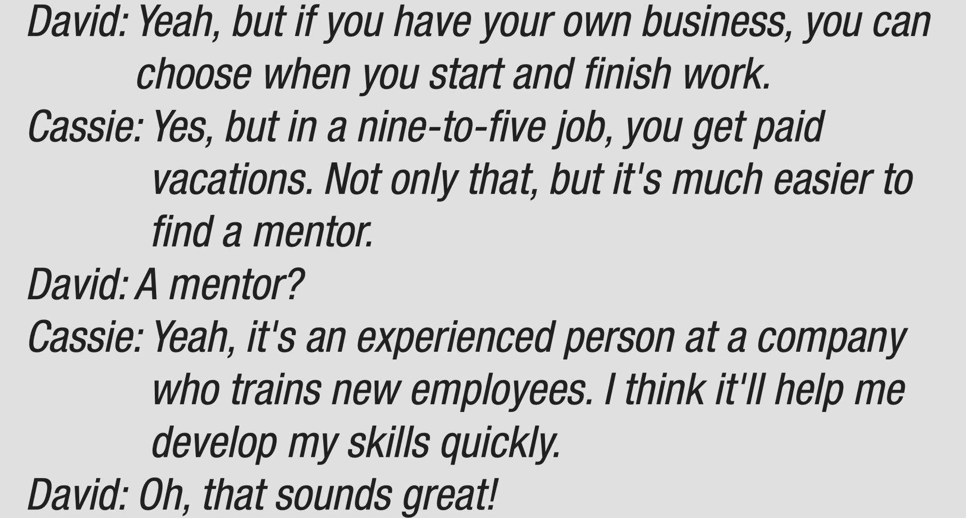
Pre-listening
 | getting an apprenticeship
Explanation
Notes:
Click on CD1 45 for listening
Hit the RIGHT ARROW on the keyboard for answer keys.

Slide 11
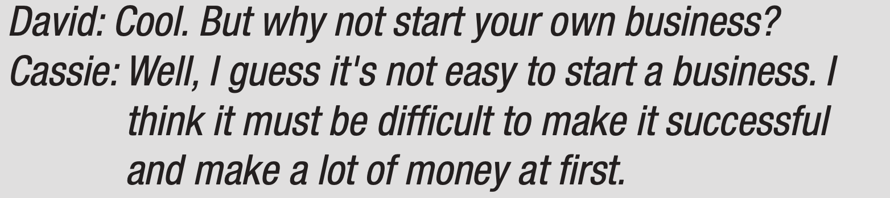
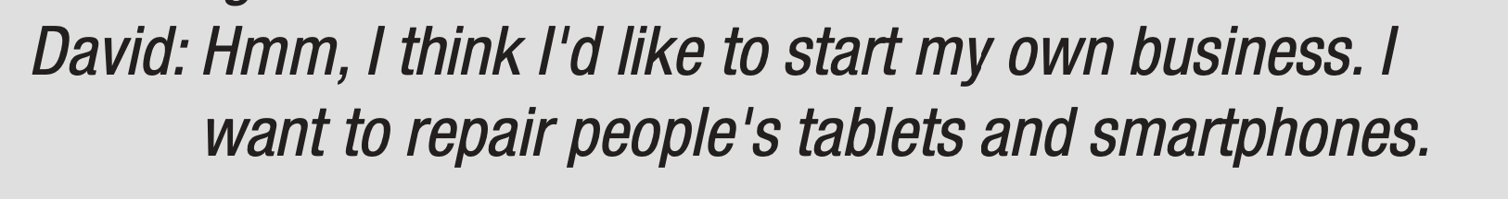
Pre-listening
 | having their own business
Explanation
Notes:
Click on CD1 45 for listening
Hit the RIGHT ARROW on the keyboard for answer keys.

Slide 12
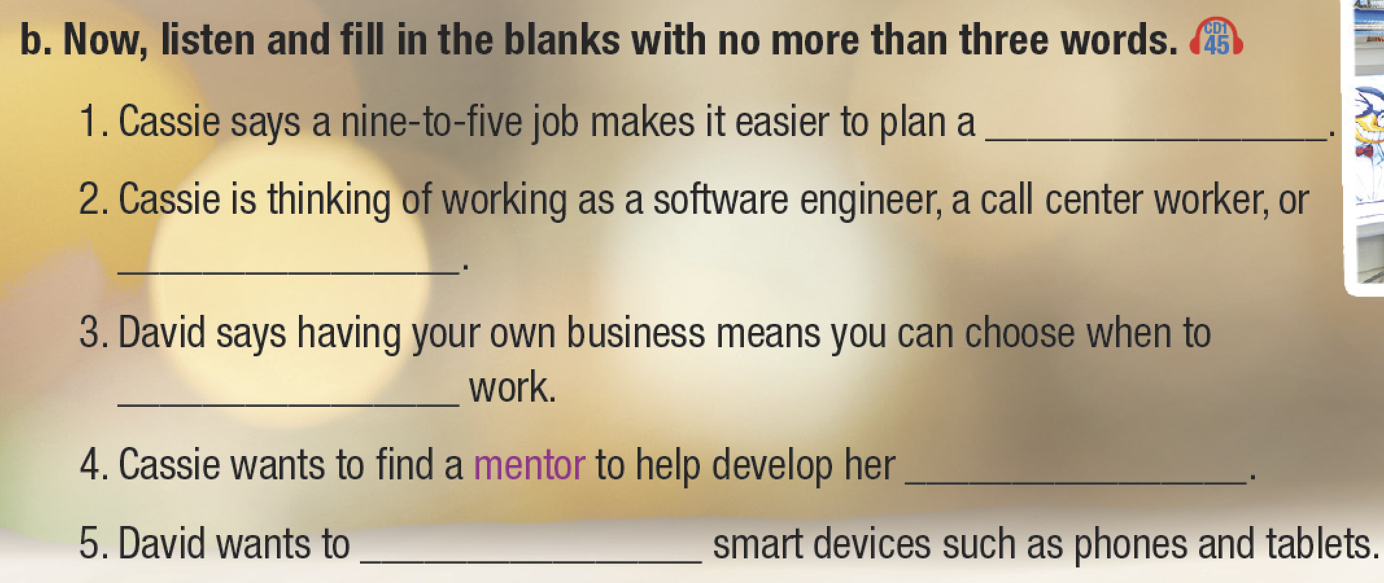

Slide 13
Pre-listening
Read the statements and underline the key words. Guess the type of missing information.
1. Cassie says a nine-to-five job makes it easier to plan a ___________.
noun
2. Cassie is thinking of working as a software engineer, a call center worker, or ___________ .
noun

Slide 14
Pre-listening
3. David says having your own business means you can choose when to
________________ work.
verb
noun
4. Cassie wants to find a mentor to help develop her _______________.
verb
5. David wants to ______________ smart devices such as phones and tablets.

Slide 15
II/While-listening
b. Now, listen and fill in the blanks with no more than three words.
1. Cassie says a nine-to-five job makes it easier to plan a ___________.
budget
2. Cassie is thinking of working as a software engineer, a call center worker, or ___________ .
a receptionist

Slide 16
b. Now, listen and fill in the blanks with no more than three words.
While-listening
3. David says having your own business means you can choose when to
________________ work.
start and finish
skills quickly
4. Cassie wants to find a mentor to help develop her _______________.
repair
5. David wants to ______________ smart devices such as phones and tablets.

Slide 17
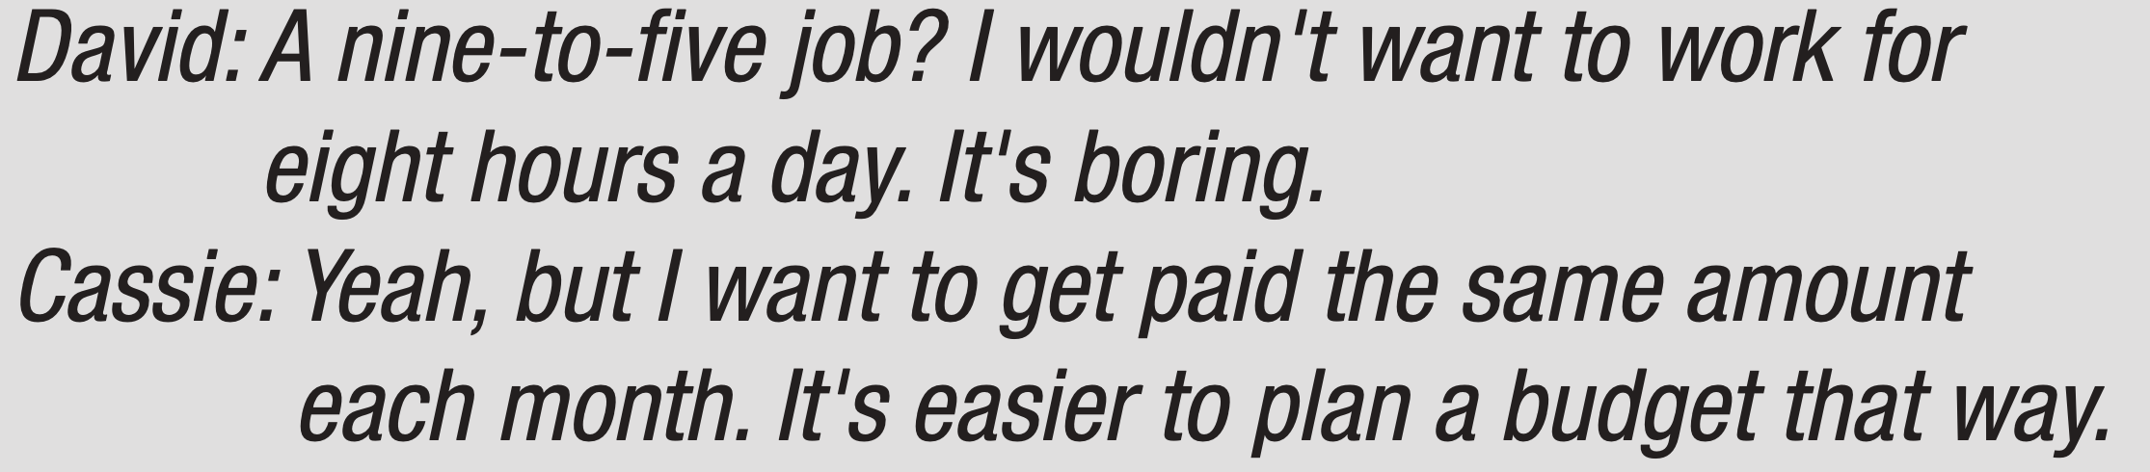
While-listening
Explanation
1. Cassie says a nine-to-five job makes it easier to plan a ________________.
budget

Slide 18
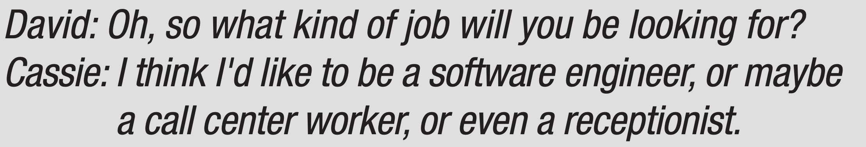
1. Cassie says a nine-to-five job makes it easier to plan a ________________.
3. David says having your own business means you can choose when to
________________ work.
4. Cassie wants to find a mentor to help develop her ________________.
5. David wants to ________________ smart devices such as phones and tablets.
While-listening
Explanation
2. Cassie is thinking of working as a software engineer, a call center worker, or ________________.
a receptionist
Notes:
Click on the rectangle: a receptionist, for listening.

Slide 19
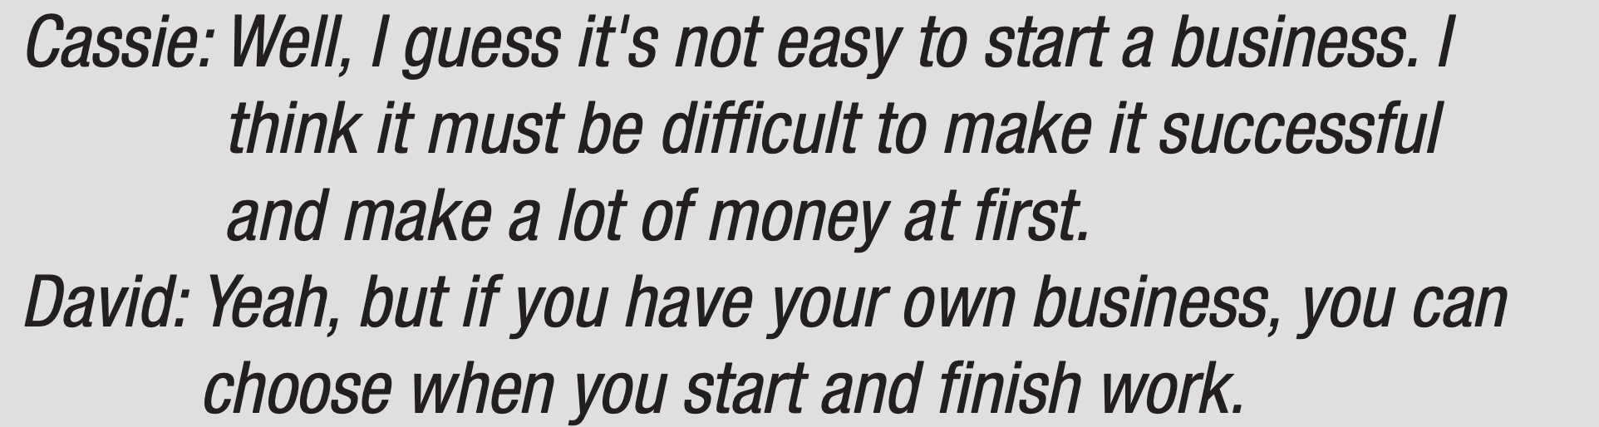
1. Cassie says a nine-to-five job makes it easier to plan a ________________.
3. David says having your own business means you can choose when to
________________ work.
4. Cassie wants to find a mentor to help develop her ________________.
5. David wants to ________________ smart devices such as phones and tablets.
While-listening
Explanation
3. David says having your own business means you can choose when to ________________ work.
start and finish
Notes:
Click on the rectangle: start and finish, for listening.

Slide 20
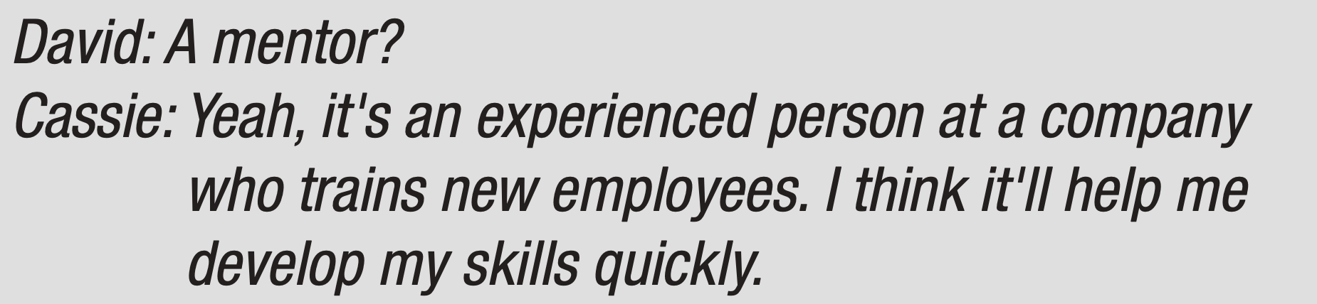
While-listening
Explanation
4. Cassie wants to find a mentor to help develop her _______________.
skills quickly

Slide 21
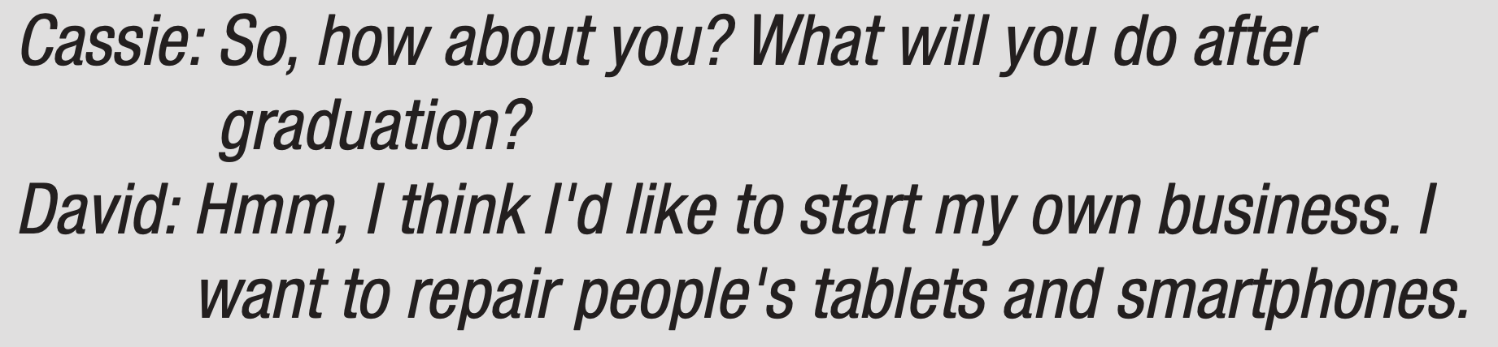
While-listening
Explanation
5. David wants to ________________ smart devices such as phones and tablets.
repair

Slide 22
In pairs: What do you think about Cassie and David's ideas?
Post-listening
Suggested answers.
It seems to me that they have weighed their opinions. Cassie is considering going for a nine-to-five job shortly after her graduation. At the same time, David has always wanted to start a business.
What do you think about their ideas?

Slide 23


Slide 24
Read Hannah's essay about her mom's job. What does Hannah think about nine-to-five jobs?
I/Pre-reading
﻿ She thinks they're great for everyone.
﻿ She thinks they're good for some people, but not everyone.
﻿ She thinks a work-life balance is better than a nine-to-five job.

Slide 25

Pre-reading
My mom is an accountant. She keeps track of the money that her company makes and spends. It's a nine-to-five job, and she really likes it. However, some people prefer not to work a nine-to-five job. This kind of job has both advantages and disadvantages.

Slide 26
Pre-reading
My mom's job has some pretty good advantages. One advantage is that she gets a regular salary, which means she makes the same money each month. This helps her save money and plan for the future more easily. Moreover, the job comes with great perks, such as a company outing each year, dinners and parties, health insurance, and even a gym membership. In addition, the work-life balance of a nine-to-five job is not terrible because you have evenings off, and you don't usually work on the weekends.

Slide 27
Pre-reading
On the other hand, I think there are some disadvantages of working a nine-to-five job, too. If you want to make more money, it can be pretty difficult. Your salary is the same each month. You have to get promoted to a higher position or leave and find a job with a higher salary. In contrast to my mom's job, some nine-to-five jobs don't offer good benefits at all.

Slide 28
Pre-reading
Finally, some people don't like the work-life balance of nine-to-five jobs. My mom has to work about 40 hours each week, which is quite a lot, and the hours aren't usually flexible.
In summary, there are some good benefits to my mom's nine-to-five office job, but not every job has them. It's great to have a regular salary and perks, but some people might prefer a better work-life balance.

Slide 29
II/While-reading
What does Hannah think about nine-to-five jobs?
﻿ She thinks they're great for everyone.
﻿ She thinks they're good for some people, but not everyone.
﻿ She thinks a work-life balance is better than a nine-to-five job.
Explanation
“… However, some people prefer not to work a nine-to-five job. This kind of job has both advantages and disadvantages…”

Slide 30
While-reading
My mom is an accountant. She keeps track of the money that her company makes and spends. It's a nine-to-five job, and she really likes it. However, some people prefer not to work a nine-to-five job. This kind of job has both advantages and disadvantages.

Slide 31
While-reading
My mom's job has some pretty good advantages. One advantage is that she gets a regular salary, which means she makes the same money each month. This helps her save money and plan for the future more easily. Moreover, the job comes with great perks, such as a company outing each year, dinners and parties, health insurance, and even a gym membership. In addition, the work-life balance of a nine-to-five job is not terrible because you have evenings off, and you don't usually work on the weekends.

Slide 32
While-reading
On the other hand, I think there are some disadvantages of working a nine-to-five job, too. If you want to make more money, it can be pretty difficult. Your salary is the same each month. You have to get promoted to a higher position or leave and find a job with a higher salary. In contrast to my mom's job, some nine-to-five jobs don't offer good benefits at all.

Slide 33
While-reading
Finally, some people don't like the work-life balance of nine-to-five jobs. My mom has to work about 40 hours each week, which is quite a lot, and the hours aren't usually flexible.
In summary, there are some good benefits to my mom's nine-to-five office job, but not every job has them. It's great to have a regular salary and perks, but some people might prefer a better work-life balance.

Slide 34
Match the bold words in the text with their definitions.
While-reading
1 __________ : | a short trip that you go on with a group of people, usually for fun or education
2 ___________ : | able to change to suit new situations
3 ___________ : | a job
outing
flexible
position
Notes:
1. outing
2. flexible
3. position
4. work-life balance
5. salary
6. perk

Slide 35
Match the bold words in the text with their definitions.
While-reading
4 ___________ : | the time you spend working compared with the time you spend with your family, relaxing, etc.
5 ___________ : | money that employees receive for doing their job
6 ___________ : | something, in addition to money, that people receive for doing their job
salary
work-life balance
perk

Slide 36
While-reading
Now, read and answer the questions.
1. What's a benefit of earning a regular salary?
A. You make a lot of money. | B. It's easier to plan your budget. | C. You don't work a lot.
Explanation
“… One advantage is that she gets a regular salary, which means she makes the same money each month. This helps her save money and plan for the future more easily. ”
Notes:
Hit SPACEBAR or RIGHT / DOWN arrow key for key words.
Hit the same keys for the answer key. Repeat the steps for questions 2-5.

Slide 37
While-reading
Now, read and answer the questions.
2. Which of the following is NOT mentioned as an advantage of working a nine-to-five job?
A. a great work-life balance | B. a fixed amount of money | C. health insurance
Explanation
“… gets a regular salary, … , health insurance, and even a gym membership… In addition, the work-life balance of a nine-to-five job is not terrible…”
Notes:
Hit SPACE or RIGHT / DOWN arrow key for key words.
Hit the same keys for the answer key. Repeat the steps for questions 2-5.

Slide 38
3. The word This in paragraph 2 refers to ______.
A. a nine-to-five job | B. a perk | C. Getting a regular salary
Explanation
“…My mom's job has some pretty good advantages. One advantage is that she gets a regular salary, which means she makes the same money each month. This helps her save money and plan for the future more easily …”
Notes:
1.B 2.A 3.C 4.A 5.A

Slide 39
4. How can people with nine-to-five jobs increase their salary?
A. get a different job | B. work more hours | C. Work harder
Explanation
“… If you want to make more money, it can be pretty difficult. Your salary is the same each month. You have to get promoted to a higher position or leave and find a job with a higher salary…”
Notes:
1.B 2.A 3.C 4.A 5.A

Slide 40
5. Which of the following can be inferred from the passage?
Working faster doesn't mean more money B. You always work 40 hours a week. C. Very few jobs have great perks
Explanation
“… some nine-to-five jobs don't offer good benefits at all. Finally, some people don't like the work-life balance of nine-to-five jobs. My mom has to work about 40 hours each week, which is quite a lot, and the hours aren't usually flexible…”
Notes:
1.B 2.A 3.C 4.A 5.A

Slide 41

In pairs: Would you like to work a nine-to-five job? Why (not)?
III/Post-reading
Suggested answer
A: | Would you like to work from nine to five?
B: | I would say yes if I had a job offer with stable and predictable hours.
A: | Absolutely! It’s a big plus, but what else would make a 9-to-5 job appealing to you?
B: | Well, many full-time positions offer benefits such as health insurance, retirement plans, paid time off, and sometimes perks.
A: | These are excellent points.
Notes:
Hit the RIGHT ARROW key for suggested answer.

Slide 42

CONSOLIDATION

Slide 43
V.Homework
Learn the vocabulary again and practice making sentences using them.
Do the exercises on page 18, WB.
Prepare the next lesson (Speaking & Writing pages 35 & 36, SB)
Play the consolidation games on www.eduhome.com.vn

Slide 44

Lesson 3
Stay positive and have a nice day!

