Slide 1
TUY PHUOC 2 HIGH SCHOOL
Teacher : HUYNH TH I KIM VUI
CLASS : 12A4
SCHOOL YEAR :2024-2025

Slide 2

Unit 3: WORLD OF WORK
Lesson 1.2: Grammar
Pages: 27 & 28

Slide 3
Lesson Outline
Warm-up
Presentation
Practice
Production
Wrap-up

Slide 4

I.WARM-UP

Slide 5
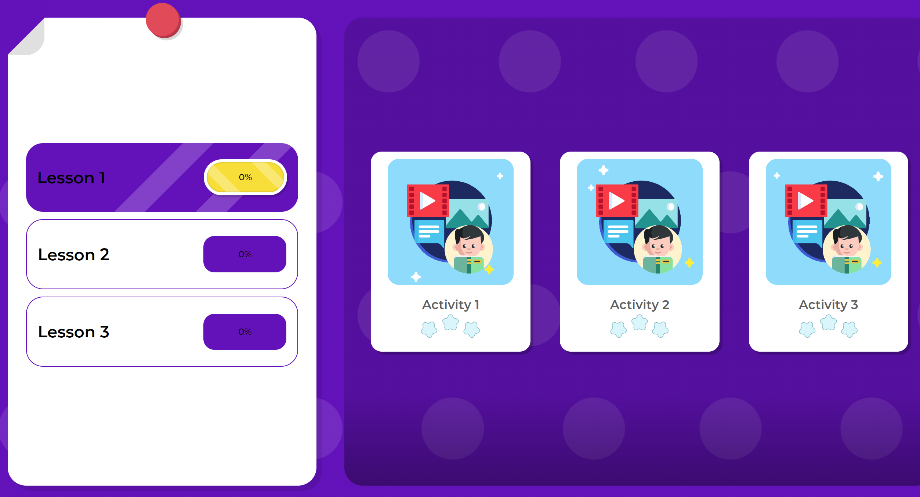
Play the vocabulary game on DHA on Eduhome

Slide 6

II.PRESENTATION

Slide 7
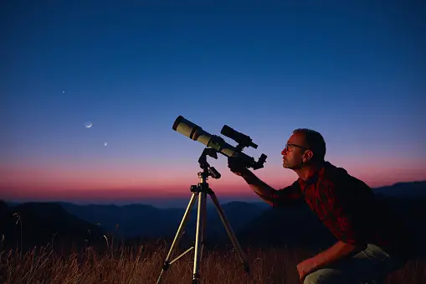
PRESENTATION
Choose the sentence that best describes the picture.
A. He’s looking the stars through a telescope.
B. He’s looking at the stars through a telescope.
C. He’s looking to the stars through a telescope.

Slide 8
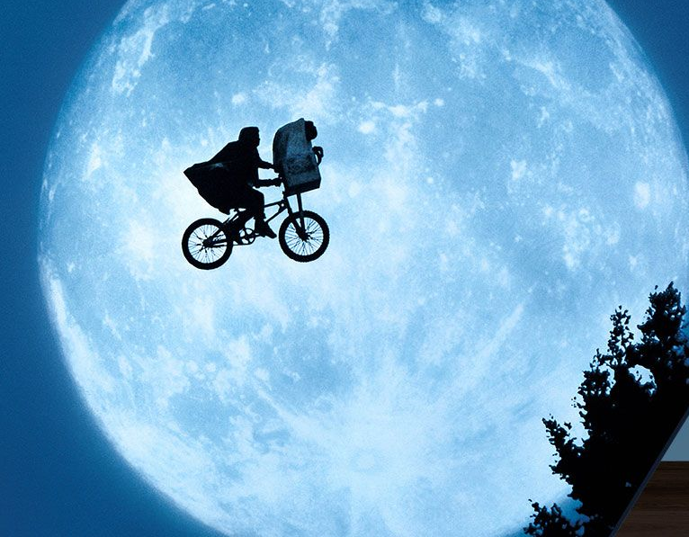
Choose the correct option to complete the sentence.
PRESENTATION
Last night, I dreamt ______ flying over the moon.
A. over
B. about
C. of

Slide 9
PRESENTATION
preposition
He’s looking at the stars through a telescope.
Verb
Object
Last night, I dreamt about flying over the moon.
Verb
Object
preposition
Notes:
Hit the RIGHT ARROW key for annimations.

Slide 10
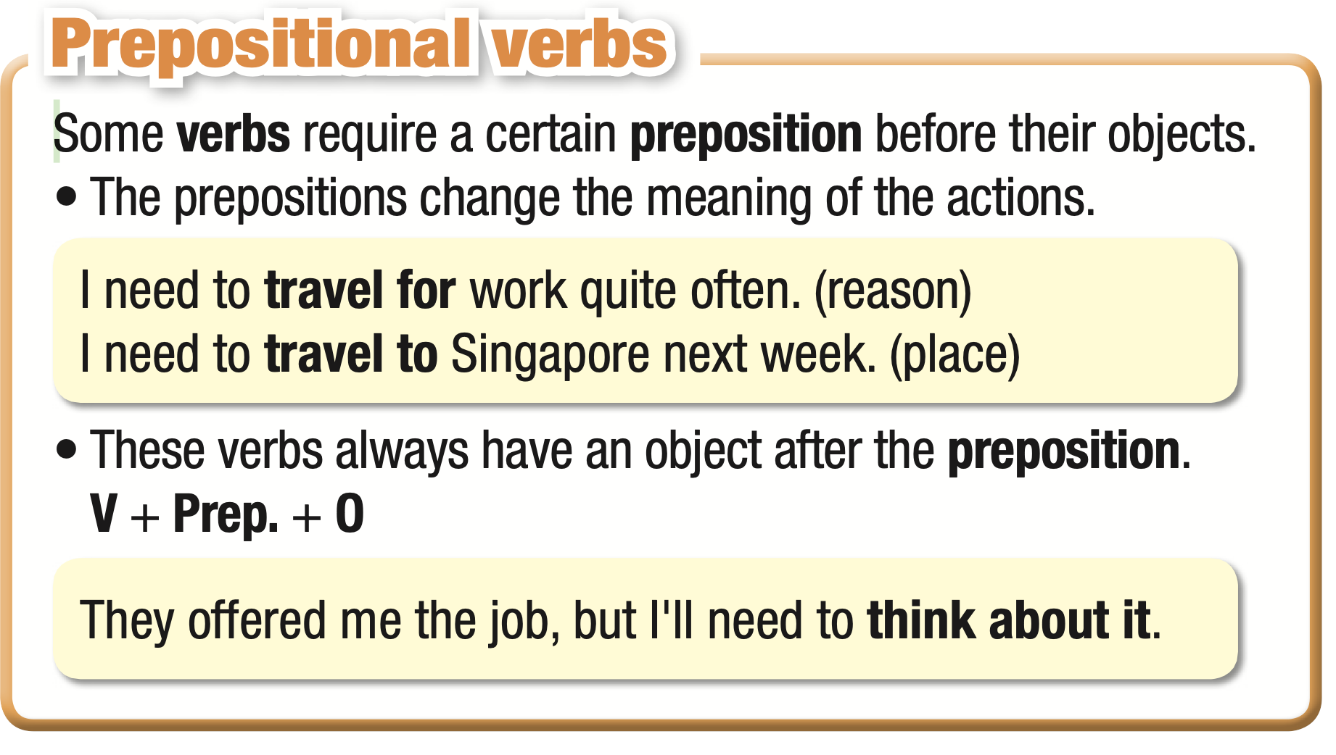
a. Read about prepositional verbs.

Slide 11
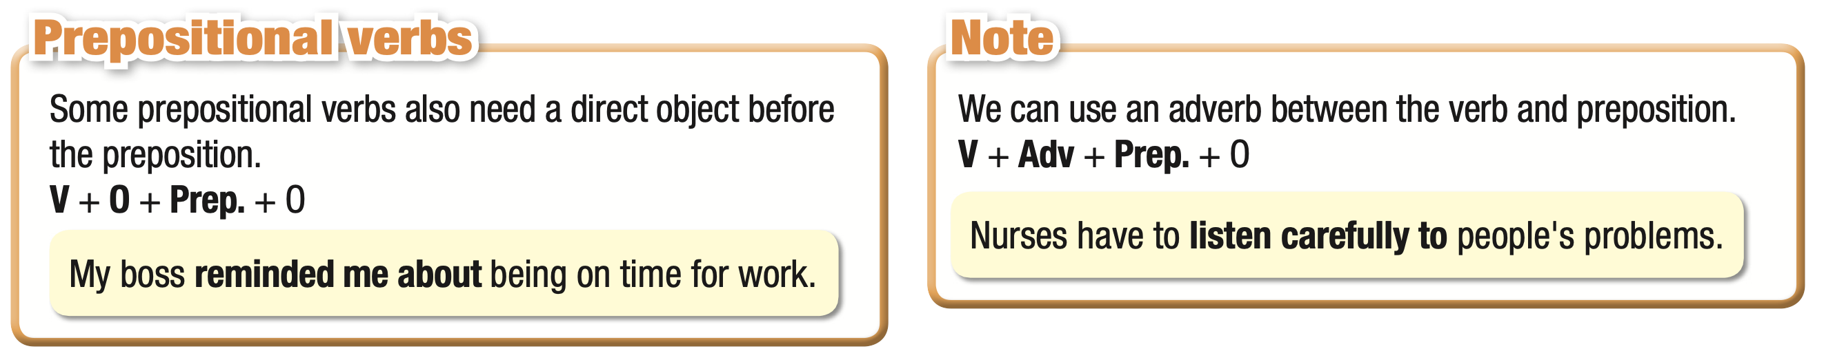
a. Read about prepositional verbs.
Notes:
Hit the RIGHT ARROW / SPACE key for annimations.

Slide 12
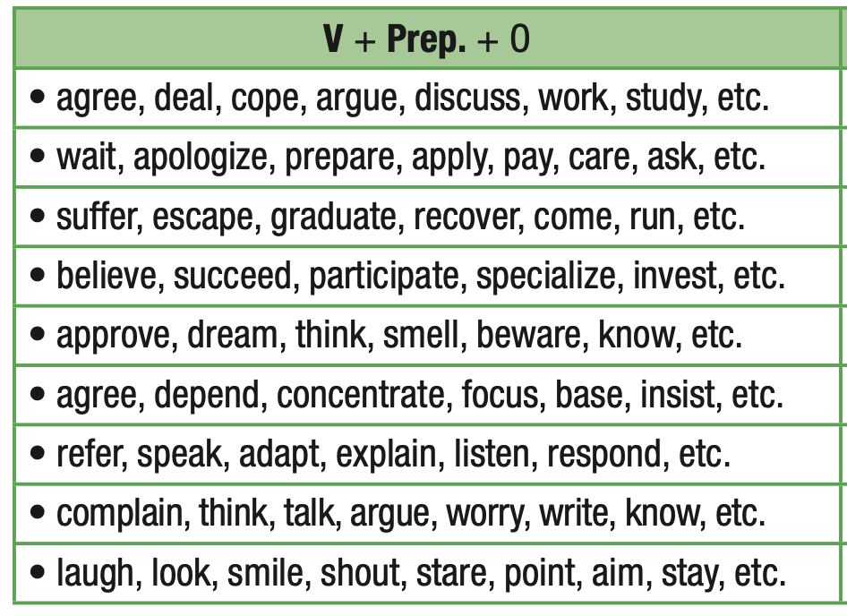
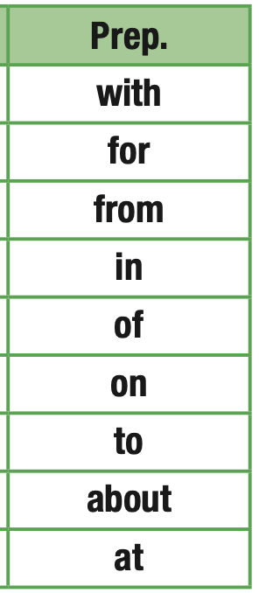
a. Read about prepositional verbs.

Slide 13
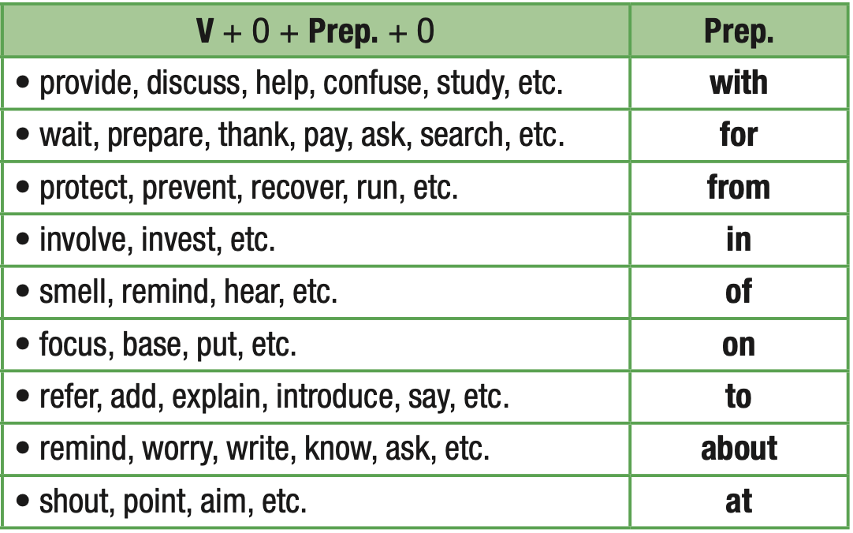
a. Read about prepositional verbs.

Slide 14

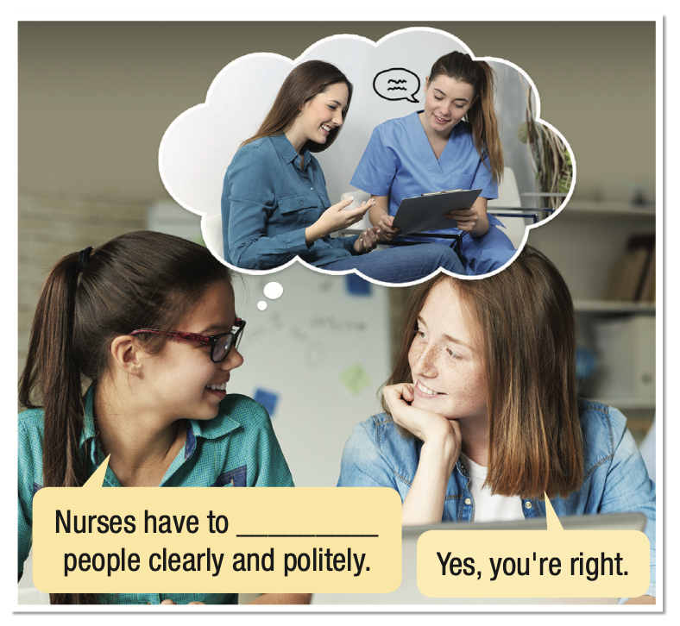
b. Fill in the blank, then listen and check.
ANSWER KEY
talk to
Notes:
Hit

Slide 15
Listen and repeat.
talk to
Notes:
Hit

Slide 16
PRACTICE

Slide 17
c. Fill in the blanks with the correct prepositions.
with to of about with
with
I really enjoy working ___________ Tony and my other friends.
2. An accountant needs to know ___________ business and how their company works.
about
Notes:
SPACE bar for answer keys

Slide 18
c. Fill in the blanks with the correct prepositions.
with to of about with
3. Receptionists have to listen carefully ___________ lots of customers and visitors.
4. Teachers have to think ___________ lots of different games for their students.
5. An architect has to deal ___________ building design problems.
to
of
with
Notes:
SPACE bar for answer keys

Slide 19
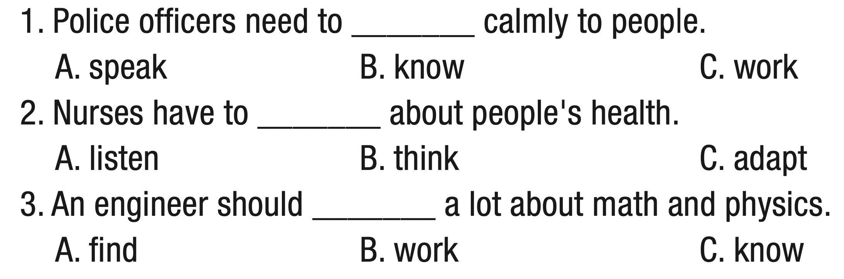
d. Choose the correct answers.
Notes:
1.A 2.B 3.C 4.A 5.C

Slide 20
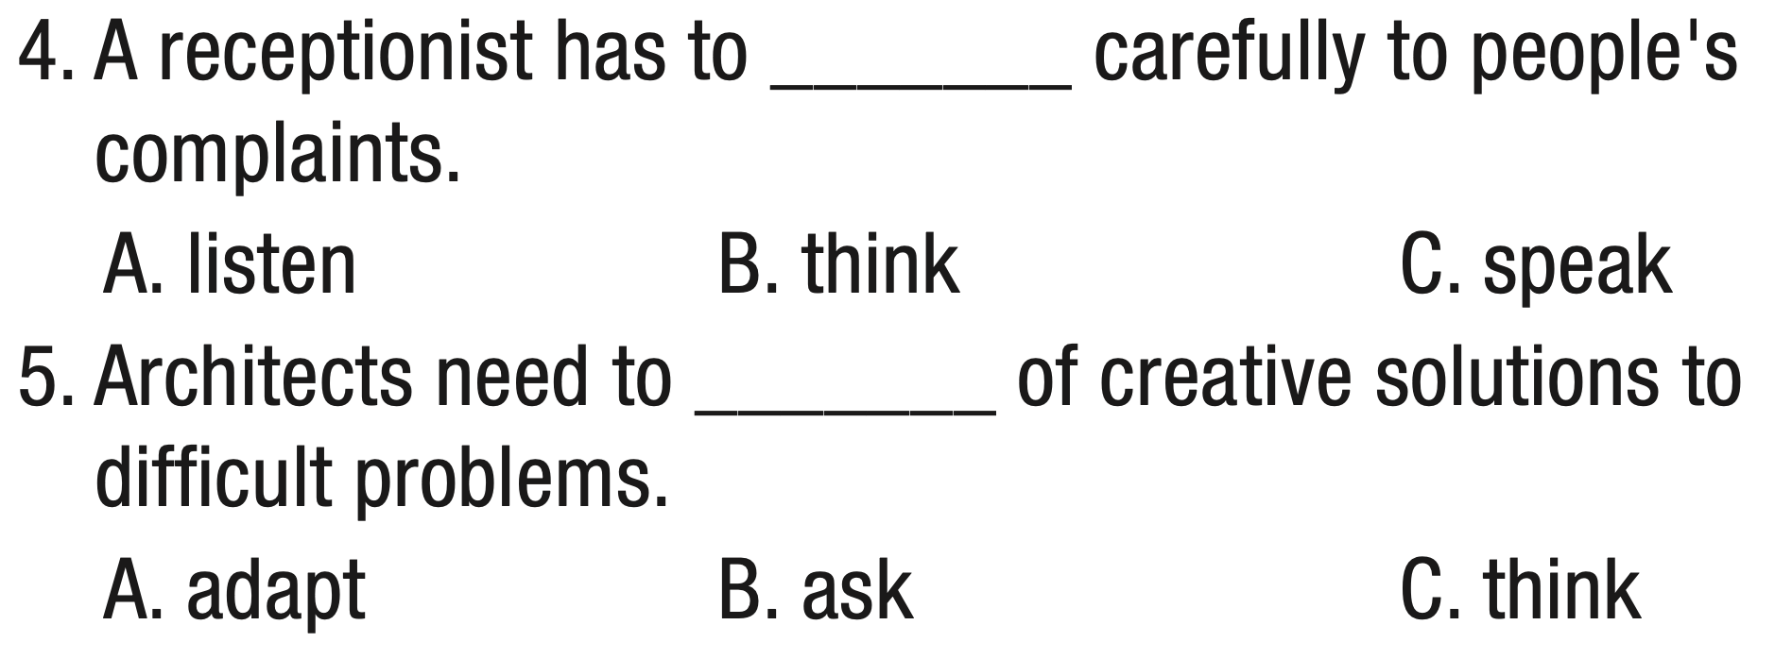
d. Choose the correct answers.
Notes:
1.A 2.B 3.C 4.A 5.C

Slide 21
Extra Practice
a. Choose the correct answers.
1. We’re talking to/in an architect about designing our new house.
2. We were worried that she’d be stressed about moving to a new place, but she’s adapted to/about it very well.
3. Engineers also need to know in/about the law.
Notes:
a. Circle the correct words.

Slide 22
Extra Practice
a. Choose the correct answers.
4. The customer didn’t like your idea. You need to think of / with a new solution.
5. He felt very lucky to have the opportunity to work to / with professional and friendly people.
Notes:
a. Circle the correct words.

Slide 23
b. Fill in the blanks with the correct prepositional verbs.
think of listen to know about
work with speak to adapt to
1. When you speak to difficult customers, it's very important to _____________ let them feel that you really them.
listen to
adapt to
2. Being able to ____________new situations is a useful skill in many jobs.
think of
3. As a blogger, you need to always ___________new ideas to attract readers.

Slide 24
b. Fill in the blanks with the correct prepositional verbs.
think of listen to know about
work with speak to adapt to
work with
4. It isn't easy to _____________ him because he isn't organized and has many strange requests. Our projects with him always need lots of changes.
know about
5. An architect needs to ____________construction and the law.
speak to
6. Doctors and nurses need to ___________ people in a calm and easy to understand way.

Slide 25
PRODUCTION

Slide 26

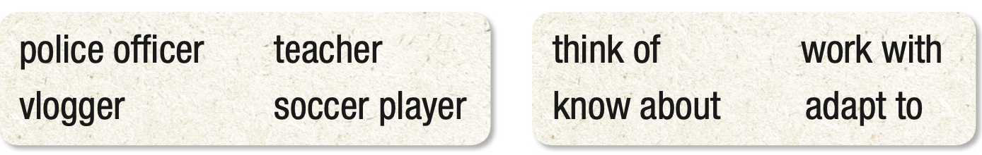
e. In pairs: Make sentences about the jobs using the prepositional verbs in the box.
Vloggers have
to think of lots of
creative ideas.
Notes:
Hit the RIGHT ARROW key for annimations.

Slide 27
e. In pairs: Make sentences about the jobs using the prepositional verbs in the box.
Suggested answers
Vloggers have to think of lots of creative ideas.
Teachers should know about their students' needs and learning styles.
Police officers have to adapt to lots of different situations.
Soccer players work with other players and coaches.

Slide 28

WRAP-UP

Slide 29
Today’s lesson
Grammar: Prepositional verbs

Slide 30
Today’s lesson
Grammar:
practiced and used specific prepositional verbs: think of, know about, speak to, etc., for making sentences and speaking.

Slide 31
Homework
Make sentences with the prepositional verbs
Do the exercises on page 15, WB.
Prepare the next lesson (Pronunciation & Speaking pages 28 & 29, SB)
Play the consolidation games on www.eduhome.com.vn

Slide 32

Lesson 3
Stay positive and have a nice day!

