Slide 1
TUY PHUOC 2 HIGH SCHOOL
TEACHER: NGUYEN THI THANH PHUONG
CLASS: 10A1
SCHOOL YEAR: 2024-2025

Slide 2




Lesson .
LESSSON OUTLINE
Consolidation

Slide 3

By the end of this lesson,
students will be able to:
stress on the negative in the sentence.
review vocabulary about leisure activities.
talk about how much they like/dislike something.

Slide 4



Slide 5

Work in pairs.
Choose the word whose main stress is placed
differently from the others.
A. aerobics B. canoeing C. karate D. fantasy
2. A. crossword B. puzzle C. running D. reuse
3. A. leisure B. fishing C. Monday D. balloon
/erˈoʊbɪks/
/kəˈnu:ɪŋ/
/kəˈrɑ:ti/
/ˈfæntəsi/
/ˈkrɑ:swɜ:d/
/ˈpʌzəl/
/ˈrʌnɪŋ/
/ˌri:ˈju:s/
/ˈli:ʒə/
/ˈfɪʃɪŋ/
/ˈmʌndeɪ/
/bəˈlu:n/

Slide 6
Work in pairs.
Choose the word whose underlined part is
pronounced differently from that of the other words.
A. member B. soccer C. event D. metal
2. A. like B. mind C. rise D. sit
3. A. ride B. shine C. light D. ring
/ˈmembə/
/ˈsɑ:kə/
/ɪˈvent/
/ˈmetəl/
/laɪk/
/maɪnd/
/raɪz/
/sɪt/
/raɪd/
/ʃaɪn/
/laɪt/
/rɪŋ/

Slide 7

Look at the picture, review the vocabulary about leisure activities.

Slide 8
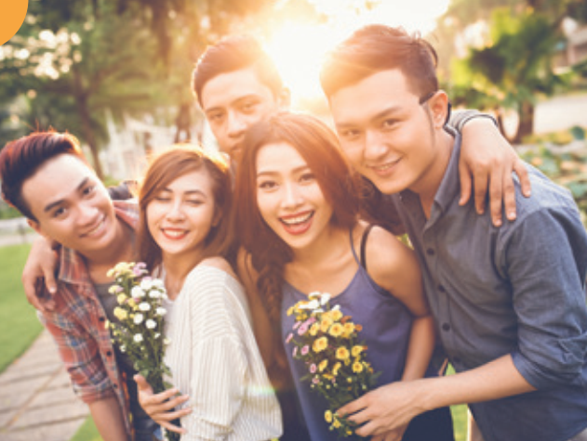
hang out with friends

Slide 9
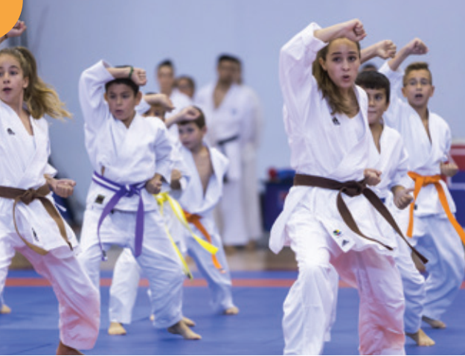
do karate

Slide 10
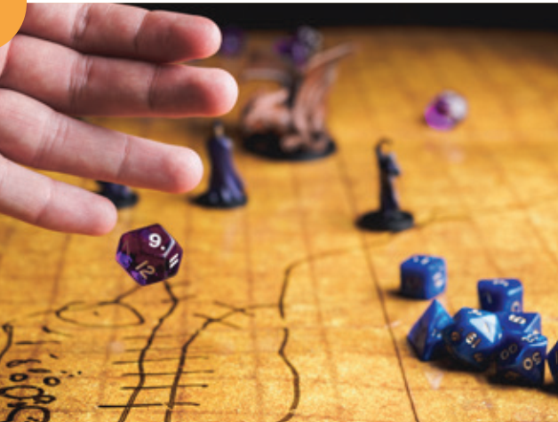
play role-playing games

Slide 11
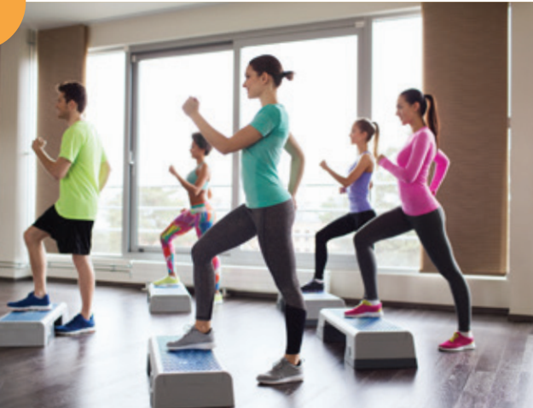
do aerobics

Slide 12
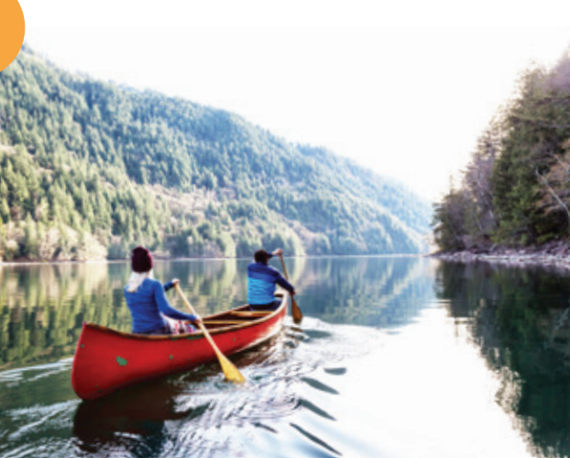
go canoeing

Slide 13
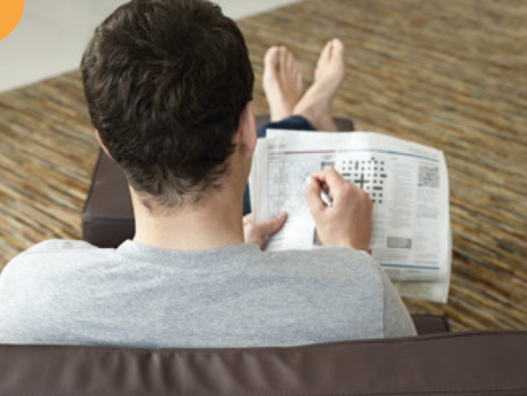
do crossword puzzles

Slide 14
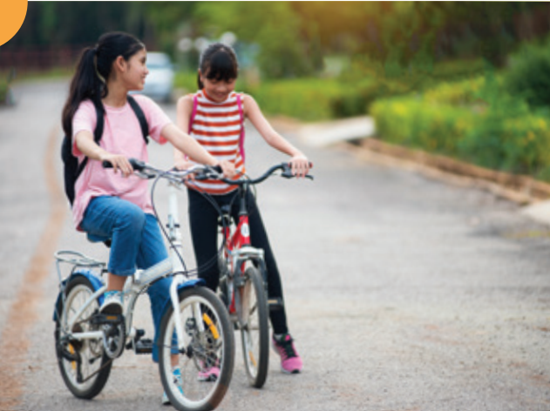
go for a bike ride

Slide 15
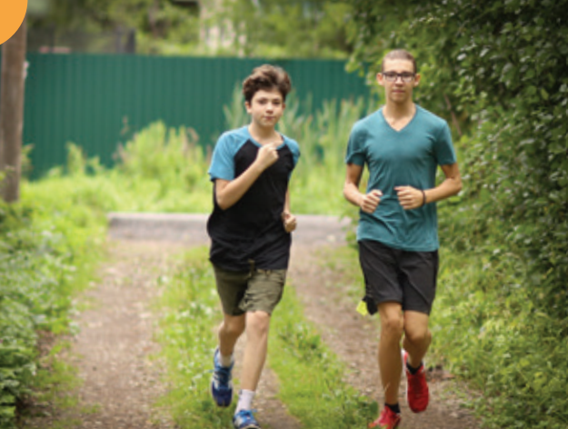
go running

Slide 16



Slide 17


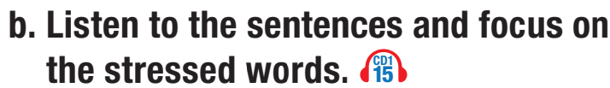

We stress on the negative (don’t, can’t, aren’t, isn’t, haven’t, …)
in the sentence.

I really don't like going running.
I can't stand doing aerobics.



Slide 18

We stress on the negative (don’t, can’t, aren’t, isn’t, haven’t, …) in the sentence.

I hate going shopping. He can't stand doing aerobics.


The stress on "shopping” is wrong.
The correct stress is: I hate going shopping.

Slide 19
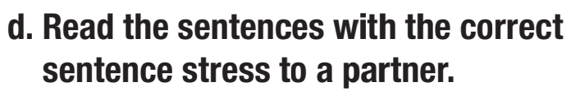
We stress on the negative (don’t, can’t, aren’t, isn’t, haven’t, …) in the sentence.
I hate going shopping.
He can’t stand doing aerobics.
I really don't like going running.
I can't stand doing aerobics.





Slide 20

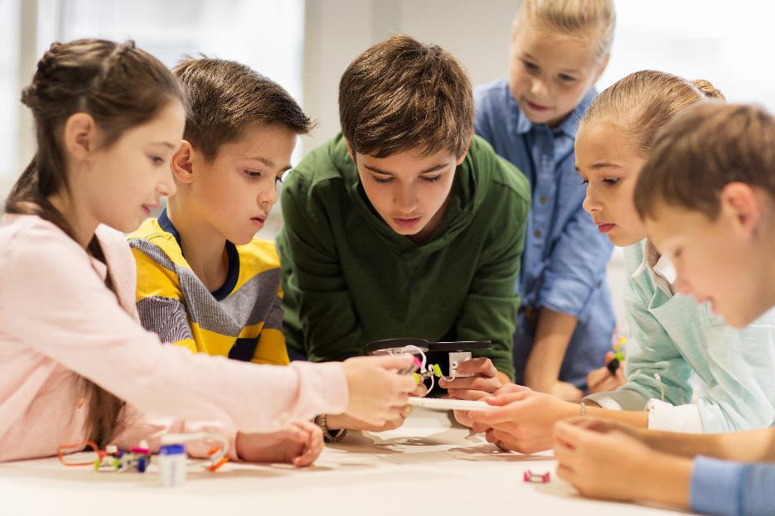

Slide 21
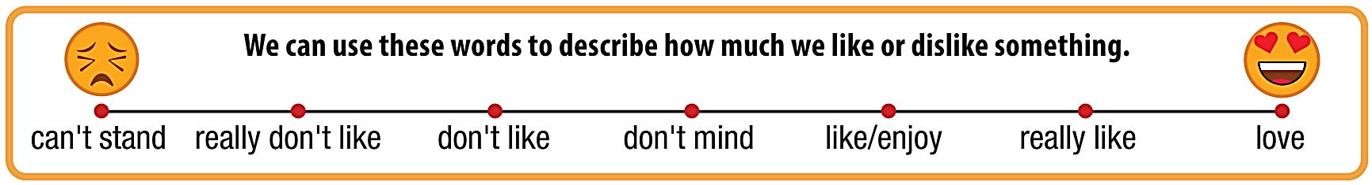
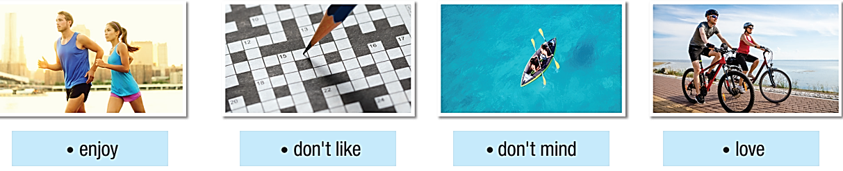

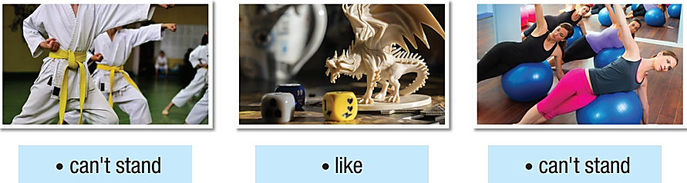


Slide 22
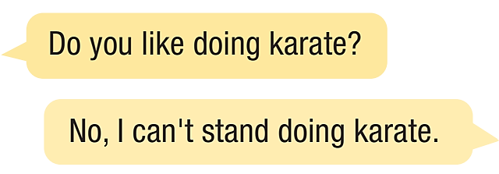

Slide 23



Slide 24
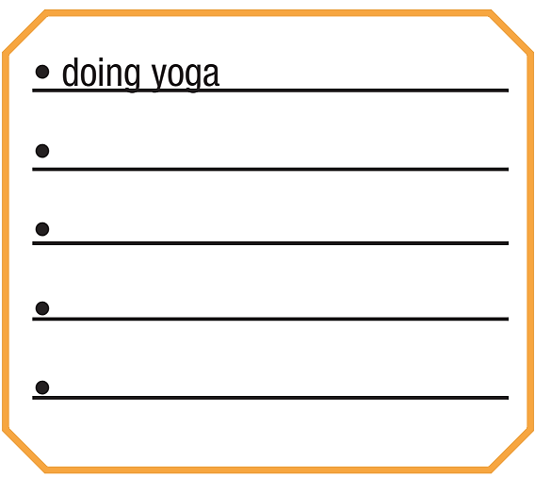

a. Add four activities to the list.
In fours: Talk about how you feel about each activity in the list
and say why you like or don't like the activities.

Slide 25


b. Which activity does your group like the most? Which activity do you like the least? Why?

Slide 26

Consolidation

Slide 27
Work in pairs.
Talk about activities you like/don’t like doing after school.

Slide 28
Today’s lesson
Wrap-up
Vocabulary: leisure activities.
Pronunciation: sentence stress (stress on the negative).
Speaking: describing how much we like/dislike something.

Slide 29
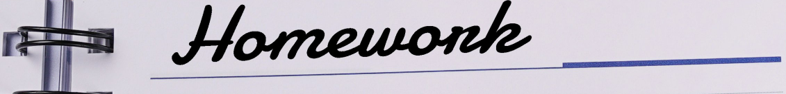
Review the vocabulary and grammar notes Tiếng Anh 10 i-Learn Smart World Notebook on pages 8 & 9.
Prepare the next lesson on page 15, SB.
Play the consolidation games in Tiếng Anh 10 i-Learn Smart World DHA App on www.eduhome.com.vn

Slide 30
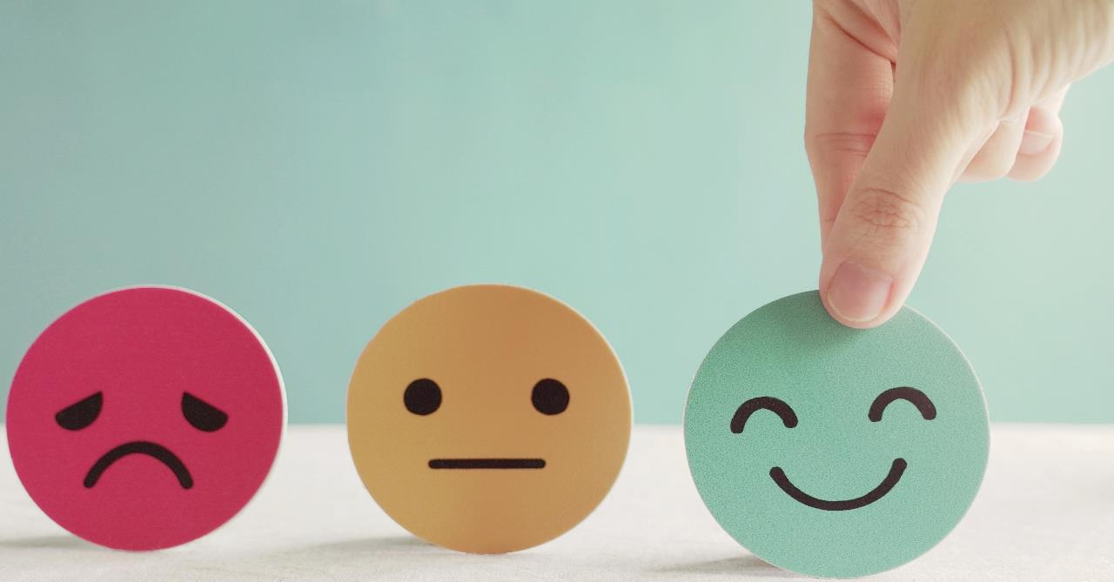
Have a nice day!

