Slide 1
TUY PHUOC 2 HIGH SCHOOL
TEACHER: NGUYEN THI THANH PHUONG
CLASS: 10A5
SCHOOL YEAR: 2024-2025

Slide 2
Welcome to our class

Slide 3
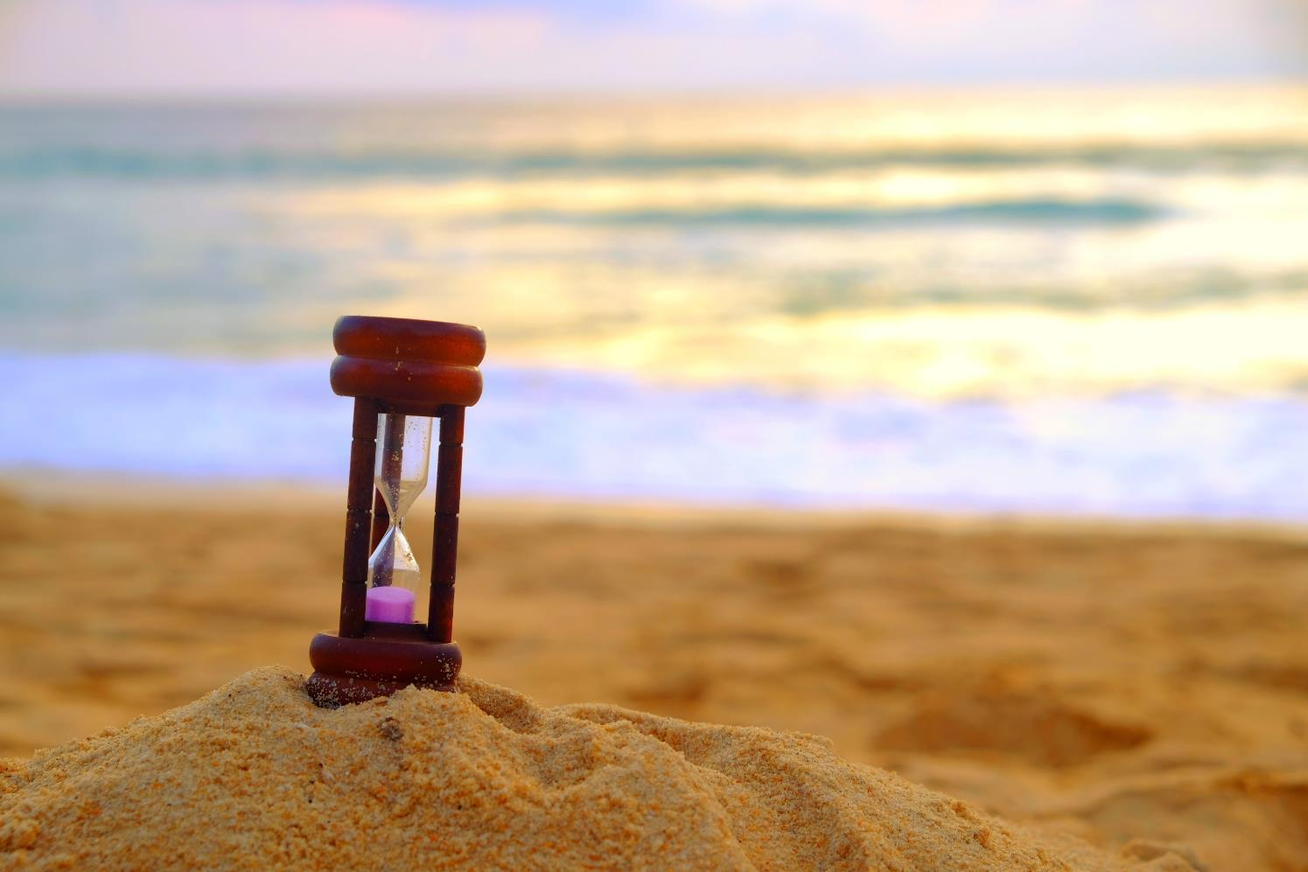

Slide 4
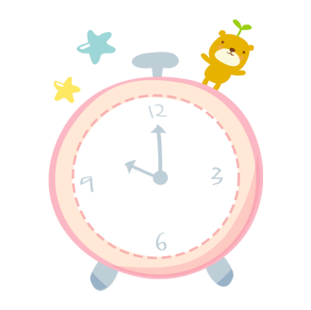
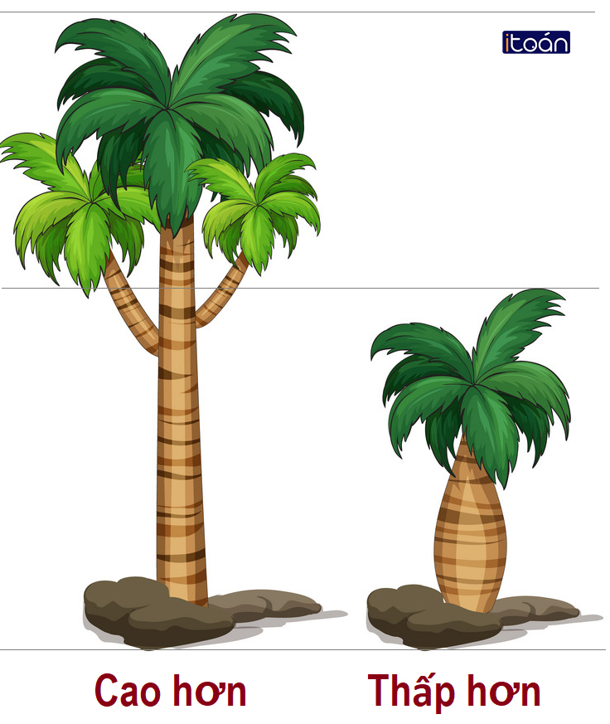
START
An adjective that has 4 letters
describes a tree.
12
9
3
6
Time Out
TALL

Slide 5
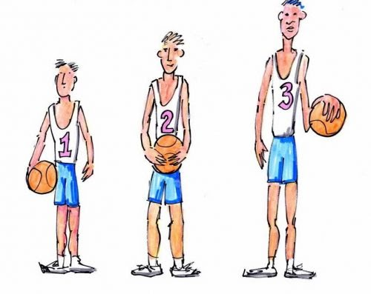
START
An adjective that has 5 letters
describes a boy.
12
9
3
6
Time out
SHORT

Slide 6
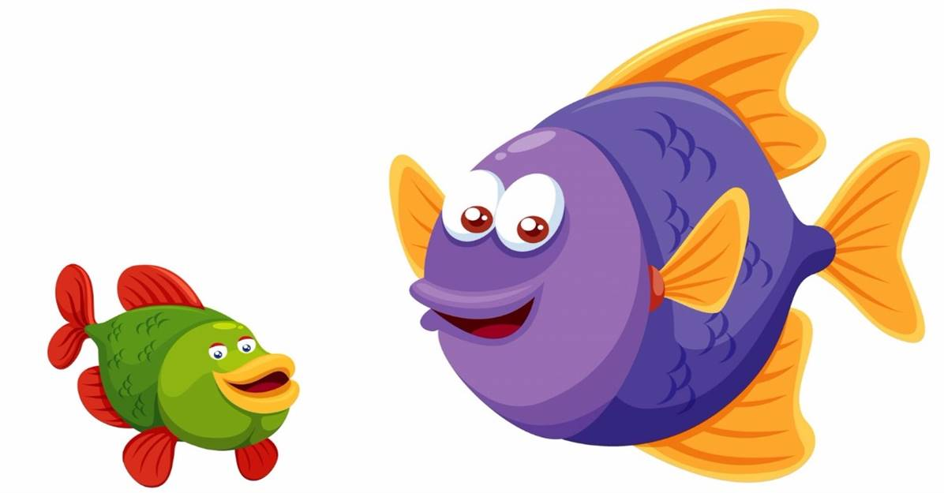
START
An adjective that has 3 letters
describes a fish.
12
9
3
6
Time out
BIG

Slide 7
START
An adjective that has 3 letters
describes a fish.
12
9
3
6
Time out
BIG

Slide 8
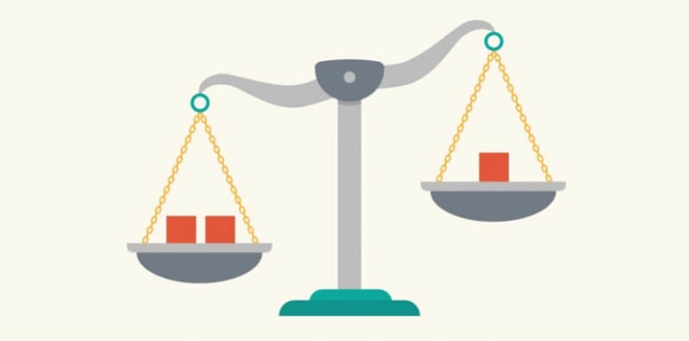
START
12
Guess: LESSON TOPIC
(10 LETTERS)
9
3
6
Time out
COMPARISON

Slide 9
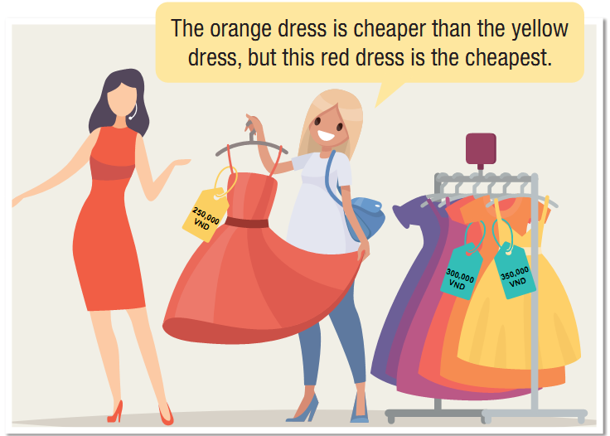
Unit 3 SHOPPING
LESSON 1.2: Grammar

Slide 11
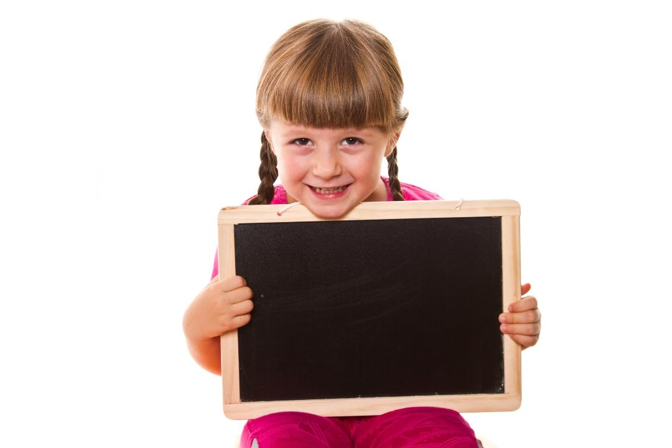
Presentation

Slide 12
Unit 3 Lesson 1.2
Notes:
Please, click on each phrase to hear the sound

Slide 13
Unit 3 Lesson 1.2
1. What is the comparative adjective?
→ cheaper (than)
2. What is the superlative adjective?
→ the cheapest
Notes:
Please, click on each phrase to hear the sound

Slide 14
Unit 3 Lesson 1.2
3. How can we form the comparative and superlative adjectives?
Notes:
Please, click on each phrase to hear the sound

Slide 15
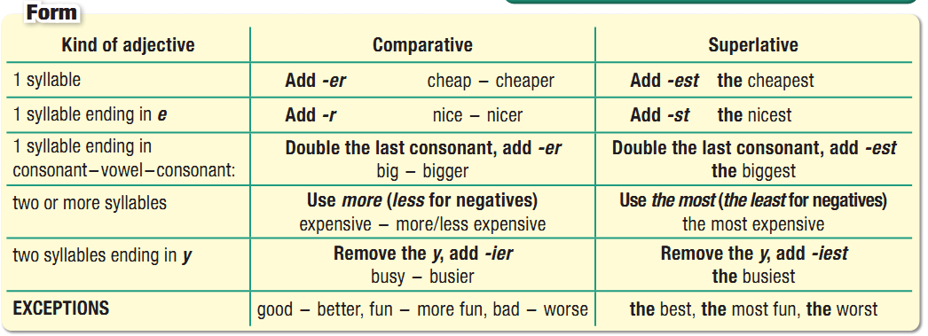
Unit 3 Lesson 1.2
Comparative and Superlative Adjectives
Notes:
Please, click on each phrase to hear the sound

Slide 16
GRAMMAR
Remember!
Form | Comparative | Superlative
Short adj | S1+ be+ Adj-ER + than S2 | S+ be+ the Adj-EST
Long adj | S1+ be+ MORE+ Adj + than S2 LESS | S+ be+ the MOST+ Adj LEAST

Slide 17
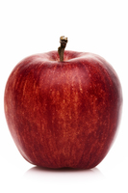
GRAMMAR
Remember!
Use | Comparative | Superlative
 | Used to compare two things/ two people Used to show changes | Used to compare a person or thing with the whole group of which person or thing is a member

Slide 18
GRAMMAR
Remember!
Adjective | Comparative | Superlative
cheap | Cheaper | Cheapest
large | larger | largest
big | bigger | biggest
happy | happier | happiest
good | better | best

Slide 19
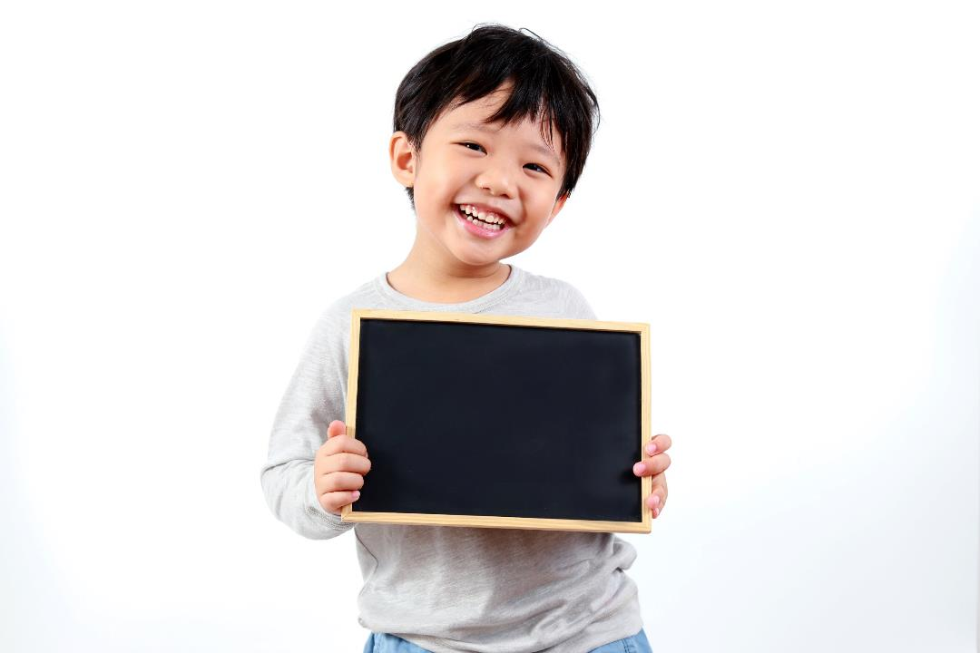
Practice

Slide 20
Unit 3 Lesson 1.2
b. Circle the correct words.
1. I think you should buy this pair of sunglasses. It looks cooler/coolest than the other pair.
2. Can I borrow some money? This dress is more/most expensive than I thought.
3. This restaurant may not have the greatest food in town but their customer service is definitely the best/better. We eat here at least twice a month.
4. It's best if you come on Wednesday, when I'm less busy/busiest. We'll have time to chat.
5. Shopping is my less/least favorite thing to do. It's boring and takes a lot of time.
Notes:
Please, click on each phrase to hear the sound

Slide 21
Unit 3 Lesson 1.2
c. Fill in the blanks with the right forms of the adjectives.
prettier than
1. I think this dress is _________________ (pretty) the other one.
2. This is _________________ (good) place to shop for shoes in town. All the other stores are too expensive.
3. I rarely wear my green jacket. It's _______________________ (comfortable) my red one.
4. Do you have a _________________ (expensive) bag? This one is a bit too much.
5. We'll never go back to that restaurant. It has _________________ (bad) customer service ever.
6. The black shirt is _________________ (good) the white one, so it will last longer.
the best
less comfortable than
less expensive
the worst
better than
Notes:
Please, click on each phrase to hear the sound

Slide 22
Unit
Lucky numbers
Work in 2 teams.
Choose a number.
Answer the question in each number and get 1 point with the correct answer.
With LUCKY NUMBER, you get 2 points without answering the question.

Slide 23
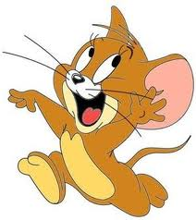
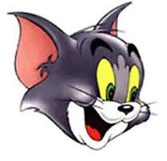
LUCKY NUMBERS
1
2
3
4
5
6
7
8
4
3
2
1
6
5
4
3
2
1
0
6
7
0
7
5
Tom
Jerry

Slide 24
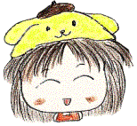
lucky number

Slide 25
1. I think this dress is __ (pretty) the other one.
more prettier than
B. prettier
C. more pretty than
D. prettier than

Slide 26
6. The black shirt is ____ (good) the white one, so it will last longer.
better than
gooder than
best than
the best

Slide 27
5.We'll never go back to that restaurant. It has _____ (bad) customer service ever.
badder
the worse
the worst
the baddest

Slide 28
2. This is ____ (good) place to shop for shoes in town. All the other stores are too expensive
the best
the goodest
C. better
D. The better

Slide 29
4. Do you have a _______ (expensive) bag? This one is a bit too much.
less expensive
B. more expensive
C. the most expensive.
D. the less expensive.

Slide 30
Production

Slide 31
Unit 3 Lesson 1.2
d. In pairs: Compare computer games.
Use the prompts from the box.
Notes:
Please, click on each phrase to hear the sound

Slide 32
Unit 3 Lesson 1.2
e. In pairs:
Are you more similar to Sam or Alice? Why?
I am similar to Same/Alice because ……

Slide 33
Consolidation

Slide 34
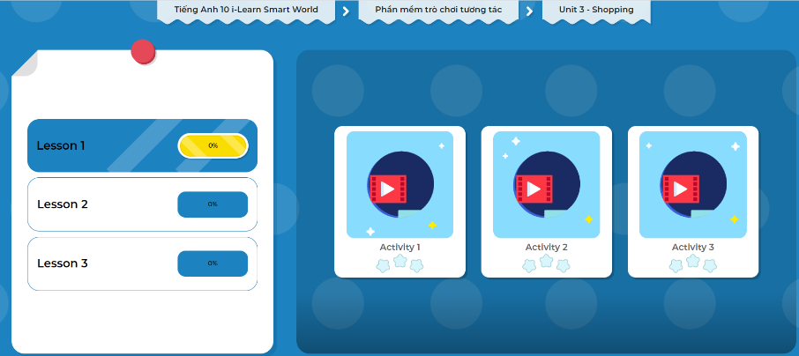
Let’s play!
Click here to play the games!

Slide 35
Unit 3 Lesson 1.2
Today’s lesson
Wrap-up
Grammar: Comparative and Superlative Adjectives

Slide 36
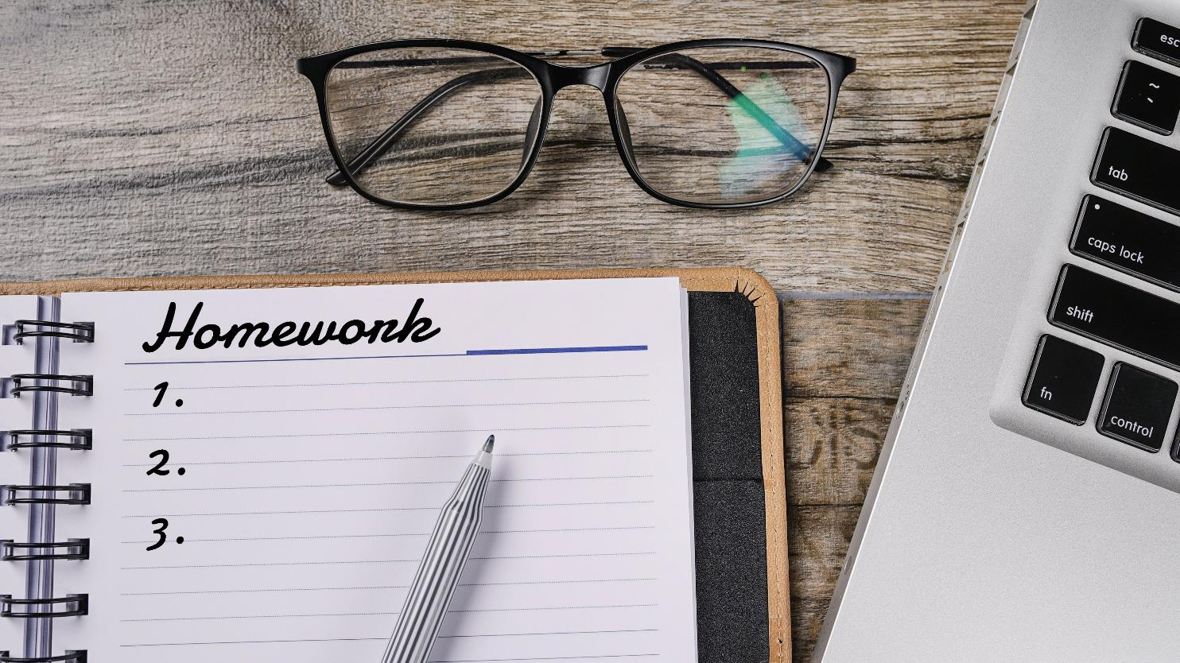

Slide 37
Homework
Make 10 sentences, using comparative and superlative adjectives.
Prepare the next lesson – Pronunciation, SB (page 22)

Slide 38
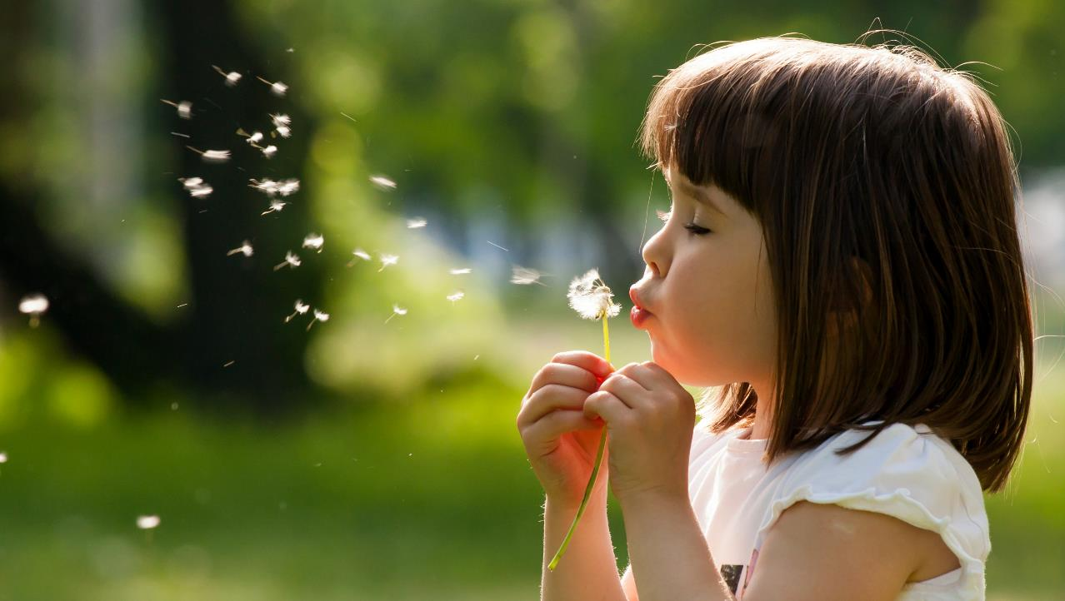
Enjoy your day!

