Slide 1
Trường THPT Số 2 Tuy Phước Giáo viên: Võ Thị Cẩm Hà Môn: Tiếng Anh, Lớp 12 Bài 2: Out into The World Bộ sách: Tiếng Anh 12 I- learn Smart World

Slide 2
WARM-UP
CROSSWORD
Work in groups.
Take turns to choose a word.
If you get the correct answer ➔ 1 point.
- If the answer is wrong or you don’t have the answer ➔ the chance is for other groups.
After 6 words you can answer the key word ➔ 5 points
If the key word is incorrect ➔ you are out of the game.

Slide 3
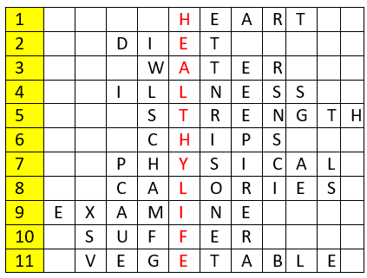
WARM-UP
KEY WORD: (11 letters)
A way of living that helps you enjoy more aspects of your life.

Slide 4
WARM-UP
Question 1
Eating too much fat can cause __________ diseases.

Slide 5
WARM-UP
Question 2
Go on a ______ means to begin a specific nutritional plan in an attempt to lose weight or achieve some other health benefits.

Slide 6
WARM-UP
Question 3
A clear liquid that has no color or taste when it is pure.

Slide 7
WARM-UP
Question 4
A disease or period of sickness affecting the body or mind.

Slide 8
WARM-UP
Question 5
The noun of ‘strong’

Slide 9
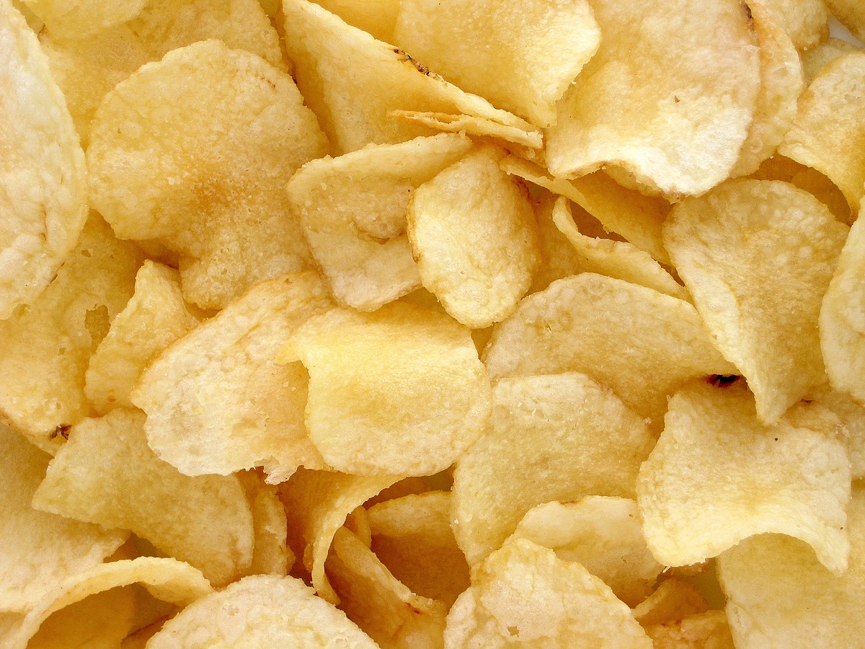
WARM-UP
Question 6
What is it?

Slide 10
WARM-UP
Question 7
The subject P.E stands for __________ Education.

Slide 11
WARM-UP
Question 8
Doing exercises can burn out many __________.

Slide 12
WARM-UP
Question 9
To look at or consider a person or thing carefully to discover something about them.

Slide 13
WARM-UP
Question 10
Do you _________ from any allergies?

Slide 14
WARM-UP
Question 11
Eating enough _____________ and fruits is good for your digestive system.

Slide 15
Unit 1: Health and Healthy Lifestyle
Lesson 1.1: Vocab & Reading
Pages: 4 & 5

Slide 16
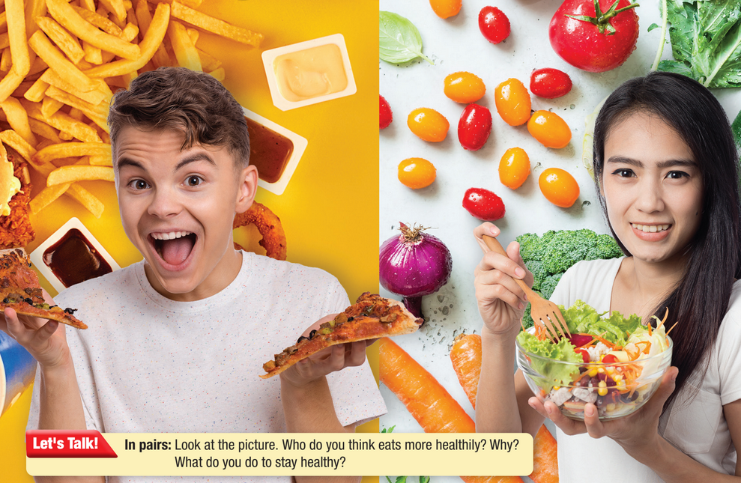

Slide 17
Work in pairs
1 What types of food are in the picture?
2 Who do you think eats more healthily? Why?
3 What do you do to stay healthy?

Slide 19
Vocabulary:
avoid (v) /əˈvɔɪd/ tránh
limit (v) /ˈlɪmɪt/ hạn chế, giới hạn
protein (n) /ˈproʊtiːn/ chất đạm
dairy (adj) /ˈderi/ làm từ sữa
processed (adj) /ˈprɑːsest/ đã qua chế biến
carbohydrates (n) /ˌkɑːrboʊˈhaɪdreɪt/ chất đường bột
Notes:
GV click vào từng cụm nghe âm thanh

Slide 20
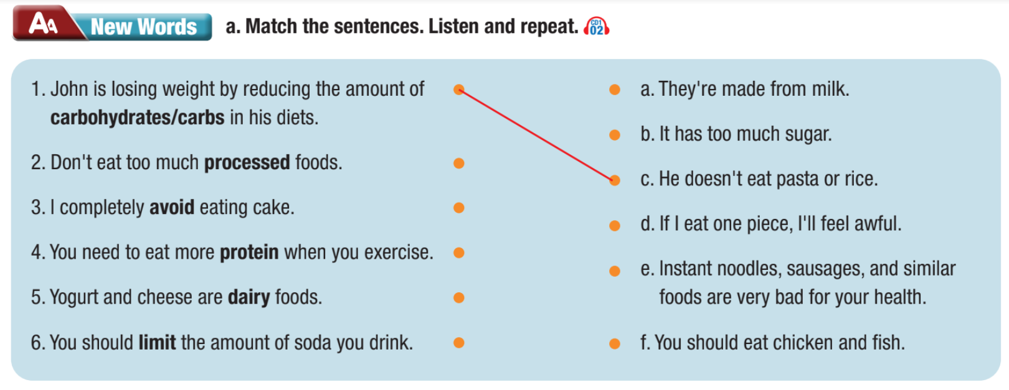

Slide 22
Work in pairs
b. Talk about which foods you limit or avoid eating. Why?

Slide 23
Reading

Slide 24
Pre - reading
Read the instruction quickly. Underline the key words.
What are we going to do?
Read and choose the best title.

Slide 25
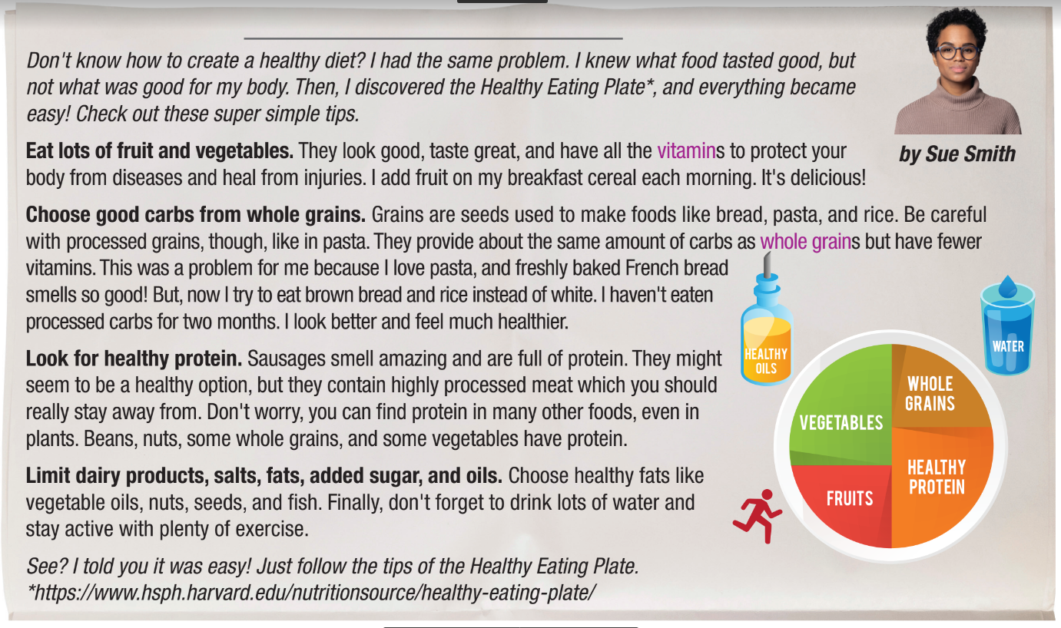
While - reading
Skim the text. Underline the key words. Choose the best title.
It’s Easy to Eat Healthy

Slide 26
Pre - reading
Read the instruction quickly. Underline the key words.
What are we going to do?
Read and circle the correct answers.

Slide 27
Pre - reading
Read the questions. Highlight the key words.
1. Which benefit of fruit and vegetables is NOT mentioned?
They heal injuries. b. They fight illnesses. c. They strengthen bones.
2. Which food has healthy carbs?
white rice b. pasta c. whole wheat bread
3. Which food has lots of protein?
beans b. most vegetables c. processed grains
4. What should you avoid?
a. fats b. highly processed meat c. sugar

Slide 28
Pre - reading
Read the questions. Highlight the key words.
1. Which benefit of fruit and vegetables is NOT mentioned?
They heal injuries. b. They fight illnesses. c. They strengthen bones.
2. Which food has healthy carbs?
white rice b. pasta c. whole wheat bread
3. Which food has lots of protein?
beans b. most vegetables c. processed grains
4. What should you avoid?
a. fats b. highly processed meat c. sugar

Slide 29
While - reading
Scan the text. Circle the answer.
1. Which benefit of fruit and vegetables is NOT mentioned?
They heal injuries. b. They fight illnesses. c. They strengthen bones.

Slide 30
While - reading
Scan the text. Circle the answer.
2. Which food has healthy carbs?
white rice b. pasta c. whole wheat bread

Slide 31
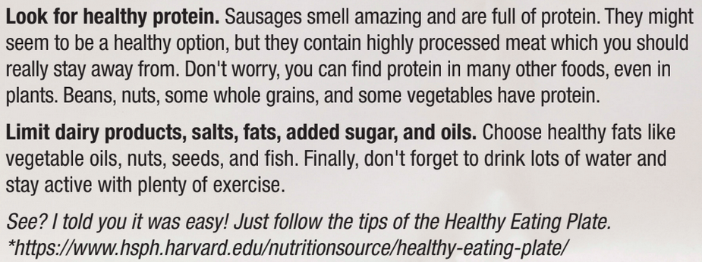
While - reading
Scan the text. Circle the answer.
3. Which food has lots of protein?
beans b. most vegetables c. processed grains

Slide 32
While - reading
Scan the text. Circle the answer.
4. What should you avoid?
a. fats b. highly processed meat c. sugar

Slide 33
Post - reading
Work in pairs
How does your diet compare to the Healthy Eating Plate? What foods do you need to eat more or less?
I need to drink less soda.
I need to eat more vegetables.

Slide 34
CONSOLIDATION

Slide 35
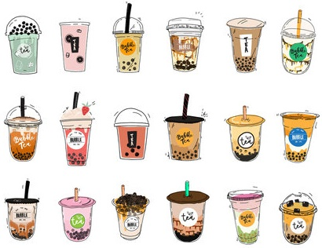
What foods do young people like to eat that are not good for your health?

Slide 36
WRAP-UP

Slide 37
Today’s lesson
Vocabularies
avoid
limit
protein
dairy
processed
carbohydrates

Slide 38
Today’s lesson
Reading:
- Understanding instructions.
Skimming and scanning for general and specific information.
Speaking:
- Talking about healthy diets.

Slide 39
Homework
Learn by hearts vocabularies and make sentences using them.
Do the exercises on pages 2 & 3 WB.
Prepare the next lesson (Grammar pages 6 & 7 SB)
Play the consolidation games on www.eduhome.com.vn

Slide 40
Lesson 3
Stay positive and have a nice day!

