Slide 2
GUESS THE LOCATIONS

Slide 3
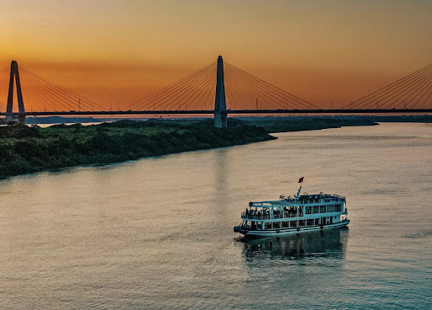
GUESS THE LOCATIONS
It is a river in the capital Hanoi.
It is a river with a total length of 1,149 km.
Its second name is Cai River.
Red River

Slide 4
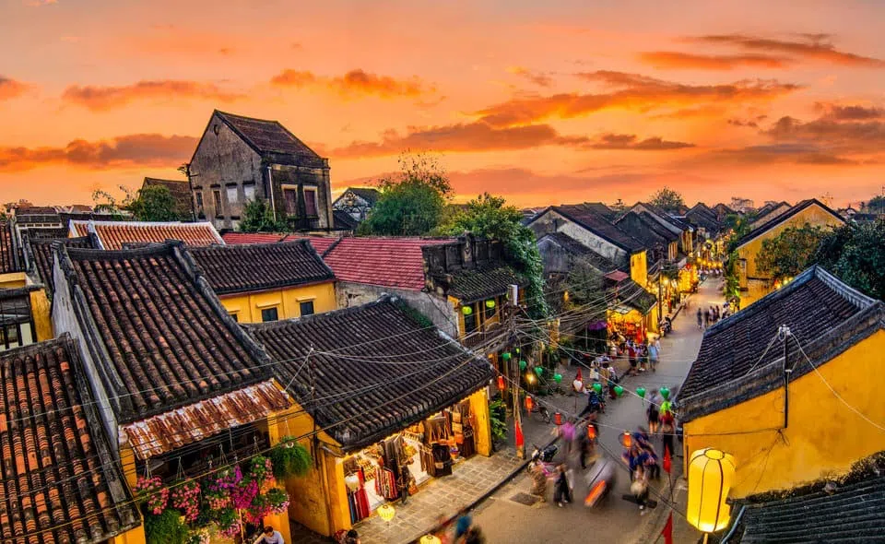
GUESS THE LOCATIONS
It is an old town in Quang Nam, about 30 km from Da Nang center
It is recognized by UNESCO as a world heritage site.
It has famous specialties such as noodles with fish sauce and Quang noodles.
Hoi An ancient town

Slide 5
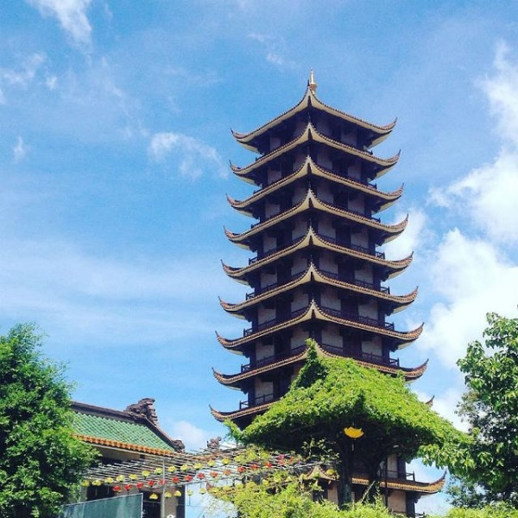
GUESS THE LOCATIONS
It is a famous pagoda in An Nhon town.
It is described as the Vietnamese version of "Phuong hoang co tran".
It attracts many tourists every year, especially during Tet.
Thien Hung Pagoda

Slide 6
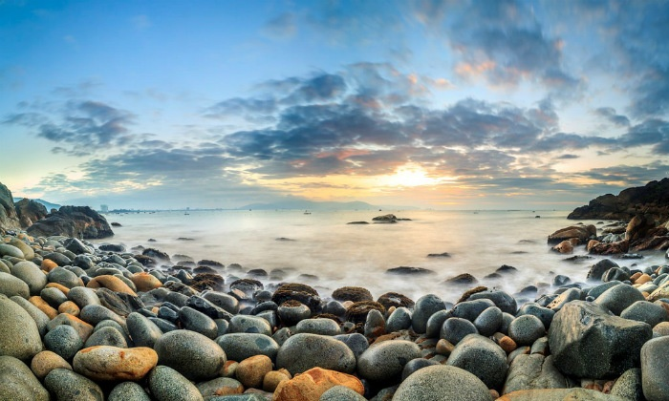
GUESS THE LOCATIONS
It is a tourist area in Quy Nhon city.
It has many stones like eggs.
It is located near the tomb of Han Mac Tu.
Ghenh Rang tourist area

Slide 7
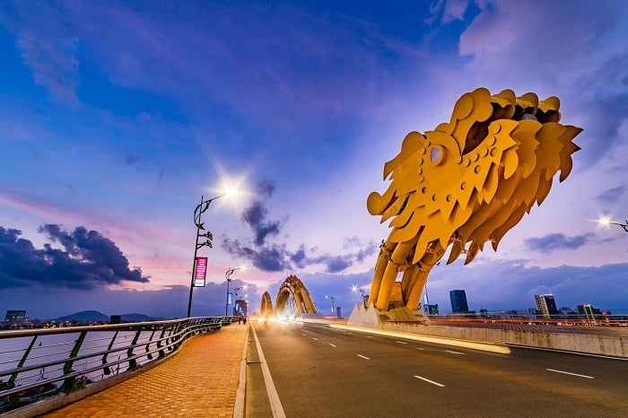
GUESS THE LOCATIONS
It is a bridge in Hai Chau district in Da Nang.
It is shaped like a dragon.
It breathes fire every Sunday and Saturday night.
Dragon Bridge

Slide 8
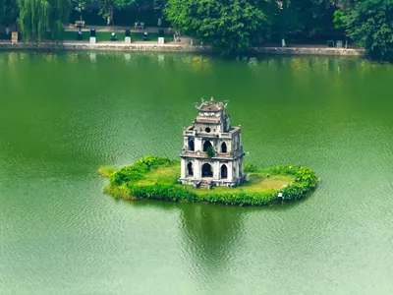
GUESS THE LOCATIONS
It is a natural freshwater lake located in Hoan Kiem district, Hanoi.
There is a three-storey turtle tower emerging in the middle of the lake.
It also has a number of other names such as Ta Vong lake and Luc Thuy lake.
Sword Lake

Slide 9
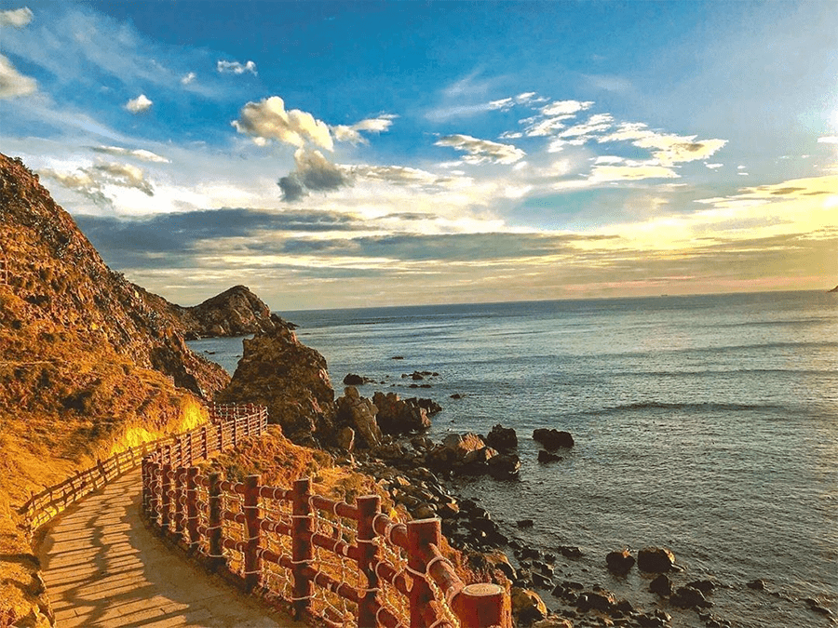
GUESS THE LOCATIONS
It is a beautiful tourist area in Quy Nhon city with a blue beach.
It is a strait in Nhon Ly commune.
It has a lot of wind.
Eo Gio tourist area

Slide 11
It’s time to
Travel with me

Slide 12
Unit 9: Travel and tourism
Lesson 1.1 Vocabulary & Reading

Slide 13
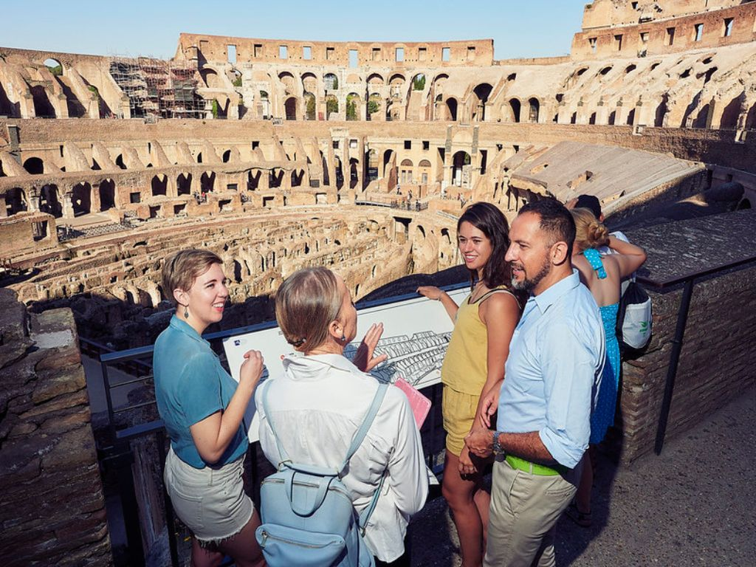
Match the words with the descriptions. Listen and repeat.
Sightseeing(n)
/ˈsaɪtsiːɪŋ/
a. a place that is said to be very important by UNESCO b. visiting interesting places, especially by people on vacation
c. a natural area that is protected by the government
d. a tall narrow building that can be part of another building or stand by itself
e. what you can see from a place
f. a large, strong building that is often built to protect people

Slide 14
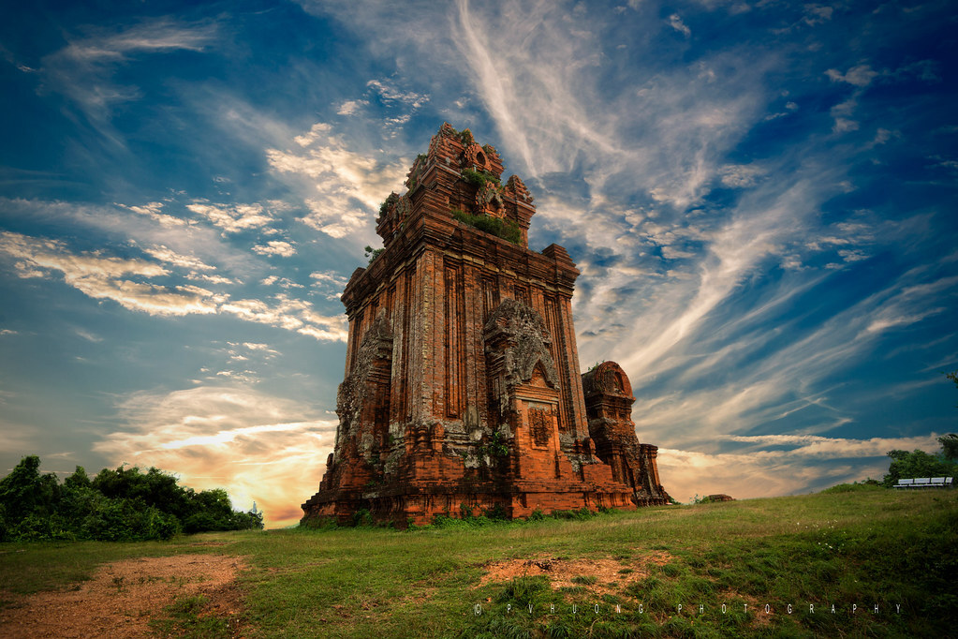
Match the words with the descriptions. Listen and repeat.
Tower (n)
/ˈtaʊər/
a. a place that is said to be very important by UNESCO b. visiting interesting places, especially by people on vacation
c. a natural area that is protected by the government
d. a tall narrow building that can be part of another building or stand by itself
e. what you can see from a place
f. a large, strong building that is often built to protect people

Slide 15
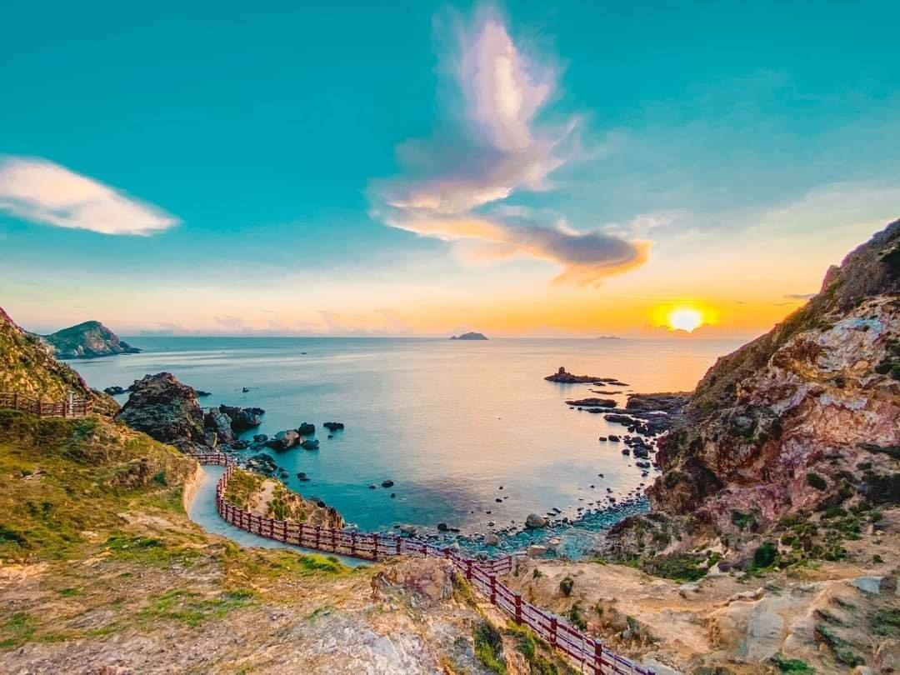
Match the words with the descriptions. Listen and repeat.
view (n)
/vjuː/
a. a place that is said to be very important by UNESCO b. visiting interesting places, especially by people on vacation
c. a natural area that is protected by the government
d. a tall narrow building that can be part of another building or stand by itself
e. what you can see from a place
f. a large, strong building that is often built to protect people

Slide 16
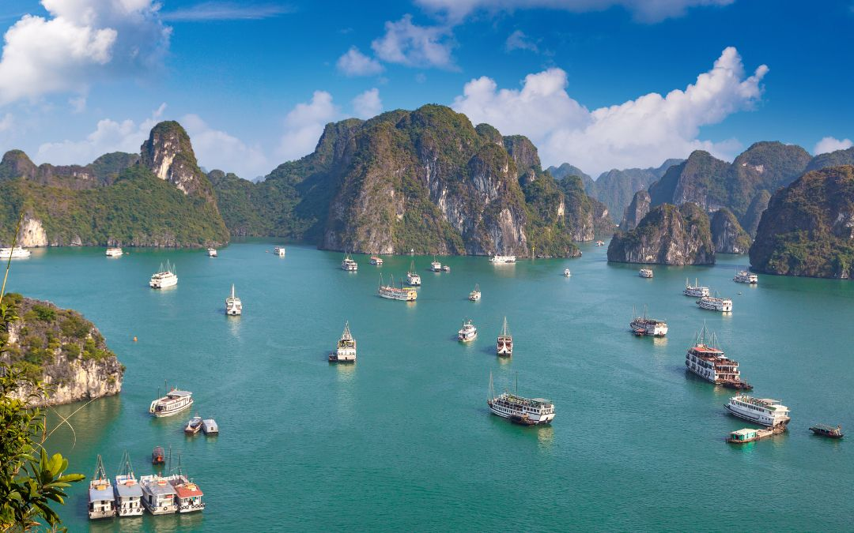
Match the words with the descriptions. Listen and repeat.
World Heritage site (n)
/ˌwɜːrld ˈherɪtɪdʒ saɪt/
a. a place that is said to be very important by UNESCO b. visiting interesting places, especially by people on vacation
c. a natural area that is protected by the government
d. a tall narrow building that can be part of another building or stand by itself
e. what you can see from a place
f. a large, strong building that is often built to protect people

Slide 17
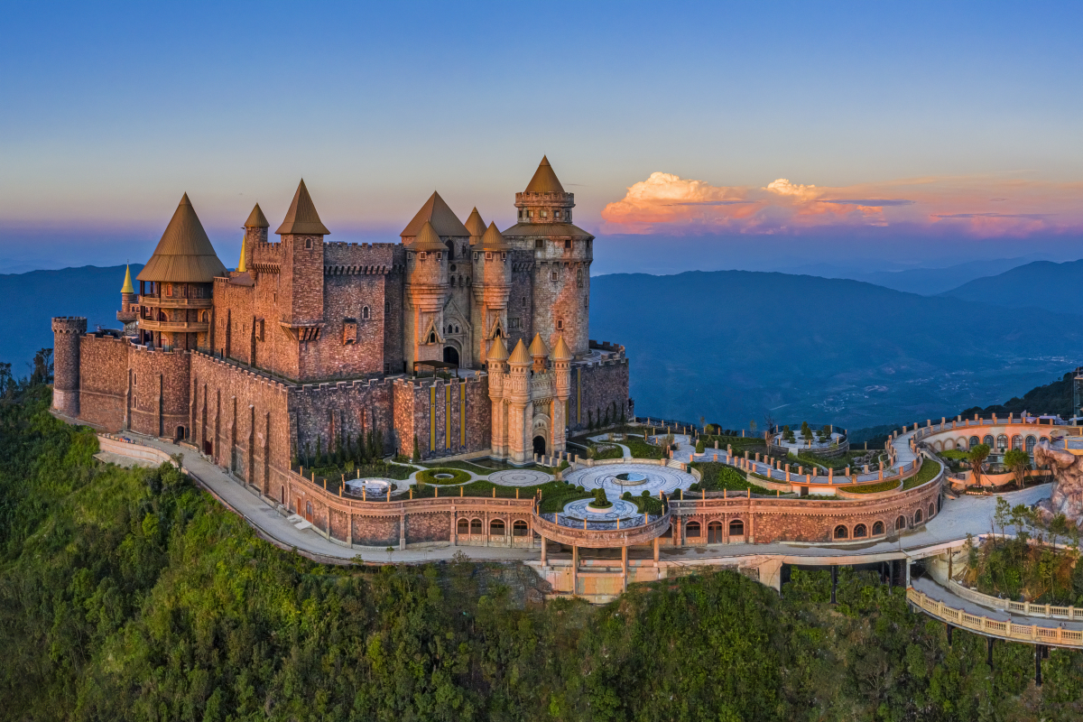
Match the words with the descriptions. Listen and repeat.
Castle (n)
/ˈkæsl/
a. a place that is said to be very important by UNESCO b. visiting interesting places, especially by people on vacation
c. a natural area that is protected by the government
d. a tall narrow building that can be part of another building or stand by itself
e. what you can see from a place
f. a large, strong building that is often built to protect people

Slide 18
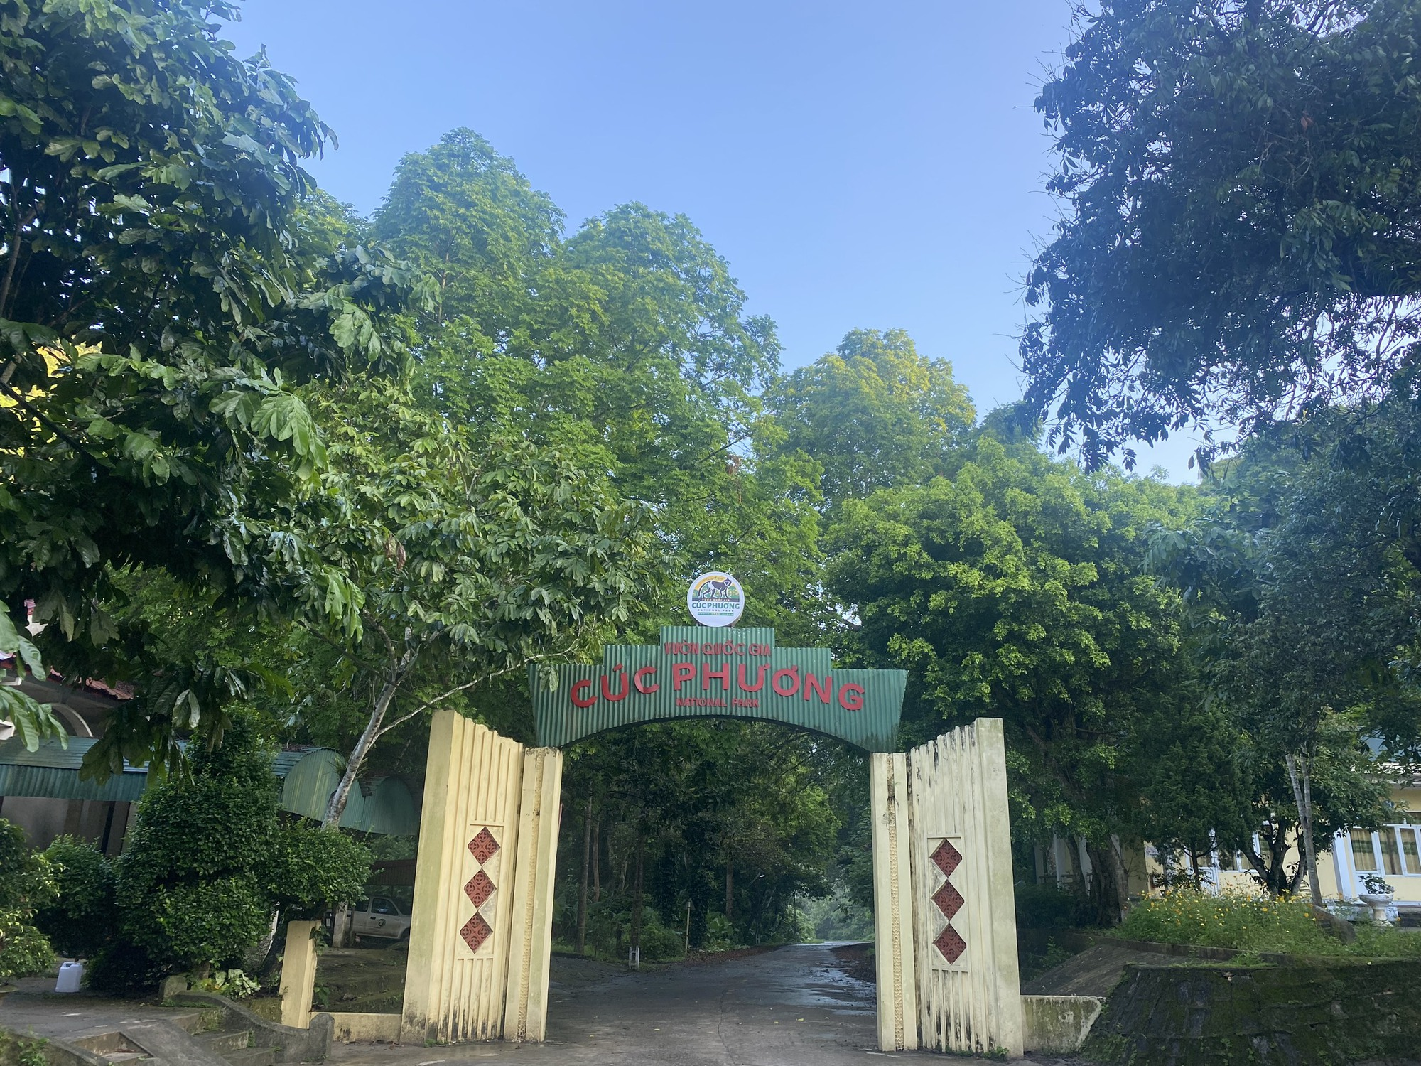
Match the words with the descriptions. Listen and repeat.
national park (n)
/ˈnæʃənl pɑːrk/
a. a place that is said to be very important by UNESCO b. visiting interesting places, especially by people on vacation
c. a natural area that is protected by the government
d. a tall narrow building that can be part of another building or stand by itself
e. what you can see from a place
f. a large, strong building that is often built to protect people

Slide 19
Listen and repeat
1. sightseeing (n) /ˈsaɪtsiːɪŋ/ việc tham quan
2. tower (n) /ˈtaʊər/ tòa tháp
3. view (n) /vjuː/ tầm nhìn, quang cảnh
4. World Heritage site (n) /ˌwɜːrld ˈherɪtɪdʒ saɪt/ di sản thế giới
5. castle (n) /ˈkæsl/ lâu đài
6. national park ( n) /ˈnæʃənl pɑːrk/ vườn quốc gia

Slide 20
b. In pairs: Use the new words to talk about places in your country.
Example:
I really enjoy sightseeing
I visited a beautiful national park

Slide 21
LET’S SHARE TOGETHER

Slide 22
VIET NAM
#Ha Long Bay
#Quy Nhon Beach
#Cuc Phuong
National Park

Slide 23
FRANCE
#The Eiffel Tower
#The Louvre museum
#The Loire river

Slide 24
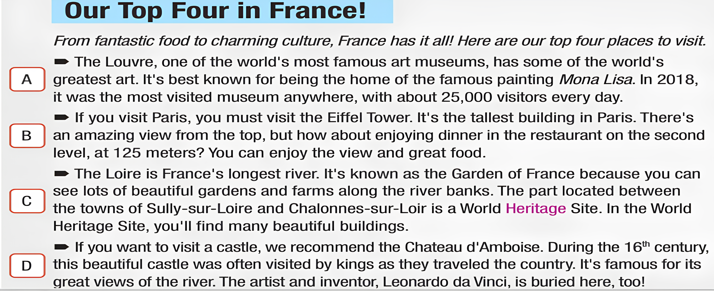
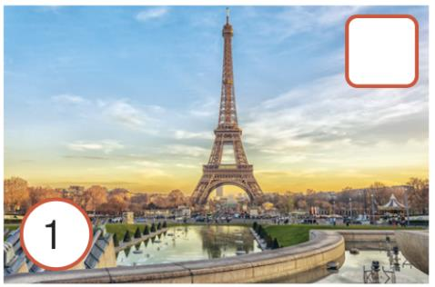
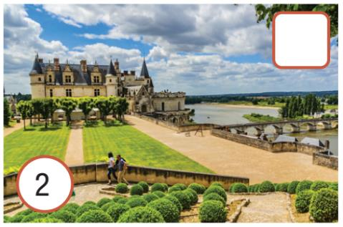
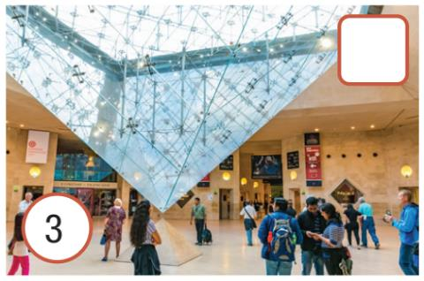
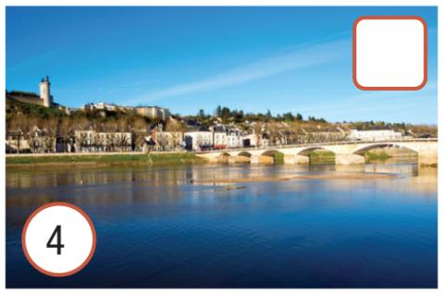
a. Read the article about visiting France. Match the paragraphs with the pictures.

Slide 25
a. Read the article about visiting France. Match the paragraphs with the pictures.
3
1
4
2

Slide 26
b. Now read and answer the questions.
1. When was the Louvre the world's most popular museum?
2. What can you do on the second level of the Eiffel Tower?
3. What can you see between the towns of Sully-sur Loire and Chalonnes-sur-Loire?
4. For what reasons is Chateau d'Amboise famous?

Slide 27
Secret gift box game

Slide 28
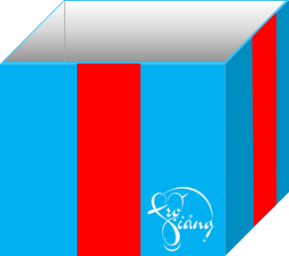
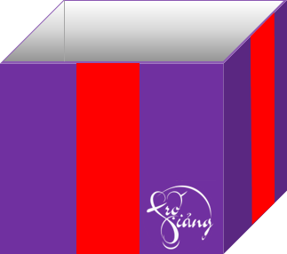

Slide 29
When was the Louvre the world's most popular museum?
in 2018
You get 3+ points
GO HOME

Slide 30
2. What can you do on the second level of the Eiffel Tower?
enjoy the view, eat dinner
You get 2+ points
GO HOME

Slide 31
Lucky gift box.
You get 4+ points.
GO HOME

Slide 32
3. What can you see between the towns of Sully-sur Loire and Chalonnes-sur-Loire?
many beautiful buildings
You get 2+ points.
GO HOME

Slide 33
4. For what reasons is Chateau d'Amboise famous?
great views of the river, Leonardo da Vinci is buried here
You get 3+ points.
GO HOME

Slide 34
Would you like to visit France ?

Slide 35
Contest: WHO’S THE BEST PRESENTER?
Which of the places in the article would you like to visit most?
Why?

Slide 36
QUALITY OF THE BEST PRESENTATOR
Grammar range and accuracy.
Pronunciation.
Lexical resource.
Fluency.
Eye contact.

Slide 37
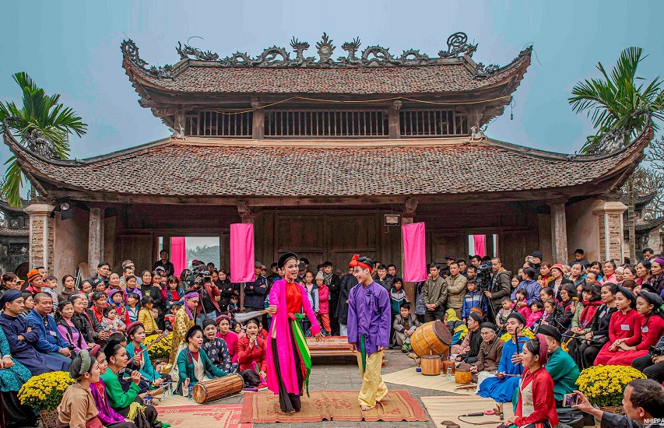
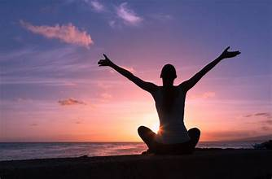
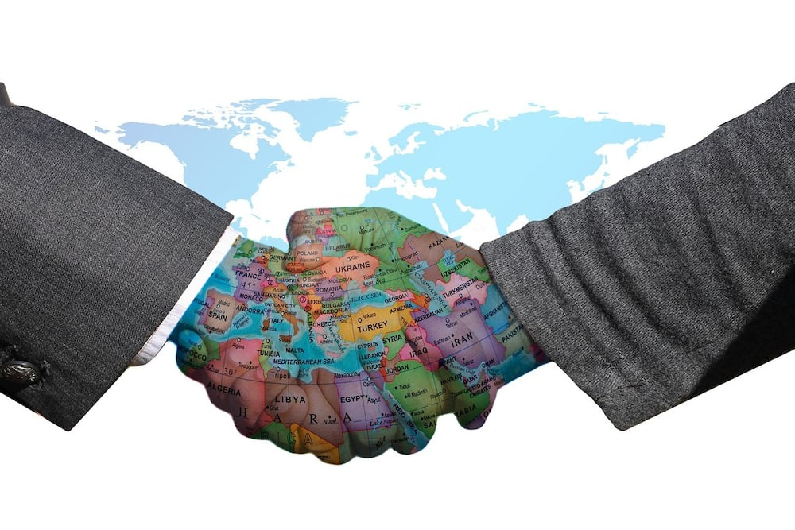
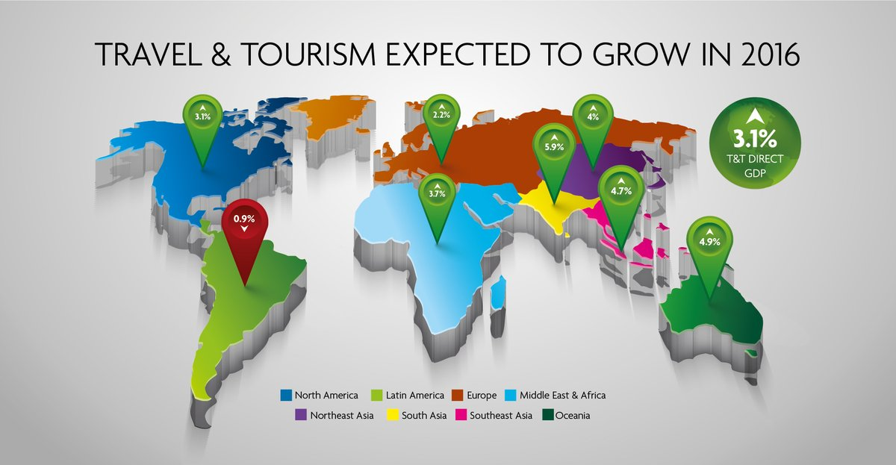
BENEFITS OF Travel
Allow us to experience new cultures,
meet different people.
Be a great way to relieve stress and take a break from our daily routines.
Strengthen international diplomacy and cooperation.
Promote the development of the economy.

Slide 38
homework
Write a paragraph to describe a place of interest in your local area.
Do the exercises in workbook on page 50.
Prepare the next lesson: Lesson 1.2 Grammar
Group 1;2 prepare a presentation on “How to use the article A/An in English”, and group 3,4 prepare a presentation on “How to use the article The in English” that you have learned.

Slide 39
Thanks for watching!

