Slide 1
WHAT IF….

Slide 2
1
2
3
4
5

Slide 3
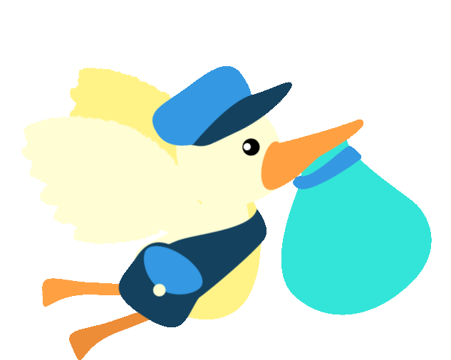
1. "If you were a bird, where would you fly?".

Slide 4
2
3
4
5

Slide 5
2. "If you could be any animal, what animal would you be?"

Slide 6
3
4
5

Slide 7
3. "If you had a time machine, where would you go?".

Slide 8
4
5

Slide 9
4. "If you lived on Mars, what would you do?"

Slide 10
5

Slide 11
5. "If you won a million dollars, what would you buy?"

Slide 12
1. "If you were a bird, where would you fly?".
2. "If you could be any animal, what animal would you be?"
3. "If you had a time machine, where would you go?".
4. "If you lived on Mars, what would you do?"
5. "If you won a million dollars, what would you buy?"

Slide 13
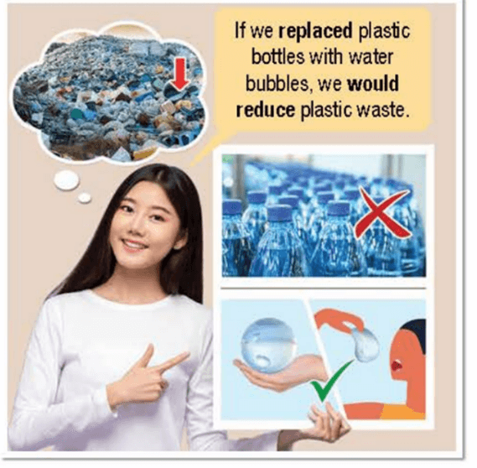
a. Listen and repeat

Slide 14
Meaning and Use:
We can use Second Conditional to talk about things that are not true now, and we don’t think will be true in the future. We sometimes use Second Conditional to talk about our hopes or dreams.
Example: “If I were a billionaire, I would donate money to environmental charities.”

Slide 15
V past simple
Would V- bare infinitive
Example: “If I were a billionaire, I would donate
money to environmental charities.”
If clause
Main clause
Form: If + S + V past simple, S + would/ could/ might + V – bare infinitive

Slide 16
Example:
If I were a billionaire, I would donate money to environmental charities.
I would donate money to environmental charities if I were a billionaire

Slide 17
b. Write sentences using prompts
What/happen/if/trees/disappear?
What would happen if trees disappeared?
2. If/bees/disappear/we/not have/enough food.
3. We have more water/if/we/have/a machine/could/create/rain.
4. If/l/be/billionaire/use/money/clean oceans.
5. We/not need/to farm/if/we/get/meals/in pills.

Slide 18
b. Write sentences using prompts
What/happen/if/trees/disappear?
What would happen if trees disappeared?
2. If/bees/disappear/we/not have/enough food.
3. We have more water/if/we/have/a machine/could/create/rain.
4. If/l/be/billionaire/use/money/clean oceans.
5. We/not need/to farm/if/we/get/meals/in pills.
=> If bees disappeared, we wouldn’t have enough food.
=> We would have more water if we had a machine that could create rain.
=> If I were a billionaire, I would use my money to clean oceans.
=> We wouldn’t need to farm if we got our meals in pills.

Slide 19
c. Write sentences using the First Conditional or Second Conditional. Write two sentences for each situation.
1. Plastic food packaging causes plastic pollution. Food packaging can't be eaten.
If-clause first: If food packaging could be eaten, we would reduce plastic pollution.
If-clause last: We would reduce plastic pollution if food packaging could be eaten.
2. We can't compost plastic. Plastic ends up in landfills and oceans.
If-clause first: _________________________________________________________________
If-clause last: __________________________________________________________________
3. We use lots of energy and water to grow food. Scientists can't make food in their labs yet.
If-clause first: __________________________________________________________________
If-clause last: ___________________________________________________________________
4. We use lots of plastic. There's lots of trash.
If-clause first: ___________________________________________________________________
If-clause last: ____________________________________________________________________

Slide 20
c. Write sentences using the First Conditional or Second Conditional. Write two sentences for each situation.
2. We can't compost plastic. Plastic ends up in landfills and oceans.
If-clause first: ___________________________________________
If-clause last: ___________________________________________
If we could compost plastic, it wouldn’t end up in landfills and oceans.
Plastic wouldn’t end up in landfills and oceans if we could compost plastic.

Slide 21
c. Write sentences using the First Conditional or Second Conditional. Write two sentences for each situation.
3. We use lots of energy and water to grow food. Scientists can't make food in their labs yet.
If-clause first: _____________________________________________________
_____________________________________________________
If-clause last: __________________________________________________________________________________________________________
If scientists could make food in their labs, we wouldn’t use lots of energy and water to grow food.
We wouldn’t use lots of energy and water to grow food if scientists could make food in their labs.

Slide 22
c. Write sentences using the First Conditional or Second Conditional. Write two sentences for each situation.
4. We use lots of plastic. There's lots of trash.
If-clause first: ___________________________________________
If-clause last:
_________________________________________
If we use less plastic, there will be less trash.
There will be less trash if we use less plastic.

Slide 23
d. In pairs: Say what you would do to help the environment if you were your town's mayor.

Slide 24
Find and correct the mistakes.
1. Loren won’t be lost now if he bought a city map before starting his trip.
2. If Sam talks about her problems to a close friend, she would feel much better right now.
3. If he speak English fluently, he would apply for the international company now.
4. If I are you right now, I would go to the party with Jean tonight.
5. I will feel delighted now if I went out with you this morning.
won't be lost → wouldn't be lost
talks → talked
speak → spoken
are → were
will feel → would feel

Slide 25
Prepare the next lesson: Lesson 2.3 – Pronunciation & Speaking (page 69).
Do exercise: Write five sentences about your dreams using the Second conditional.

Slide 26
Rewrite the sentences using “if”.
1. My boss doesn’t let me take a rest. I feel exhausted now.
2. I’m not going to buy this car for you because it wastes too much money.
3. The weather is not good today. We can’t go out for a walk.
4. They don’t tell her the truth. She is very upset now.
5. I don’t know Ronald’s address so I can’t send him the party invitation

