Slide 1
Name environmental problems
Time: 2 minutes
Each team takes turns writing down Noun phrases related to “environmental problems”.
The team with more correct answers will be the winner.

Slide 2
Air pollution
Deforestation
Noise pollution
Global warming
Soil pollution
Climate change
Water pollution
Ice melting

Slide 3
Let's talk

Slide 4
Let's talk
What environmental problems can you see?
Do you have these problems where you live?
What other problems are there in your hometown?
drought
flood
water pollution

Slide 5
Listening
a. Listen to a lecture about climate change.
What is discussed in the lecture?
The causes and effects of climate change
The causes of and solutions to climate change

Slide 6
Listening
b. Listen and answer the questions.
1. How much has the global temperature increased since 1880?
→
2. When did the Little Ice Age begin?
→
3. What will happen in the future?
a. cold winters
b. deadly storms and floods
4. Which human activity is the main cause of climate change?
→
5. What helps reduce CO2 and flooding?
→

Slide 7
Listening
1. How much has the global temperature increased since 1880?
by about one degree Celsius
2. When did the Little Ice Age begin?
in the fourteenth century

Slide 8
Listening
3. What will happen in the future?
a. cold winters
b. deadly storms and floods
4. Which human activity is the main cause of climate change?
burning fuel

Slide 9
Listening
5. What helps reduce CO2 and flooding?
forests

Slide 10
Reading
a. Read and choose the best title for Jane's essay.
1. How plastic harms fish
2. Why we should stop using single-use plastic
Our oceans are an important source of food, but now there is a serious threat from something we use every day: plastic.
Plastic pollution is a big problem because it affects animals that live in the sea, and it can make humans sick, too. Plastic can break up into tiny pieces called microplastics. These microplastics stay in the stomachs of fish and sea animals, and it stops them from eating real food. Plastic in clothes and water bottles also releases microplastics that we breathe in, eat, and drink. This can make us very sick.
One solution is to ban single-use plastic. We use too many plastic shopping bags, so supermarkets should stop giving them away for free. Cafés and restaurants should use paper straws instead of plastic ones.
It is important to ban single-use plastic because it cannot be recycled and ends up in the oceans. Plastic pollution is a world problem that affects all life on our planet. We should stop using single-use plastics before the problem becomes even worse.

Slide 11
TIPS
Phrases or words that appear many times
The opening and closing sentences of each paragraph

Slide 12
a. Read and choose the best title for Jane's essay.
1. How plastic harms fish
2. Why we should stop using single-use plastic
Our oceans are an important source of food, but now there is a serious threat from something we use every day: plastic.
Plastic pollution is a big problem because it affects animals that live in the sea, and it can make humans sick, too. Plastic can break up into tiny pieces called microplastics. These microplastics stay in the stomachs of fish and sea animals, and it stops them from eating real food. Plastic in clothes and water bottles also releases microplastics that we breathe in, eat, and drink. This can make us very sick.
One solution is to ban single-use plastic. We use too many plastic shopping bags, so supermarkets should stop giving them away for free. Cafés and restaurants should use paper straws instead of plastic ones.
It is important to ban single-use plastic because it cannot be recycled and ends up in the oceans. Plastic pollution is a world problem that affects all life on our planet. We should stop using single-use plastics before the problem becomes even worse.

Slide 13
ONE
Reading
b. Read and complete the notes. Write word only for each blank.
Problem: plastic pollution
Solution: (3) _______ single-use plastic
Terrible effects on wildlife and humans:
breaks up and releases (1) _____
(2) ______ and sea animals eat plastic and die
could make people sick
no plastic bags and (4) ________
Single-use plastic can't be (5) ______

Slide 14
Save the ocean

Slide 15
There is too much trash in the sea.
Please help me put trash in the right place by answering the questions correctly.

Slide 16
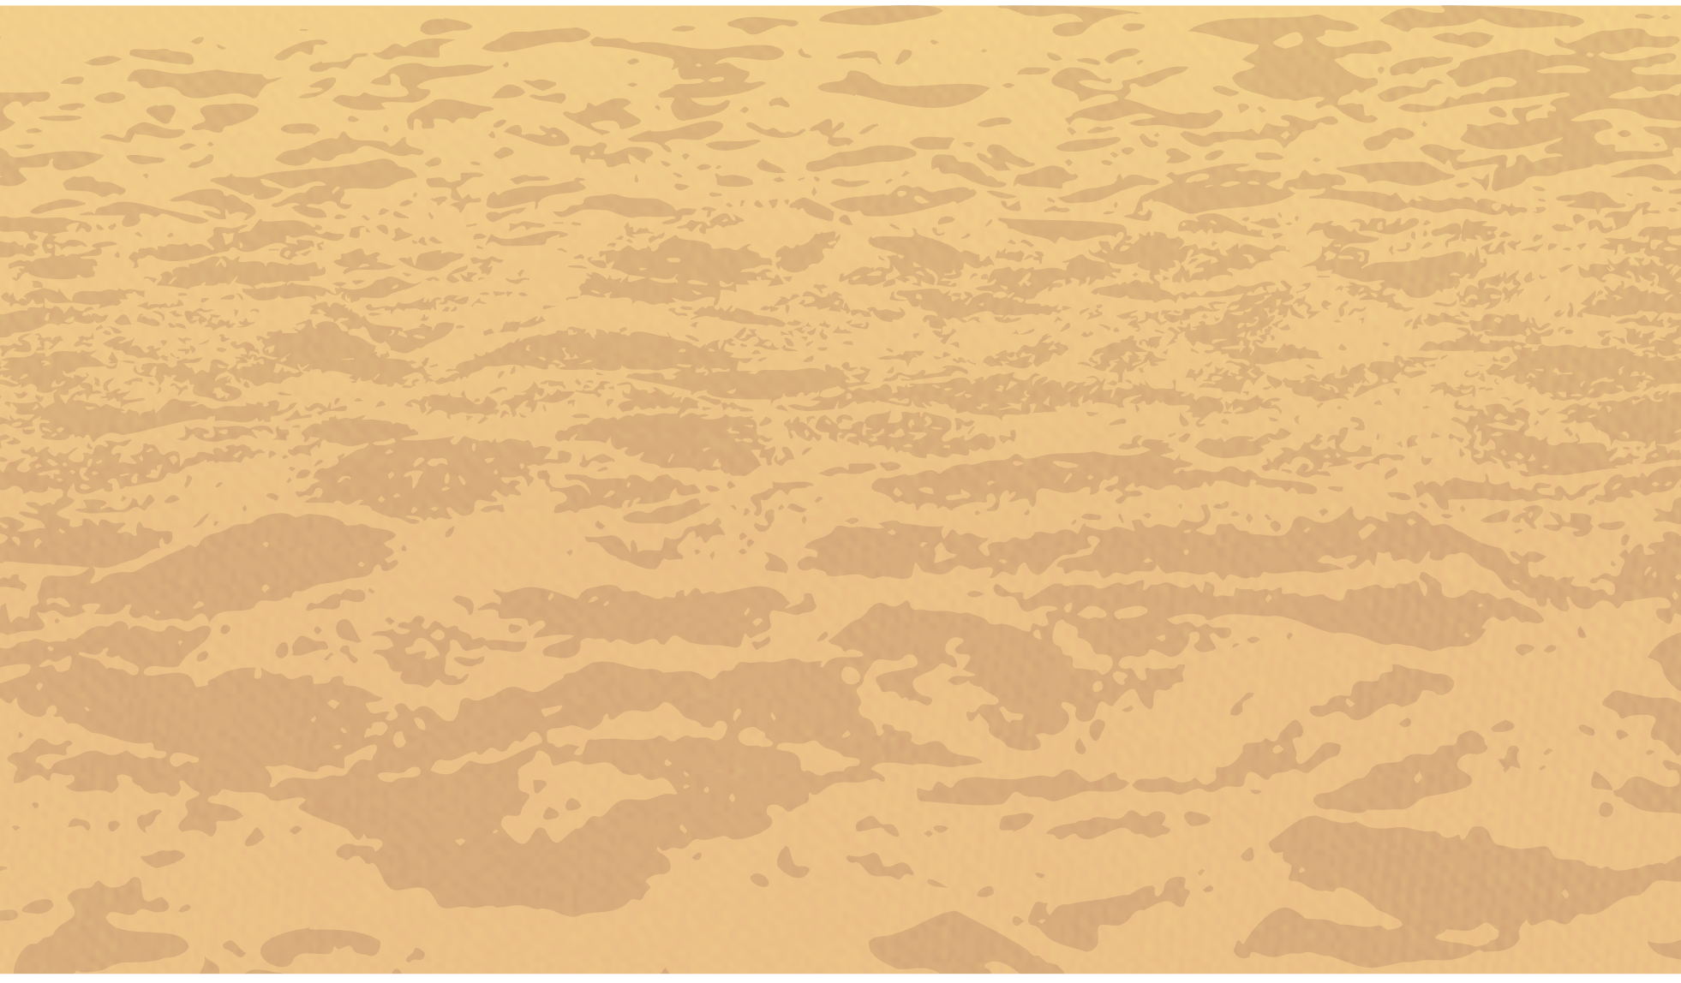
Problem: plastic pollution
Terrible effects on wildlife and humans:
breaks up and release (1) ________________
microplastics
Plastic can break up into tiny pieces called microplastics.

Slide 17
(2) _______________ and sea animals eat plastic and die.
Fish
These microplastics stay in the stomachs of fish and sea animals, and it stops them from eating real food.

Slide 18
Solution: (3) ________ single-use plastic
ban
One solution is to ban single-use plastic.

Slide 19
No plastic bags and (4) _________
straws
Cafés and restaurants should use paper straws instead of plastic ones.

Slide 20
Single-use plastic can’t be (5)__________
recycled
It is important to ban single-use plastic because it cannot be recycled and ends up in the oceans.

Slide 21
Reading
b. Read and complete the notes. Write ONE word only for each blank.
ban
Problem: plastic pollution
Solution: (3) _______ single-use plastic
Terrible effects on wildlife and humans:
breaks up and releases (1) _______
(2) ______ and sea animals eat plastic and die
could make people sick
no plastic bags and (4) ________
microplastics
straws
Fish
Single-use plastic can't be (5) ______
recycled

Slide 24
c. In groups:
Which idea is better: stop giving away plastic bags or use paper straws? Why?

Slide 25
reason
stop giving away plastic bags/
use paper straws
reason
reason
reason
reason

Slide 26
A. Water pollution is a serious environmental problem because it affects not only human lives but also the natural habitats of animals and plants.
B. In conclusion, water pollution is harmful to the health of people as well as the natural environment. In order to solve this issue, action should be taken by both people and the government.
C. One effective solution to deal with this issue is to reduce the amount of waste in water. People should not pour fat or oil from cooking directly into the sink. They should have a jar or a bottle to collect this waste. We should also only use washing machines or dishwashers when they are full to save water and cleaning liquid. The government can help by checking and evaluating the wastewater treatment system of factories and farms. Waste and chemicals should be removed before water runs into the environment and causes damage.
D. Water pollution includes the pollution in lakes, rivers, oceans, or underground water. Pollutants from households, factories, and farms are the three main causes of water pollution. This is because these places are usually located quite near the water sources. Wastewater from homes runs into lakes or rivers. The polluted water in lakes affects the underground water, which turns into drinking water later. Wastewater from industry and farming also harms the environment if their wastewater treatment system is not sufficient. Water from lakes and rivers carries the pollutants to oceans, and this kills sea animals and plants.
A. A-D-B-C
D. C-D-B-A
B. A-D-C-B
C. C-D-A-B

Slide 27
A. Water pollution is a serious environmental problem because it affects not only human lives but also the natural habitats of animals and plants.
B. Water pollution includes the pollution in lakes, rivers, oceans, or underground water. Pollutants from households, factories, and farms are the three main causes of water pollution. This is because these places are usually located quite near the water sources. Wastewater from homes runs into lakes or rivers. The polluted water in lakes affects the underground water, which turns into drinking water later. Wastewater from industry and farming also harms the environment if their wastewater treatment system is not sufficient. Water from lakes and rivers carries the pollutants to oceans, and this kills sea animals and plants.
C. One effective solution to deal with this issue is to reduce the amount of waste in water. People should not pour fat or oil from cooking directly into the sink. They should have a jar or a bottle to collect this waste. We should also only use washing machines or dishwashers when they are full to save water and cleaning liquid. The government can help by checking and evaluating the wastewater treatment system of factories and farms. Waste and chemicals should be removed before water runs into the environment and causes damage.
D. In conclusion, water pollution is harmful to the health of people as well as the natural environment. In order to solve this issue, action should be taken by both people and the government.

Slide 28
1. What does water pollution affect?
A. Only human lives B. Only animals and plants
C. Both humans and the natural environment D. The air we breathe
2. What kinds of water sources are polluted?
A. Only lakes and rivers B. Only oceans
C. Swimming pools D. Lakes, rivers, oceans, and underground water
3. What can the government do to help the environment?
A. Ignore wastewater treatment
B. Check wastewater treatment systems
C. Allow factories to dump waste
D. Encourage people to use more water

Slide 29
HOMEWORK
Prepare the next lesson: Lesson 3.2 – Writing (page 71).
Complete the vocabulary exercise in Tiếng Anh 10 i-Learn Smart World Notebook (page 48).

