Slide 1



Slide 2


Slide 3
UNIT 8: ECOLOGY AND THE ENVIRONMENT
Lesson 2.2 – Grammar
Page 68

Slide 4
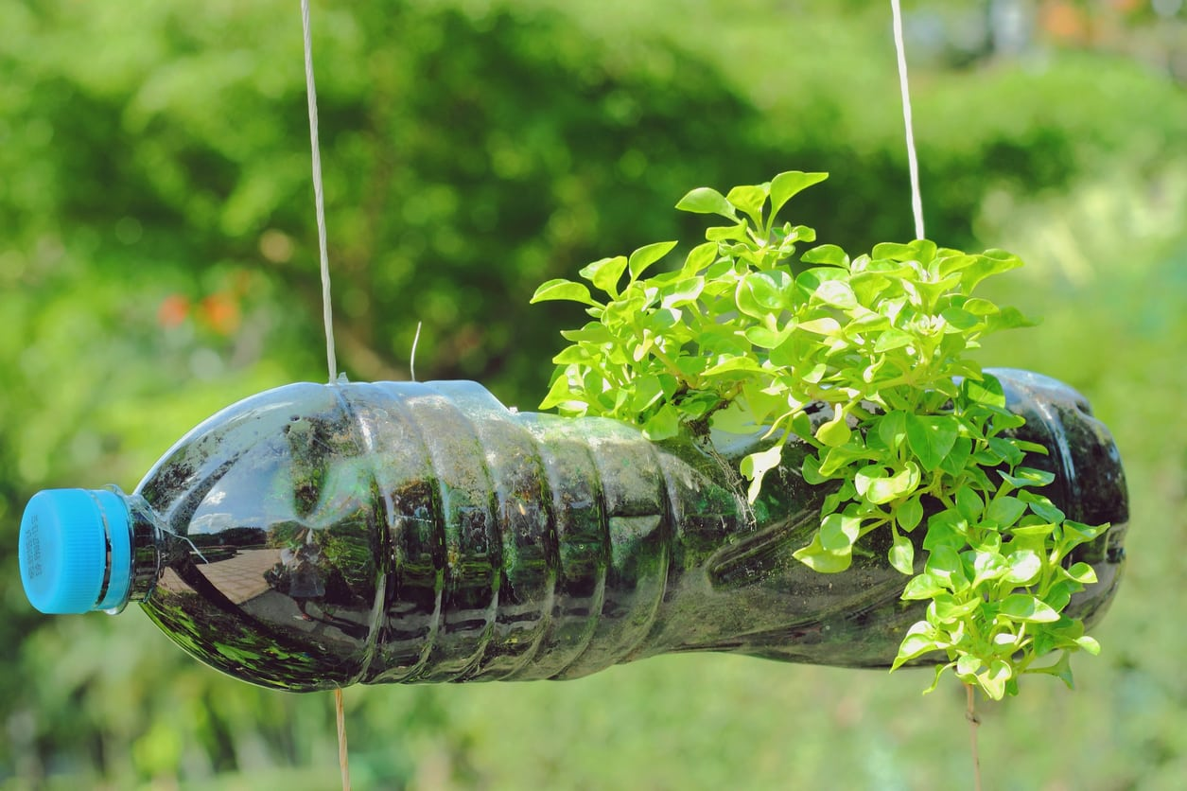
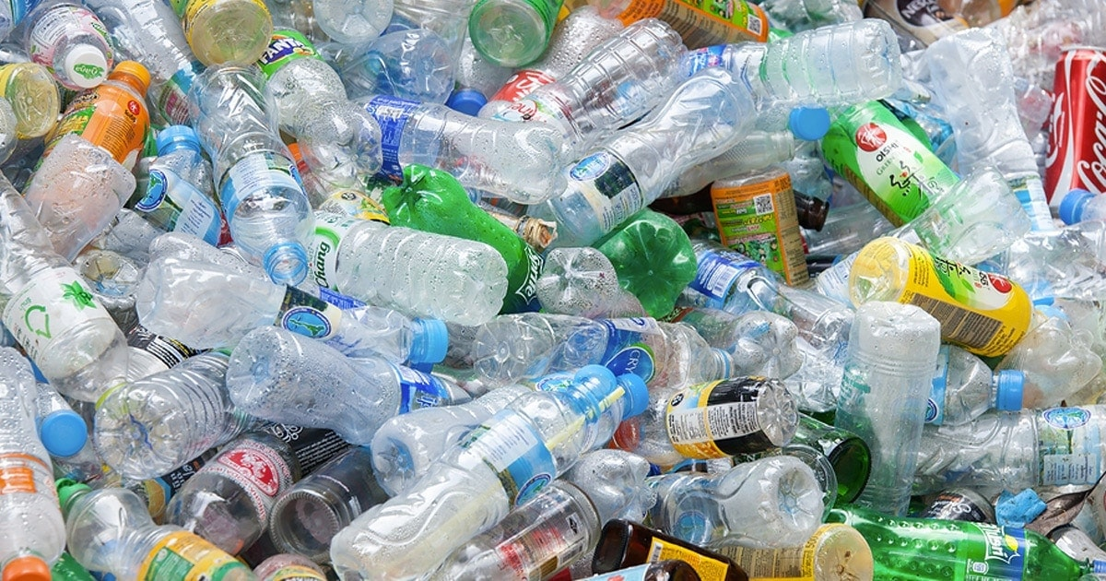
First Conditional
If we reuse water bottle,
thing can be real now
there will be less trash.
future result will be real

Slide 5
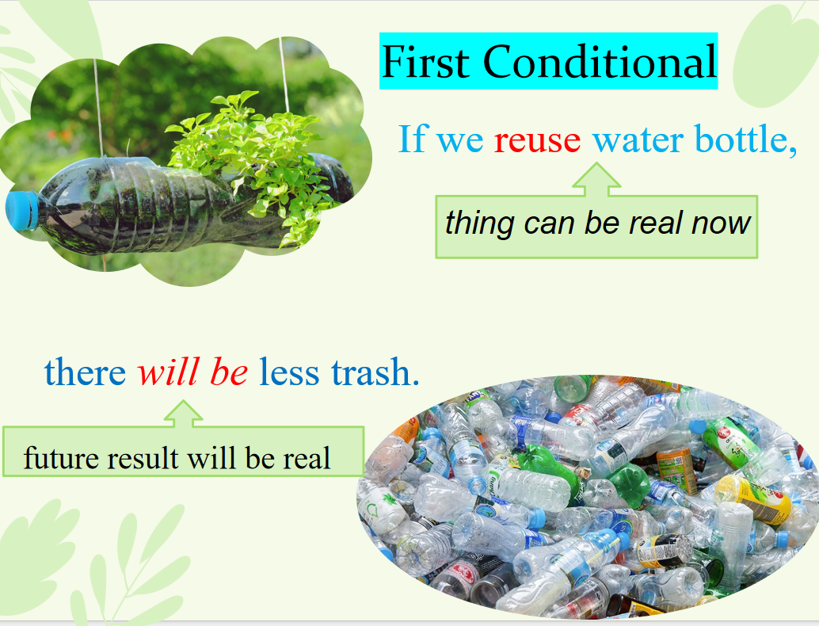

Slide 6
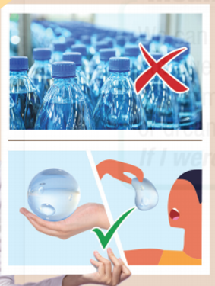
Second Conditional
If we replaced plastic bottles with water bubbles,
thing is not true now
we would reduce plastic waste.
future result will be not true

Slide 7
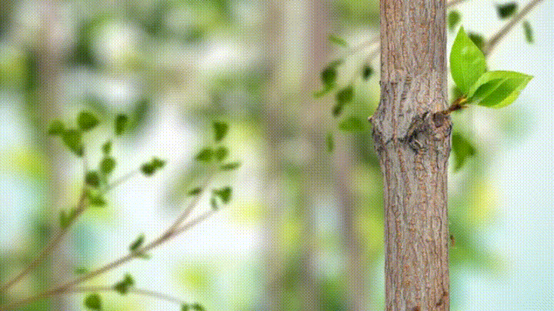
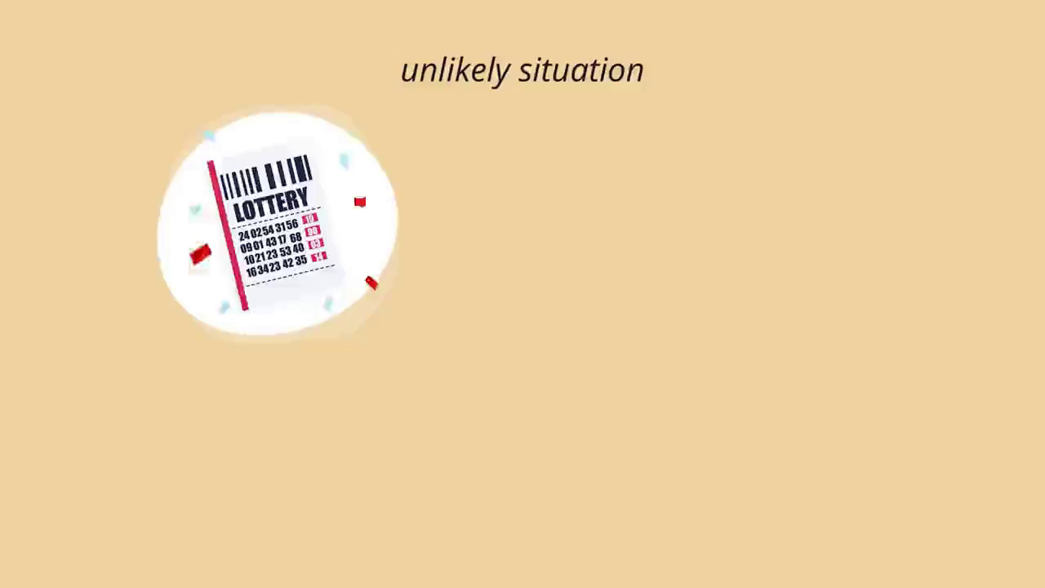

Slide 8
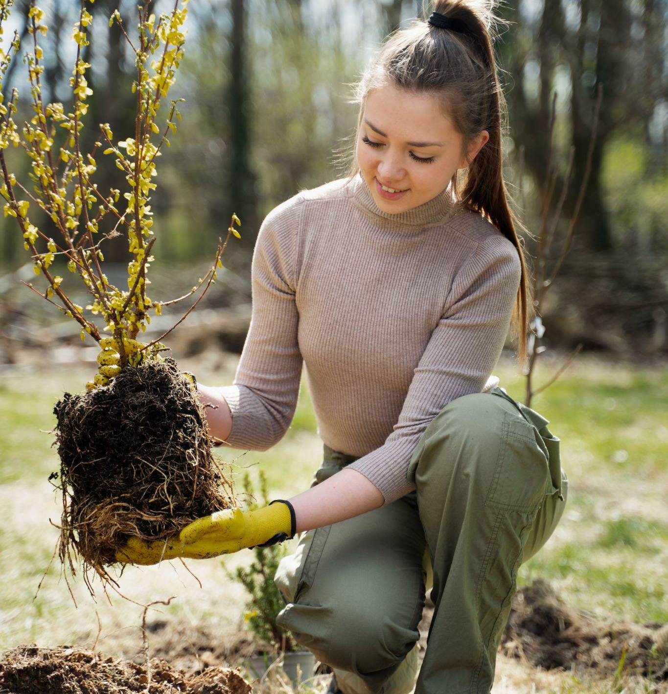
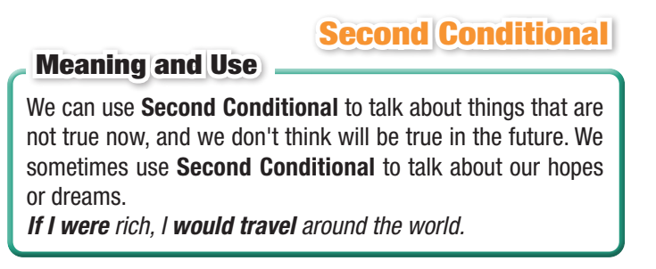

Slide 9


Slide 10
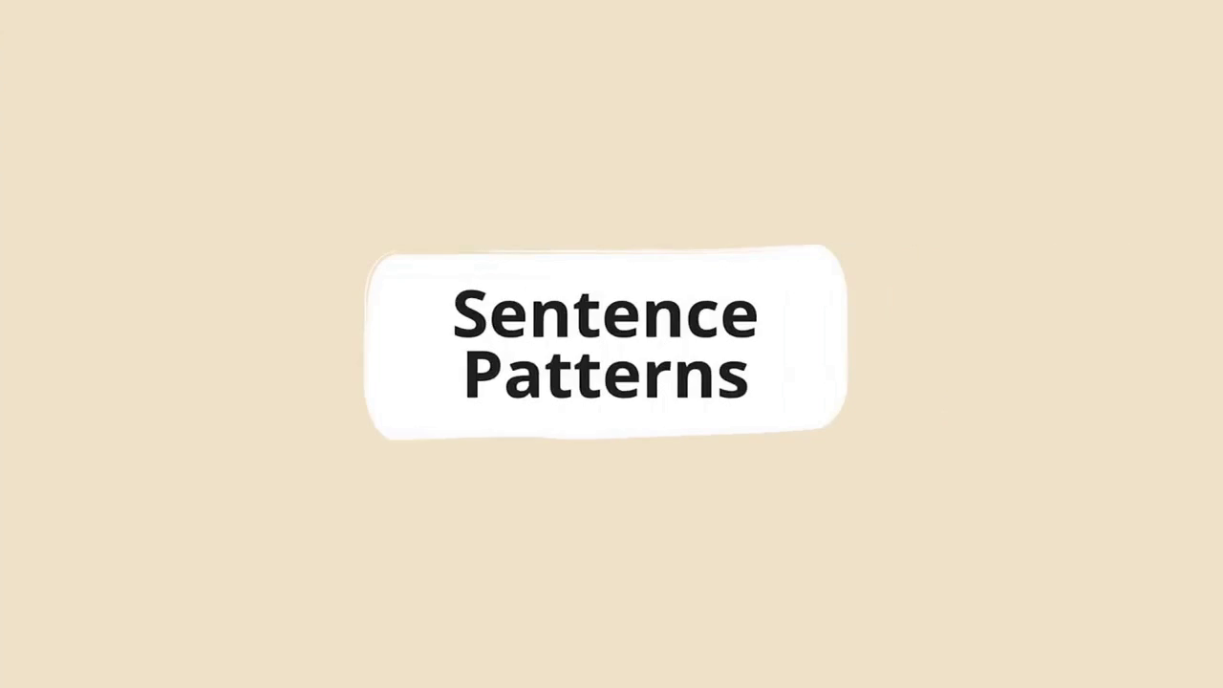

Slide 11
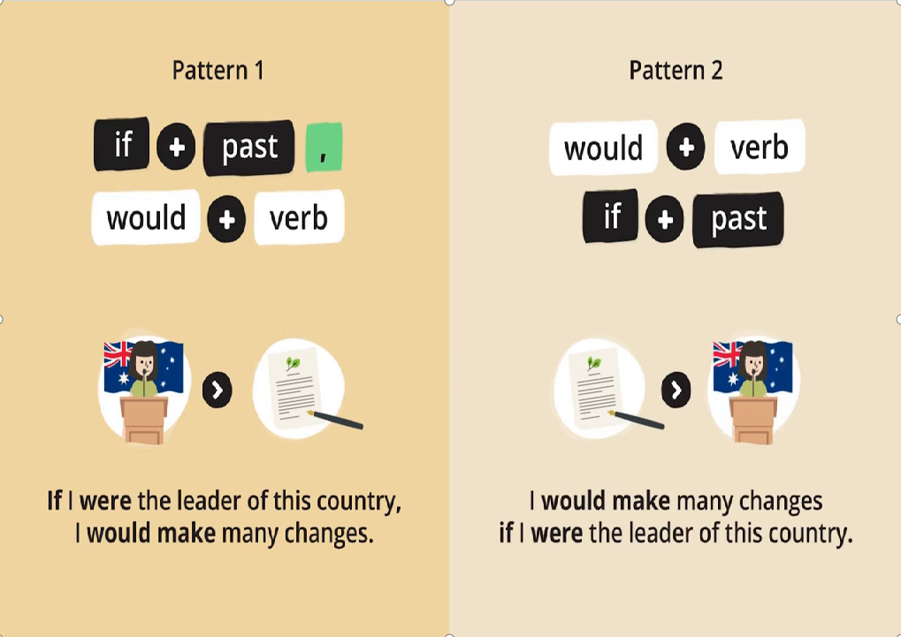

Slide 12
b. Write the sentences using the prompts
What/ happen/if/trees/disappear?
What would happen if trees disappeared?
2. If/bees/disappear/we/not have/ enough food.
3. We/have more water/if/we/have/a machine/ could/create/rain.
4. If/I/be/millionaire/I/use/money/clean oceans.
5. We/not need/ to farm/if/ we/ get/meals/in pills

Slide 13
b. Write the sentences using the prompts
What/ happen/if/trees/disappear?
What would happen if trees disappeared?
2. If/bees/disappear/we/not have/ enough food.
3. We/have more water/if/we/have/a machine/could/create/rain.
4. If/I/be/millionaire/I/use/money/clean oceans.
5. We/not need/ to farm/if/ we/ get/meals/in pills
If bees disappeared, we wouldn’t have enough food.
We would have more water if we had a machine that could create rain
If I were a billionaire, I would use money to clean oceans.
We wouldn’t need to farm if we got our meals in pills.

Slide 14
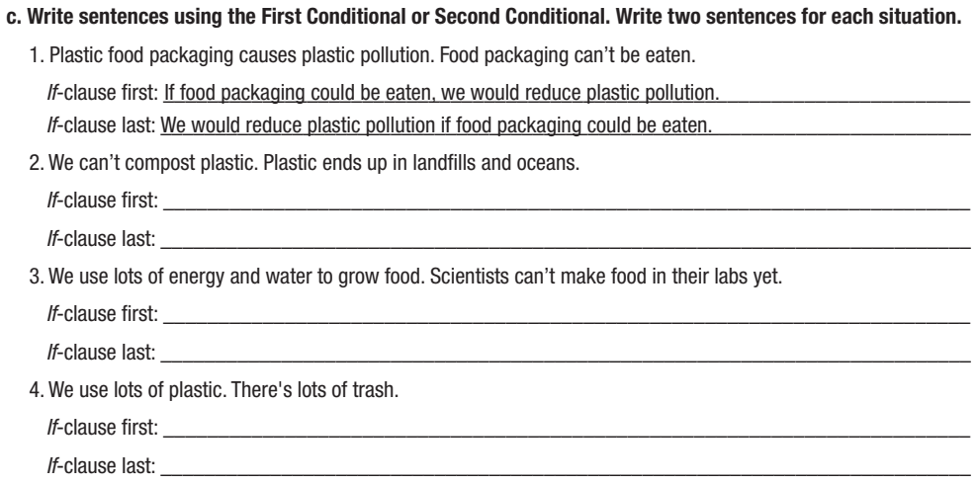

Slide 15
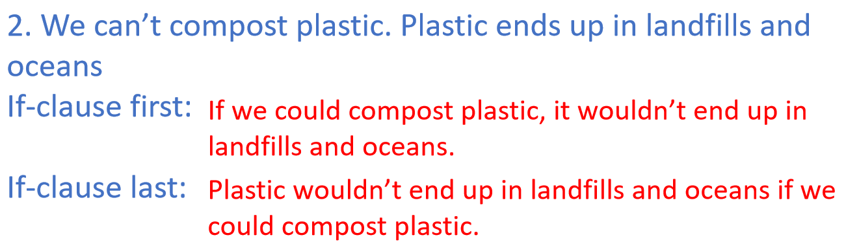
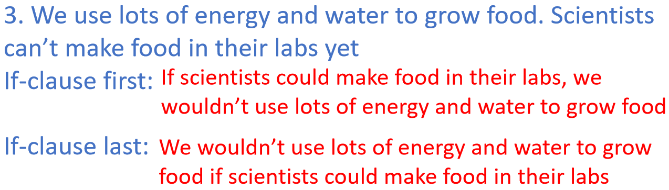
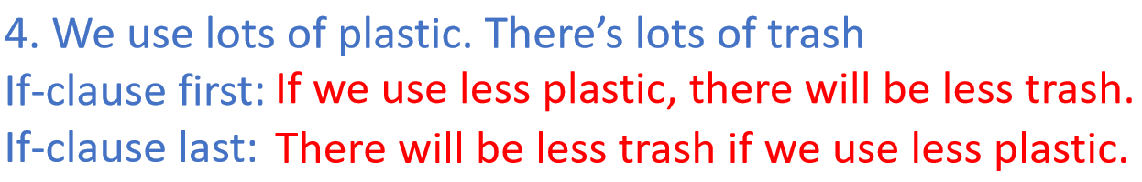

Slide 16
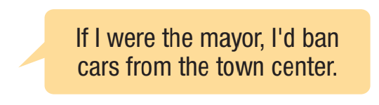
Let’s imagine!
Who were you?
What would you do to help the environment?

Slide 17
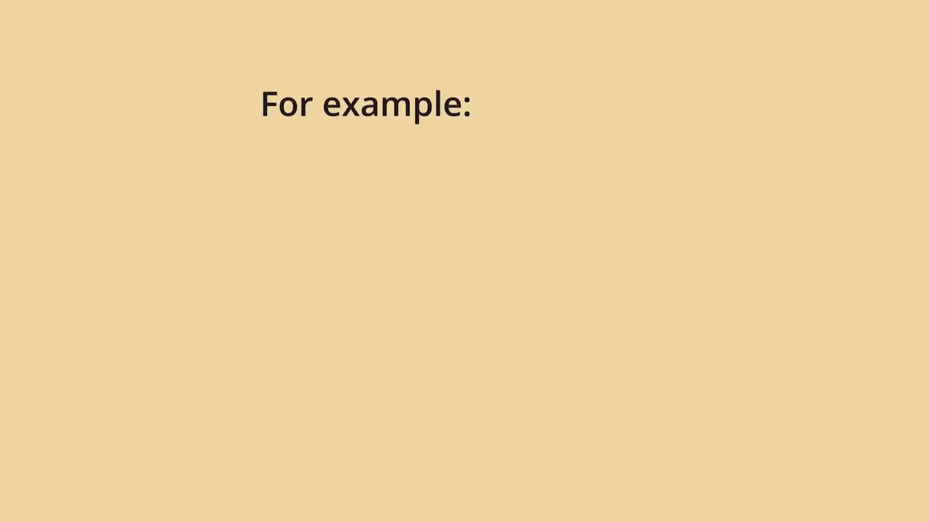

Slide 18
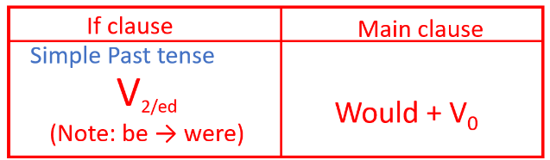
Wrap-up
Today’s lesson
The Second Conditional Sentence
Form:
Meaning and use: The Second Conditional Sentence is used to talk about things that are not true now and we don’t think will be true in the future, sometimes it is also used to express hopes or dreams

Slide 19
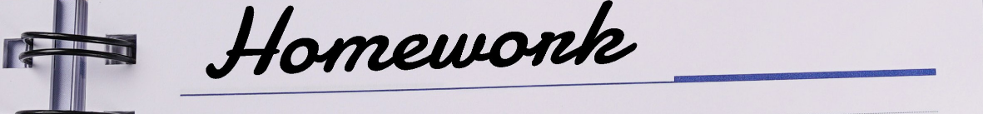
-Complete the grammar notes in Tiếng Anh 10 i-Learn Smart World Notebook on page 47
-Do the Writing exercises in workbook on page 47.
-Prepare the next lesson - Lesson 2.3 – Pronunciation & Speaking (page 69).
-Play the consolidation games in Tiếng Anh 10 i-Learn Smart World DHA App on www.eduhome.com.vn

Slide 20
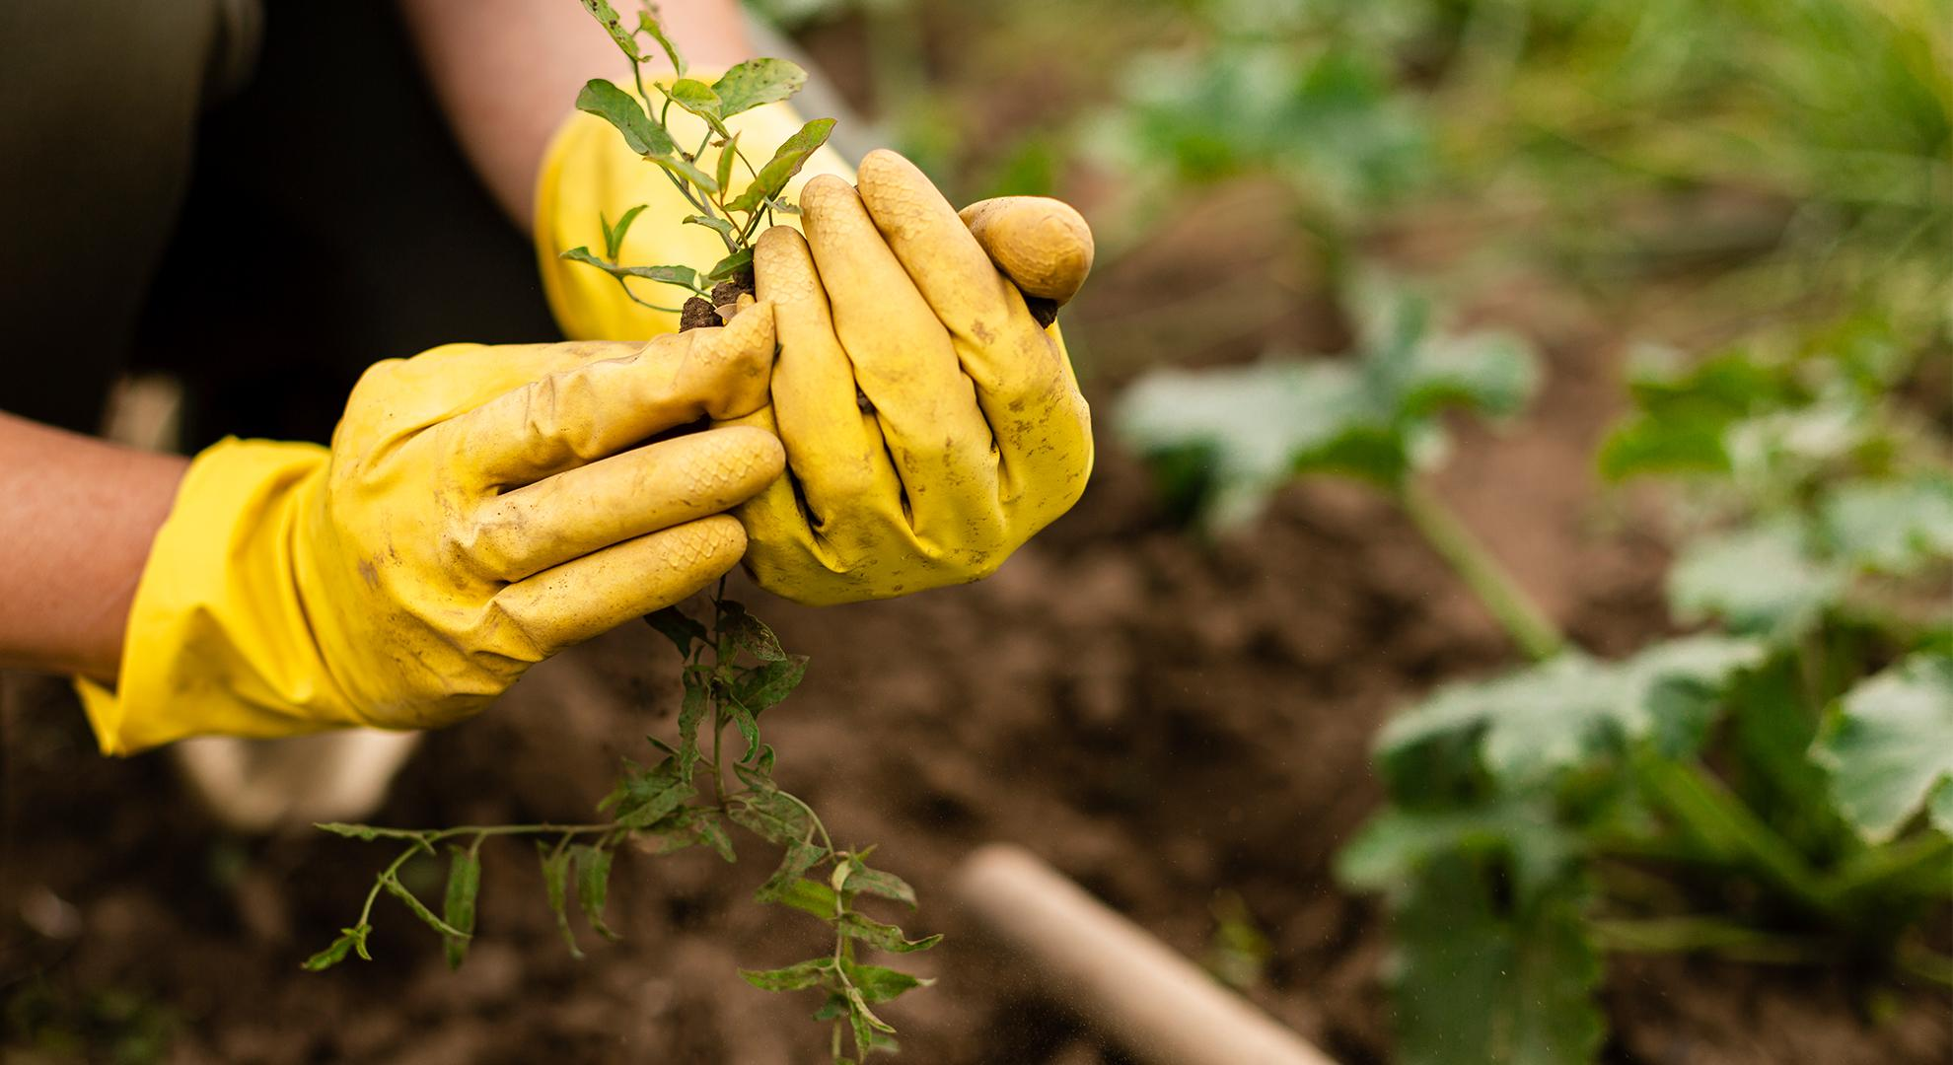
THANK YOU FOR JOINING OUR CLASS

