Slide 1
GOOD MORNING
11B1

Slide 2
MUSIC TIME
- Listen to the song.
- Complete the lyrics

Slide 3
PAYPHONE
I’m at a payphone trying home
All of my change I spent on you
Where have the times gone?
Baby, it’s all wrong
Where are the plans we made for two?
Yeah, I, I know it’s hard
The people we used to be
It’s even harder
That you’re not here next to me
You say it’s too late it
But is it too late ?
And in our time that you wasted
All of our bridges burned downt
I’ve wasted my nights
You turned out the lights
Now I’m paralyzed
Still stuck in that time, when we called it love
But even the sun sets in paradise
I’m at a payphone, trying home
All of my change I spent on you
Where have the times gone?
Baby, it’s all wrong
Where are the plans we made for two?

Slide 4
PAYPHONE
I’m at a payphone trying to call home
All of my change I spent on you
Where have the times gone?
Baby, it’s all wrong
Where are the plans we made for two?
Yeah, I, I know it’s hard to remember
The people we used to be
It’s even harder to picture
That you’re not here next to me
You say it’s too late to make it
But is it too late to try?
And in our time that you wasted
All of our bridges burned down
I’ve wasted my nights
You turned out the lights
Now I’m paralyzed
Still stuck in that time, when we called it love
But even the sun sets in paradise
I’m at a payphone, trying to call home
All of my change I spent on you
Where have the times gone?
Baby, it’s all wrong
Where are the plans we made for two?

Slide 5
It’s hard to remember
ADJ
TO-INFINITIVE

Slide 6
UNIT 8
INDEPENDENT LIFE
Lesson 2.2 - Grammar
To-infinitive clauses
after adjectives

Slide 7
OPINION ADJECTIVE
?
easy, difficult, important, useful, convenient,...

Slide 8
Grammar meaning and use
Task a. Look at the picture. What do you think the girl is saying?

Slide 9
Grammar meaning and use
Task b. Listen and check.
It’s easy to cook.

Slide 10
Grammar meaning and use
Task c. Listen and repeat.
It’s easy to cook.

Slide 11
Grammar form
It’s important to learn how to drive
It’s not easy for teens to choose a career
TALKING ABOUT TEENS

Slide 12
Grammar form
show whom the adjectives refer to in the action
FOR + OBJECT
noun, pronoun, name

Slide 13
PRACTICE

Slide 14
Task a. Correct the mistakes in the sentences
1. It's useful knew how to drive.
2. It isn't easy to learning new recipes.
3. It's difficult for teenagers to found part-time jobs.
4. Is it convenient for you to drove to university?
5. It's important not to relying on other people too much.
to know
learn
find
drive
rely

Slide 15
Task b. Write sentences and questions using the prompts

Slide 16
MINI ACTIVITY: SAVE THE CRAB
PASS THE CRAB TO YOUR FRIEND
THE BOMB EXPLODES
GIVE ANSWER

Slide 17
MINI ACTIVITY: SAVE THE CRAB

Slide 18
Task b. Write sentences and questions using the prompts
1. It's easy to cook spaghetti.
2. It isn't/It's not good to rely on other people.
3. Is it important for teenagers to get part-time jobs?
4. It isn't/It's not easy for young people to choose a career.
5. Is it useful for high school students to know how to ride a bicycle?

Slide 19
Task c. In pairs: Ask and answer using the prompts in the table.
easy/learn a language? | useful/teenagers/own a bicycle? | healthy/eat out every day? | convenient/go university/bus?
difficult |  | unhealthy

Slide 20
Sample conversation
1
2
Practice
A: Is it easy to learn a language?
B: No, it isn’t. It’s difficult.
A: Why?
B: It’s not easy to remember the new words.
useful/teenagers/own a bicycle?
healthy/eat out every day?
convenient/go university/bus?

Slide 21
Wrap-up
To-infinitive clauses after adjectives
Mini task: Make sentences using To-infinitive clauses about some essential skills to live independently.
*Suggestions: You can use these adjectives: good, useful, important, easy, difficult,...

Slide 24
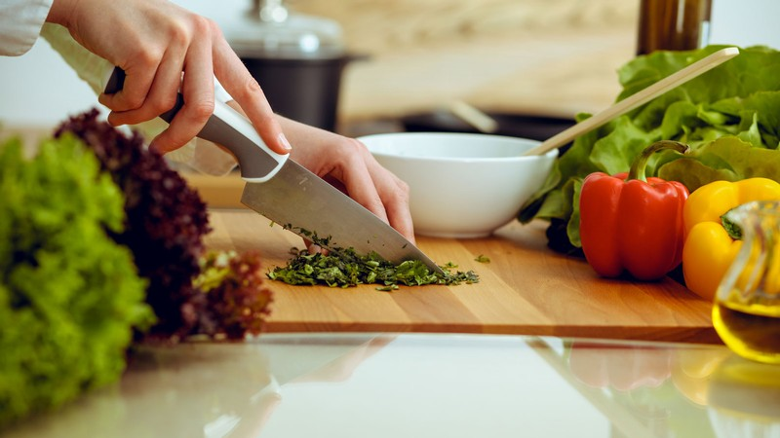

Slide 27
THANK YOU

