Slide 1
Welcome to class 11C3

Slide 2
Unit 6: World Heritages
Lesson 2.3: Pronun. & Speaking

Slide 3
Choose the word whose main stress is placed
differently from the others.
Work in pairs:
A. unused B. clever C. amazed D. unique
2. A. responsible B. intelligent C. historical D. fashionable
3. A. carry B. surround C. expand D. declare
/ˈklevər/
/əˈmeɪzd/
/ju:ˈniːk /
/ʌnˈjuːzd /
/rɪˈspɑːnsəbl/
/ɪnˈtelɪdʒənt/
/ˈfæʃənəbəl/
/hɪˈstɔːrɪkl/
/ˈkæri/
/səˈraʊnd/
/ɪkˈspænd/
/dɪˈkler/

Slide 4
Work in pairs.
Choose the word whose underlined part is
pronounced differently from that of the other words.
A. protein B. column C. shoulder D. photo
2. A. sunset B. curfew C. jungle D. study
3. A. invest B. pretend C. impress D. preserve
/ˈkɑːləm/
/ˈʃoʊldə/
/ˈfoʊtoʊ/
/ˈproʊtiːn /
/ˈsʌnset /
/ˈkɜːrfjuː/
/ˈstʌdi/
/ˈdʒʌŋɡl/
/ɪnˈvest /
/prɪˈtend/
/ ɪmˈpres/
/prɪˈzɜːrv/

Slide 5
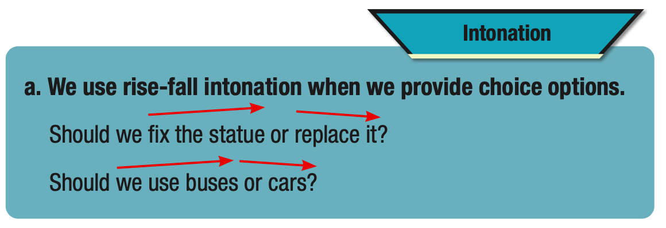

Slide 6
Listen to the sentence and focus on how the intonation rises then falls.
Should we put up signs or hire security?

Slide 7
Listen and cross out the sentence with the wrong intonation.
Should we preserve the old buildings or knock them down?
Should we prevent people from cutting down trees or put up signs saying "Don't leave trash"?
Read the sentences with the correct intonation to a partner.

Slide 8
Task a
Ask questions about the problems.
Give your opinion (using the possible solutions or your own ideas), and then ask for your partner's opinion.

Slide 9
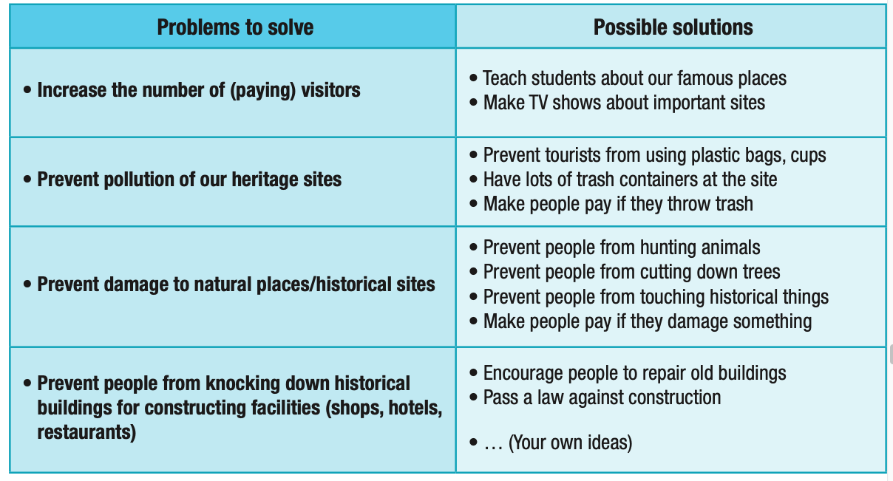

Slide 10
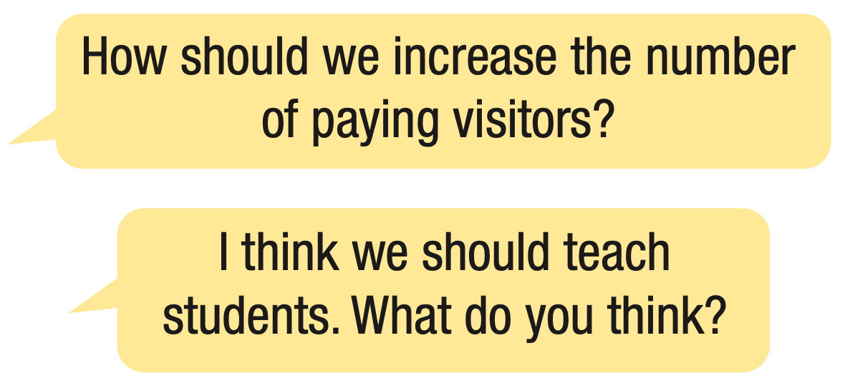

Slide 11
Task b
Practice with your own ideas.

Slide 12
PRESERVING OUR HERITAGE

Slide 13
Task a
Choose a world heritage site from below or another site you know.
List the possible problems the site may have, e.g. not being famous, pollution, damage, etc.
Discuss the best ways of dealing with those problems to best preserve the site.

Slide 14
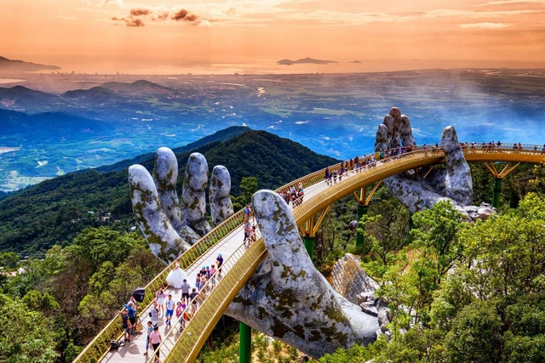
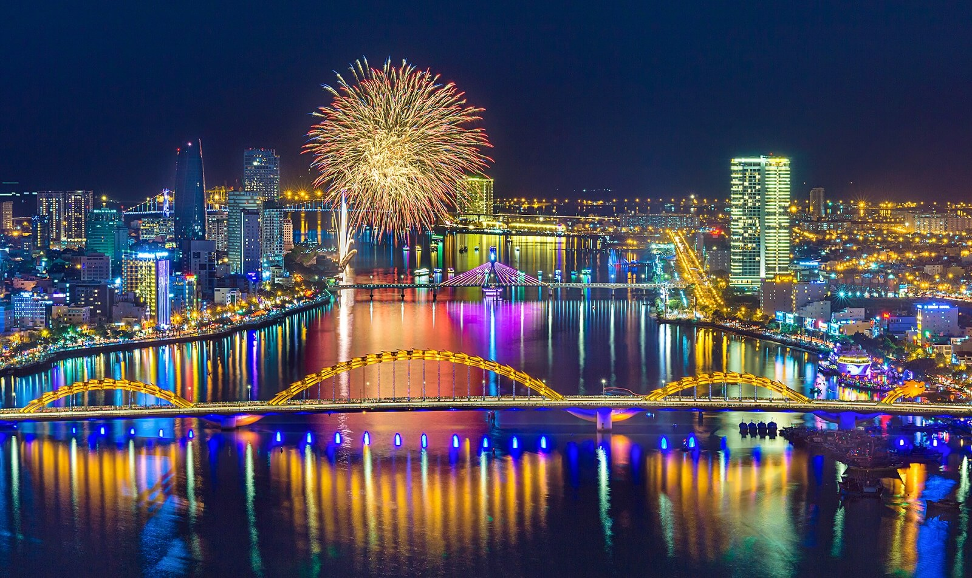
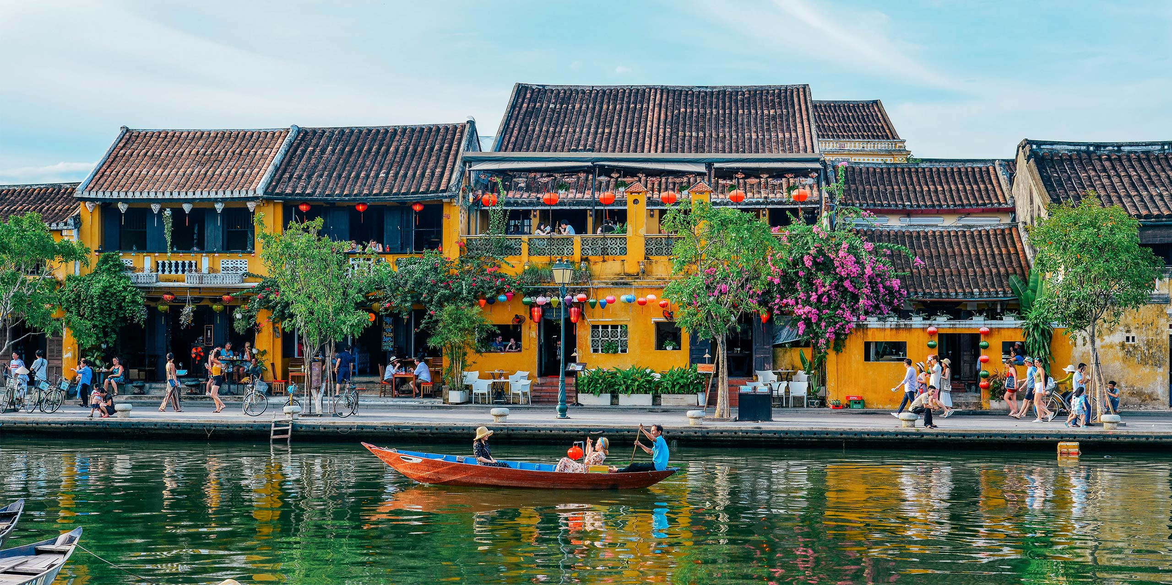
Join another pair and tell them the site you chose.
Share the problems you think it may have, and your solutions.

Slide 15
Write 3 sentences about ways to preserve heritage sites.
Example:
Schools should teach students the cultural and historical values of heritage sites so that they are willing to preserve them.

Slide 16
- Practice intonation for choice options.
- Do the exercises in workbook on page 35.
- Prepare the next lesson: Lesson 3.1 –Listening & Reading (page 66 SB).

Slide 17
Goodbye teacherts and students!

