Slide 1
UNIT 9
EDUCATION
IN THE FUTURE
Lesson 2.1 - Vocabulary & Reading

Slide 2
WARM UP

Slide 3
Look at the picture of technological items on the screen for 30s
- Try to remember
Write down what you have seen in 1 minute

Slide 4
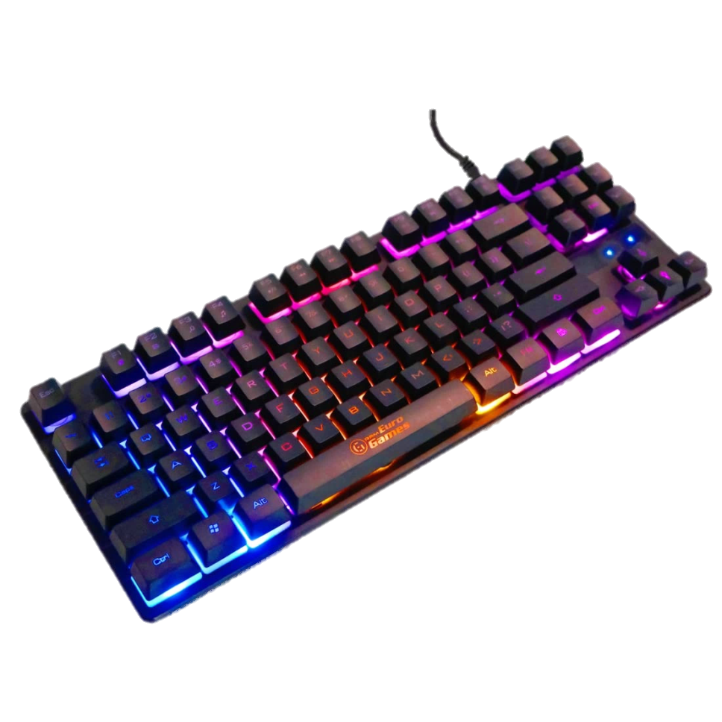
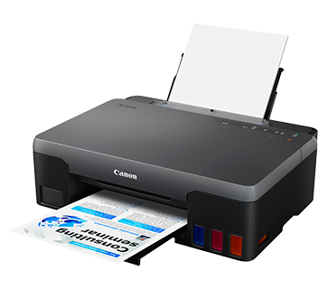
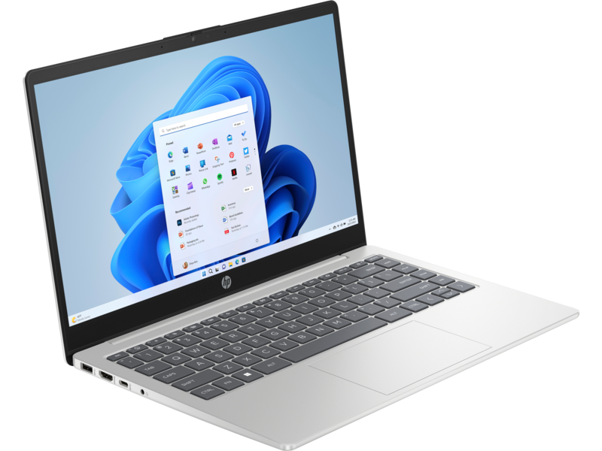
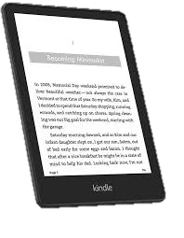
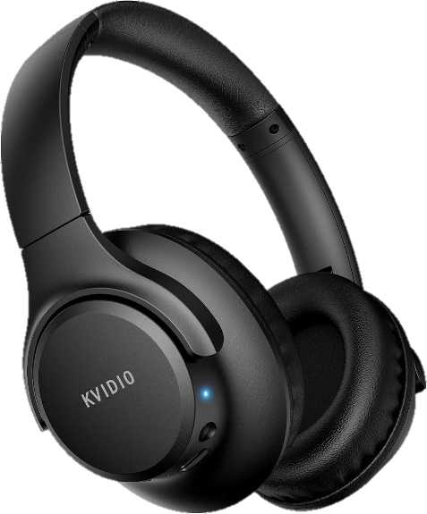
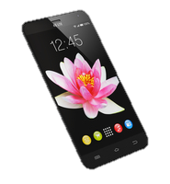
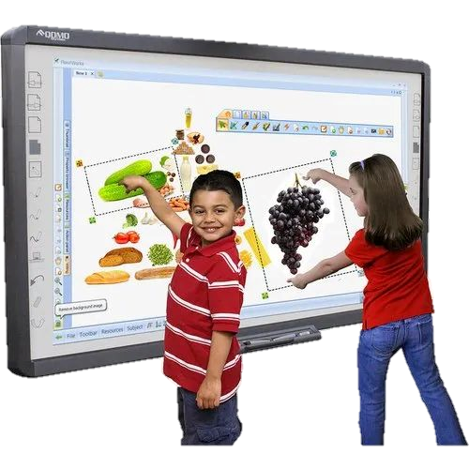
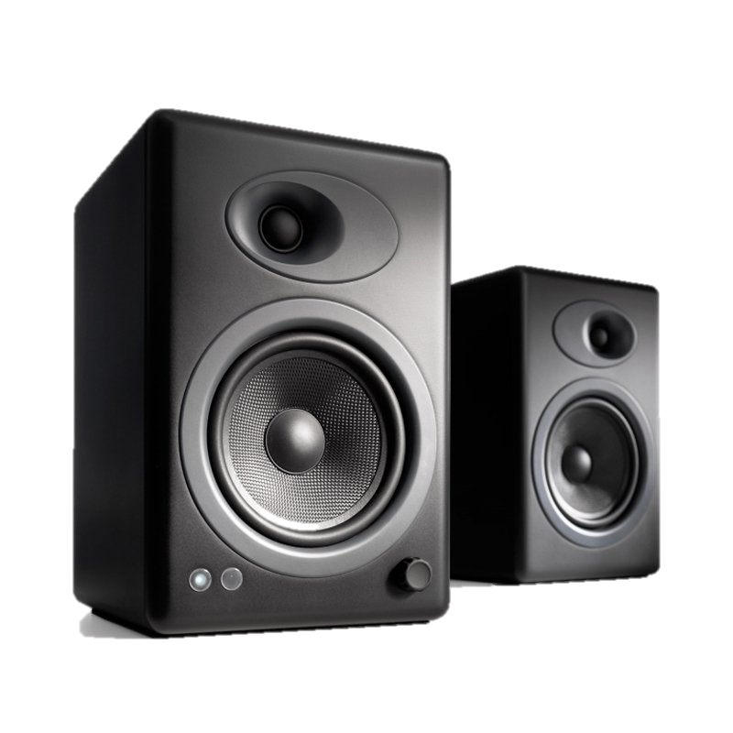
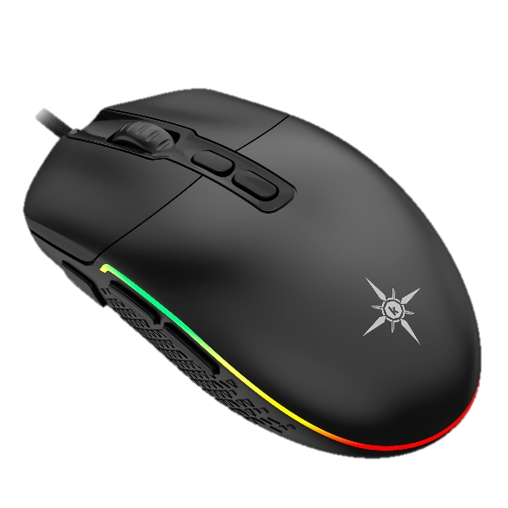
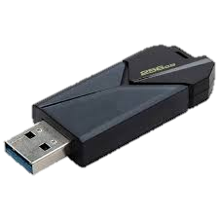
30s

Slide 5
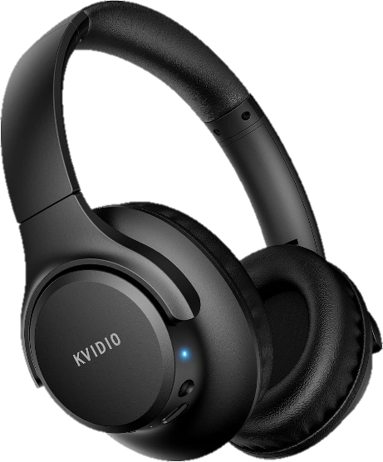
E-reader
laptop
keyboard
printer
projector
headphone
microphone
smartphone
USB
smartboard
speaker
mouse

Slide 6
Vocabulary

Slide 8
charge /tʃɑːrdʒ/ (v)
Charging…..

Slide 9
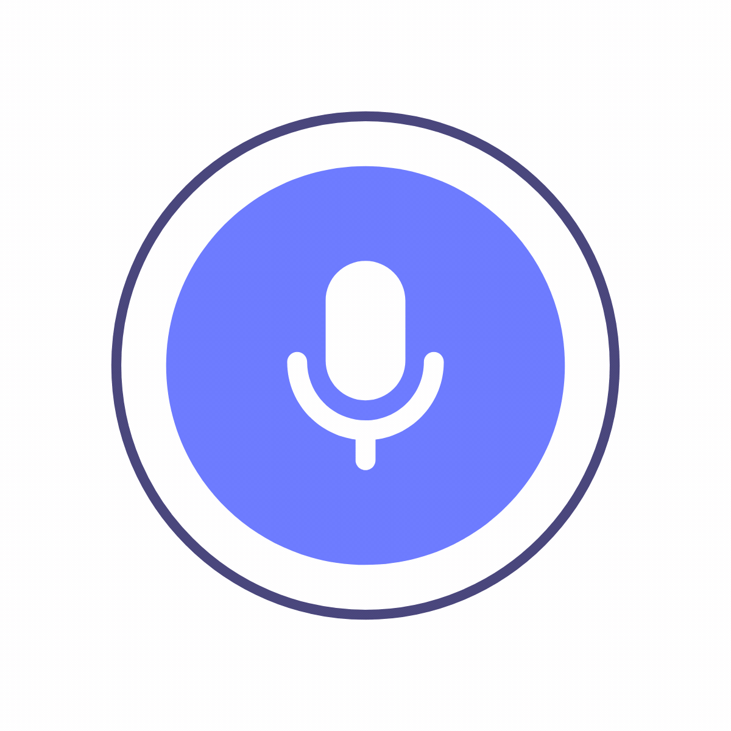
convert /kən'vɜ:rt/ (v)
He converts his voice to text

Slide 10
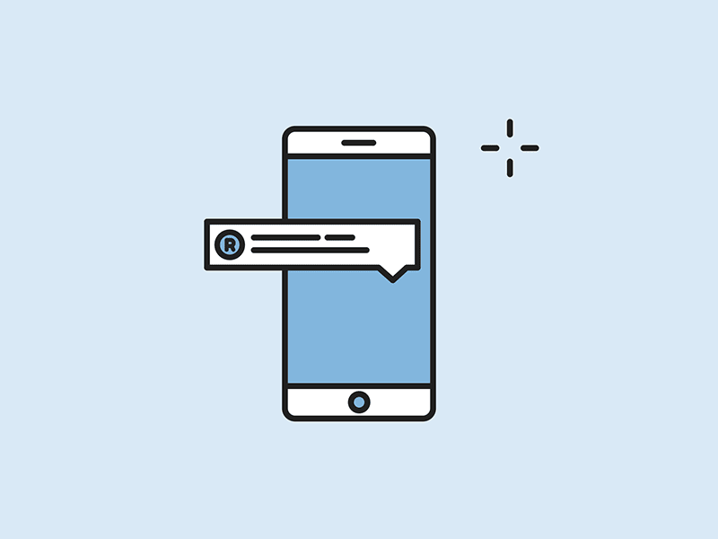
instant message /instənt ˈmesɪdʒ/ (n phr)

Slide 11
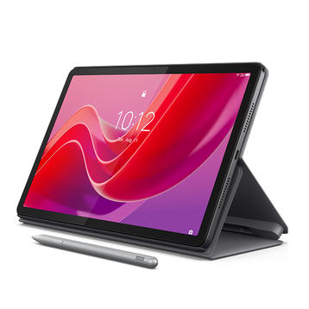
tablet /ˈtæblət/ (n)

Slide 12
social media /ˈsoʊʃl ˈmiːdiə/ (n phr)

Slide 13
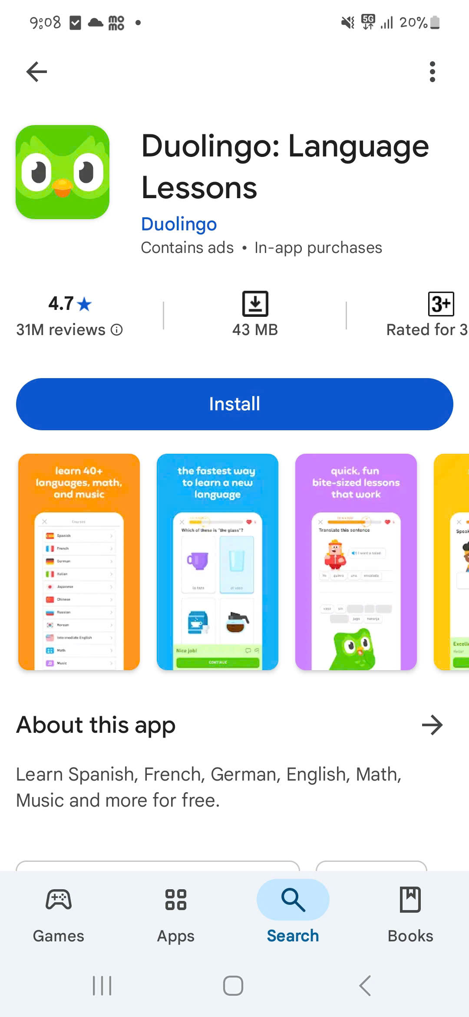
install /ɪnˈstɑːl/ (v)
install

Slide 14
Task a
Match the underlined words to the pictures and definitions.
install, tablet, instant messages, social media, charge, post
4. websites where you can post photos and videos, and write
messages to friends _____________
5. display something in a public place or online ____________
6. make an app or game ready to use after downloading it ____________

Slide 15
install
tablet
instant messages
social media
charge
post
instant messages
charge
4. websites where you can post photos and videos, and write
messages to friends _____________
5. display something in a public place or online ____________
6. make an app or game ready to use after downloading it ____________
social media
post
install

Slide 16
Task b
In pairs: Talk about how and when people use smart devices. What do you like to do on a smart device? Why?
I like to use my phone to listen to music because it helps me relax.
I use my tablet to read e-book and watch videos

Slide 17
Let’s do a chain-speaking activity

Slide 18
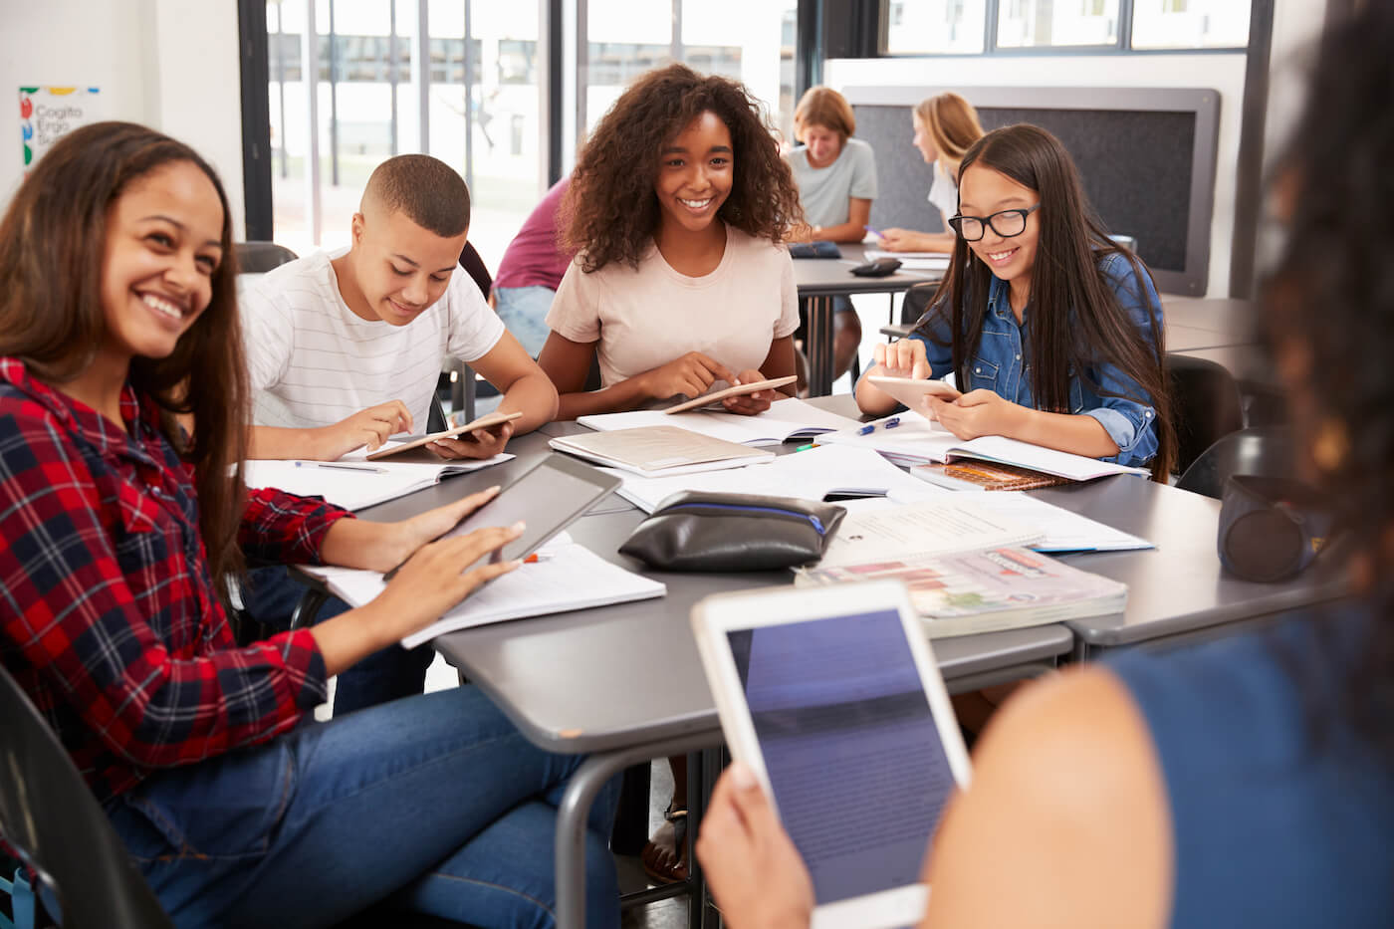
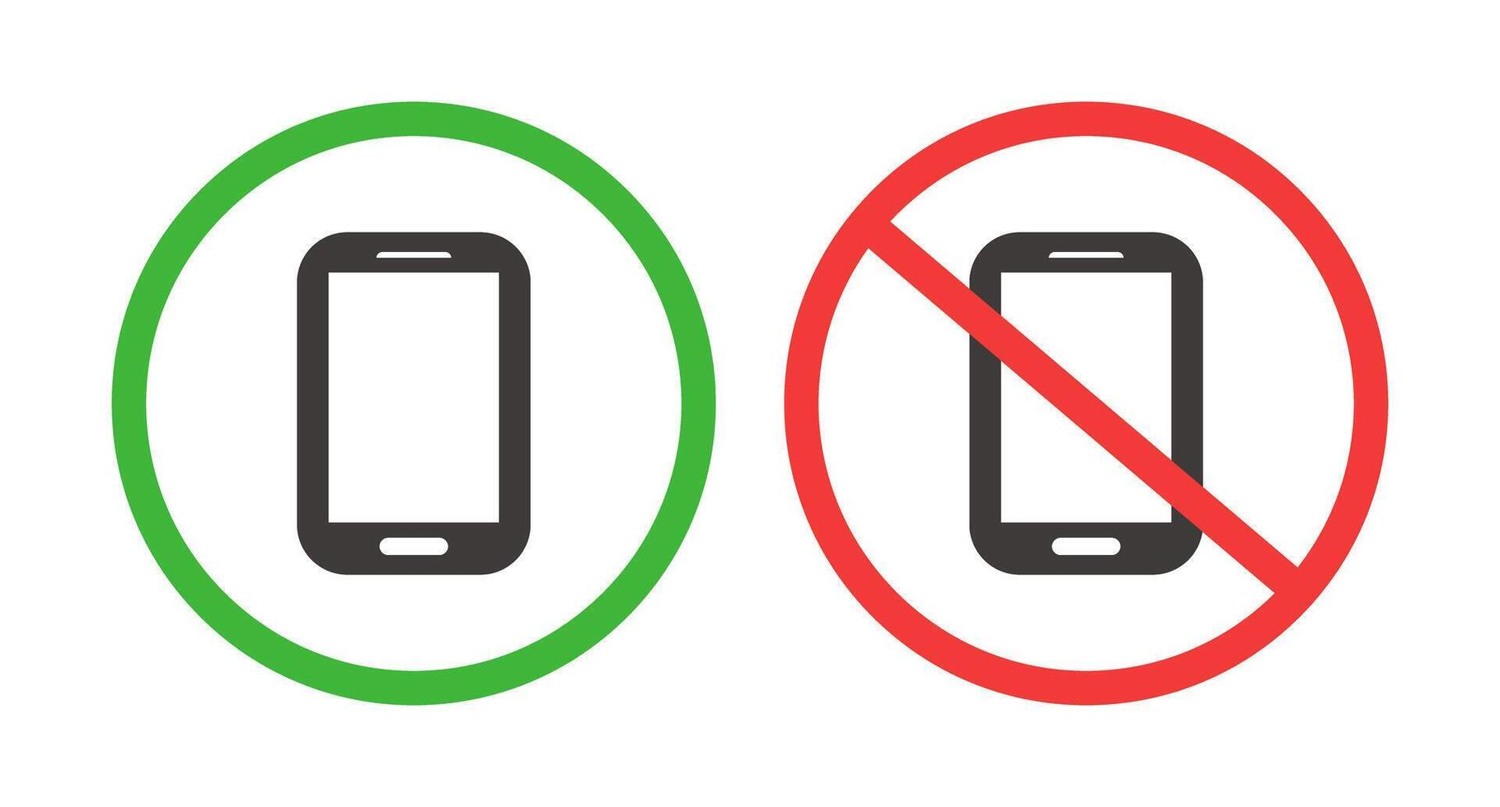
Should students be allowed to use smart devices in class ?

Slide 19
Task a
Read the email and choose the best subject line.
1. Benefits of e-learning
2. A new rule for students
3. A new school club
- Who write the email ?
- To whom ?

Slide 20
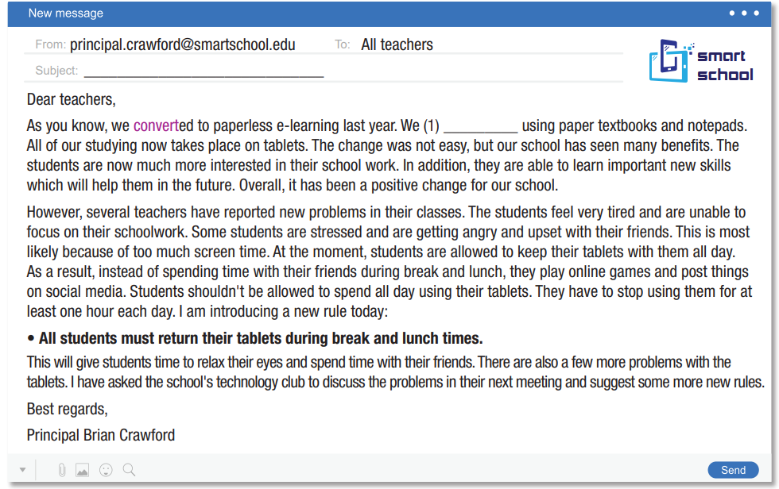
Read and check.
2. A new rule for students

Slide 21
Task b
Read and circle the answer that best fits the numbered gap.
1. a. started b. continued c. stopped
Dear teachers,
As you know, we converted to paperless e-learning last year. We (1) _________ using paper textbooks and notepads. All of our studying now takes place on tablets. The change was not easy, but our school has seen many benefits. The students are now much more interested in their school work. In addition, they are able to learn important new skills which will help them in the future. Overall, it has been a positive change for our school.

Slide 22
Read the first halves of the sentences and underline the key words.
2. Overall, the principal thinks that …
3. Some students are having problems because …
4. The principal doesn't think that …
5. The principal's new rule says that …

Slide 23
2. Overall, the principal thinks that …
b. the tablets are good for the school.
Dear teachers,
As you know, we converted to paperless e-learning last year. We (1) _________ using paper textbooks and notepads. All of our studying now takes place on tablets. The change was not easy, but our school has seen many benefits. The students are now much more interested in their school work. In addition, they are able to learn important new skills which will help them in the future. Overall, it has been a positive change for our school.

Slide 24
3. Some students are having problems because …
c. they use the tablets too much.
However, several teachers have reported new problems in their classes. The students feel very tired and are unable to focus on their schoolwork. Some students are stressed and are getting angry and upset with their friends. This is most likely because of too much screen time. At the moment, students are allowed to keep their tablets with them all day. As a result, instead of spending time with their friends during break and lunch, they play online games and post things on social media.

Slide 25
4. The principal doesn't think that …
d. students should spend all day using tablets.
Students shouldn't be allowed to spend all day using their tablets. They have to stop using them for at least one hour each day.

Slide 26
5. The principal's new rule says that …
a. students cannot use the tablets at break time.
I am introducing a new rule today:
• All students must return their tablets during break and lunch times.
This will give students time to relax their eyes and spend time with their friends. There are also a few more problems with the tablets. I have asked the school's technology club to discuss the problems in their next meeting and suggest some more new rules.

Slide 27
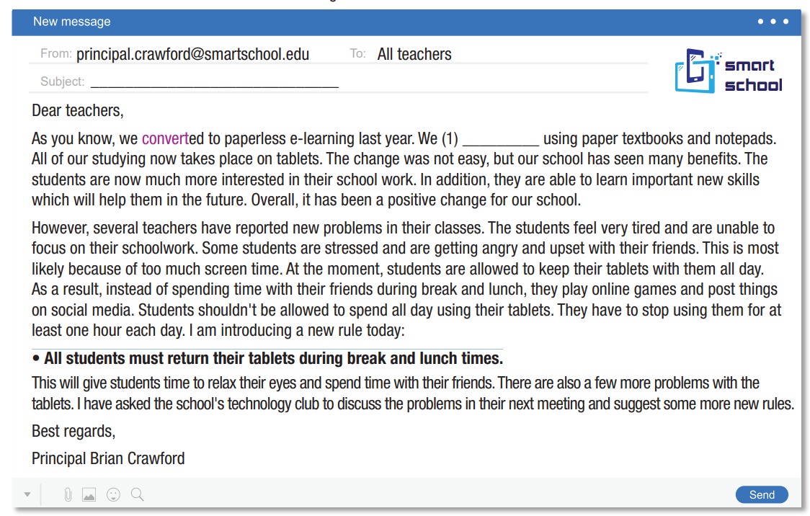
Task c
Listen and read.

Slide 28
Task d
Work in group and discuss the question:
Would you like to study at a school like this? Why (not)?
We would like to study at a school like this because ……/ We don’t really like studying at this school because…

Slide 29
WRAP-UP

Slide 30
Today’s lesson
Vocabularies
Install
Tablet
Instant messages
Social media
Charge
Post
Convert
Reading:
- Understanding instructions
Skimming and scanning for general and specific information
Speaking:
- Talking about new school rules

Slide 31
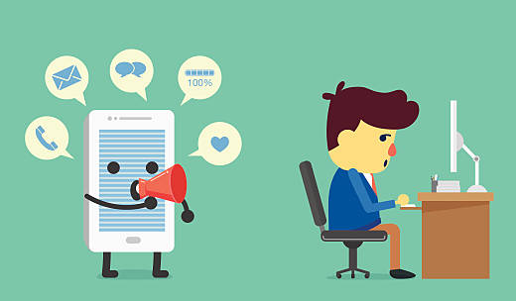
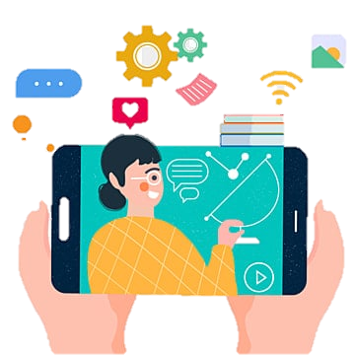
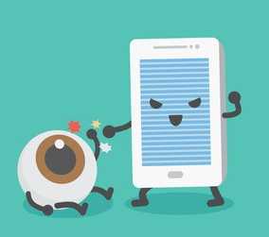
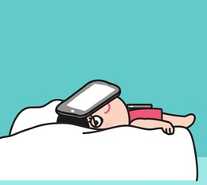

Slide 32
Homework
Learn by hearts vocabularies and make sentences using them.
Do the exercises on page 52 WB and listen & read the email again (CD43) on www.eduhome.com.vn
Prepare the next lesson (pages 95 & 96 SB)

