Slide 2


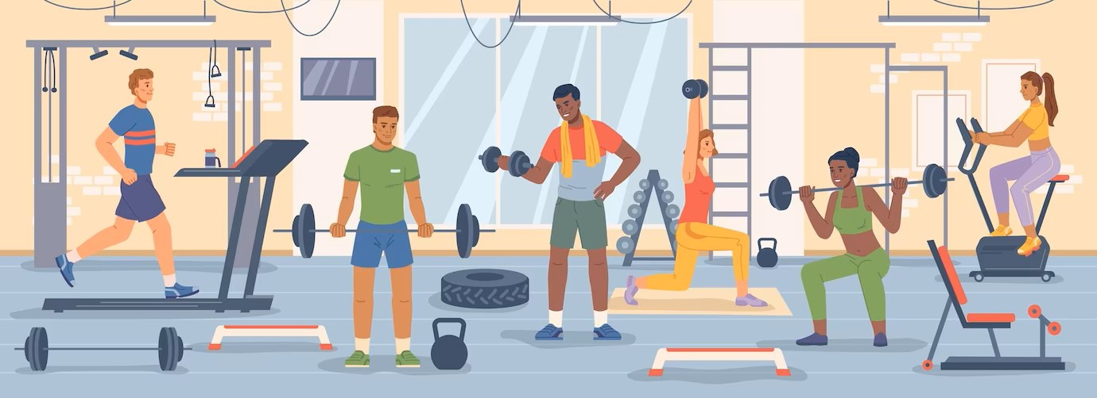
Unit
8
SPORTS AND GAMES
LESSON 1: GETTING STARTED
At the gym
1

Slide 3

SPORTS
AND GAMES
WARM-UP
chess
basketball
football
running
cycling
hiking
tennis
badminton
swimming

Slide 4
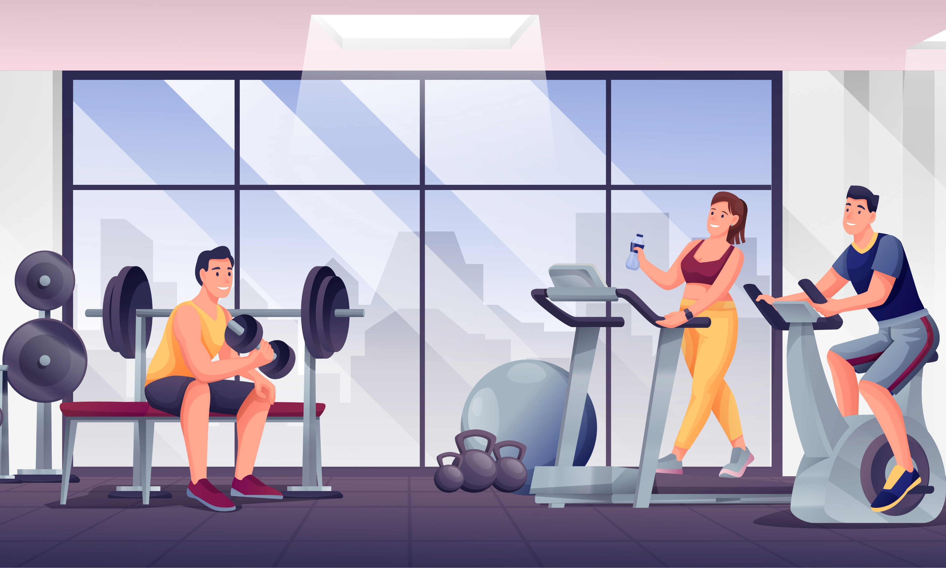

PRESENTATION
gym (n)
/dʒɪm/
trung tâm
thể dục thể thao

Slide 5
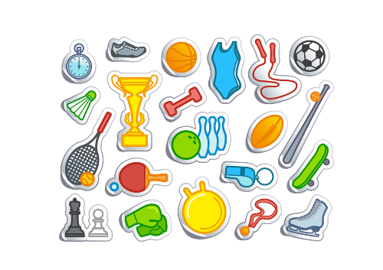
PRESENTATION
equipment (n)
/ɪˈkwɪpmənt/
thiết bị, dụng cụ

Slide 6
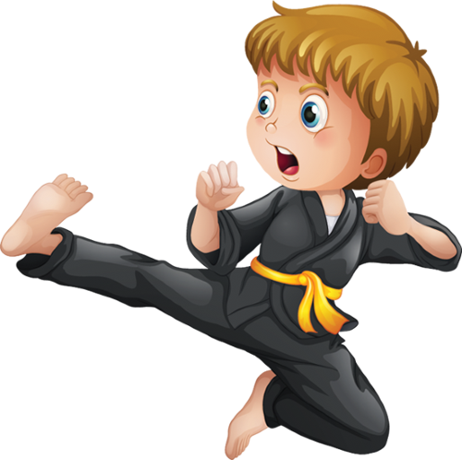
PRESENTATION
karate (n)
/kəˈrɑːti/
võ ka-ra-tê

Slide 7
PRESENTATION
New words | Pronunciation | Meaning
1. gym (n) | /dʒɪm/ | trung tâm thể dục thể thao
2. equipment (n) | /ɪˈkwɪpmənt/ | thiết bị, dụng cụ
3. karate (n) | /kəˈrɑːti/ | võ ka-ra-tê

Slide 8
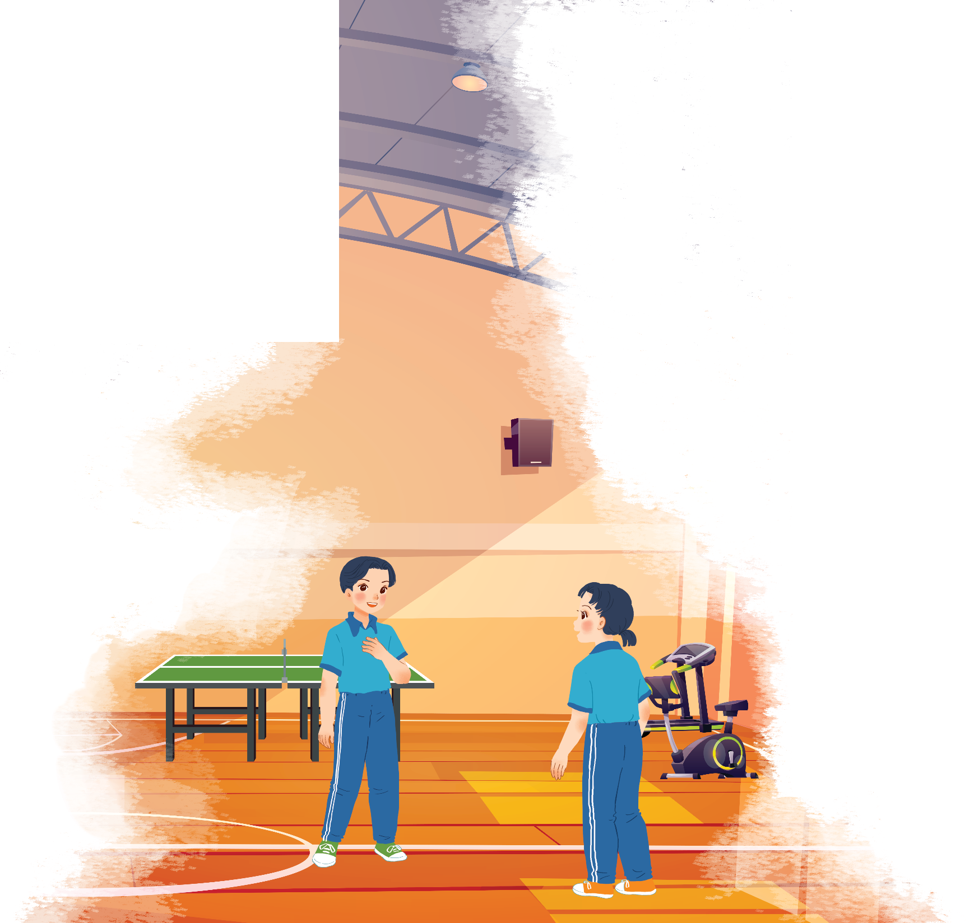
PRACTICE
1. Where are the two kids?
→ They are in the gym.
2. What sports are they going to play?
→ They are going to run.

Slide 9
PRACTICE
1
Listen and read.
Duong: Wow! This gym is big!
Mai: Yeah. The equipment is great. What sports do you do, Duong?
Duong: Well, I do karate, and I play table tennis. Yesterday I played with Duy, and I won!
Mai: Congratulations! You look fit! I’m not good at sports.
Duong: I have an idea – you can go to the karate club with me.
Mai: No, I can’t do karate.
Duong: But you can learn! You’ll love it.
Mai: Well ... OK.
Duong: Great! I’ll meet you there at 10 a.m. on Sunday.
Mai: Where’s the club?
Duong: It’s Superfit Club, in Pham Hung Road. You can cycle there.
Mai: OK. See you then.

Slide 10
PRACTICE
2
Put ONE word from the conversation in each gap.
1. Duong looks ______. He often does karate.
2. Mai likes coming to the _______. The equipment there is great.
3. Duong played ____________ with Duy yesterday, and he won.
4. Mai and Duong will meet at Superfit ______ on Sunday.
5. Mai will _______ to Superfit Club.
fit
gym
table tennis
Club
cycle

Slide 11
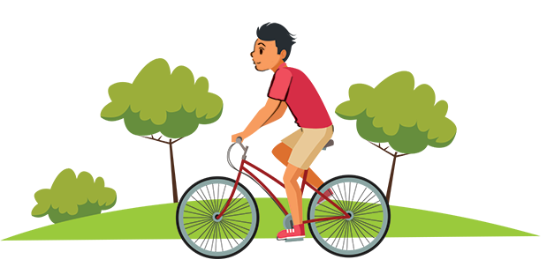
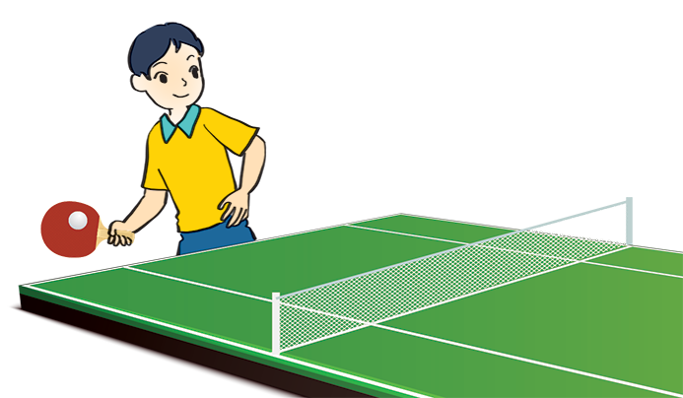
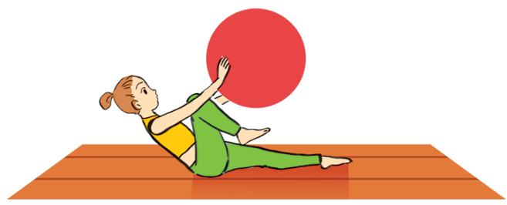
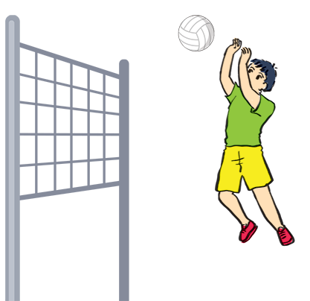
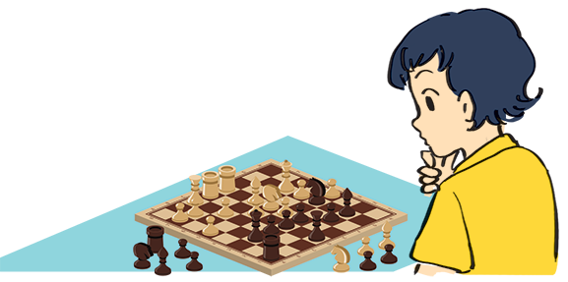
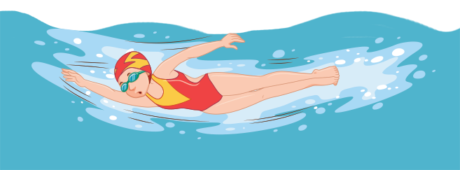
PRACTICE
3
Name these sports and games, using the words from the box.
chess
aerobics
table tennis
cycling
swimming
volleyball
1. ___________
2. ___________
3. ___________
cycling
aerobics
table tennis
6. ___________
4. ___________
5. ___________
volleyball
swimming
chess

Slide 12
What is the difference between
A SPORT AND A GAME ?
PRACTICE

Slide 13
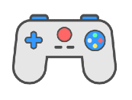
What is the difference between a sport and a game?
PRACTICE
vs.
A sport
A game
an activity that you do for pleasure and that needs physical exercise.
an activity or a sport with rules in which people or teams compete against each other.

Slide 14
PRACTICE
4
Work in pairs. Ask your partners these questions to find out how sporty they are.
1. Can you swim?
A. Yes B. No
2. Do you play outdoors every day?
A. Yes B. No
3. Do you usually do morning exercise?
A. Yes B. No
4. What do you usually do at break time at school?
A. Play in the schoolyard.
B. Sit in the classroom.
5. What do you think of sports and games?
A. Very good B. Not useful
If your answers to the questions are mostly “A”, you are sporty.
If they are mostly “B”, do more sport and try to be more active.

Slide 15

CONSOLIDATION
1
Wrap-up
What have we learnt in this lesson?
Have an overview about the topic Sports and games
Use the vocabulary and talk about sports and games

Slide 16

CONSOLIDATION
2
Homework
Do exercises in the workbook.
Name some sports and games that you know.
Start preparing for the Project of the unit

Slide 17






Website: hoclieu.vn
Fanpage: facebook.com/www.tienganhglobalsuccess.vn/

