Slide 1

Groups of 6: Think of what you like on the first day at school
I like new friends and new teachers
I like new friends and new teachers
and ……………..…
I like new friends
CHAIN GAME

Slide 2
Unit 1
My new school
Lesson 1. Getting started

Slide 3
OBJECTIVES
By the end of this unit, students will be able to:
✓ An overview about the topic My New School.
✓ Vocabulary to talk about school things.

Slide 4
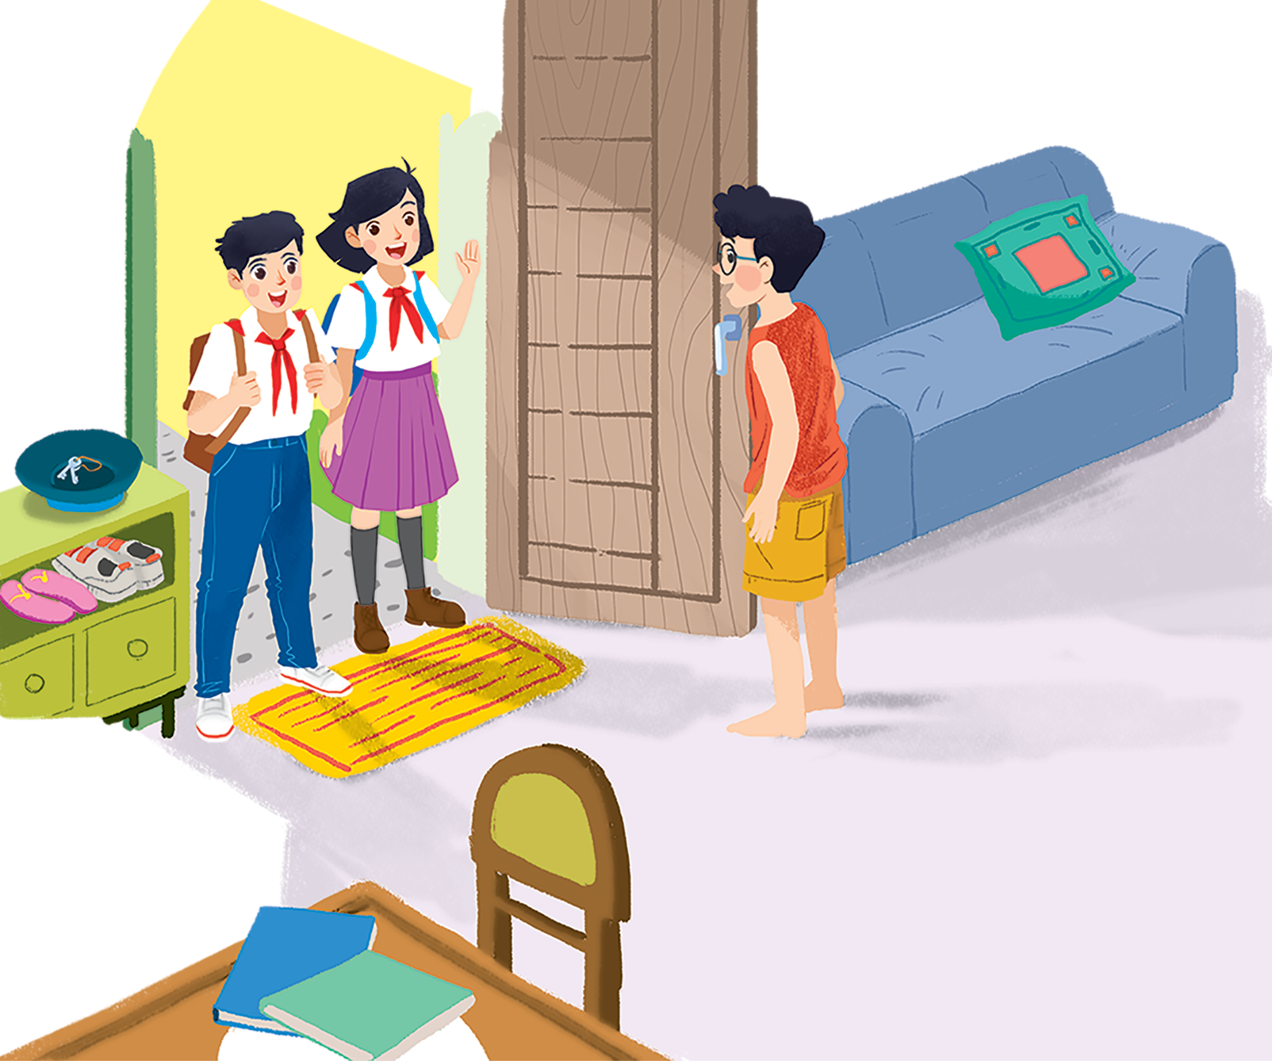
Vy
Phong
A special day
Duy-Vy’s new friend

Slide 5
Look at the picture and answer these questions.
01
Where are they?
02
What are Duy and Vy wearing?
03
Why it is a special day?
What are they exactly talking about?
Notes:
Play the CD twice.
Ask Ss what exactly Vy, Phong and Duy are talking about
Confirm the correct answer: Vy introduces her new friend, Duy. Then they talk about their new school and their first day at school, etc.

Slide 6

Ex 1. (p 6) Listen and read.
Phong: Hi, Vy.
Vy: Hi, Phong. Are you ready?
Phong: Just a minute.
Vy: Oh, this is Duy, my new friend.
Phong: Hi, Duy. Nice to meet you.
Duy: Hi, Phong. I live near here, and we go to the same school!
Phong: Good. Hmm, your school bag looks heavy.
Duy: Yes! I have new books, and we have new subjects to study.
Phong: And a new uniform, Duy! You look smart!
Duy: Thanks, Phong. We always look smart in our uniforms.
Phong: Let me put on my uniform. Then we can go.

Slide 7
Ex 2. (p 7) Read these sentences and underline the keywords .
01
Vy, Phong and Duy go to the same school.
Vy, Phong and Duy go to the same school.
02
Duy is Phong’s friend.
Duy is Phong’s friend.
03
Phong says Duy looks smart in his uniform.
Phong says Duy looks smart in his uniform.
04
They have new subjects to study.
They have new subjects to study.
05
Phong is wearing a school uniform.
Phong is wearing a school uniform.

Slide 8
Ex 2. (p 7) Decide True (T) or False (F).
01
Vy, Phong and Duy go to the same school.
Vy, Phong and Duy go to the same school.
True.
Phong: Hi, Duy. Nice to meet you.
Duy: Hi, Phong. I live near here, and we go to the same school!
02
Duy is Phong’s friend.
False.
Duy is Phong’s friend.
Vy: Oh, this is Duy, my new friend.

Slide 9
Ex 2. (p 7) Decide True (T) or False (F).
03
Phong says Duy looks smart in his uniform.
Phong says Duy looks smart in his uniform.
True.
Phong: And a new uniform, Duy! You look smart!
04
They have new subjects to study.
They have new subjects to study.
True.
Duy: Yes! I have new books, and we have new subjects to study.
05
Phong is wearing a school uniform.
Phong is wearing a school uniform.
False.
Phong: Let me put on my uniform. Then we can go.

Slide 10
Ex 3. (p 7) Write ONE word from the box in each gap.
go subjects has wear uniforms
1. Students __________ their uniforms on Monday.
2. Vy ___________ a new friend, Duy.
3. - Do Phong, Vy and Duy ___________ to the same school?
- Yes, they do
4. Students always look smart in their ___________.
5. - What ___________ do you like to study?
- I like to study English and history.
wear
has
go
uniforms
subjects

Slide 11
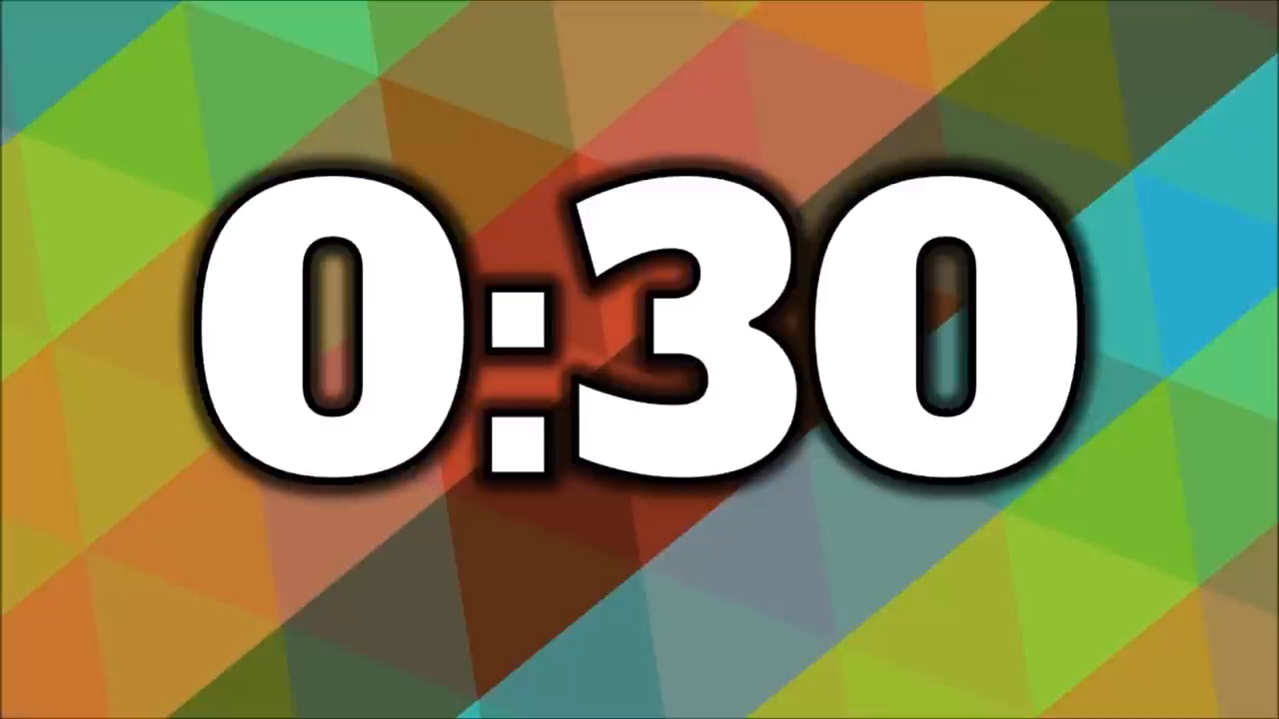
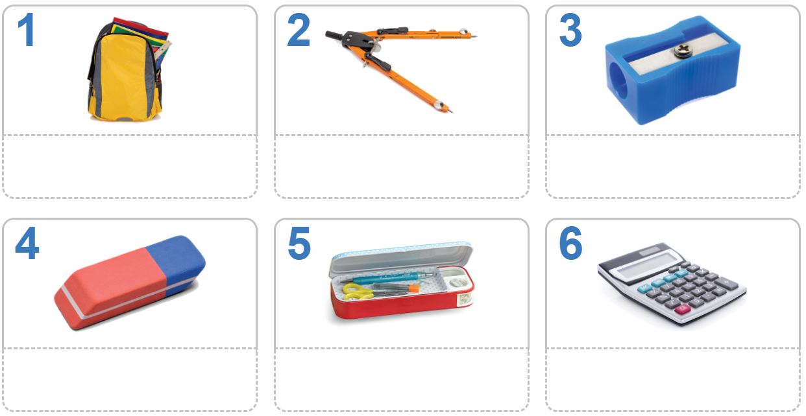
Ex 4. (p 7) Here are the school things that Vy, Phong, and Duy bring to school.
In 30 seconds, look and remember.

Slide 12
Write down the school things you remember.
school bag
compass
pencil sharpener
rubber
pencil case
calculator

Slide 13

RECAP
School things races
Write as many school things as you can.

Slide 14
Thank you!

