Slide 1
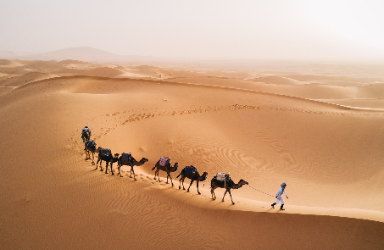
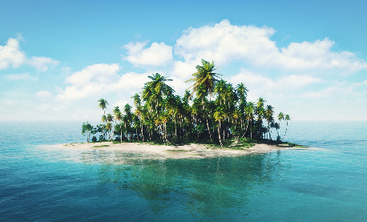
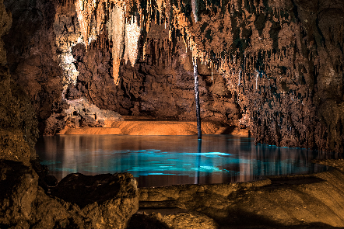
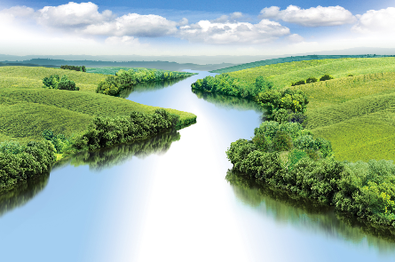
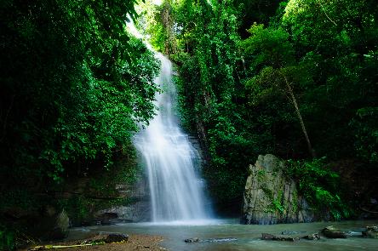
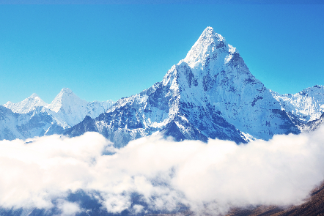
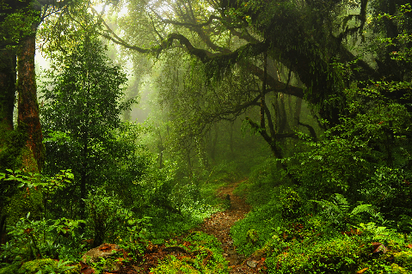
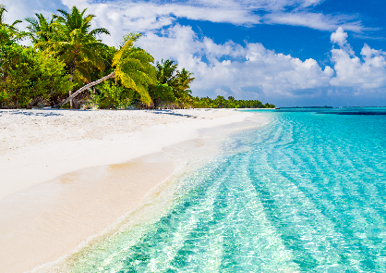
Review the old lesson
a.
desert
b.
island
c.
cave
d.
river
waterfall
mountain
forest
beach
e.
f.
g.
h.

Slide 2
Unit 5:
NATURAL WONDERS OF VIETNAM
Lesson 2 :
A Closer Look 1

Slide 3
Vocabulary
Pronunciation
/t/ and /d/
Write a word under each picture. Practise saying the words.
Listen and repeat the words.
Complete the following sentences. Use the words in 1.
Listen and repeat. Pay attention to the bold-typed parts of the words.
Now put the items in order of usefulness. Number 1 is the most useful, number 6 is the least useful on holiday.

Slide 4
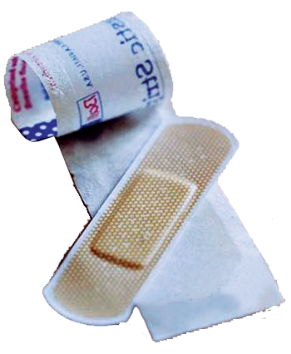
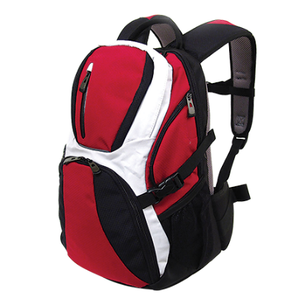
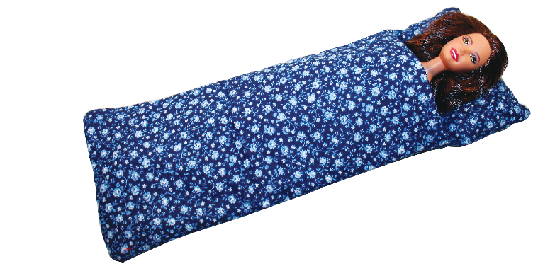
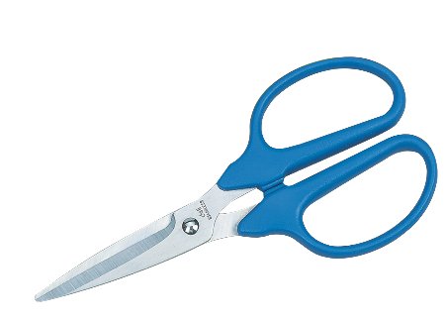
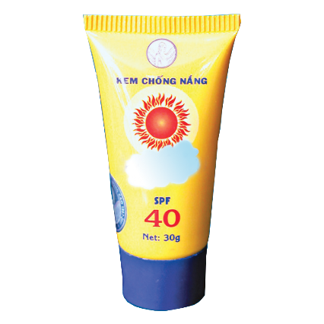
Vocabulary
- plaster (n) :
băng cá nhân
- sleeping bag (n) :
túi ngủ
- backpack (n) :
ba lô
- compass (n) :
la bàn
- suncream (n) :
kem chống nắng
- scissors (n) :
cái kéo

Slide 5
Write a word under each picture.
Practise saying the words.
plaster
sleeping bag
backpack
compass
suncream
scissors
2. suncream
3.
1.
2.
1. plaster
3. sleeping bag
4. scissors
5. backpack
6. compass
4.
5.
6.

Slide 6
Complete the following sentences. Use the words in 1.
plaster
sleeping bag
backpack
compass
suncream
scissors
1.
We’re lost. Please give me the .
compass
It’s so sunny today. I need to put on some .
2.
suncream
3.
A
sleeping bag
is very useful when you go camping overnight.
is very useful when you go camping overnight.
4.
I’ve finished packing. All my things are in my .
backpack
5.
My foot hurts. I need to put a on my foot.
plaster

Slide 7
Now put the items in order of usefulness. Number 1 is the most useful, number 6 is the least useful on holiday.
plaster
scissors
backpack
compass
suncream
scissors
1.
1.
1.
2.
2.
2.
3.
3.
3.
4.
4.
4.
5.
5.
5.
6.
6.
6.

Slide 8
Pronunciation
/t/ and /d/

Slide 9
Listen and repeat the words.
/t/ | /d/
mountain waterfall desert plaster | wonder island guide holiday

Slide 10
Listen and repeat. Pay attention to the bold-typed parts of the words.
1.
Where’s my hat?
Oh, it’s on your head.
2.
Where do they stay on their holiday?
3.
I need some meat for my cat.
4.
The Sahara is a very hot desert.
5.
I want to explore the island by boat.

