Slide 1
UNIT 5 FOOD AND DRINK
LESSON 1. GETTING STARTED

Slide 2
Objectives
By the end of this lesson, Ss will be able to gain:
An overview about the topic.
Vocabulary to talk about Food and Drink.

Slide 3
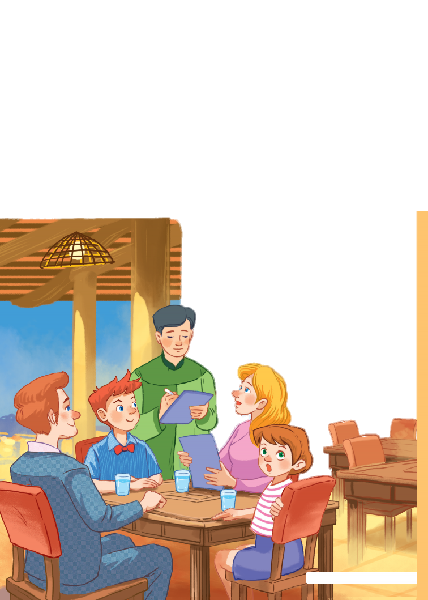
At a Vietnamese restaurant
Have you ever been to a restaurant?
Where and when?
What food and drink did you have there?

Slide 4
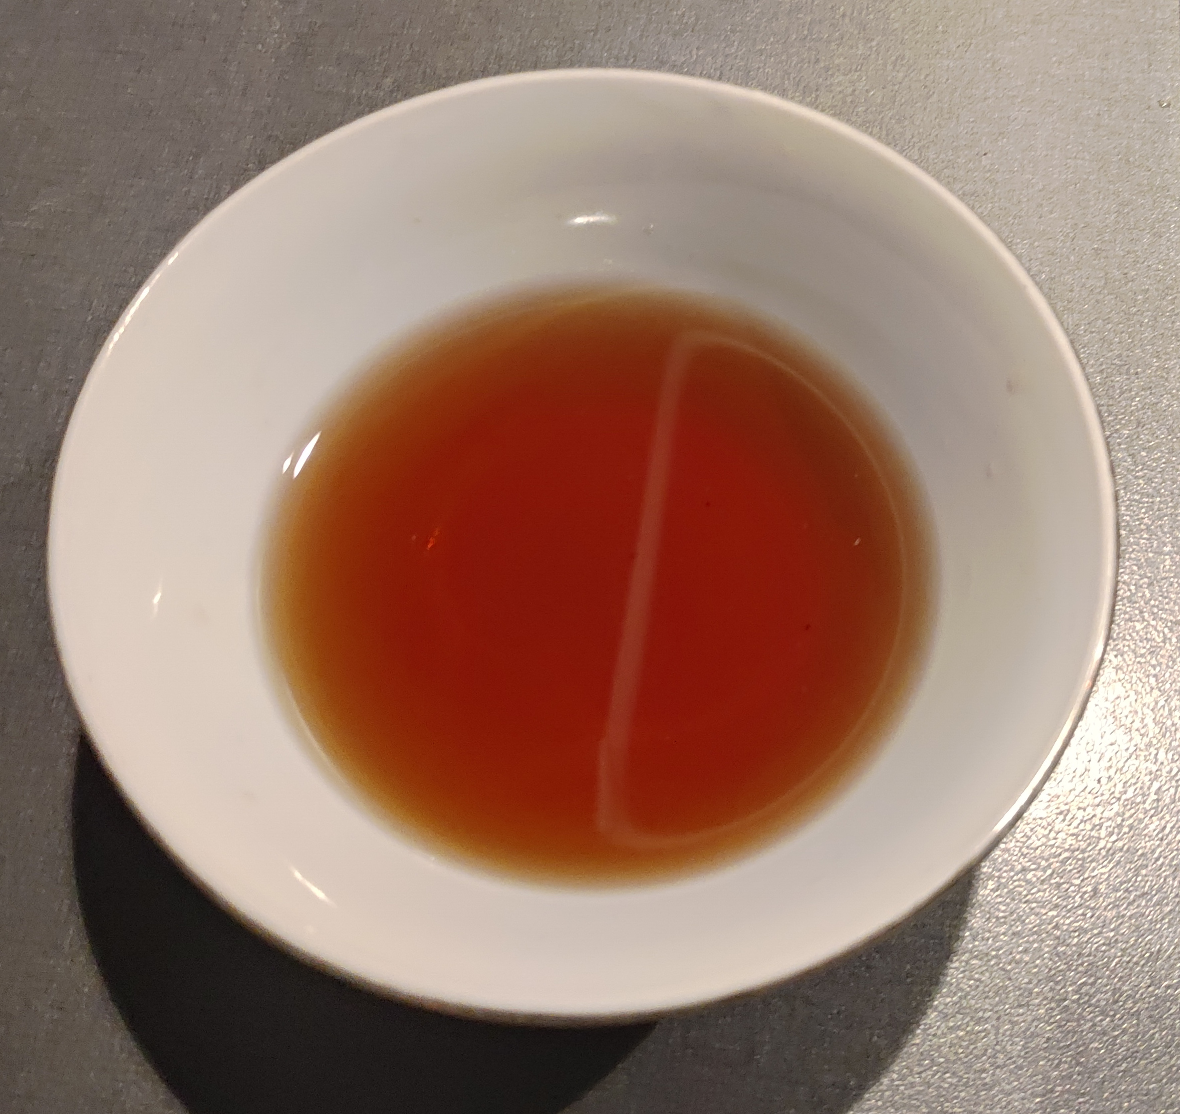
Vocabulary
fish sauce (n.p)
/fɪʃ/ /sɔːs/
nước mắm

Slide 5
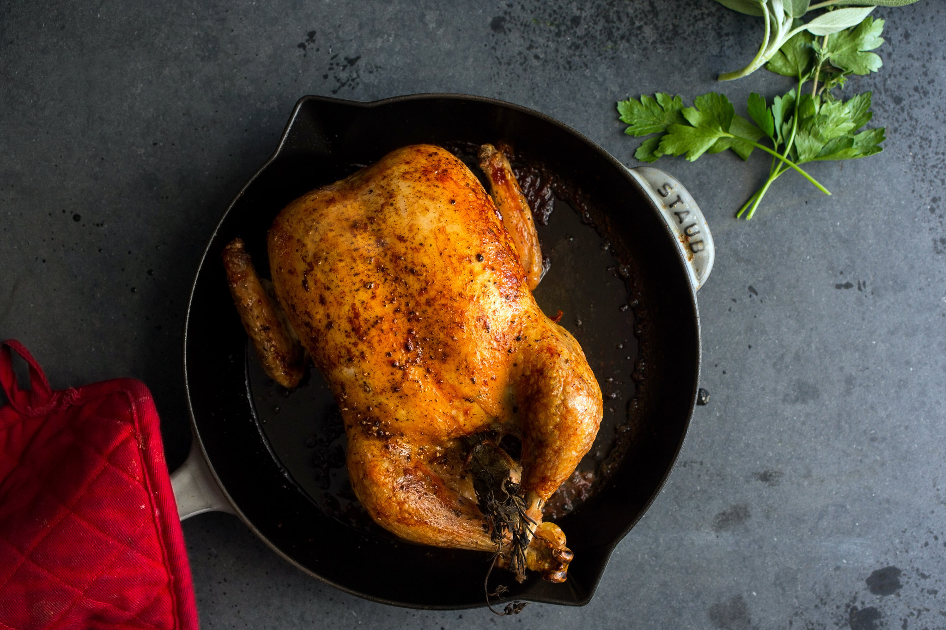
Vocabulary
roast chicken (n)
/rəʊst ˈʧɪkɪn/
gà quay

Slide 6
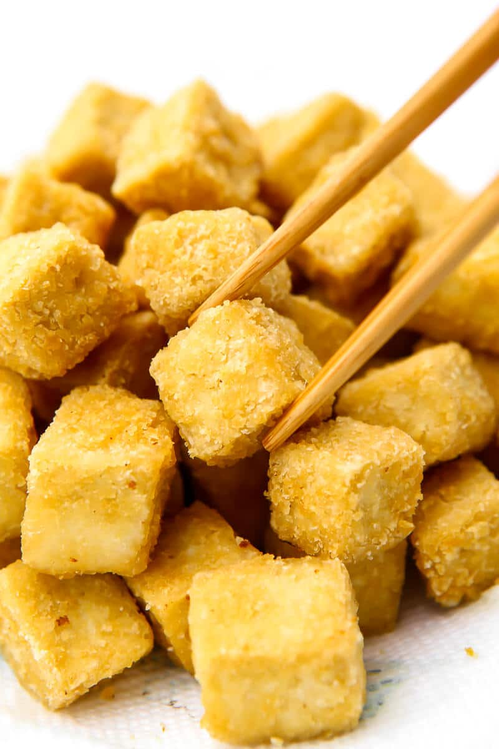
Vocabulary
fried tofu (n)
/fraɪd ˈtəʊfuː/
đậu rán

Slide 7
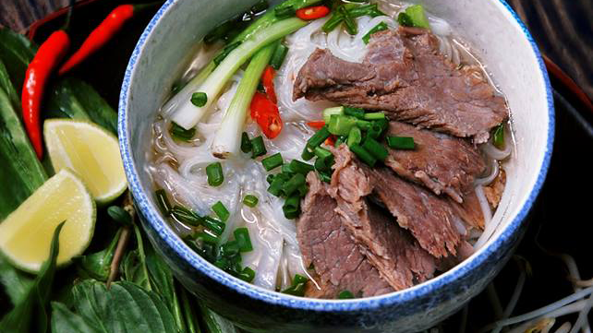
Vocabulary
beef noodle soup (n.p)
/biːf/ /ˈnuːdl/ /suːp/
phở bò

Slide 8
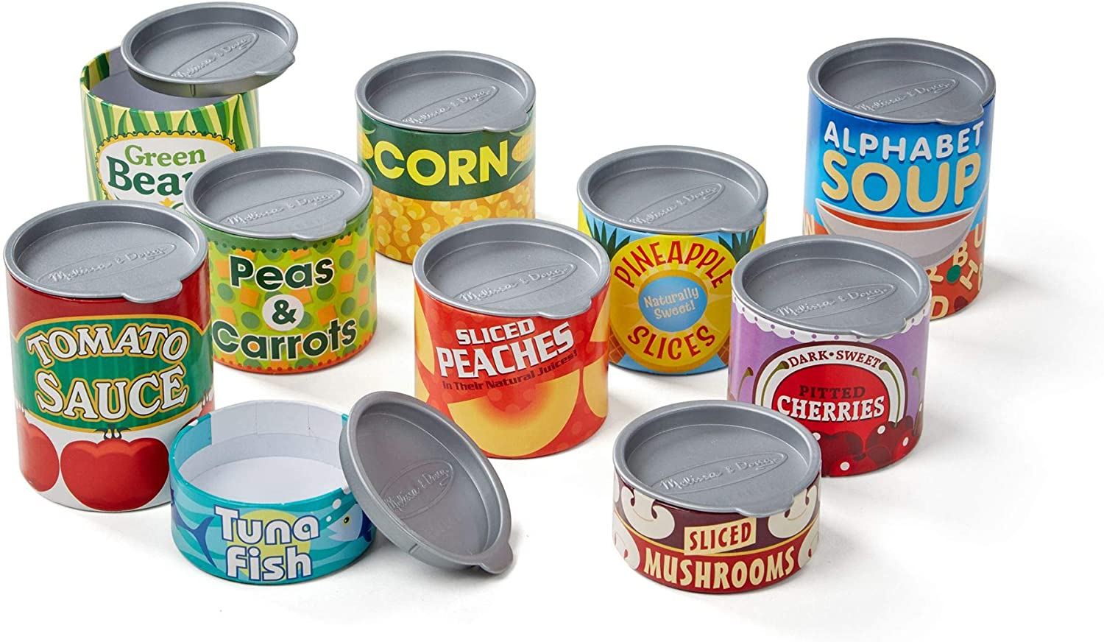
Vocabulary
lon
can (n):
/ˈkæn/

Slide 9
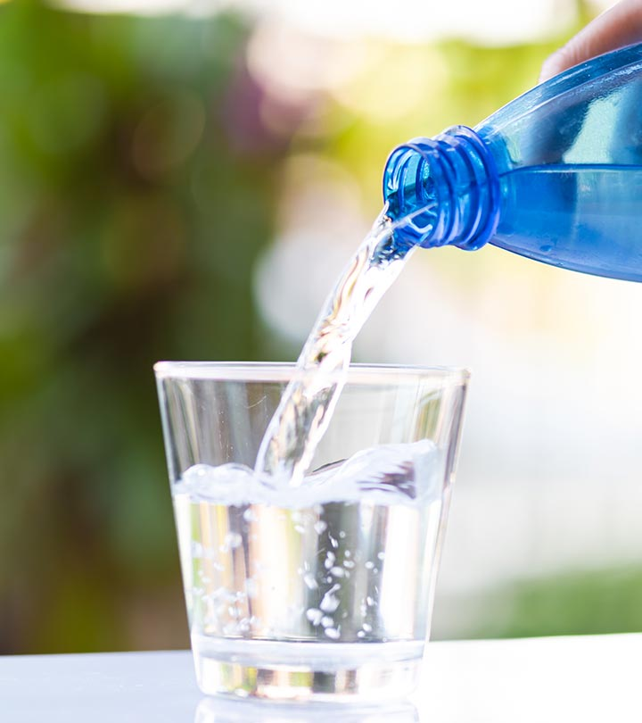
Vocabulary
mineral water (n)
/ˈmɪnərəl/ /ˈwɔːtə/
nước khoáng

Slide 10
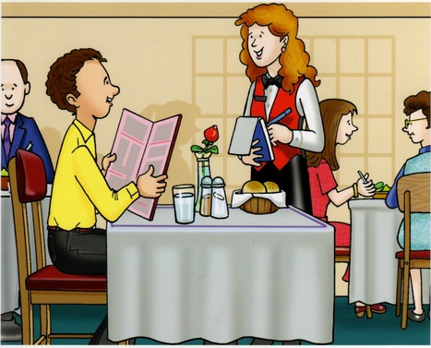
Vocabulary
gọi món
order (v):
/ˈɔːdə(r)/

Slide 11
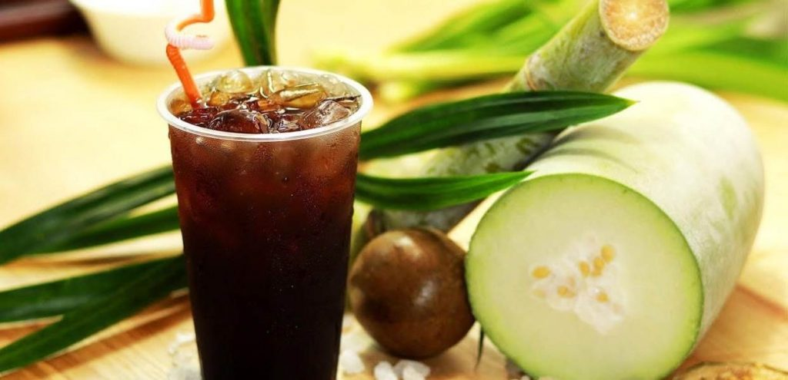
Vocabulary
winter melon juice (n.p)
/ˈwɪntə ˈmɛlən ʤuːs /
nước ép bí đao

Slide 12

Vocabulary
Example:
She is preparing for her dinner.
prepare for (v.p)
/prɪˈpeə fɔː/
chuẩn bị cho

Slide 13
Vocabulary
Example:
His mother doesn't allow children to watch TV during dinner.
allow someone to do something (v.p)
/laʊ ˈsʌmwʌn tuː duː ˈsʌmθɪŋ/
cho phép ai đó làm gì

Slide 14

Listen and read
What is Mark’s family doing?
Orderding food for dinner.
Preparing for their dinner.
Talking about their favourite food.

Slide 15

Listen and read
Waiter: Good evening. What can I get you today?
Mark's mum: We'd like rice with some pork cooked in fish sauce. Oh, could we also have an order of roast chicken and fried vegetables?
Mark: And I'd like some fried tofu and spring rolls too.
Waiter: OK. Would you like any canh? It's a kind of Vietnamese soup. We often have it with rice.
Mark's dad: Let me see ... I think we'll try some canh.
Waiter: With shrimp or fish?
Mark's dad: With shrimp, please.
Waiter: Would you like anything to drink? We have a lot of drinks: juice, lemonade, green tea, mineral water, ...
Mark's mum: Mineral water for me, green tea for my husband, and juice for my children.
Waiter: What kind of juice would you like?
Mark's sister: Do you have winter melon juice?
Waiter: Let me see. Er, yes. How many cans would you like?
Mark's sister: One ... No, wait, two please. By the way, how much is a can of winter melon juice?
Mark: The menu says it's 10,000 dong.
Waiter: That's right. I'll be right back with your order.
Ex 3. (p 51) Find the words and phrases
about food and drink.
food
rice,
pork,
fish sauce,
roast chicken,
fried vegetables,
fried tofu,
spring rolls,
soup,
shrimp,
fish.
drink
juice,
lemonade,
green tea,
mineral water,
winter melon juice.

Slide 16
T
F
Ex 4. (p 51) Underline the keywords
Ex 4. (p 51) Tick T or F
1. Mark’s family is at a Vietnamese restaurant.
Because they order many delicious foods in Vietnam like fried tofu, spring rolls, pork cooked in fish sauce, rice,... so they are at a Vietnamese restaurant.
1. Mark’s family is at a Vietnamese restaurant.
T
T
F
2. Mark wants fried tofu and beef for dinner.
T
F
2. Mark wants fried tofu and beef for dinner.
F
Mark: And I'd like some fried tofu and spring rolls too.
3. They don’t order canh.
T
F
3. They don’t order canh.
F
Mark's dad: Let me see ... I think we'll try some canh.
4. Mark’s mum wants mineral water.
4. Mark’s mum wants mineral water.
T
T
F
Mark's mum: Mineral water for me,…
5. His mum doesn’t allow her children to drink juice during dinner.
5. His mum doesn’t allow her children to drink juice during dinner.
F
T
F
Mark's mum: ... and juice for my children.

Slide 17
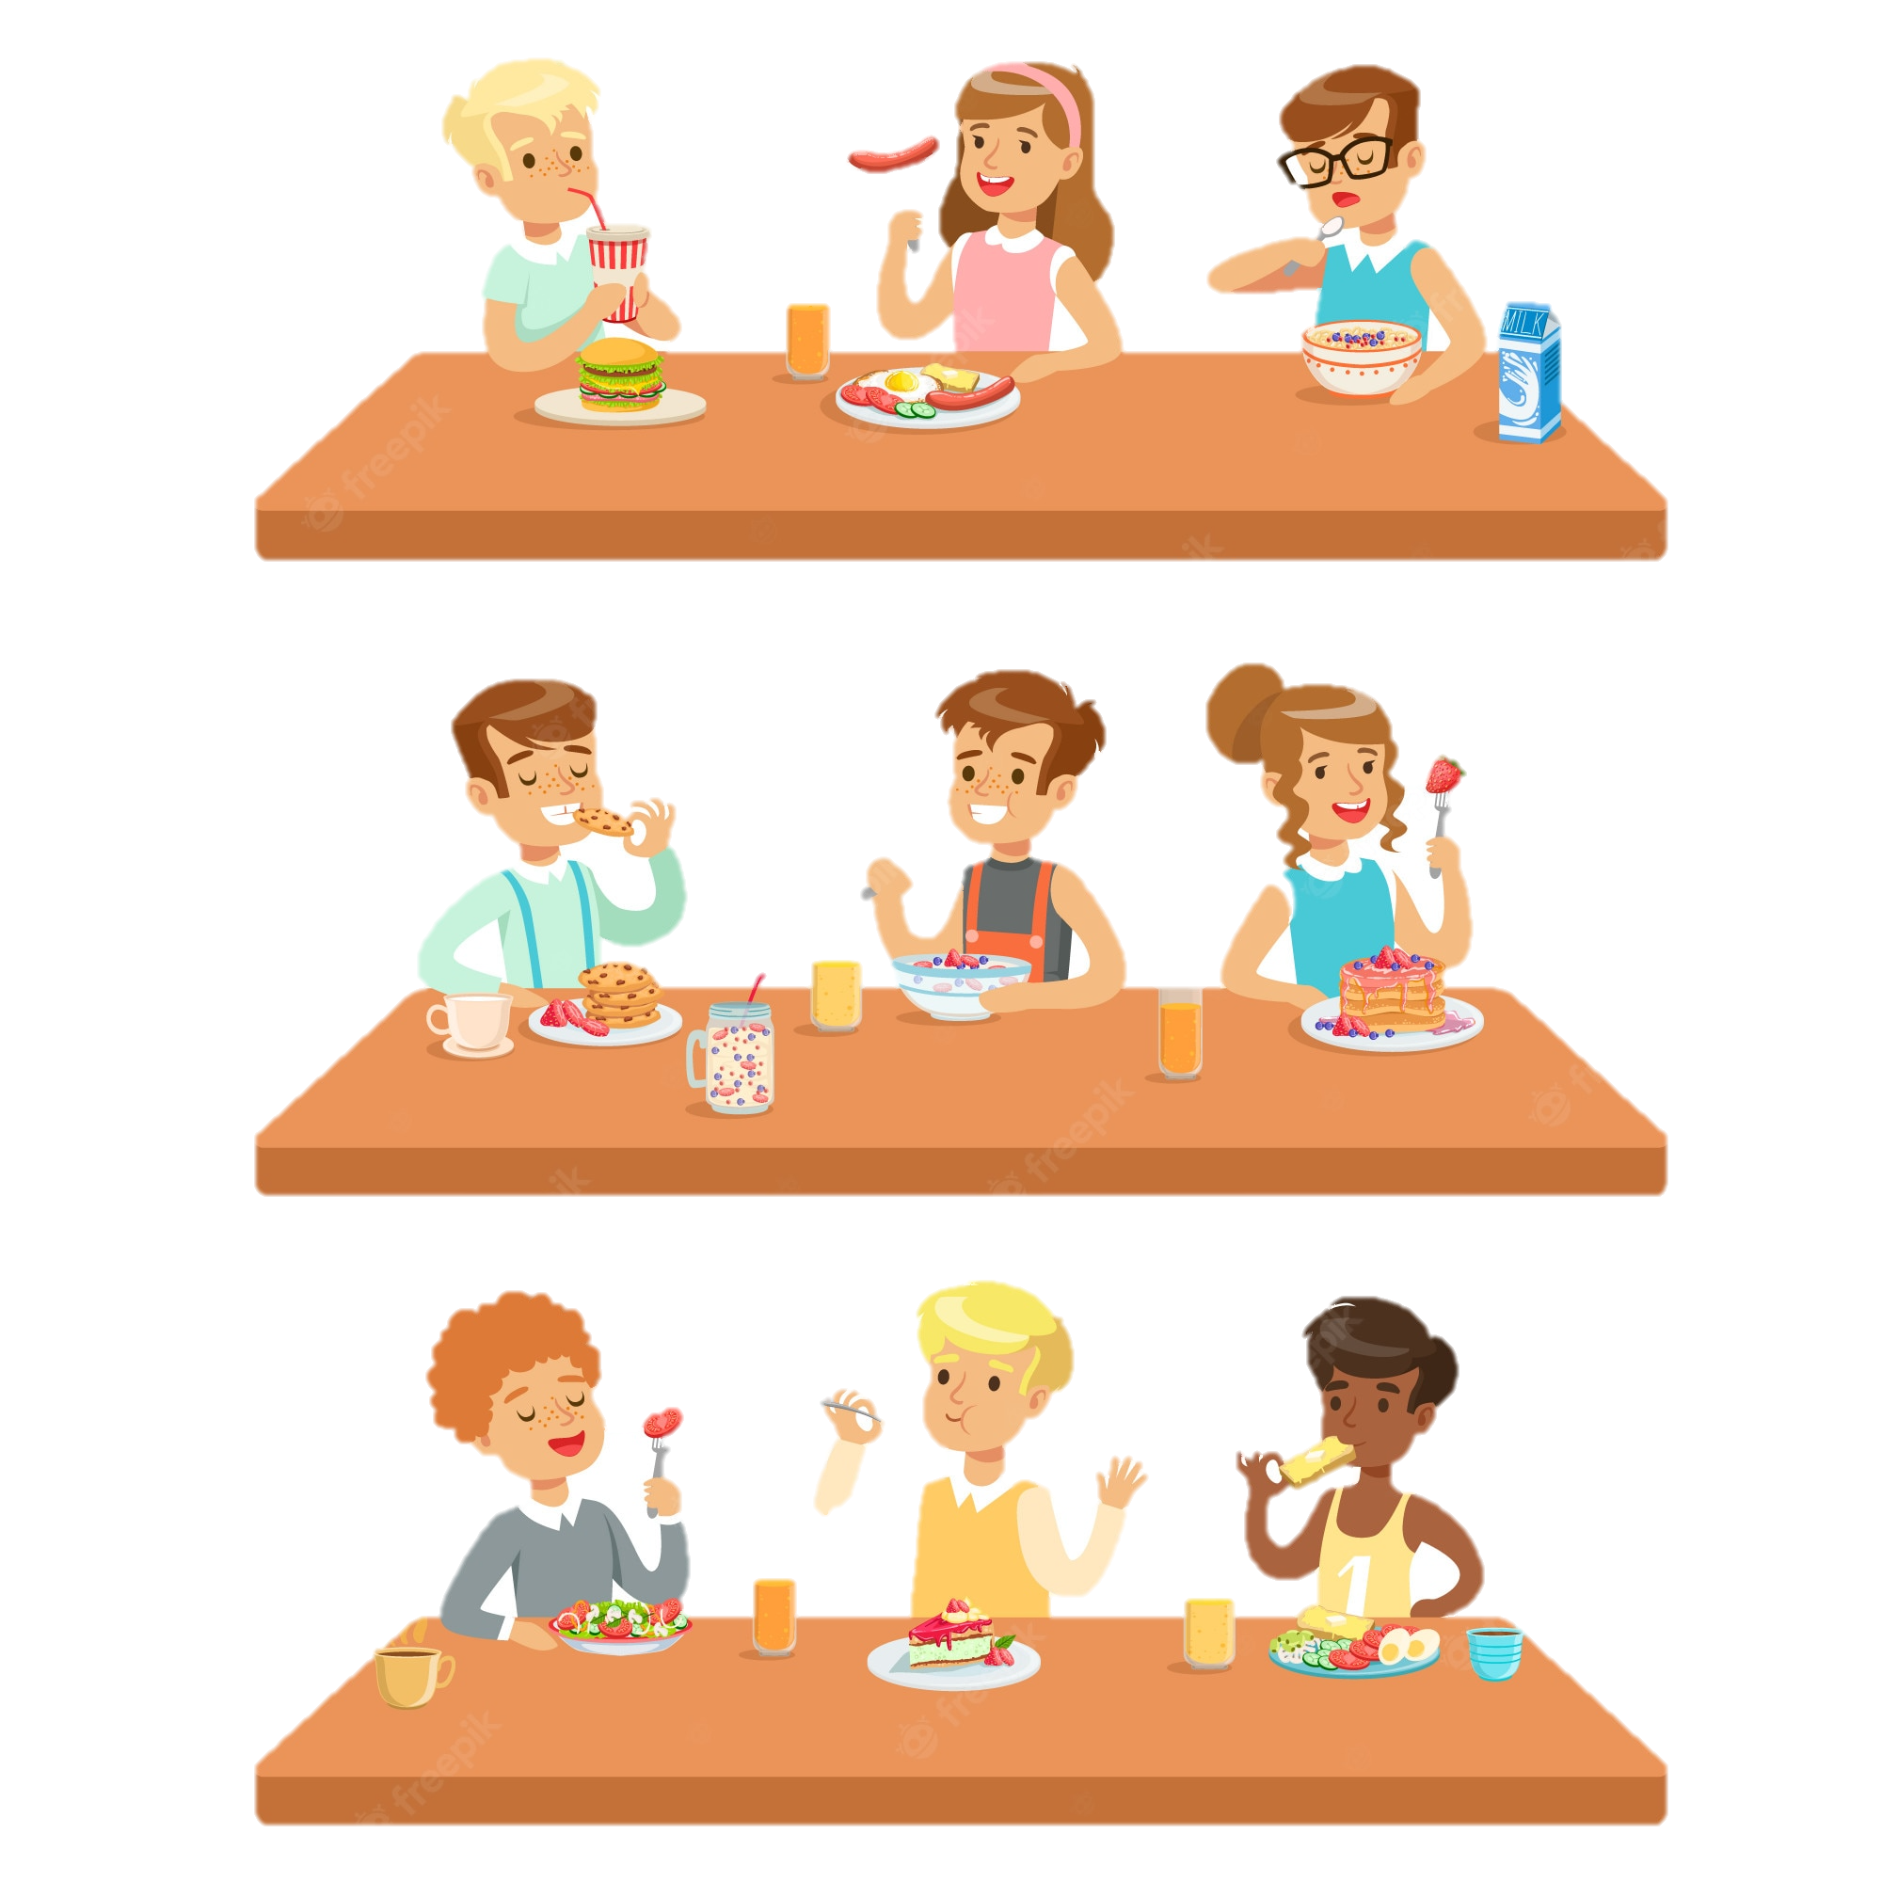
Ex 5. (p 51) Work in pairs.
Ask your partner about his or her favourite food and drink.
Example:
A: What's your favourite food?
B: It's pho bo - beef noodle soup.
A: When do you usually have it?
B: In the morning.
Structure:
A: What's your favourite food/drink?
B: It’s + name of food/drink.
A: When do you usually have it?
B: frequence.

Slide 18
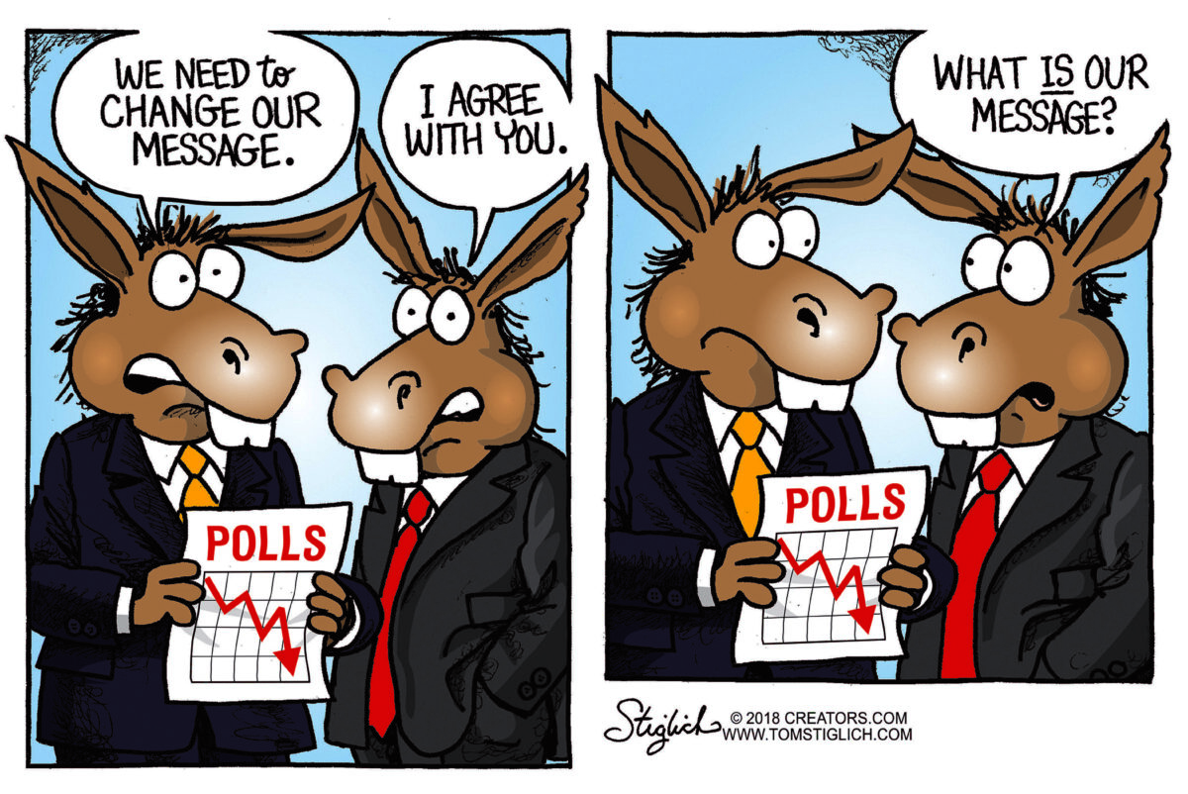
RECAP
CAN YOU REPEAT SOME WORDS / PHRASES FOLLOWING THE TOPIC?

Slide 19
Thank you!

