Slide 1
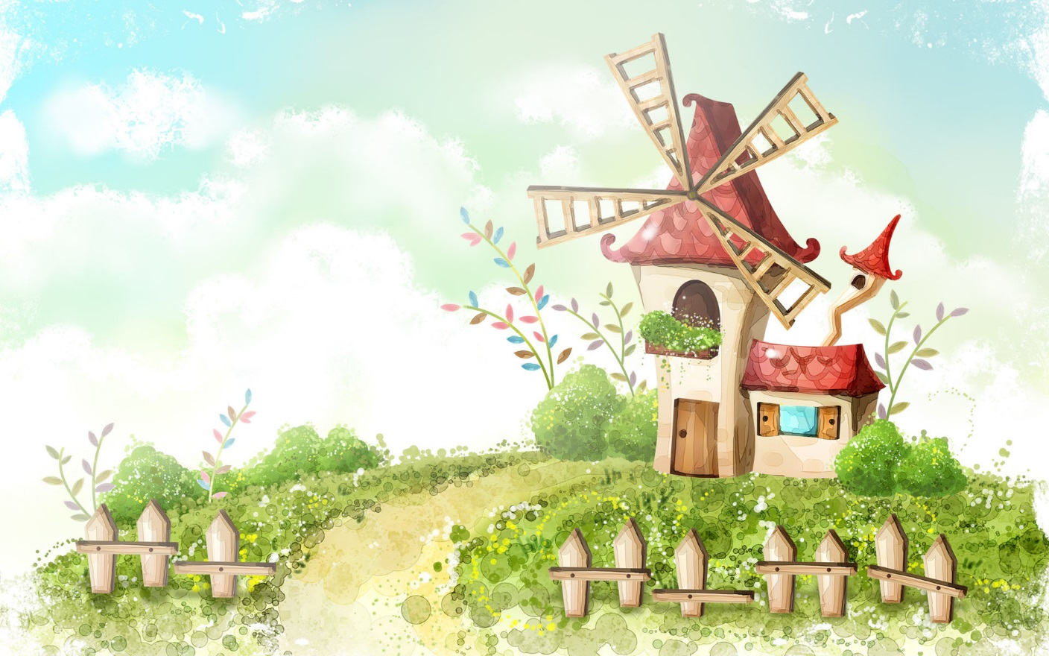
Welcome to our class

Slide 2

Listen an English Song.

Slide 3

GAME:
- Network
Who
What
Question words
What
Why
Where
How many
which
How often
How
What time
When

Slide 4



Friday, January 13th ,2023
Unit 7. TELEVISION
LESSON 3

Slide 5





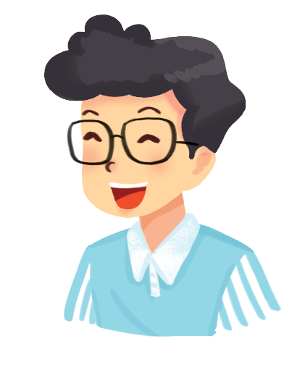



* Grammar 1:
WH – questions
Read the conversation and underline the question words.
Hi, Phong. What are you doing tomorrow?
I’m going to a book exhibition.
Where is it?
It’s in Van Ho street.
How long is it on?
From the 4th to the 7th January.

Slide 6

Match each question word with the information it needs.
Question word
When
How many
How often
What
Where
Who
Why
The information it needs
time
number
repetition
thing
place
people
reason
The information it needs
thing
time
people
reason
repetition
number
place

Slide 7
Match each question word with the information it needs.
Question word
When
How many
How often
What
Where
Who
Why
The information it needs
time
number
repetition
thing
place
people
reason

Slide 8

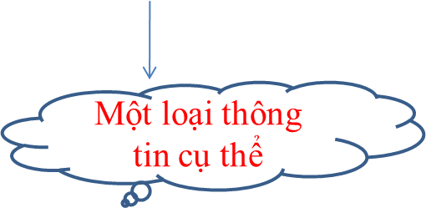
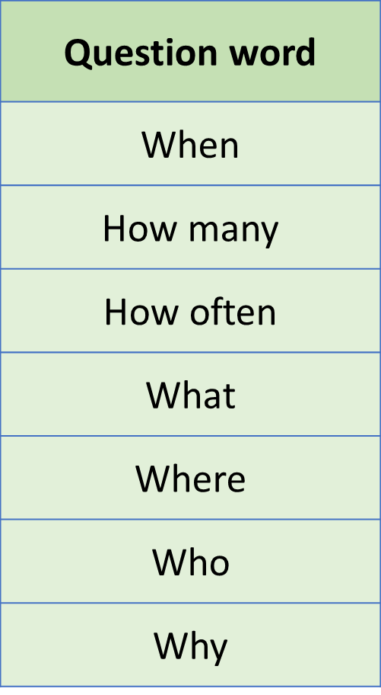
* Grammar:
WH – questions
* Each question word is used for a specific piece of information.
The information it needs
time ( thời gian)
number ( con số)
repetition (số lần)
thing ( đồ vật)
Place (nơi chốn)
People ( người)
Reason ( nguyên nhân)

Slide 9


Use the question words in the box to complete the conversations. Then listen Track and check your answers.
When
Who
What
Where
How often

Slide 10

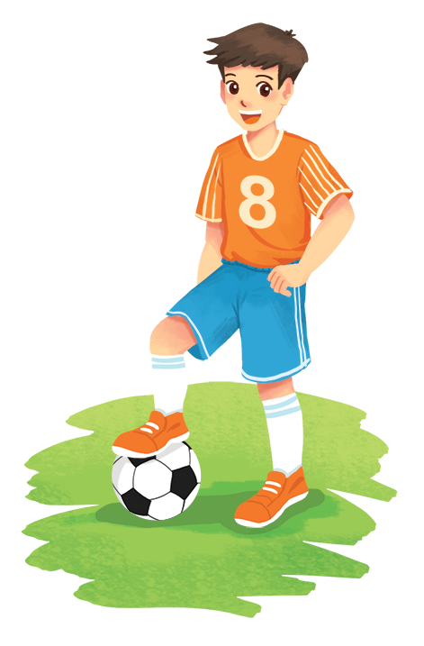
When
What
Who
Where
How often
* Conversation 1
A: _______ do you watch TV?
B: Not very often. Two or three times a week.
A: _______ do you watch TV?
B: It depends. But I like talent shows the most.
* Conversation 2
_______ do you like the most in Doraemon?
A:
B: Nobita. He’s so funny.
* Conversation 3
A:
B: Usually on Saturday or Sunday.
A:
B: In the yard.
_______ do you play football?
_______ do you play?

Slide 11

Grammar 2:
Conjunctions in compound sentences
* We use conjunctions to combine two clauses into a compound sentence.
Examples:
- I like watching cartoons, but my brother likes watching sports.
- I enjoy sports, so I spend a lot of time outdoors.
- I’m helping decorate the house, and my brother is busy cooking.

Slide 12
* Grammar 2
Conjunctions in compound sentences
- “and”: is used for addition.
- “but” is used for the contrast.
- “so” is used for the result
+ Make 3 compound sentences using three target conjunctions.
+ It is still painful, so I go to see a doctor.
+ She is tall, but her sister is short.
+I like music, and I like watching TV, too.

Slide 13

Match the beginnings with the endings.
Beginnings | Endings
1. I like animal programmes, | a. so I can be at the stadium on time.
2. I’ll get up early tomorrow, | b. but he can’t draw.
3. Sometimes we read books, | c. and my brother likes them, too.
4. My little brother can colour pictures, | d. so we spend every Saturday playing sports.
5. We love outdoor activities, | e. and sometimes we play sports.

Slide 14
Match the beginnings with the endings.
Beginnings | Endings
1. I like animal programmes, | c. and my brother likes them, too.
2. I’ll get up early tomorrow, | a. so I can be at the stadium on time.
3. Sometimes we read books, | e. and sometimes we play sports.
4. My little brother can colour pictures, | b. but he can’t draw.
5. We love outdoor activities, | d. so we spend every Saturday playing sports.

Slide 15

Use and, but or so to complete the sentences.
1.
I’m tired,
_______ I’ll go to bed early.
2.
My sister is good at school,
_______ I’m not.
3.
We trained hard,
_______ we won the game.
4.
The programme is interesting,
_______ it’s too long.
5.
I’ll write him some instructions, _______ I hope he’ll
follow them.

Slide 16

3
5
1
4
2
0
CHOOSE THE BEST ANSWER
1. My sister is good at school .…. I am not.
⬧
A
and
B
so
C
but
D
although
Notes:
16

Slide 17
5
4
3
1
0
2
CHOOSE THE BEST ANSWER
⬧
2. ……………… hours a day do you watch TV?
A
How many
B
What
C
Why
D
How long
Notes:
17

Slide 18
5
4
3
1
0
2
CHOOSE THE BEST ANSWER
3. He stays up late ,………………………..…
⬧
A
because he doesn’t have time for breakfast.
B
but he doesn’t have time for breakfast.
C
although he doesn’t have time for breakfast.
D
so he doesn’t have time for breakfast.
Notes:
18

Slide 19
5
4
3
0
2
1
CHOOSE THE BEST ANSWER
4. ………. do you watch TV?
⬧
A
What time
B
How often
C
Why
D
When
Notes:
19

Slide 20

3
5
1
4
2
0
CHOOSE THE BEST ANSWER
5. ……..… do children like watching cartoons?
⬧
Because they are funny and interesting.
A
What
B
How
C
Why
D
When
Notes:
20

Slide 21
5
4
3
1
0
2
CHOOSE THE BEST ANSWER
6. Who is your favourite TV person?
⬧
A
Cartoon “Tom and Jerry”
B
Film “Harry Potter”
C
Animal programme
D
Hoai Linh
Notes:
21

Slide 22
5
4
3
1
0
2
CHOOSE THE BEST ANSWER
7. I want to go to school in time, …… I go to bed early.
⬧
A
although
B
and
C
but
D
so
Notes:
22

Slide 23
3
5
1
4
2
0
CHOOSE THE BEST ANSWER
8. ……..…….. the programme is late, we will wait to watch it.
⬧
A
And
B
But
C
Although
D
So
Notes:
23

Slide 24
Use and, but or so to complete the sentences.
1.
I’m tired,
_______ I’ll go to bed early.
so
2.
My sister is good at school,
_______ I’m not.
but
3.
We trained hard,
_______ we won the game.
so
but
4.
The programme is interesting,
_______ it’s too long.
5.
I’ll write him some instructions, _______ I hope he’ll
follow them.
and .

Slide 25
IV. Consolidation
A closer look 2
Wh-questions
Conjunctions
Each question word is used for a specific piece of information.
“and” is used for addition
“but”
is used for the contrast
“so”
is used for the result.
Some question words: What / Where/ When/ Who/ Why/ How/ How long/ How many/ How often...

Slide 26

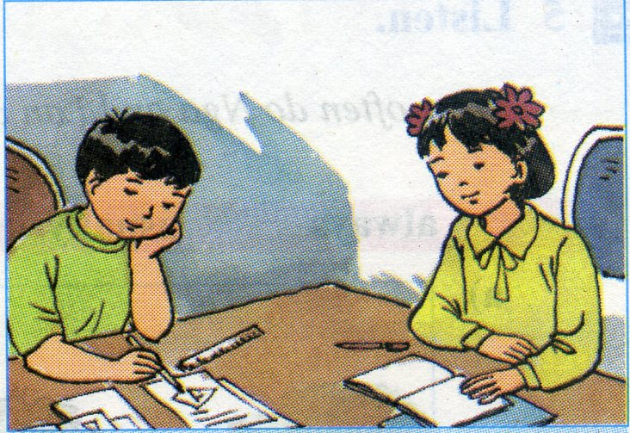
* Homework
- Study the grammar.
- Make more examples.
- Prepare : Lesson 4: Communication.

Slide 27


