Slide 1
Unit 11
Science and Technology
Lesson 3. A closer look 2

Slide 2
Objectives
Identify what direct speech and reported speech are.
01
Realise some differences between a direct speech and a reported speech (statements).
02
Be aware of changes in tenses, pronouns, time, and place expressions.
03

Slide 3

Let’s watch!
What type of sentence do they use after direct sentence?
What things have been changed in the indirect speech?
When should we use indirect speech?

Slide 4
We often use reported speech to:
1. Give someone a telephone message.
2. Tell someone news that we heard from someone else.
3. To report something that happened earlier.

Slide 5
Rules of changing direct speech to reported speech
1. Change pronoun
Direct speech
Indirect speech/
Reported speech
I
We
You
He/she
They
I/ we
    Ex:
Peter said “ I am so hungry”
Peter said he was so hungry.

Slide 6
Rules of changing direct speech to reported speech
2. Change possessive adjective
Direct speech
Indirect speech/
Reported speech
my
our
Your
Her/his
Their
My/our
    Ex:
    Mary said to me “ I met your mother yesterday’
    Mary said (that) she had met my mother the day before.

Slide 7
Rules of changing direct speech to reported speech
3. Change object
Direct speech
Indirect speech/
Reported speech
me
us
You
Her/him
Them
Me/us
    Ex:
He said to me “ I will give you the book”
He said he would give me the book.

Slide 8
Rules of changing direct speech to reported speech
4. Rule is to "backshift" the tense.
Direct speech
Indirect speech/ Reported speech
Present simple
Present continuous
Present perfect
Past simple
Past continuous
Past perfect
Past simple
Past continuous
Past perfect
Past perfect
Past perfect continuous
Past perfect

Slide 9
Rules of changing direct speech to reported speech
5. Change modal verb
Direct speech
Indirect speech/
Reported speech
Will
Can
May
Shall
Must
Would
Could
Might
Should
Must/ Hadto
    Ex:
She said “ I will tell him”
She said he would tell him.

Slide 10
Rules of changing direct speech to reported speech
6. Change adverbs of time/place
Direct speech
Indirect speech/ Reported speech
Yesterday
Tomorrow
Now
Today /Tonight
Last week
Ago
Next week
This / These
The day before/ the previous day
The following day/ the next day
Then
That day/ that night
The week before/ the previous week
Before
The following week/ the next week
That/ those

Slide 11
Summary
Direct speech
Indirect speech/ Reported speech
1.
Đổi đại từ, tính từ sở hữu, tân ngữ cho
phù hợp.
  Lùi thì của V.
  2.
  3.
  Thay đổi trạng từ chỉ thời gian/nơi chốn.

Slide 12
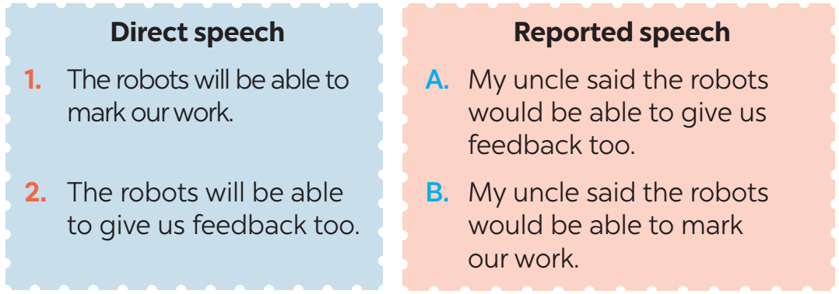
Ex 1. (p 118) Look at part of the conversation in GETTING STARTED again. Then match Minh’s uncle’s direct speech with his reported speech.
Minh: …My uncle said the robots would be able to mark our work and give us feedback too.

Slide 13
Ex 2. (p 118) Complete the second sentences using the correct verb form.
1. “I am a member of the IT club.”
→ Minh said that he _______ a member of the IT club.
2. “Mai will take an online course to improve her speaking.”
→ Nam said Mai ______ take an online course to improve her speaking.
3. “I am talking to Phong on the phone.”
→ Tom said he _____________ to Phong on the phone.
was
would
was talking

Slide 14
Ex 2. (p 118) Complete the second sentences using the correct verb form.
4. “They are going to send me an email.”
→ He said they ___________ to send him an email.
5. “I don’t have an iPod to listen to music.”
→ She said that she ___________ an iPod to listen to music.
were going
didn’t have

Slide 15




Rule:
Step 1: Find the keyword.
Step 2: Choose the correct answer.

Slide 16


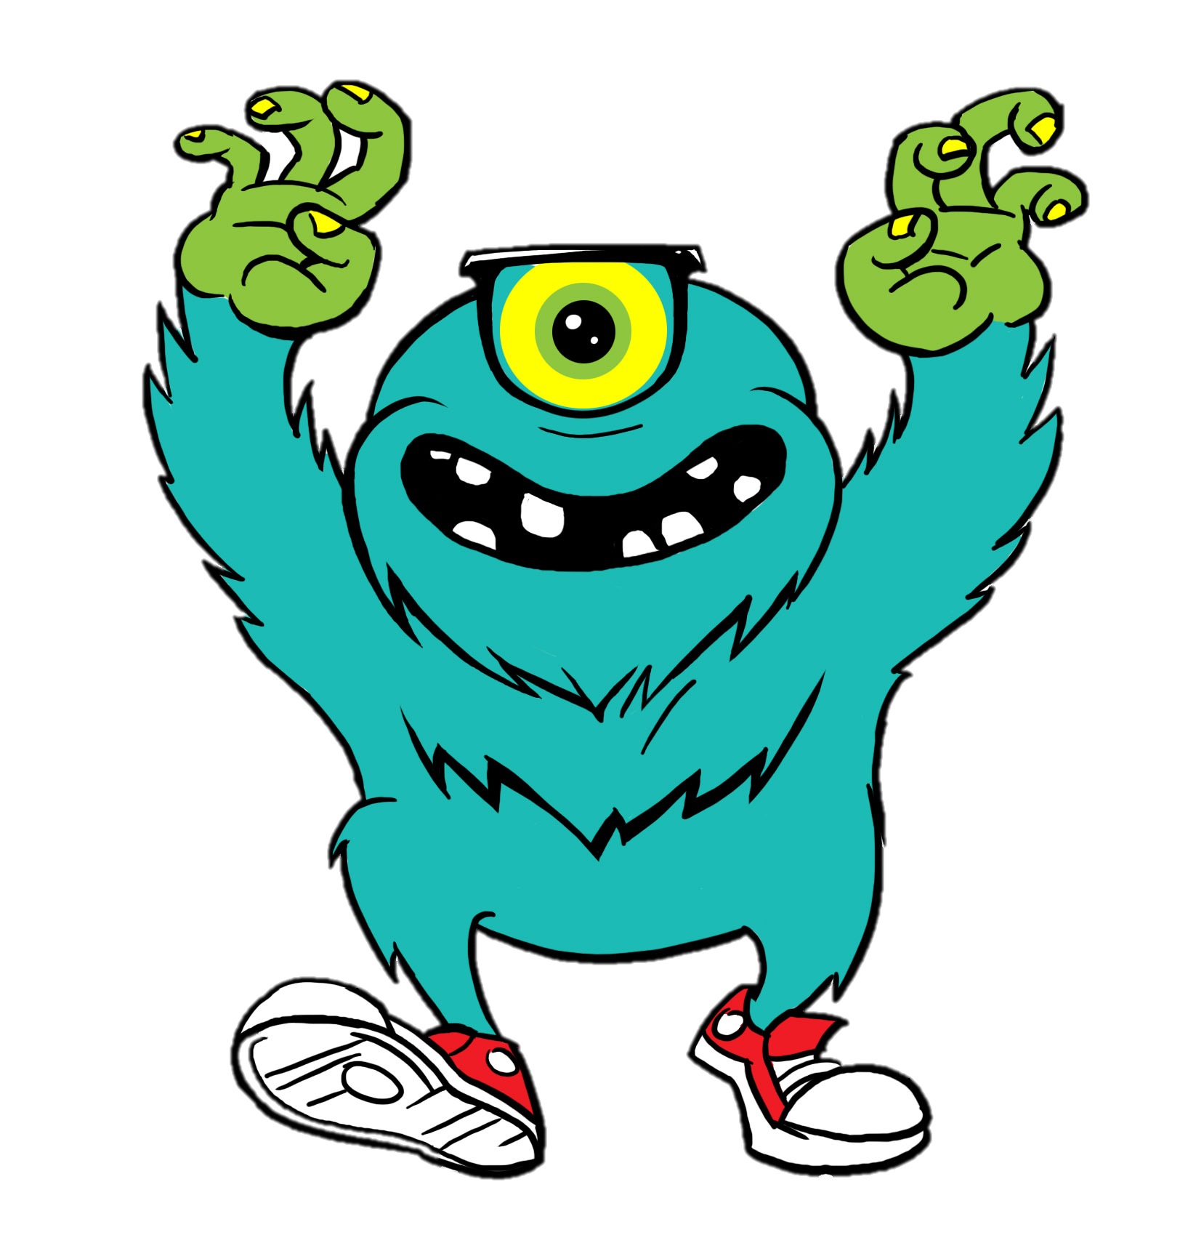





that day
the next day
1/5
there
that year
then
KEYWORD: here
“My teacher will park her car here,” said Mi.
Mi said her teacher would park her car __________.
there

Slide 17





that day
2/5
the next day
that year
there
then
KEYWORD: today
“Mai is reading about Thomas Edison today,” the teacher said.
The teacher said that Mai was reading about Thomas Edison __________.
that day

Slide 18
KEYWORD: this year
3/5
that day
that year
there
then
the next day
“They will invent a smart cooker this year,” my mum said.
My mum said that they would invent a smart cooker__________.
that year

Slide 19
KEYWORD: now
then
4/5
that day
the next day
that year
there
“The group is working on their project now,’ Tom said.
Tom said the group was working on their project __________.
then

Slide 20
KEYWORD: tomorrow
5/5
then
there
that year
the next day
that day
EXIT
“I'm having a science test tomorrow.” Mary said.
Mary said she was having a science test ____________.
the next day

Slide 21
Ex 4. (p 118) Complete the second sentence in each pair so that it means the same as the first one.
1. “We will live much longer in the future.” said the scientist.
→ The scientist said that ______________________________________.
2. “Our school is going to have a new laboratory here,” said our teacher.
→ Our teacher said that ________________________________________.
3. “They are developing technology to monitor students better,” my dad said.
→ My dad said that _________________________________________________________.
4. “There are no classes tomorrow because our teacher is ill,” Tom said.
→ Tom said that __________________________________________________________.
5. “We want some students to join the science club next semester,” the teacher said.
→ The teacher said that ____________________________________________________.

Slide 22
Ex 4. (p 118) Complete the second sentence in each pair so that it means the same as the first one.
1. “We will live much longer in the future.” said the scientist.
→ The scientist said that _______________________________
________________.
we would live much longer
in the future

Slide 23
Ex 4. (p 118) Complete the second sentence in each pair so that it means the same as the first one.
2. “Our school is going to have a new laboratory here,” said our teacher.
→ Our teacher said that _______________________________
___________________________.
our school was going to have
a new laboratory there

Slide 24
Ex 4. (p 118) Complete the second sentence in each pair so that it means the same as the first one.
3. “They are developing technology to monitor students better,” my dad said.
→ My dad said that ______________________________________
______________________________.
they were developing technology
to monitor students better

Slide 25
Ex 4. (p 118) Complete the second sentence in each pair so that it means the same as the first one.
4. “There are no classes tomorrow because our teacher is ill,” Tom said.
→ Tom said that ______________________________________
________________________________.
there were no classes the next day
because their teacher was ill

Slide 26
Ex 4. (p 118) Complete the second sentence in each pair so that it means the same as the first one.
5. “We want some students to join the science club next semester,” the teacher said.
→ The teacher said that ___________________________________
_________________________________________________.
they wanted some students
to join the science club the next semester

Slide 27



Ex 5. (p 118) He / She said that …
She said she would go home late.
1. Work in pairs
- Student 1. Say a sentence.
- Student 2. Change that sentence into reported speech.
2. Then swap roles
“I will go home late.” my mom said

Slide 28
Show your assignment!!!
Is the subject correct?
Let’s check
Has the tense been moved back yet?
Have the time and place been changed yet?

Slide 29
RECAP
subject, object, pronouns,
verb of tenses, positive adjectives, place, time.
Reported speech
What have you learnt today?
What things have you changed in reported speech?

Slide 30

Thank you!

Slide 31
Alternative resources
Here’s an assortment of alternative resources whose style fits that of this template:
Vectors:
Hand drawn national science day instagram posts collection

