Slide 1
Unit 1.
Leisure time
Lesson 4. Communication

Slide 2
Objectives
By the end of this lesson, Ss will be able to:
01
02
03
Knowledge
Competences
- Invite and accept invitations
- Develop communication skills and creativity
- Be collaborative and supportive in pair work and teamwork
- Actively join in class activities
Personal qualities
- Be ready and confident in real life conversations

Slide 3
Chatting
1. What do you like doing in your free time?
2. What do your friends like doing in their free time?
3. What do young people in Viet Nam
often do in their free time?

Slide 4

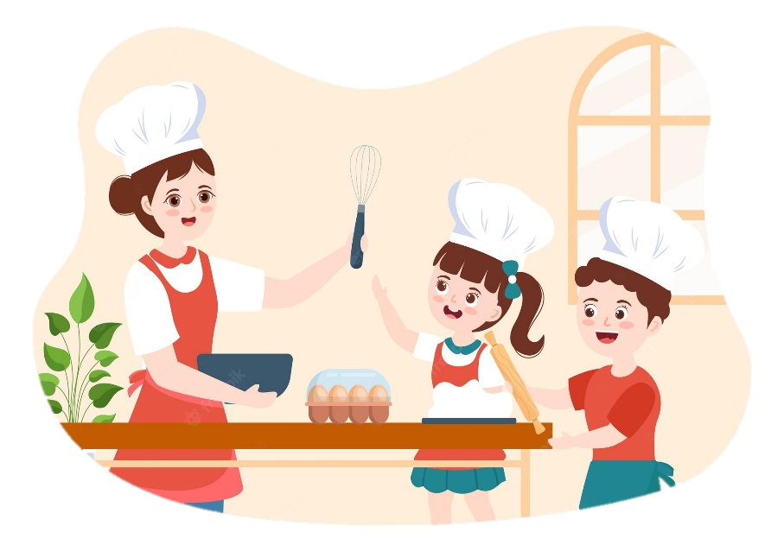
Ex 1 (p 12). Listen and read the conversations. Pay attention to the highlighted sentences.
Trang: Would you like to go to the
cooking club with me this Sunday?
Ann: I’d love to. Thanks.
1
Tom: Do you fancy going for a walk?
Mark: That’s great. Thanks.
2
Structures | Examples
How to invite | Would you like + to V …? Do you fancy + V-ing …?
How to accept invitations | I’d love to. That’s great.

Slide 5

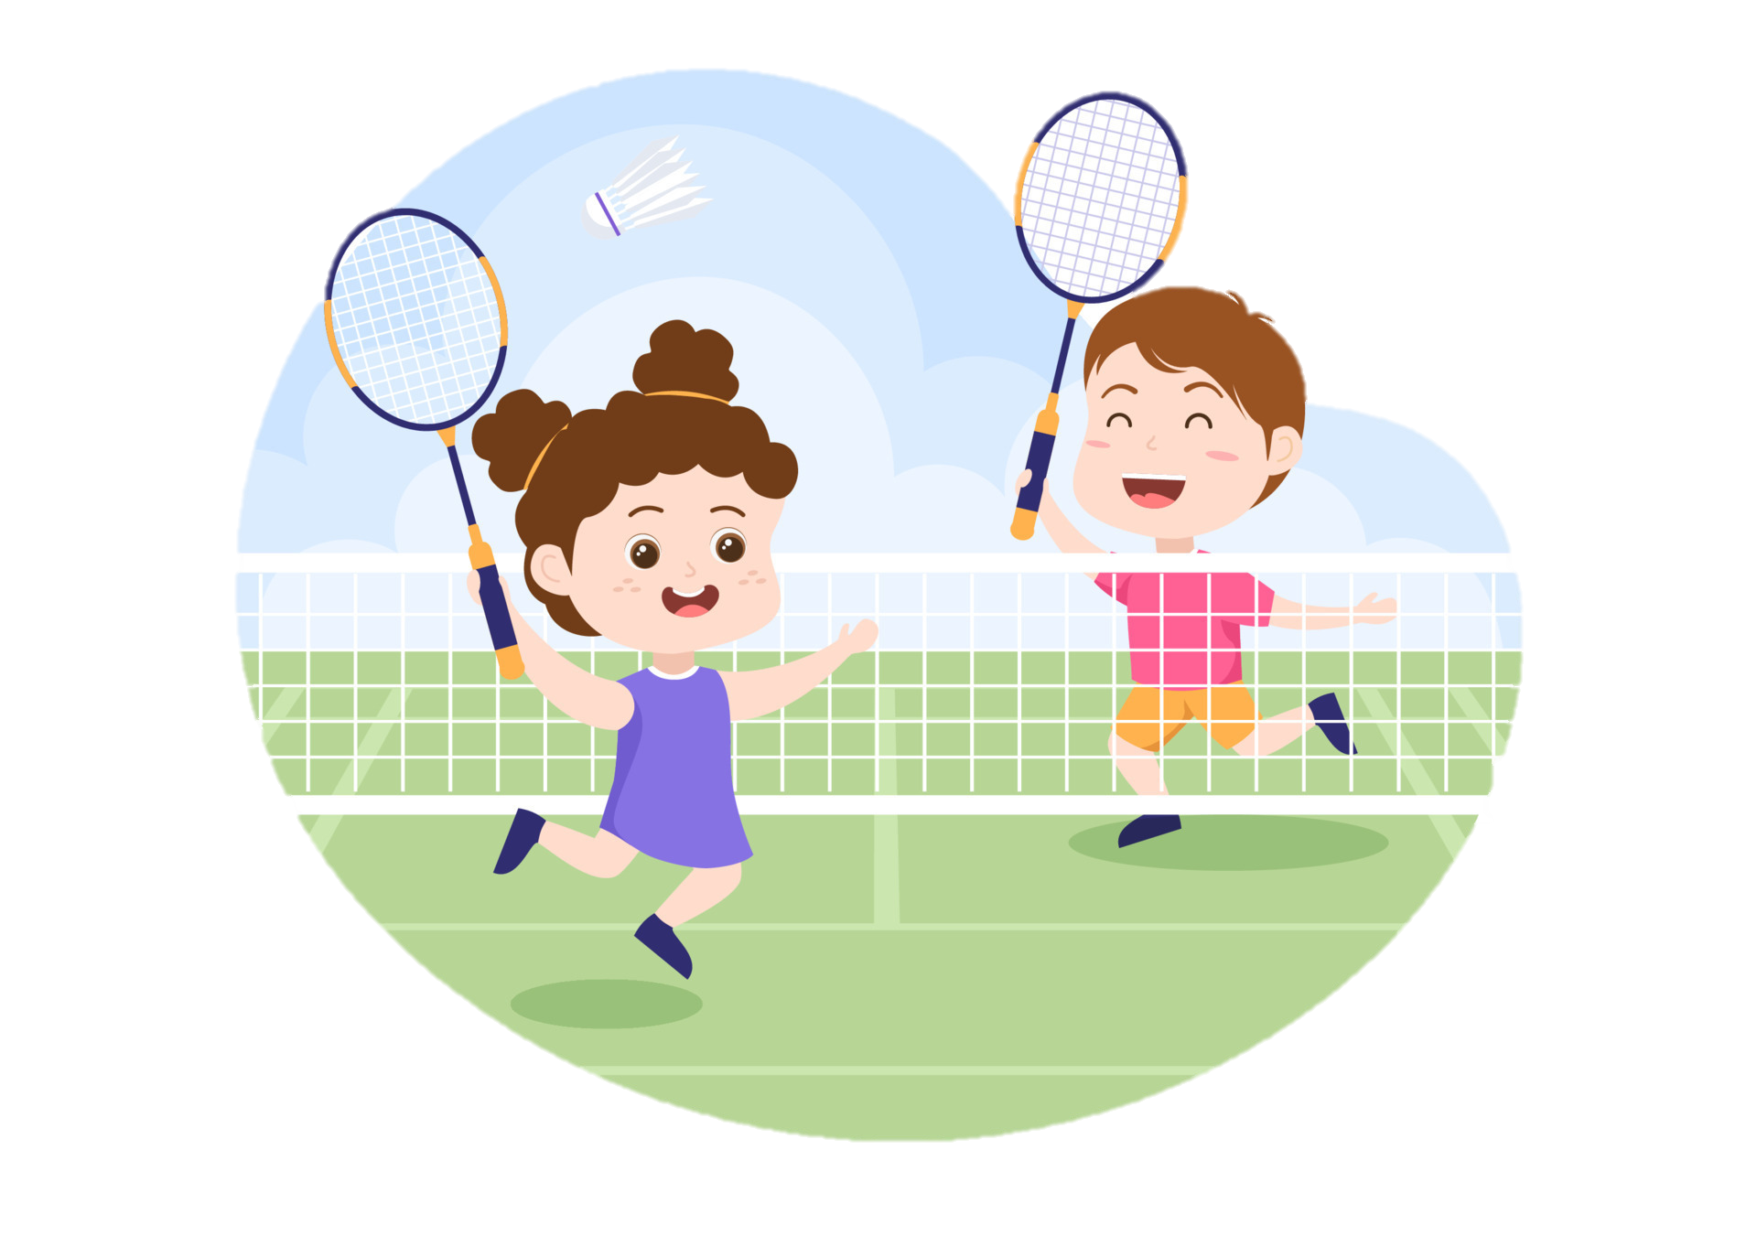
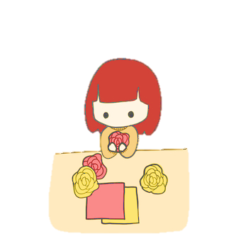
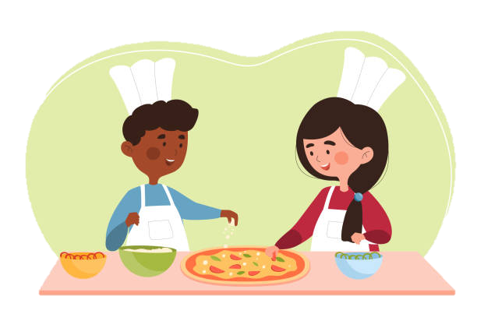
Ex 2 (p 12). Work in pairs. Create dialogues according to the following situations using the highlighted parts in Ex 1.
You invite your friend to play badminton.
You invite your friend to make paper flowers with you.
You invite your friend to try your home-made pizza.

Slide 6
What leisure activities do teenagers around the world do in their free time?

Slide 7
TEENS’ LEISURE ACTIVITIES AROUND THE WORLD

Slide 8

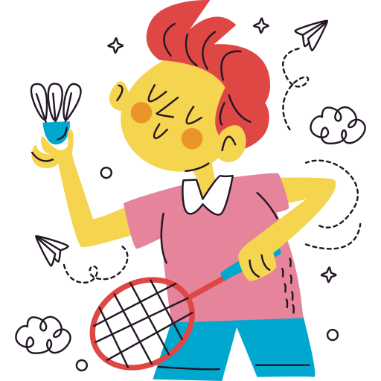

Ex 3 (p 12). Work in pairs. Answer the question.
What is the activity in each picture?
doing origami
playing badminton
snowboarding
Notes:
Which country’s teenagers do origami? – Japan
Which country’s teenagers often go snowboarding? – Australia,…

Slide 9



Ex 4 (p 13). Read what three teenagers say about their leisure activities. Complete the table with the information from the text.
Eric (St. Gallen, Switzerland):
My hometown has some famous ski resorts. I'm into snowboarding and usually go to a nearby ski resort with my parents at weekends. Snowboarding improves my overall health and balance.
Lan (Quang Binh, Viet Nam): I'm keen on playing sport, especially badminton. My best friend lives next door, so we play badminton almost every afternoon. It’s an easy sport, and it also improves my muscle strength and helps reduce stress.
Sakura (Kyoto, Japan): Origami is the art of paper folding. I love doing it on my own in my free time. With just some sheets of paper, I can create almost anything: flowers, birds, or fans. Doing origami helps me to relax.
Name | Country | Leisure activity | Person / People to do the activity with | Benefits of the activity
Sakura | Japan
Eric | Switzerland
Lan | Viet Nam
doing origami
no one
helps her to relax
snowboarding
parents
improves his overall health and balance
playing badminton
best friend
- improves her muscle strength
- reduces stress

Slide 10

Ex 5 (p 13). Work in groups. Ask and answer the questions.
Which of the activities in Ex 4 do you want to try?
Why do you want to try it?
Example: I want to try snowboarding. It seems fun and adventurous. Also, it helps improve overall heath and balance.

Slide 11
Report your group’s answer to the class
Example: I want to try snowboarding. It seems fun and adventurous. Also, it helps improve overall heath and balance.

Slide 12
RECAP
Find Synonyms of
“DOING ORIGAMI”
in this lesson today.
→ paper folding

Slide 13
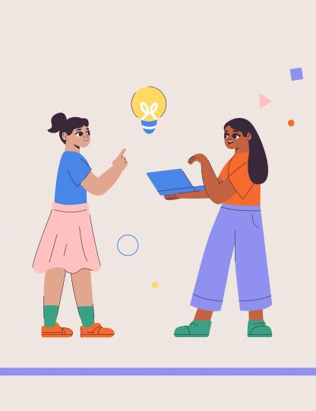

What have you learnt today?
RECAP
Invite and accept invitations
Invite and refuse invitations
Giving suggestions

Slide 14
— HOMEWORK —
PREPARE NEXT LESSON:
UNIT 1. LESSON 5. SKILLS 1

Slide 15
Thank you!

