Slide 1







WELCOME
TO OUR CLASS!
Presented by: …………

Slide 2


Let’s watch

Slide 3
Unit 8:
TOURISM
Lesson 3: A Closer Look 2

Slide 4


Look at the examples:
I know a girl who works as a tour guide in Singapore.
I am reading a travel brochure which I picked up in Japan.
N (person)
N (thing)
Who and which are relative pronouns. They are used after a noun to show which person/ whing we are talking about.
Who refers to a person, and which refers to a thing.

Slide 5
Look at the examples:
The man whose book you are reading is my friend.
We visited a city whose houses are painted in different bright colours.
N (person)
N (thing)
Whose is a relative pronoun. It is used to show possessive by people and things.

Slide 6


1. Underline the noun or noun phrase in each sentence that which or who refers to.
1. People who travel abroad usually use travel apps.
2. The brochure which you can get free at the airport is useful for your stay in Bangkok.
3. Is this the video which explains some new trends in tourism?
4. Could you recommend to me a local tour guide who can speak English?
5. They want to visit a city which is famous for its rich history.

Slide 7


2. Underline the correct relative pronoun for each sentence
1. This is the brochure which / who provides the information you need for your visit to Beijing.
2. ABC is the company which / who won the Best Travel Agency Award last year.
3. The elders which / who are not good at using online apps prefer package tours.
4. A hop-on hop-off bus which / who runs from here every hour is the fastest way to visit a city.
5. Food tourism is for tourists which / who want to explore the unique dishes of a place.

Slide 8
+
3. Complete each sentence with “who” or “whose”
1. Mr Minh, _________ will guide us on our Cu Chi Tunnel tour, is on his way.
2. This is the writer _________ book Travel on $50 a Day is my favourite travel guide.
3. My son, _________ is a huge fan of Taylor Swift, is on a music tour to see her in concert.
4. Ha Giang, _________ beauty and history are appealing, is a must-go in my tour list.
5. While travelling, my father often spends time talking with the locals ______ stories, he says, are interesting about the land we are visiting.

Slide 9
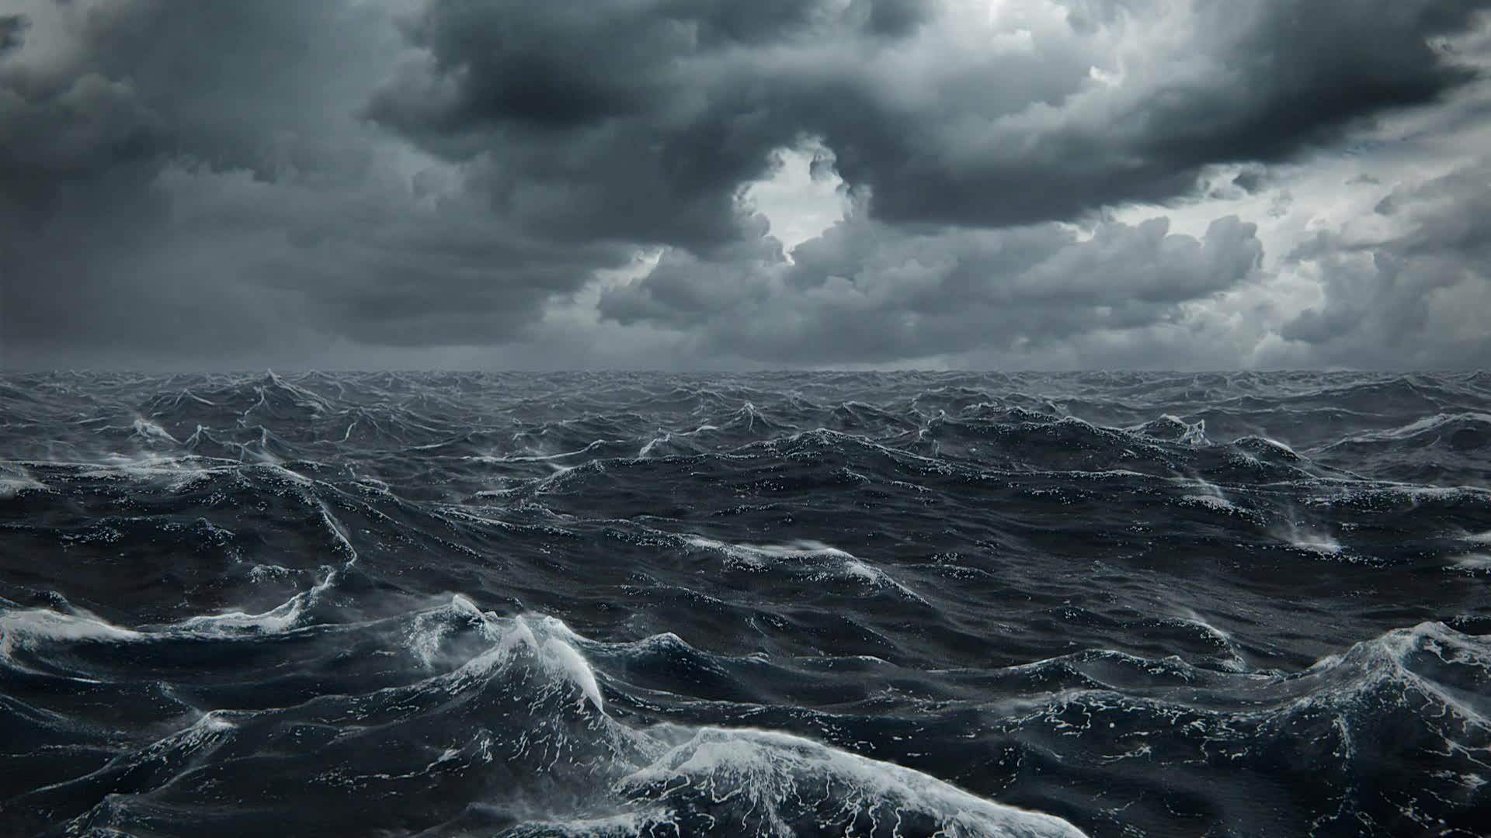

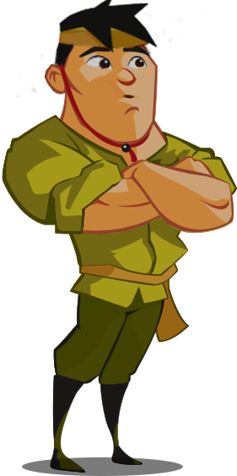
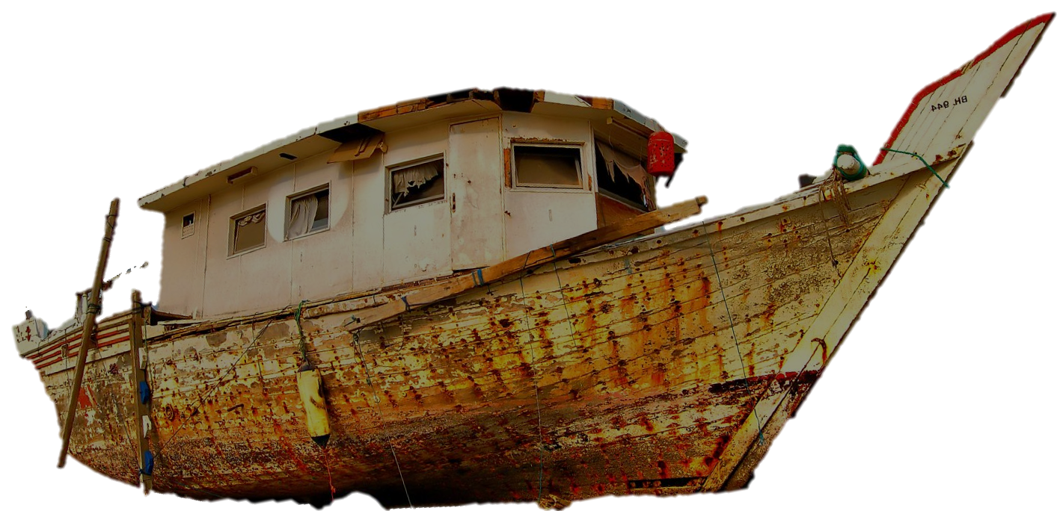
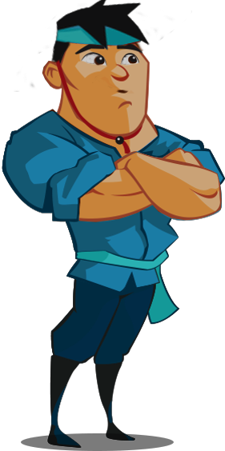
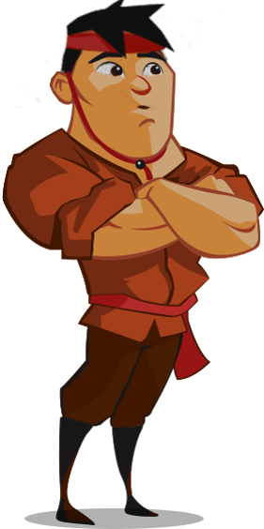
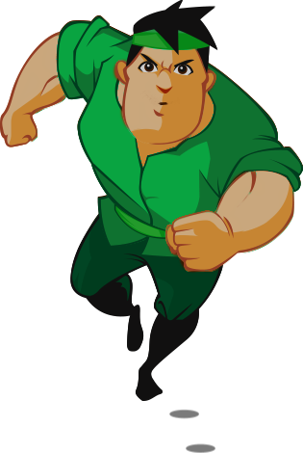
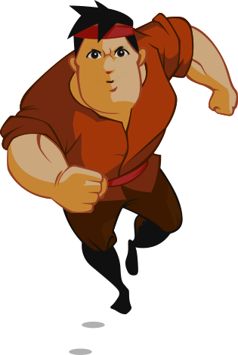

RESCUE THE FISHERMAN

Slide 10
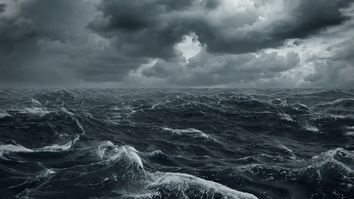

Five fishermen are in danger during the storm.
Please help the rescue team save the fishermen by answering the questions correctly.

Slide 11
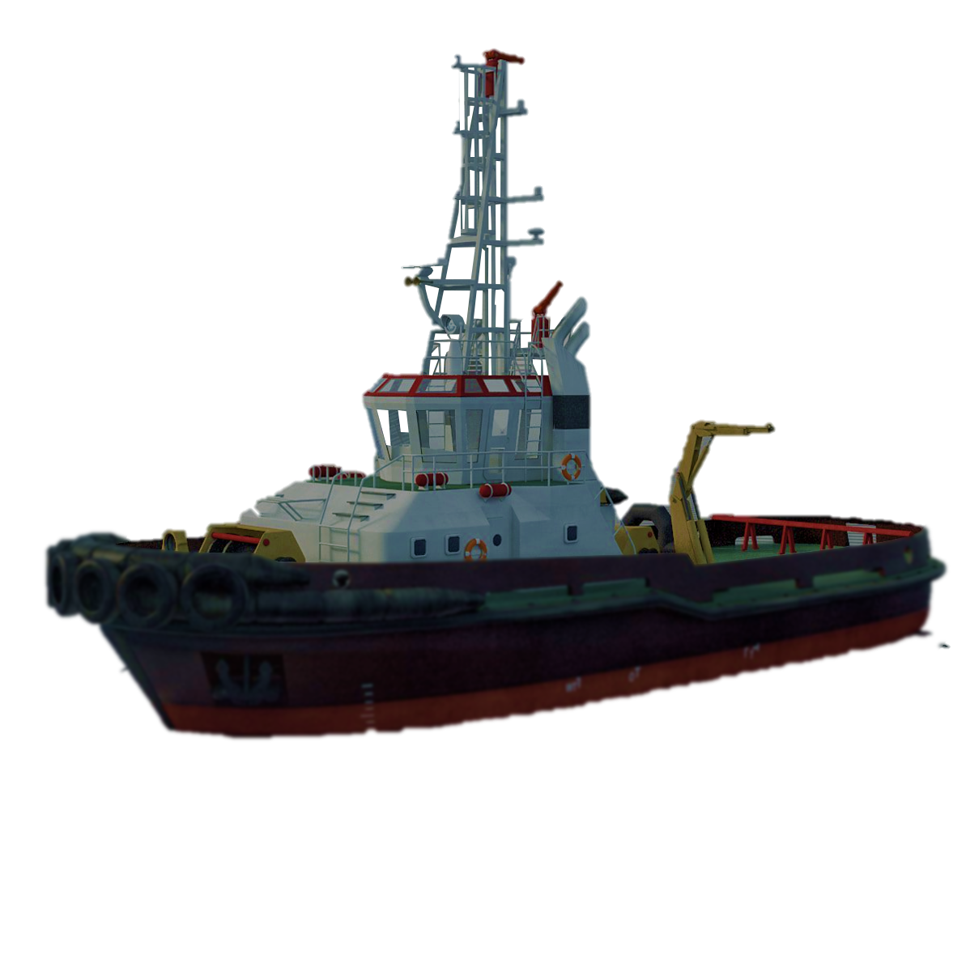
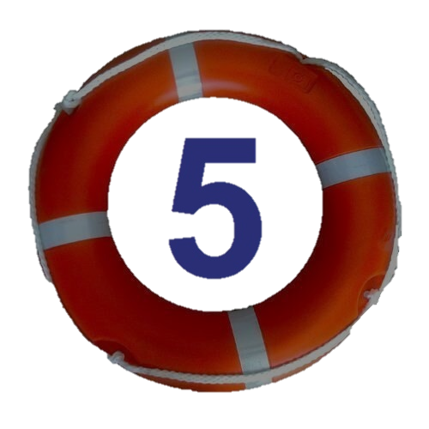
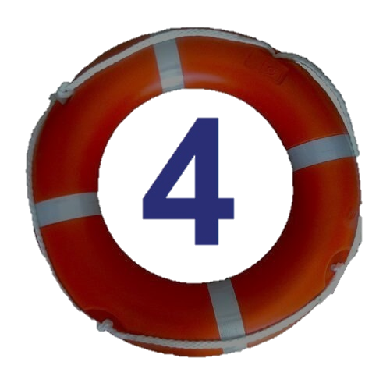



5
4
3
2
1

Slide 12

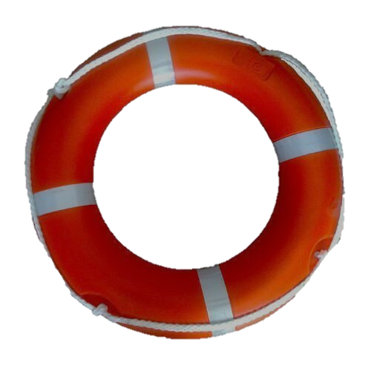
1. Mr Minh, _________ will guide us on our Cu Chi Tunnel tour, is on his way.
who

Slide 13
2. This is the writer _________ book Travel on $50 a Day is my favourite travel guide.
whose

Slide 14
3. My son, _________ is a huge fan of Taylor Swift, is on a music tour to see her in concert.
who

Slide 15
4. Ha Giang, _________ beauty and history are appealing, is a must-go in my tour list.
whose

Slide 16
5. While travelling, my father often spends time talking with the locals ______ stories, he says, are interesting about the land we are visiting.
whose

Slide 17
Look at the answers again
1. Mr Minh, who will guide us on our Cu Chi Tunnel tour, is on his way.
2. This is the writer whose book Travel on $50 a Day is my favourite travel guide.
3. My son, who is a huge fan of Taylor Swift, is on a music tour to see her in concert.
4. Ha Giang, whose beauty and history are appealing, is a must-go in my tour list.
5. While travelling, my father often spends time talking with the locals whose stories, he says, are interesting about the land we are visiting.

Slide 18
4. Match a clause in A with a clause in B to make a complete sentence
1. Don’t forget to visit the National Air and Space Museum
a. whose products are on display at the Handicraft Show.
2. Yesterday I phoned Pierre,
b. who knows a lot about the history of this area?
3. There, I could see the ruinous hall
c. which appeared in the film “Jane Eyre”.
4. Could you recommend a local tour guide
d. whose breathtaking collection is a must-to-see.
5. We were lucky to meet some artisans
e. who is arranging accommodation for our stay in Paris.

Slide 19
Check your answer
1. Don’t forget to visit the National Air and Space Museum
a. whose products are on display at the Handicraft Show.
b. who knows a lot about the history of this area?
c. which appeared in the film “Jane Eyre”.
d. whose breathtaking collection is a must-to-see.
e. who is arranging accommodation for our stay in Paris.

Slide 20
Check your answer
2. Yesterday I phoned Pierre,
a. whose products are on display at the Handicraft Show.
b. who knows a lot about the history of this area?
c. which appeared in the film “Jane Eyre”.
e. who is arranging accommodation for our stay in Paris.

Slide 21
Check your answer
3. There, I could see the ruinous hall
a. whose products are on display at the Handicraft Show.
b. who knows a lot about the history of this area?
c. which appeared in the film “Jane Eyre”.

Slide 22
Check your answer
4. Could you recommend a local tour guide
a. whose products are on display at the Handicraft Show.
b. who knows a lot about the history of this area?

Slide 23
Check your answer
5. We were lucky to meet some artisans
a. whose products are on display at the Handicraft Show.

Slide 24
Look at the answers again
1. Don’t forget to visit the National Air and Space Museum
d. whose breathtaking collection is a must-to-see.
2. Yesterday I phoned Pierre,
e. who is arranging accommodation for our stay in Paris.
3. There, I could see the ruinous hall
c. which appeared in the film “Jane Eyre”.
4. Could you recommend a local tour guide
b. who knows a lot about the history of this area?
5. We were lucky to meet some artisans
a. whose products are on display at the Handicraft Show.

Slide 25
+
5. Work in pairs. Discuss and finish the sentences.
1. Son Doong is now a world-famous destination for travellers who ______.
2. I’m personally against tours which ______.
3. We shared a holiday home with two Germans whose ______.
4. I bought a city map which ______.
5. Most travellers prefer working with tour guides who ______.

Slide 26
Suggested answer:
1. Son Doong is now a world-famous destination for travellers who ______.
2. I’m personally against tours which ______.
3. We shared a holiday home with two Germans whose
4. I bought a city map which ______.
5. Most travellers prefer working with tour guides who
look for adventures / love exploring caves.
use animals for entertainment.
English was easy to understand.
has attraction clearly marked and directions how to get there.
are friendly and helpful

Slide 27



WRAP-UP
Use relative pronouns: which, who and whose to make sentences about your travel experience
1
Practice using “who”, “which” and “whose”
2

Slide 28
HOMEWORK
1
2
3
Review relative pronouns
Do exercises in the workbook
Prepare for the next lesson

Slide 29


THANK
See you next time!
YOU!

