Slide 1






Slide 2

Our sports day
9
Lesson 2 - Period 4

Slide 3
TABLE OF CONTENTS
01
02
03
04
Warm-up & Review
Listen and tick.
Look, complete and read.
Let’s play.

Slide 4
01
Warm -up & Review

Slide 5


Slide 6
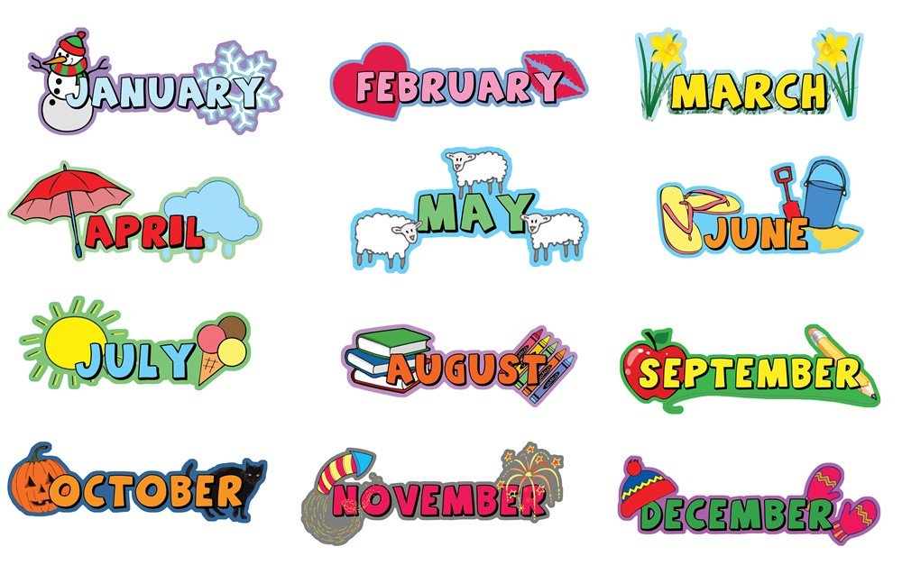
12 months of the year

Slide 7

Is your sports day in ___?
Yes, it is.
No, it isn't. It's in ____.

Slide 8
When's your sports day?
It's in _____.

Slide 9
02
Listen and tick.

Slide 10
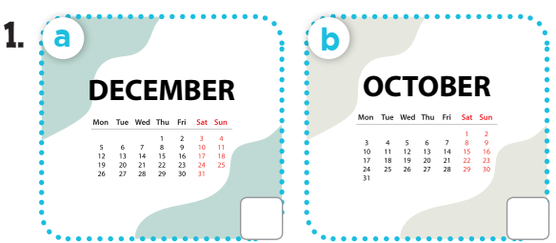
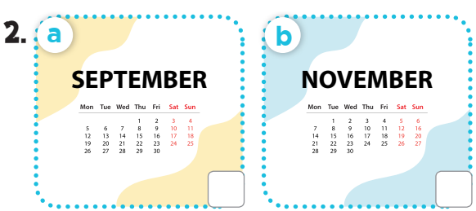
Look and say the months.

Slide 11

Listen and tick.



Slide 12
03
Look, complete and read.

Slide 13
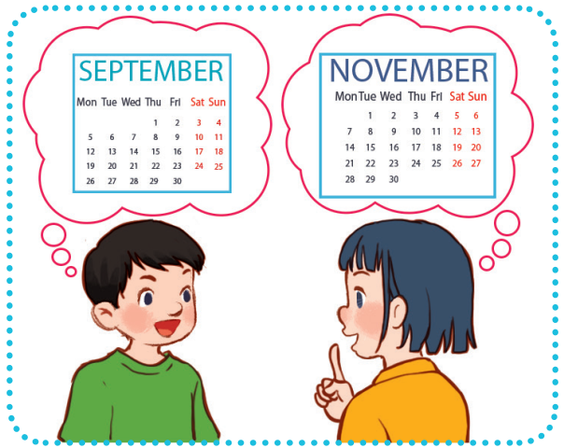
Look, complete and read.
5
1.
A: Is your sports day in September?
B: ______, it is. When’s your sports day?
A: It’s in __________.
Yes
November

Slide 14
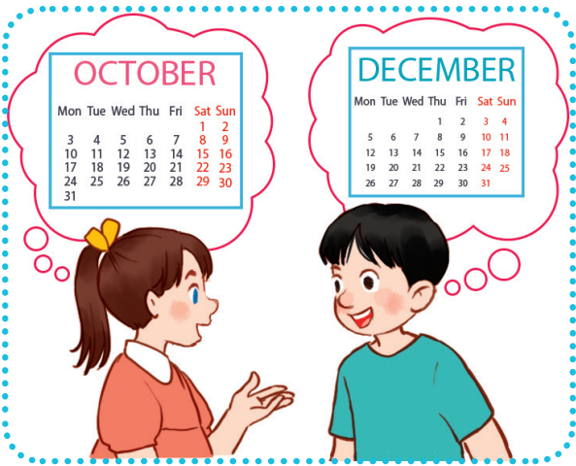
Look, complete and read.
5
2.
A: Our sports day is in October.
_____ your sports day in
October too?
B: No, it isn’t.
A: ________ your sports day?
B: It’s in __________.
Is
When’s
December

Slide 15
04
Let's play.

Slide 16
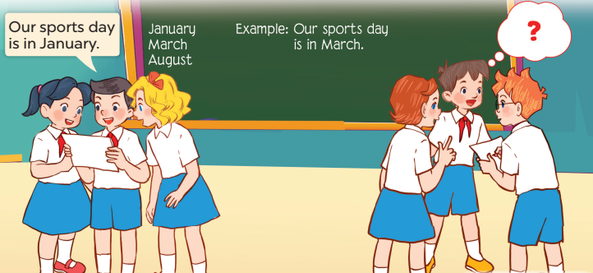
Let’s play.
6
Who’s faster?

Slide 17

1
2
3
THE
FOOTBALL GAME
4
5
6
7
8
9

Slide 18

_____ your sports day?
When's
A. When
B. Whens
C. When's

Slide 19
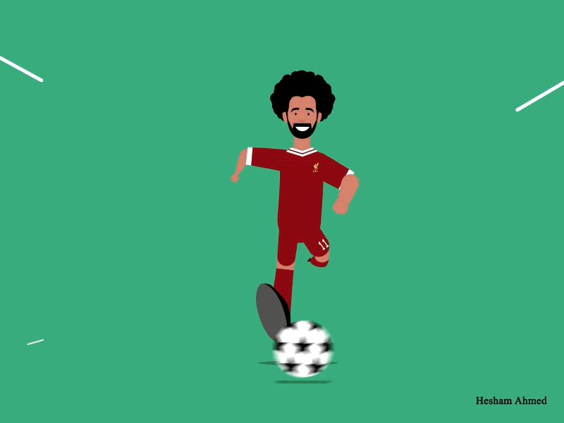
+ 3 points

Slide 20
Is
____ your sports day
in June?
A. Are
B. Is
C. It

Slide 21
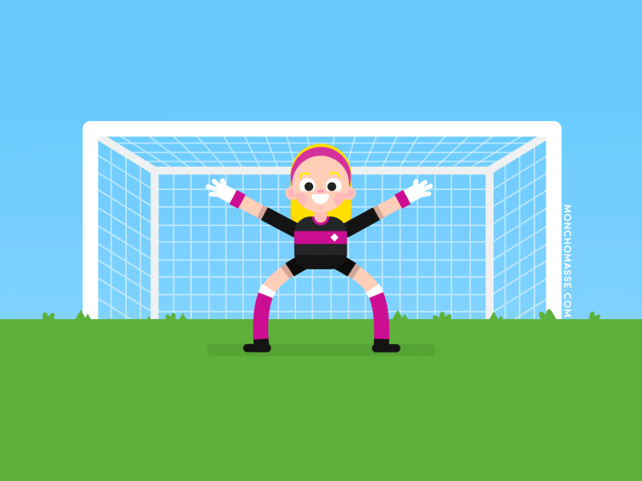
+ 5 points

Slide 22
When's your sports day?
A. It
B. It's
C. Is
___ in February.
It's

Slide 23
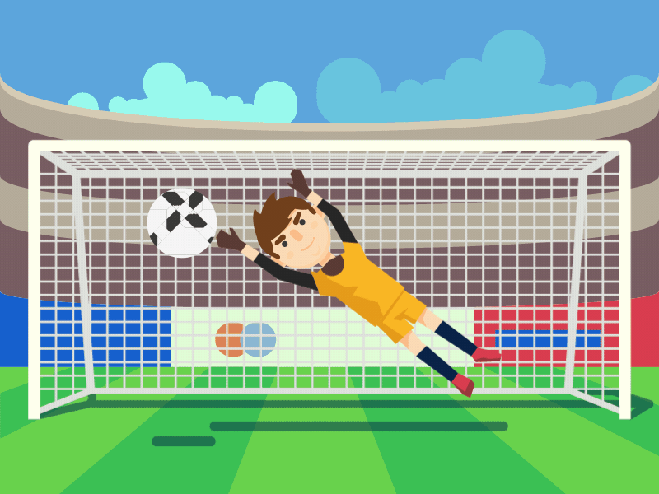
+ 2 points

Slide 24
Is your sports day
in May?
A. it is
B. it's
C. it isn't
Yes, _____.
it is

Slide 25
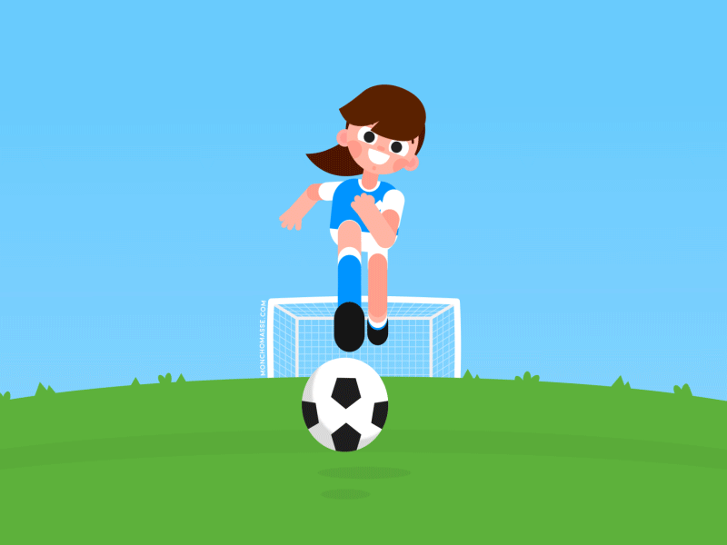
Take 2 points from another team

Slide 26
Is your sports day
in December?
A. it not
B. it's
C. it isn't
No, _______.
it isn't

Slide 27
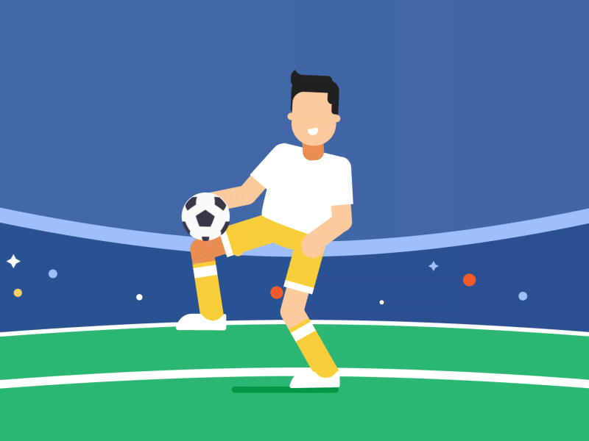
Change points with another team

Slide 28
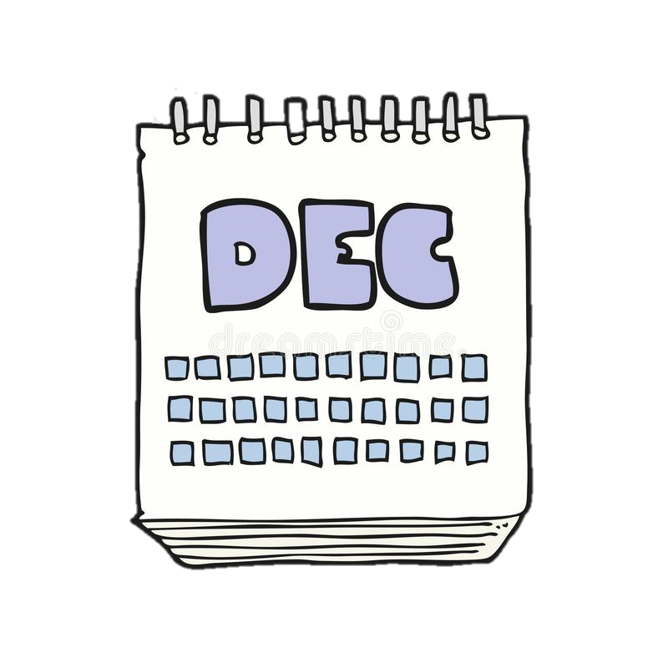

When's your sports day?
It's in _________.
December

Slide 29
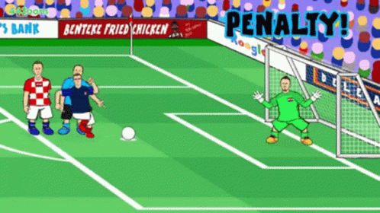
Oh no!
-3 points

Slide 30
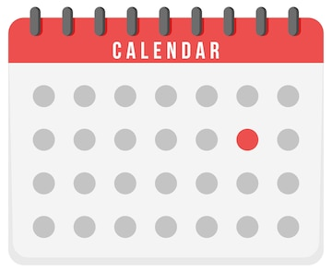

When's your sports day?
Jun
It's in _______ .
June

Slide 31
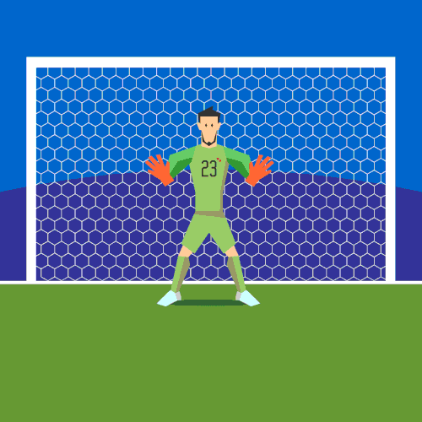
+ 4 points

Slide 32
When's your sports day?
Feb
It's in ________.
February

Slide 33
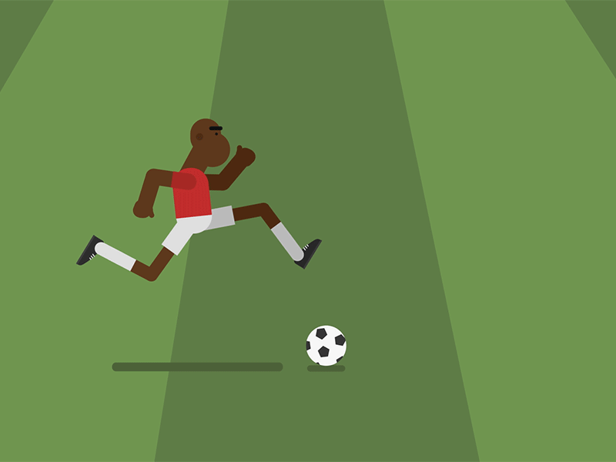
Too slow!
-2 points

Slide 34
Is your sports day
in June?
Jul
No, it isn't. It's in July.

Slide 35
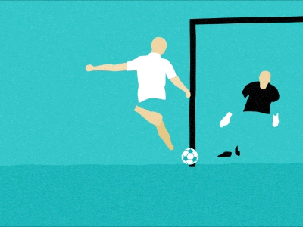
Oops!
-3 points

Slide 36


