Slide 1
1
5
2
3
6
4
LUCKY STAR
pipi

Slide 2
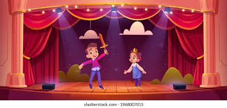
Were you at the …….. yesterday?
You are given 1 pen
theatre
GO HOME

Slide 3
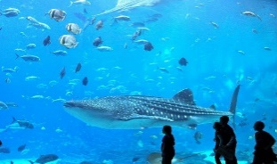
Were you at the …….. yesterday?
You are given 1 eraser
aquarium
GO HOME

Slide 4
LUCKY START
You are given 1 candy.
GO HOME

Slide 5
Were you at the …….. yesterday?
campsite
You are given 1 pen.
GO HOME

Slide 6
LUCKY START
You are given 2 STICKERS.
GO HOME

Slide 7
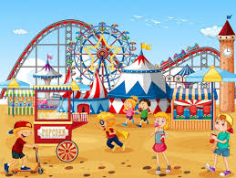
Were you at the …….. yesterday?
funfair
You are given 1 gift
GO HOME

Slide 8
Wednesday, December 18th ,2024
UNIT 9: OUR OUTDOOR ACTIVITIES
LESSON 2 ( 1, 2, 3)
Notes:
MADE BY FACEBOOK :TRAN THI THANH TAM

Slide 9
1. LOOK, LISTEN AND REPEAT
Notes:
MADE BY FACEBOOK :TRAN THI THANH TAM

Slide 10
Notes:
MADE BY FACEBOOK :TRAN THI THANH TAM

Slide 11
PLAY GAME
GUESSING GAME

Slide 12
Guessing
Guessing?
Listen to music
Notes:
MADE BY FACEBOOK :TRAN THI THANH TAM

Slide 13
Guessing
Guessing?
Dance a round the campfire
Notes:
MADE BY FACEBOOK :TRAN THI THANH TAM

Slide 14
Guessing
Guessing?
Watch the fish
Notes:
MADE BY FACEBOOK :TRAN THI THANH TAM

Slide 15
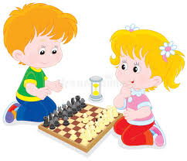
Guessing
Guessing?
Play chess
Notes:
MADE BY FACEBOOK :TRAN THI THANH TAM

Slide 16
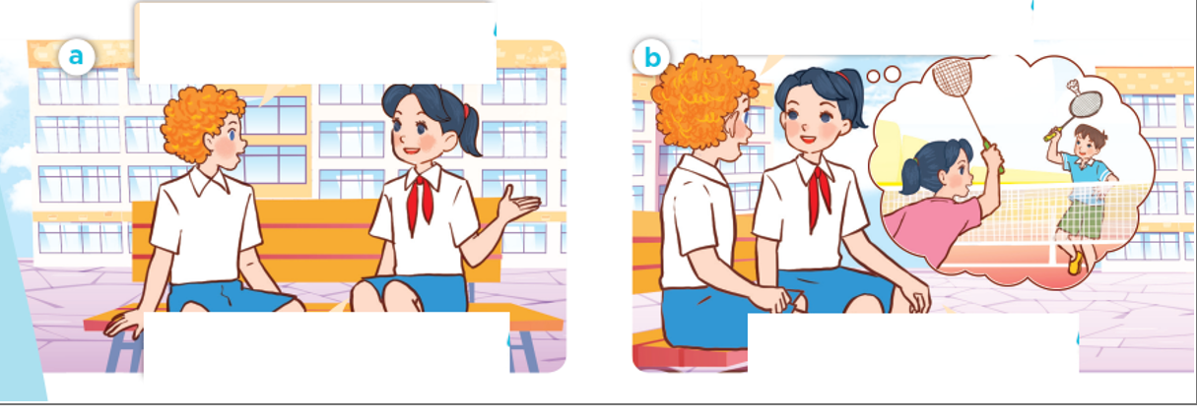

Slide 17
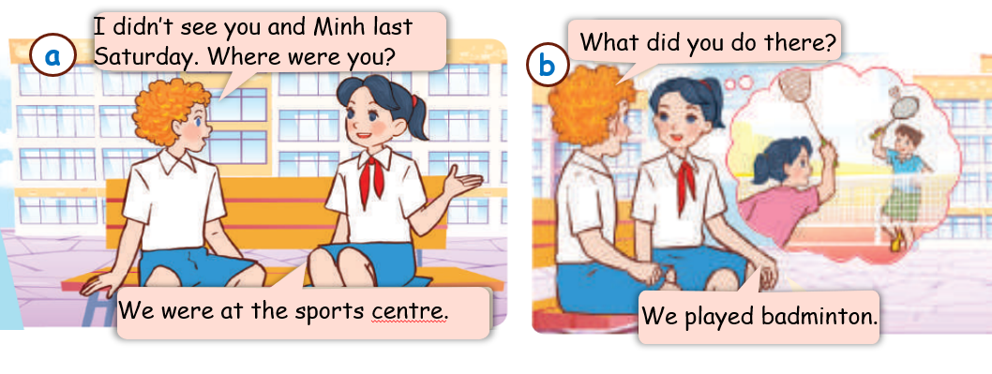
Notes:
MADE BY FACEBOOK :TRAN THI THANH TAM

Slide 18
2. LISTEN POINT AND SAY.
Listen – listened
Watch – watched
Dance – danced
Play - played
Notes:
MADE BY FACEBOOK :TRAN THI THANH TAM

Slide 19
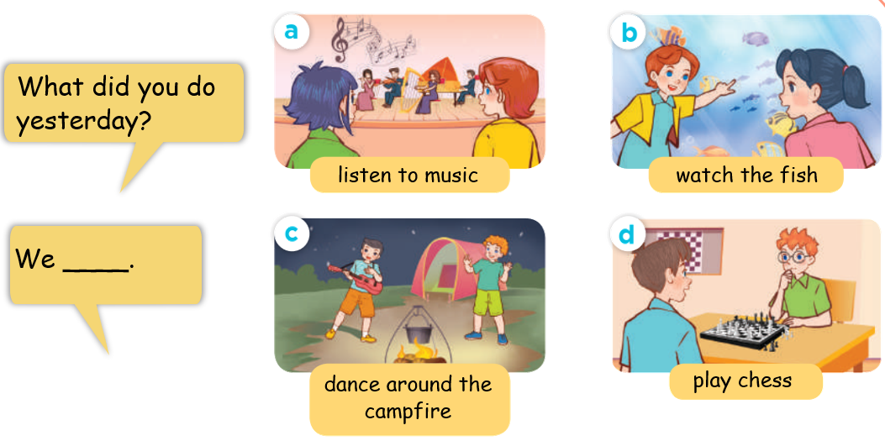
Notes:
MADE BY FACEBOOK :TRAN THI THANH TAM

Slide 20
3. Let’s talk
Where were you yesterday?
What did you do there?
Notes:
MADE BY FACEBOOK :TRAN THI THANH TAM

Slide 21
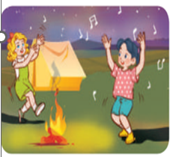

Slide 22
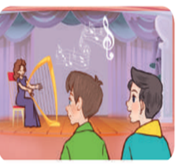
Notes:
MADE BY FACEBOOK :TRAN THI THANH TAM

Slide 23
Notes:
MADE BY FACEBOOK :TRAN THI THANH TAM

Slide 24
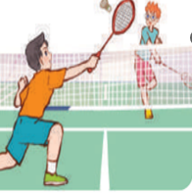

Slide 25
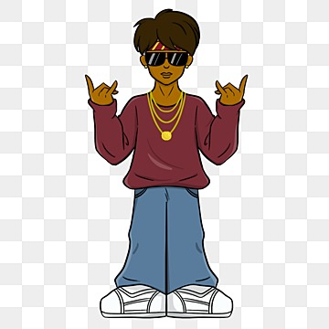
A
B

Slide 26
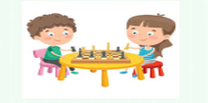
A
B

Slide 27
Homework:
- Practice more at home
- Prepare unit 9: Lesson 2: 4,5,6

Slide 28
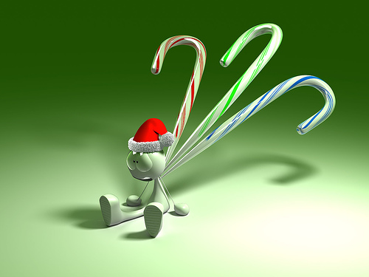
GOODBYE,
SEE YOU AGAIN !
Made by Thanh Tam

