Slide 1
Welcome to Class 3C

Slide 3
Unit 4: Our bodies
LESSON: 1,2,3

Slide 4
1.Look, listen and repeat.

Slide 5
1.
an eye
a.
2.
a hand
b.
3.
a nose
c.
4.
an ear
d.
5.
e.
a face

Slide 6
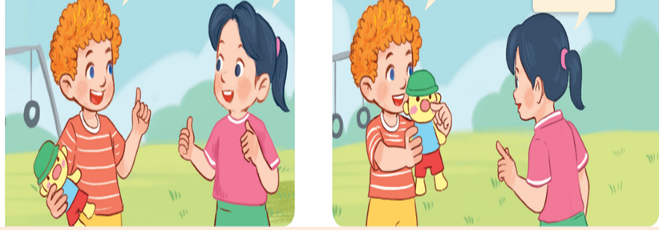

Slide 7
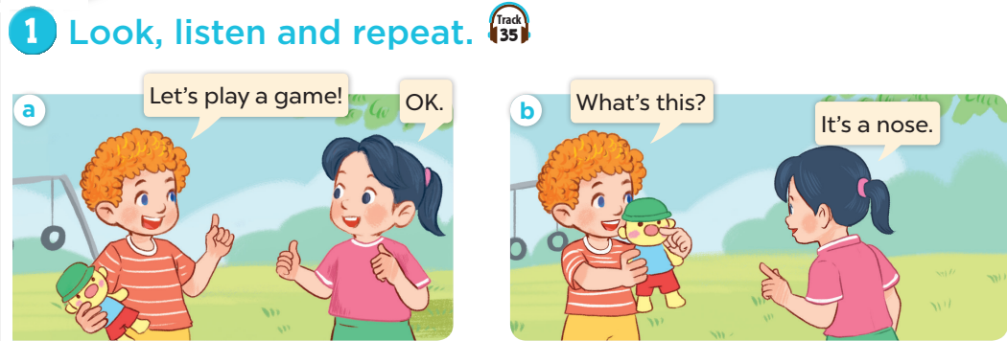

Slide 8
2.Listen, point and say.

Slide 9
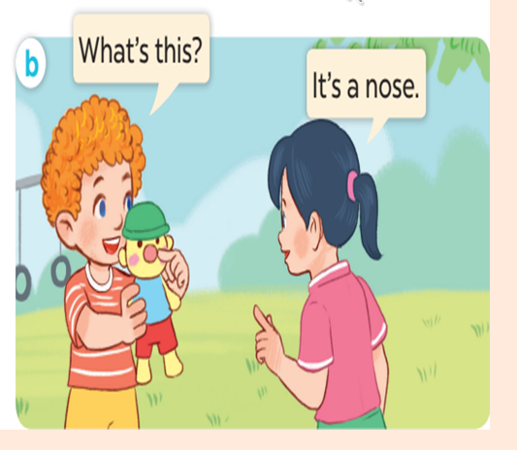

Slide 10
What’s this?
face
It’s a…….

Slide 11
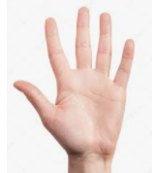
What’s this?
hand
It’s a……….

Slide 12
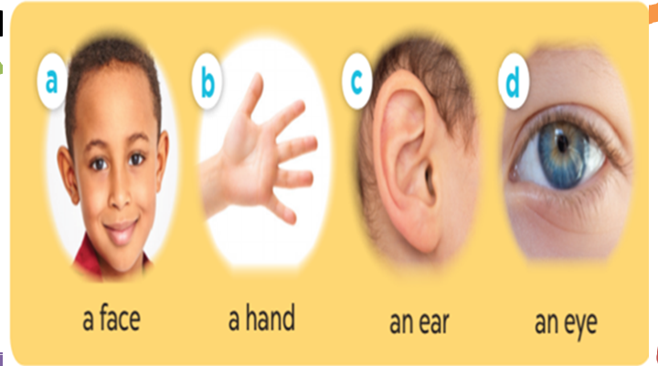

Slide 13
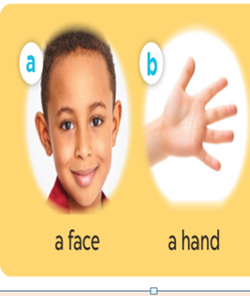

Slide 14
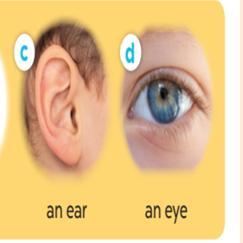

Slide 15
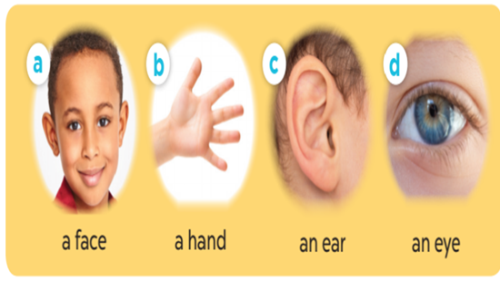

Slide 16
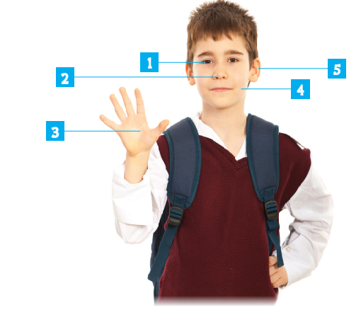
3.Let’s talk.
What’s this?

Slide 17
Guessing game

Slide 18
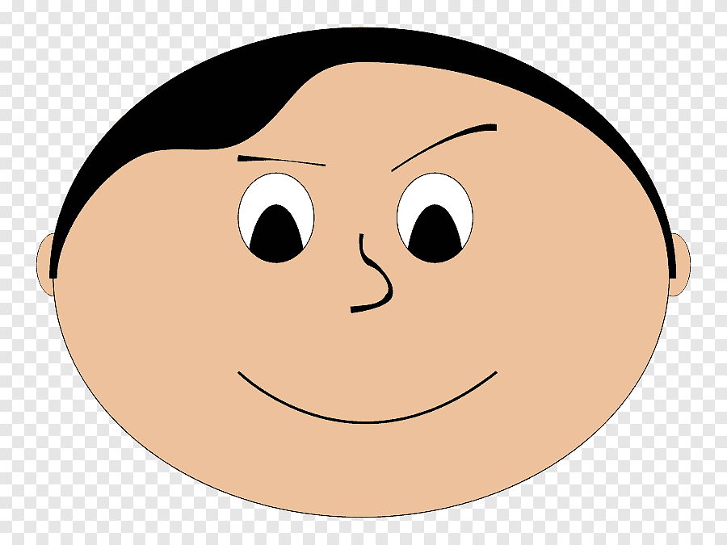

Slide 19
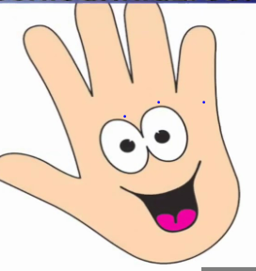

Slide 20
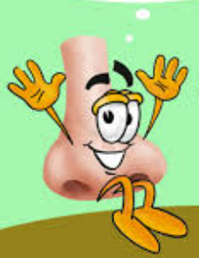

Slide 22
Homework:
- Learn vocabulary by heart
- Prepare Unit 4- lesson 1 ( 4, 5, 6)

Slide 23
Thank you very much
Good bye! See you again!

