Slide 2
5
My future job
Lesson 1 (4, 5, 6)

Slide 3
TABLE OF CONTENTs
01. Warm-up
02. Listen and number.
03. Read and complete.
04. Listen, complete and sing.
05. Homework

Slide 4
01.
Warm-up

Slide 5
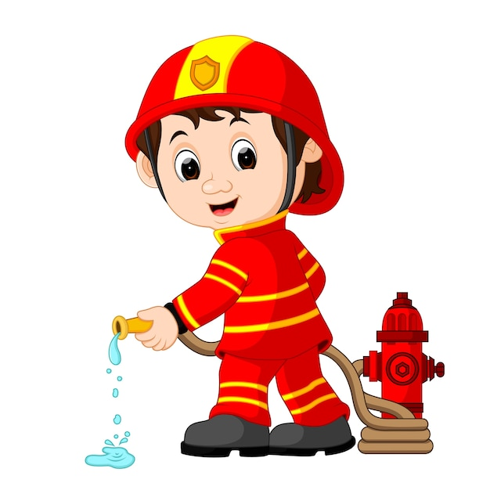
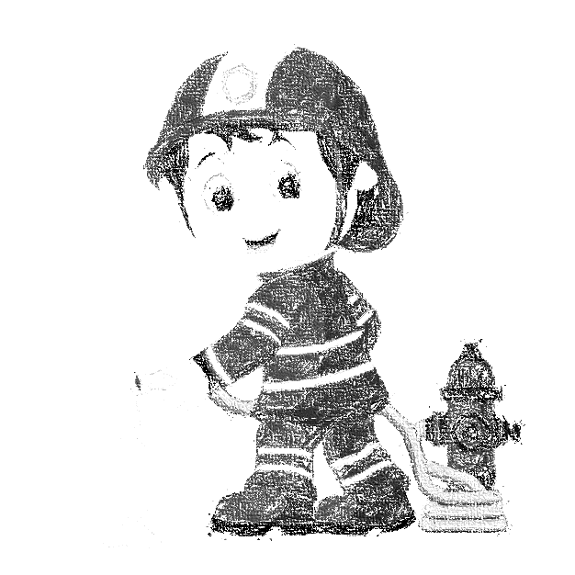
I would like to be a ______.
firefighter

Slide 6
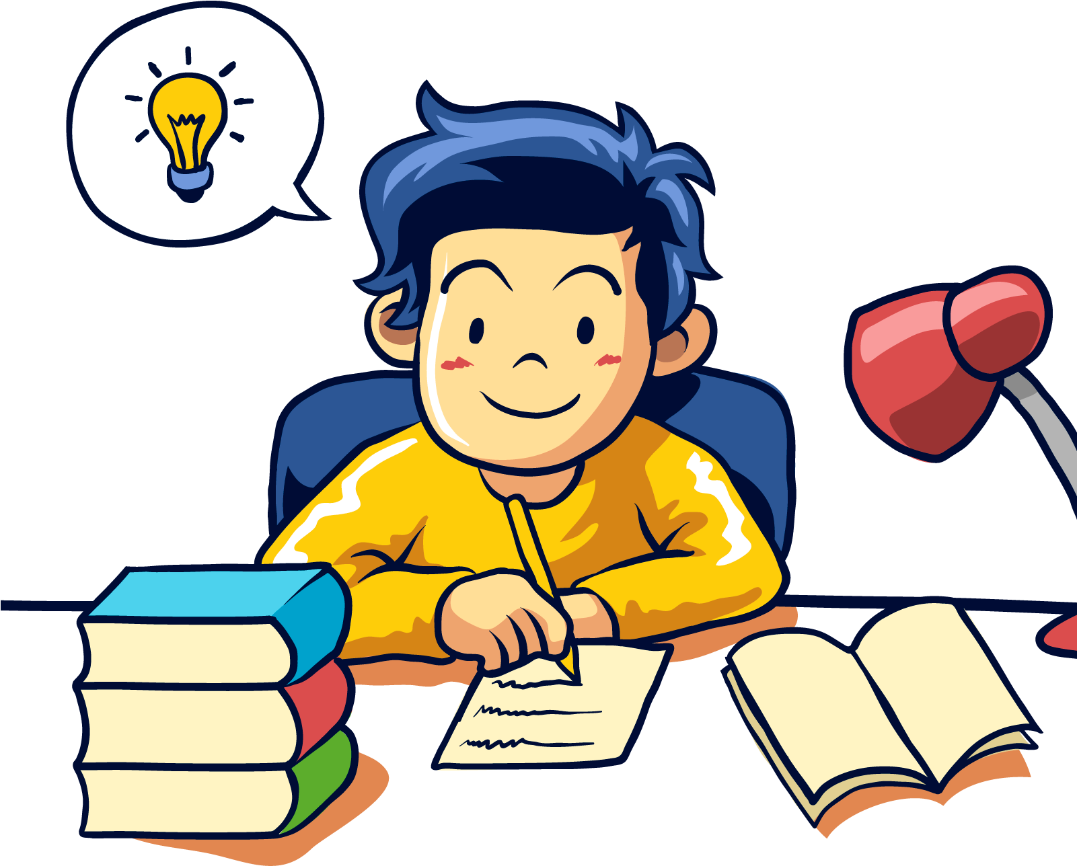
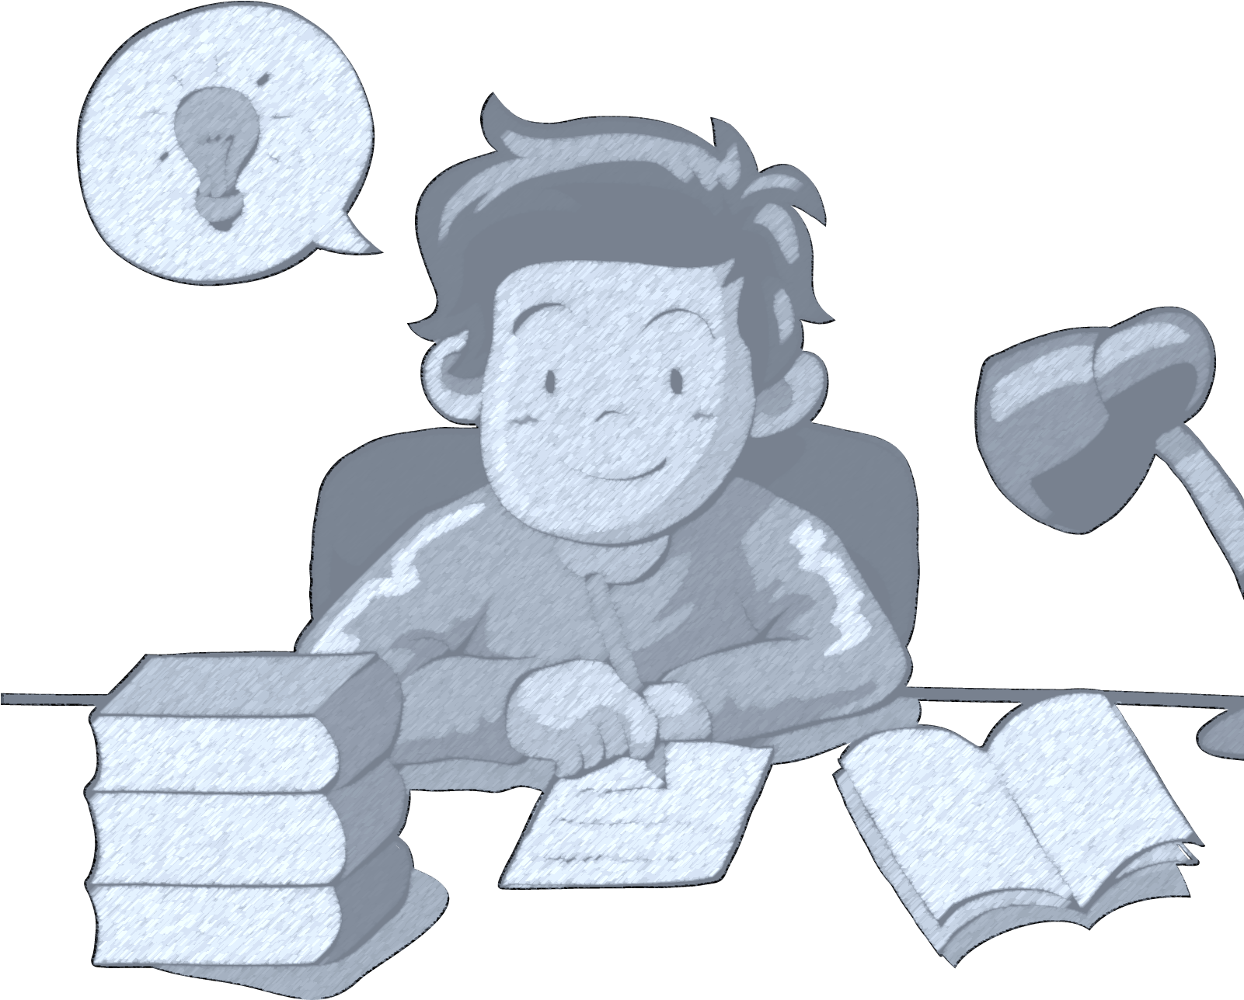
I would like to be a ______.
writer

Slide 7
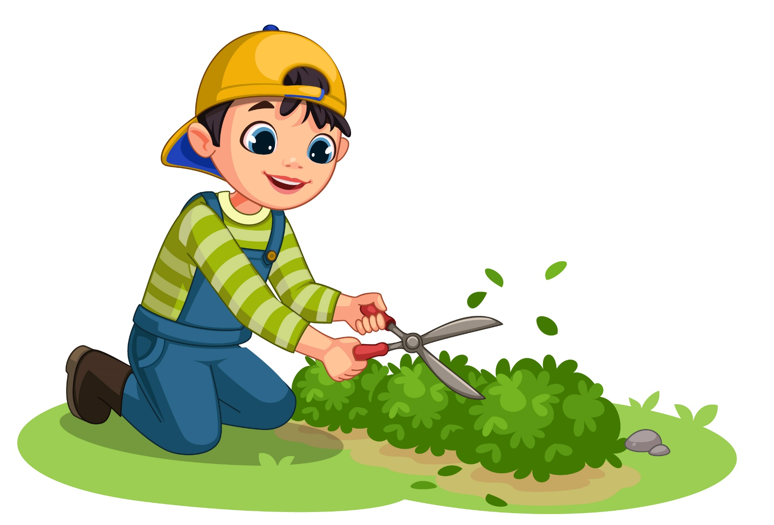
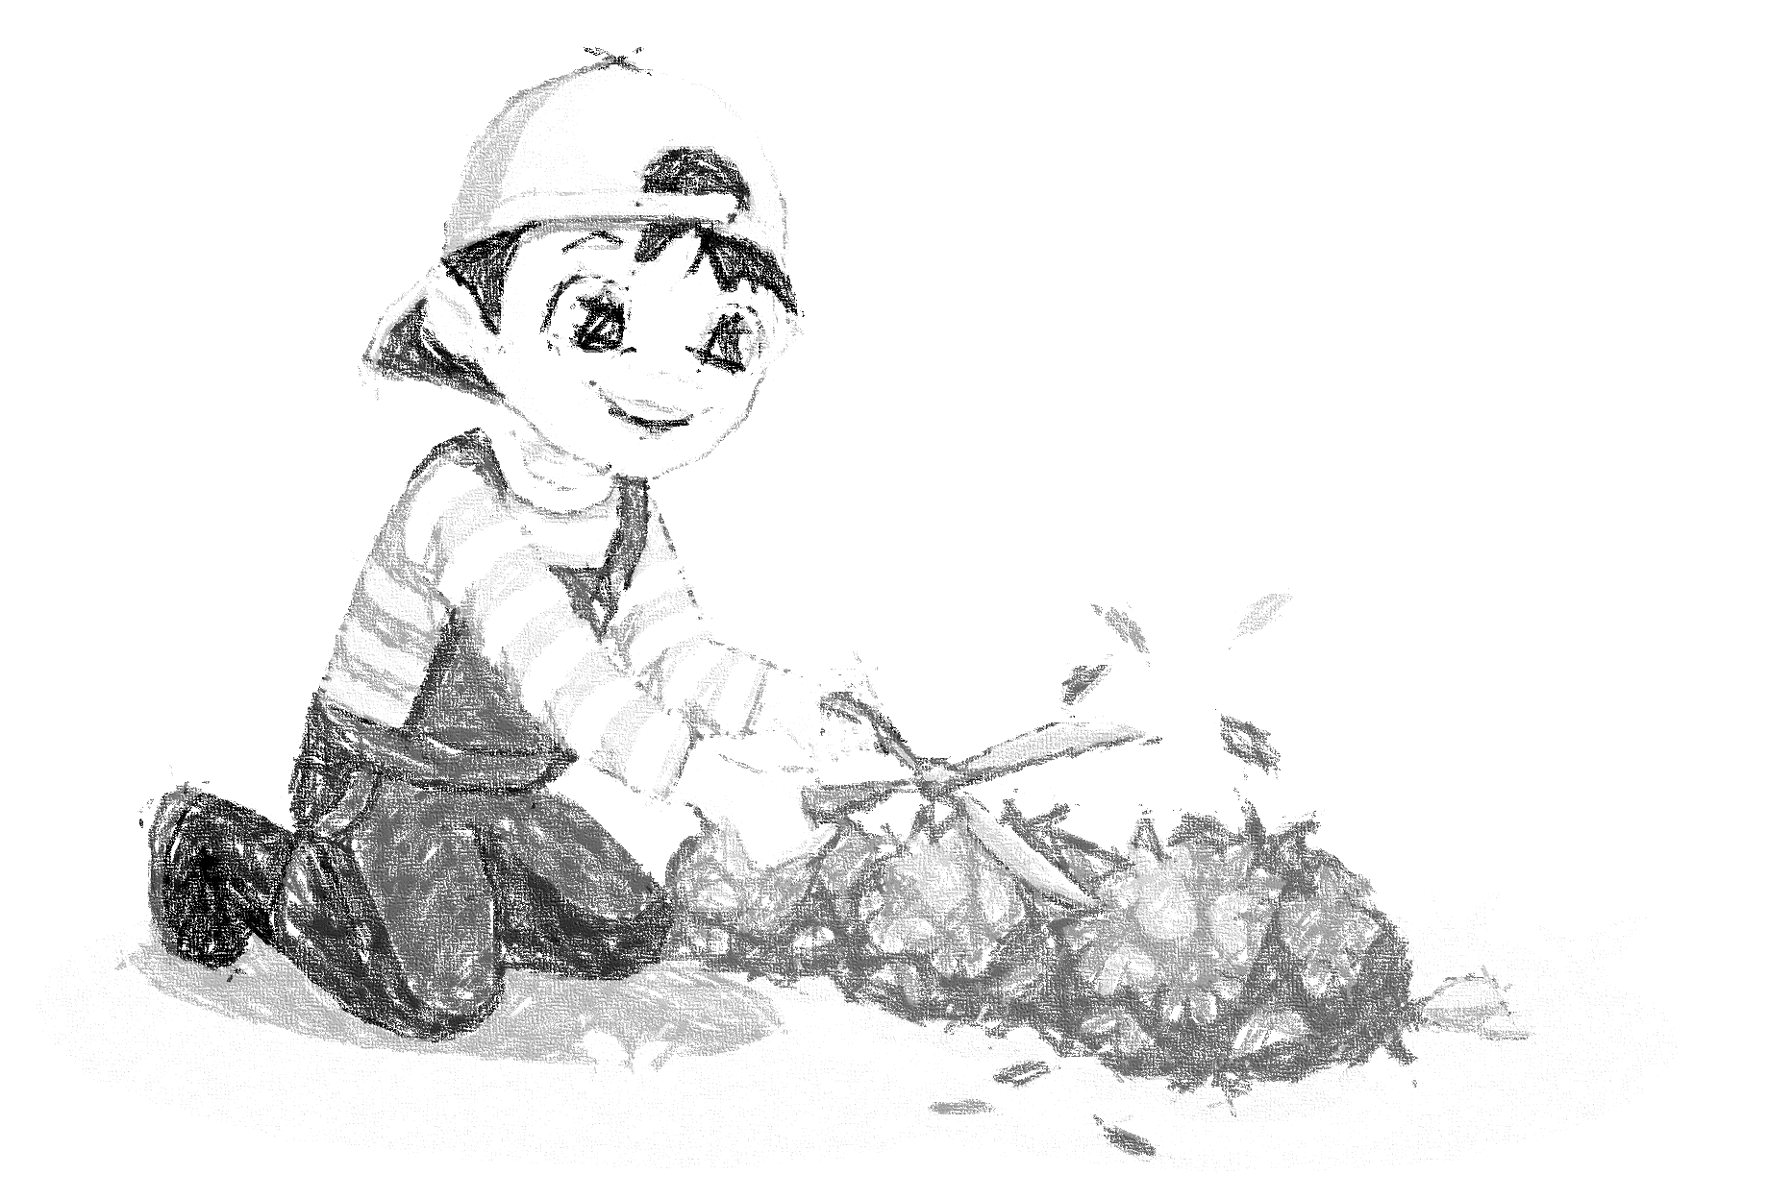
I would like to be a ______.
gardener

Slide 8
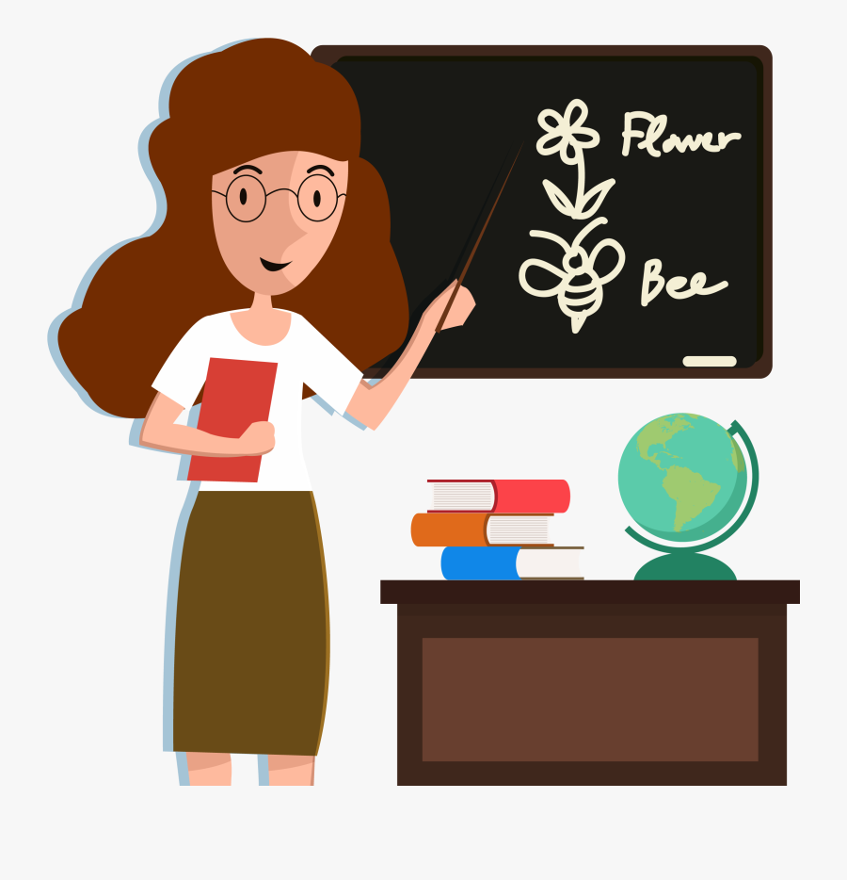
I would like to be a ______.
teacher

Slide 9
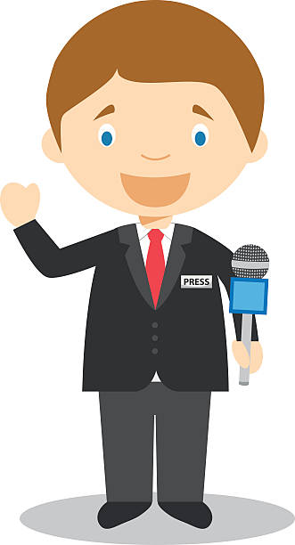
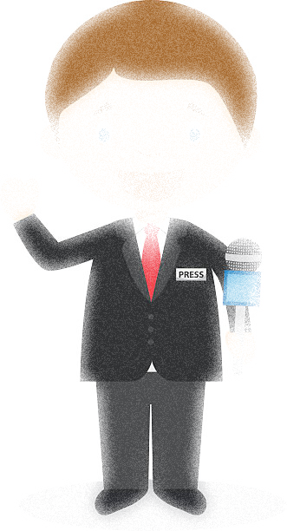
I would like to be a ______.
reporter

Slide 10
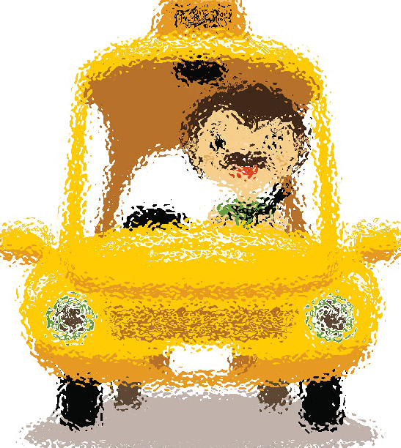
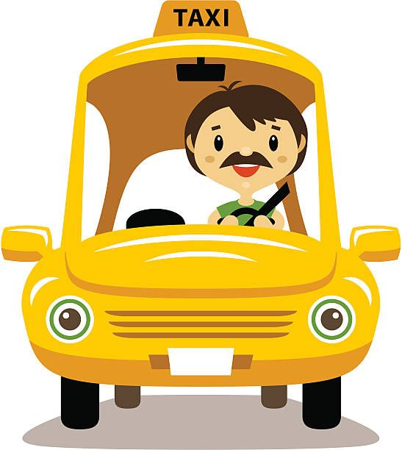
I would like to be a ______.
driver

Slide 11
02.
Listen and number.

Slide 12
Listen and number.
2
3
1
4
gardener
writer
reporter
firefighter

Slide 13
03.
Read and complete.

Slide 14
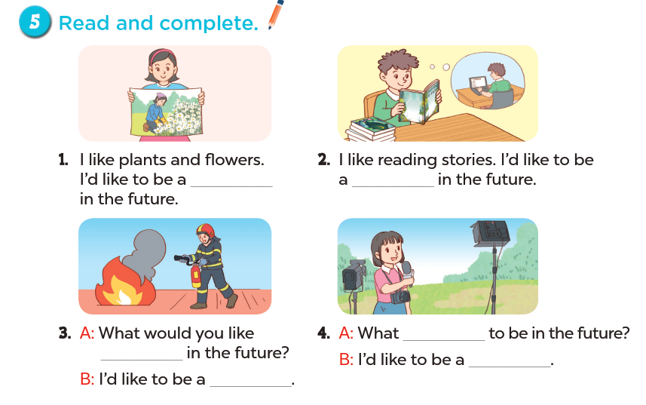
Look and say.

Slide 15
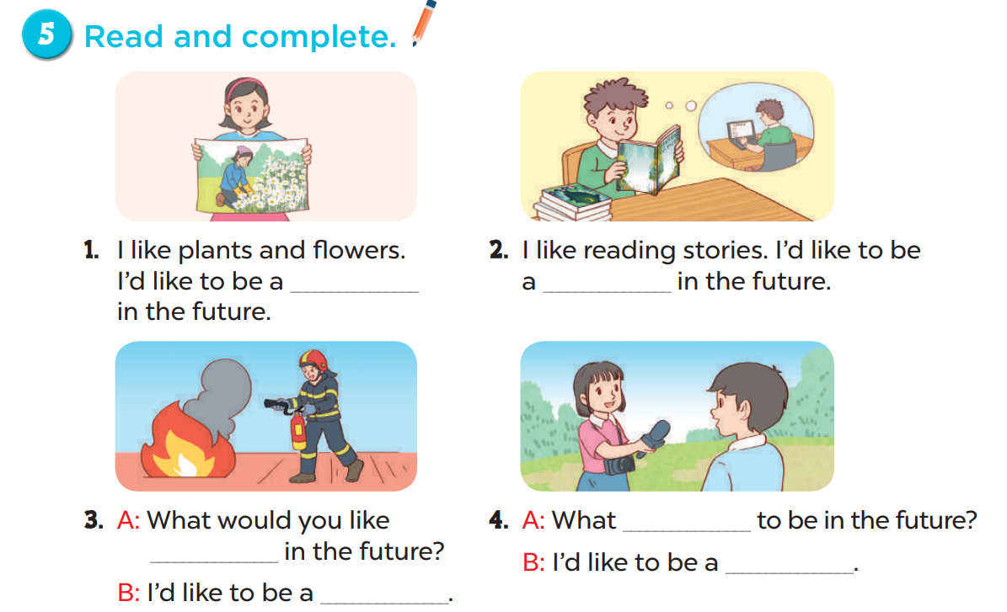
Work in groups
gardener
writer
would
to be
reporter
firefighter

Slide 16
04.
Listen, complete and sing.

Slide 17
firefighter
writer
driver

Slide 19
doctor
singer
pilot
woker

Slide 20
05.
Fun corner and wrap-up

Slide 21
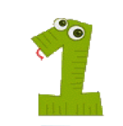
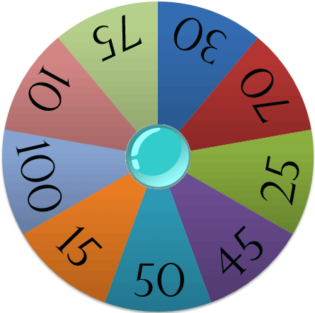
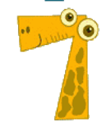
Spin the wheel
A
B
Points

Slide 22
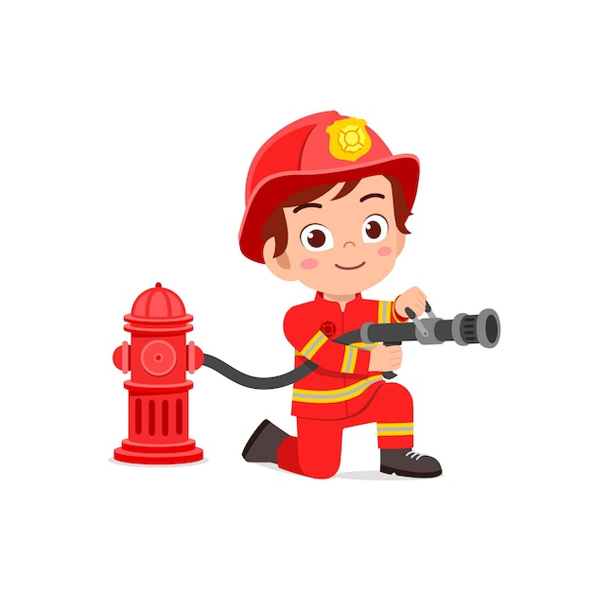
would / ’d
I _________ like to be a firefighter.
SPIN

Slide 23
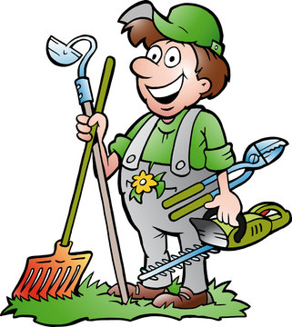
like
I’d ________ to be a gardener.
SPIN

Slide 24
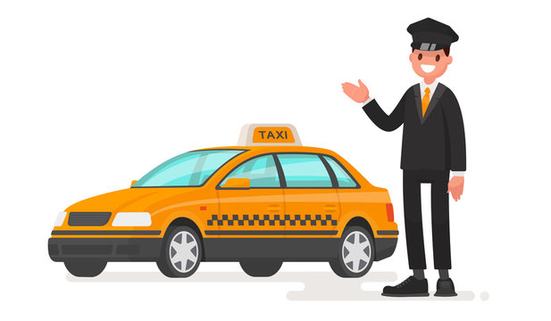
like/ I’d / to/ a/ be/./ driver/
I’d like to be a driver.
SPIN

Slide 25
I like reading stories. I’d like to be a _______.
writer
SPIN

Slide 26
reporter
I’d like to be a ________.
SPIN

Slide 27
would
What ______ you like to be in the future?
teacher
SPIN
I’d like to be a ________.

Slide 28
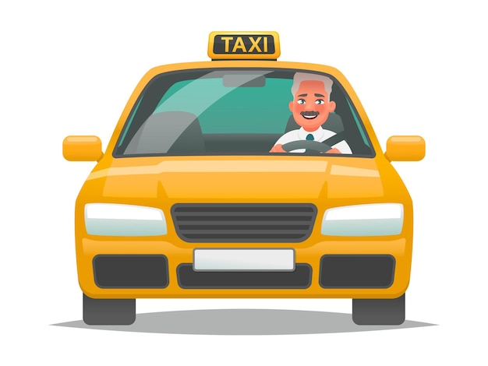
driver
I’d like to be a ________.
SPIN

Slide 29
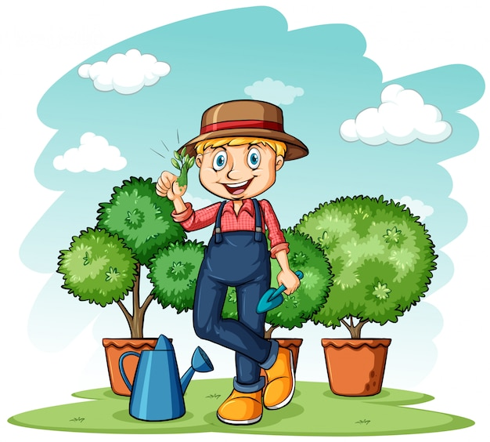
like/ to/ I’d/ gardener/ be/a/./
I’d like to be a gardener.
SPIN

Slide 30
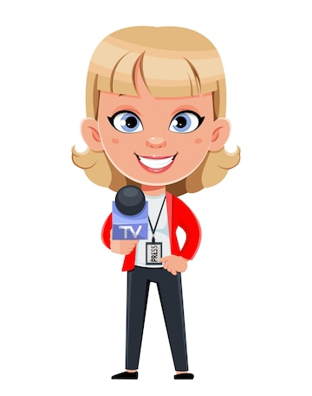
would/ reporter/ I/ like/ be/ to/ a/./
I would like to be a reporter.
SPIN

