Slide 1


Friday, December 12nd, 2025
TO OUR CLASS 12A4

Slide 3
Unit 5
The world of work
LESSON I
GETTING STARTED
Our parents’ jobs

Slide 4
LESSON I
GETTING STARTED
WARM-UP
Playing game: guess: Who am I?
PRESENTATION
Vocabulary
Task 1: Listen and read.
Task 2: Read the conversation again and put a tick (✓) in the appropriate column.
Task 3: Match the words/ phrases to make phrases mentioned in 1.
Task 4: Complete the sentences with phrases or clauses in the box based on the conversation in 1.
PRACTICE
PRODUCTION
Game: Be a footballer
CONSOLIDATION
Wrap-up
Homework

Slide 5
WARM-UP: playing game
Guess: WHO AM I?
The rules of the game:
Each team will select 2 players who are considered the best of the team.
The two players from each team come to the front.
When the game begins, the first player will look at the TV and describe the words about careers using English. Vietnamese is not allowed.
You can give clues, examples, or synonyms. You cannot say the word itself or any part of it.
3. The other player will turn round and guess the words in English.
If the player guesses correctly one word, the team earns 1 point.
4. Each team has 1 minute and 30 seconds to describe and guess the words.
5. At the end of the game, the team with more points will win.
Notes:
https://www.youtube.com/watch?v=8bZbRTh92NM&t=96s

Slide 6
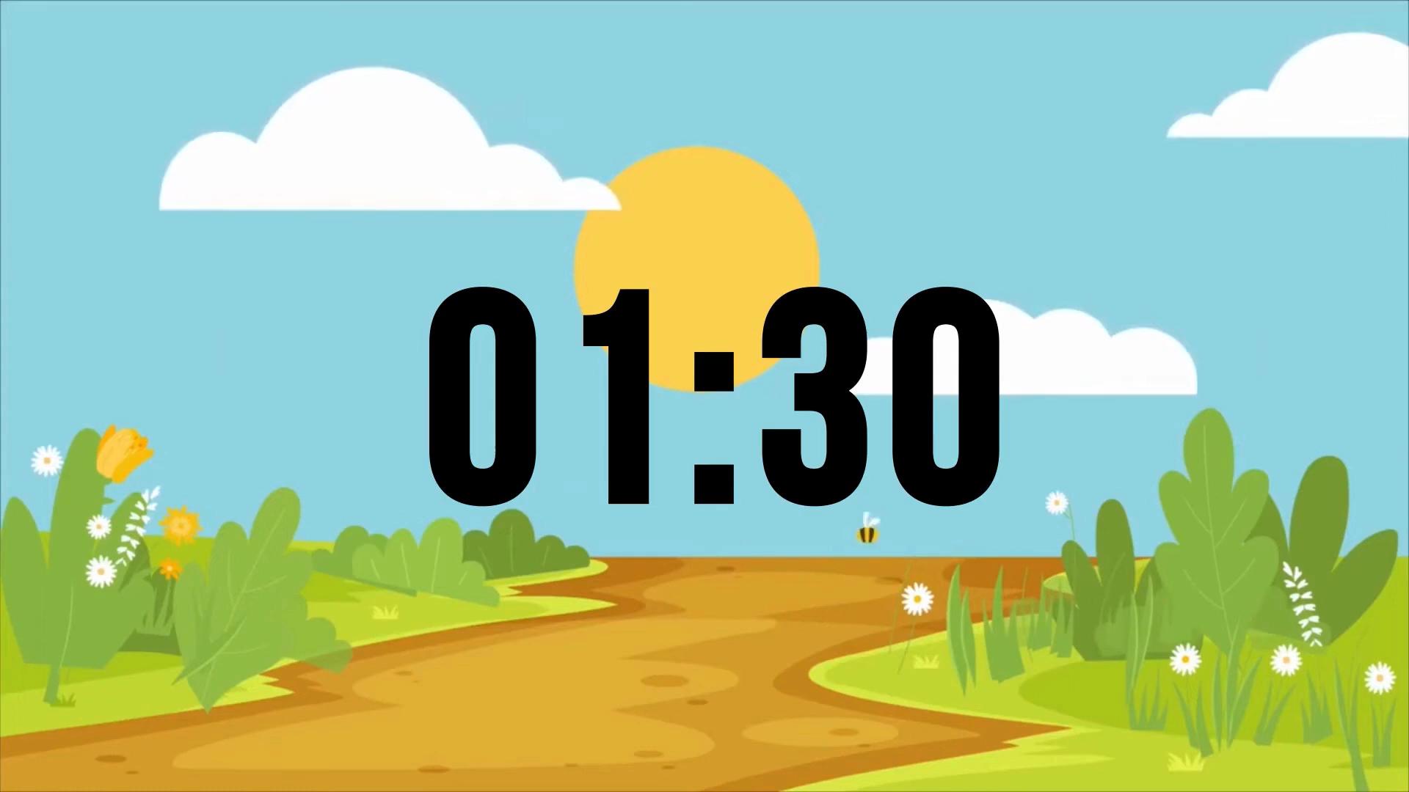
Restart
Start

Slide 7


1. Worker
2. Architect
3. Doctor
4. Secretary
5. Chef/cook
6. Photographer
7. Farmer
8. Police office
9. Student / Pupil
10. Dentist
1. Accountant
2. Builder
3. Teacher
4. Waiter/Waitress
5. Singer
6. Electrician
7. Firefighter
8. Artist
9. Driver
10. Salesperson
Restart
Start

Slide 8
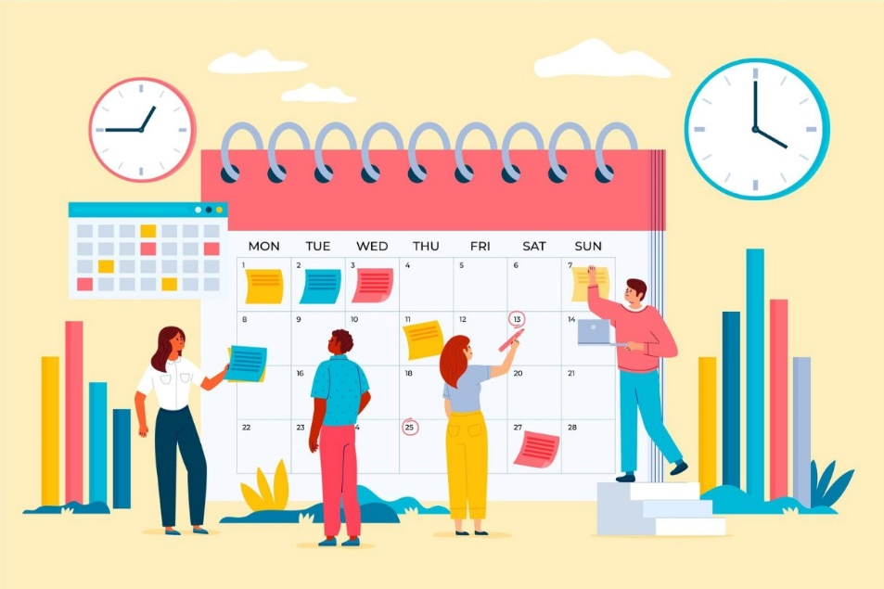

PRESENTATION: VOCABULARY
shift (n)
/ʃɪft/
a period of time worked by a group of workers who start work as another group finishes

Slide 9

PRESENTATION
nine-to-five (adj)
/naɪn tə faɪv/
a typical full-time work schedule from 9:00 a.m. to 5:00 p.m.

Slide 10
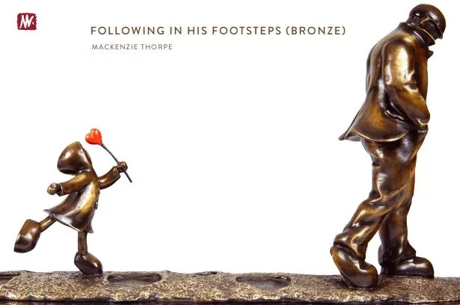
PRESENTATION
footstep (n)
/ˈfʊtstep/
the values, customs, and practices that have been passed down from parents to children over time.

Slide 11
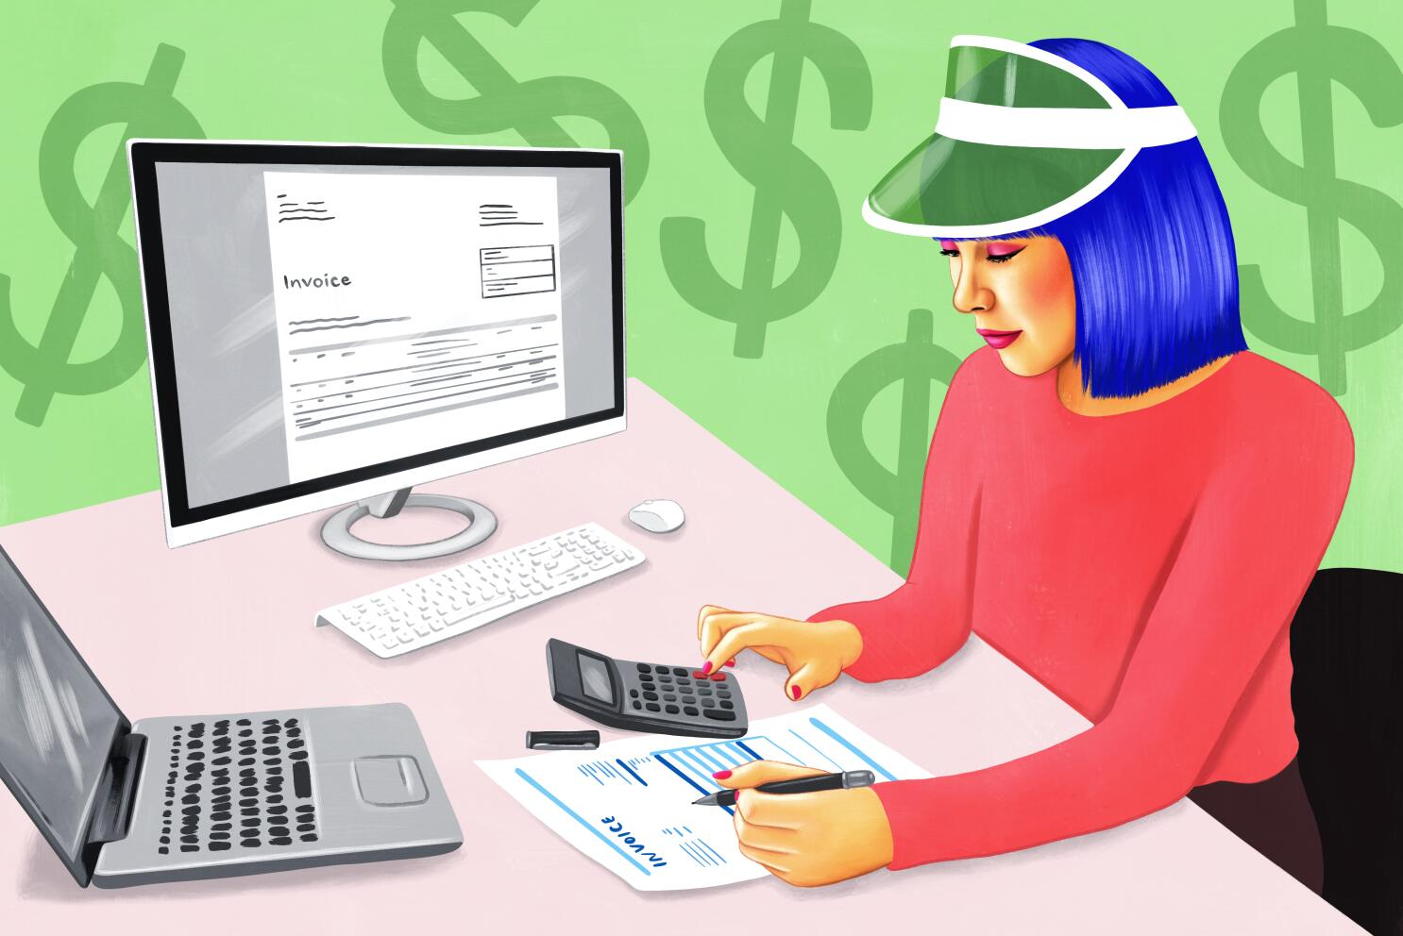
PRESENTATION
accountant (n)
/əˈkaʊntənt/
a person whose job is to keep or check financial accounts

Slide 12
PRESENTATION
Form | Pronunciation | Meaning | Vietnamese equivalent
1. shift (n) | /ʃɪft/ | a period of time worked by a group of workers who start work as another group finishes | ca làm việc
2. nine-to-five (adj) | /naɪn tə faɪv/ | a typical full-time work schedule from 9:00 a.m. to 5:00 p.m. | giờ hành chính
3. footstep (n) | /ˈfʊtstep/ | the values, customs, and practices that have been passed down from parents to children over time. | bước chân, truyền thống gia đình
4. accountant (n) | /əˈkaʊntənt/ | a person whose job is to keep or check financial accounts | kế toán

Slide 13
VOCABULARY CHECKING :
Filling the blanks with the appropriate word: nine-to-five, accountant, footsteps, shift
1. My father often works the night shift at the factory.
2. Many office workers have a nine-to-five job from Monday to Friday.
3. She wants to follow in her mother’s footsteps and become a teacher.
4. My aunt is an accountant at a big company.

Slide 14



PRESENTATION
Teaching
Woker
Accountant

Slide 15
PRACTICE
1
Listen and read.
Lan: Come in, Mark. Did you find my place easily?
Mark: Yes, I actually met your dad in the street and he showed me the way. He said he was on his way to work.
Lan: That’s right. My dad is a factory worker so he works in shifts. Today he’s on the night shift.
Mark: Working night shifts must be really hard. When does he sleep?
Lan: He goes to bed right after he comes home in the morning when there’s no one at home. My mum’s usually at work then. She teaches at a primary school.
Mark: Working with kids must be fun.
Lan: Yes, she loves her job though teaching can be tiring. Getting up in front of the class and putting up a performance every day seems so stressful.
Mark: I agree. My mum used to be a teacher, but she gave up her job to look after me and my brother.
Lan: How about your dad?
Mark: He has a nine-to-five job. He’s an accountant at a bank.
Lan: Working with numbers must be difficult.
Mark: Yes, but it’s not just numbers. You need to learn so many regulations and build good working relationships with clients.
Lan: I guess he often goes on business trips.
Mark: Not really, but he works overtime. He sometimes comes back home when I’m already in bed.
Lan: You’re good at maths so you should follow in his footsteps.
Mark: Definitely not. Neither I nor my brother wants to become an accountant. I’m interested in computer programming because it opens up so many job opportunities. What about you, Lan?
Lan: Well, I love working with children, so I want to become a primary school teacher like my mum.
Mark: Didn’t you say last year you wanted to become a scientist?
Lan: [laughing] Yeah …

Slide 16
PRACTICE
2
Read the conversation again and put a tick (✓) in the appropriate column.
Who… | Lan’s dad | Mark’s dad | Lan’s mum
1. is a factory worker?
2. is a bank accountant?
3. works in shifts?
4. is a primary school teacher?

Slide 17

PRACTICE
2
Read the conversation again and put a tick (✓) in the appropriate column.
Who… | Lan’s dad | Mark’s dad | Lan’s mum
1. WHO is a factory worker?
Lan: That’s right. My dad is a factory worker so he works in shift.

Slide 18
PRACTICE
2
Read the conversation again and put a tick (✓) in the appropriate column.
Who… | Lan’s dad | Mark’s dad | Lan’s mum
2. WHO is a bank accountant?
Lan: How about your dad?
Mark: He has a nine-to-five job. He’s an accountant at a bank.

Slide 19
PRACTICE
2
Read the conversation again and put a tick (✓) in the appropriate column.
Who… | Lan’s dad | Mark’s dad | Lan’s mum
3. WHO works in shifts?
Lan: That’s right. My dad is a factory worker so he works in shifts. Today he’s on the night shift.

Slide 20
PRACTICE
2
Read the conversation again and put a tick (✓) in the appropriate column.
Who… | Lan’s dad | Mark’s dad | Lan’s mum
4. WHO is a primary school teacher?
Lan: He goes to bed right after he comes home in the morning when there’s no one at home. My mum’s usually at work then. She teaches at a primary school.

Slide 21

PRACTICE
2
Read the conversation again and put a tick (✓) in the appropriate column.
Who… | Lan’s dad | Mark’s dad | Lan’s mum
1. is a factory worker?
2. is a bank accountant?
3. works in shifts?
4. is a primary school teacher?

Slide 22
PRACTICE
3
Match the words/ phrases to make phrases mentioned in 1.
work
business trips
1
a
go on
job
2
b
nine-to-five
shift
3
c
night
overtime
4
d

Slide 23
PRACTICE
4
Complete the sentences with phrases or clauses in the box based on the conversation in 1.
a. because it opens up so many job opportunities
b. so she wants to become a primary school teacher like her mum
c. a difficult job
d. though teaching can be tiring
1. In Lan’s opinion, being an accountant is _______.
2. Mark wants to study computer programming _______.
3. Lan likes to work with children, _______.
4. Lan's mum loves her job _______.
c
a
b
d

Slide 24
PRACTICE
4
Complete the sentences with phrases or clauses in the box based on the conversation in 1.
1c. Mark wants to study computer programming because it opens up so many job opportunities
2a. Lan likes to work with children, so she wants to become a primary school teacher like her mum
3b. In Lan’s opinion, being an accountant is a difficult job
4d. Lan's mum loves her job though teaching can be tiring
Complex sentence
compound sentence
simple sentence
Complex sentence

Slide 25
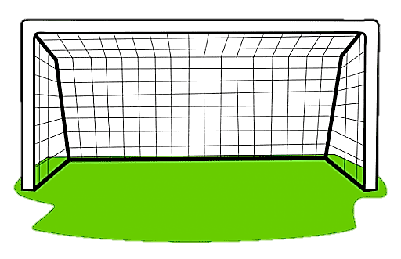
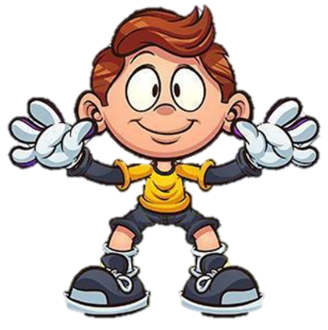

PRODUCTION: game
BE A FOOTBALLER
Instructions:
There are 5 questions. Choose the most suitable answer by selecting A, B, or C. When you give a correct answer, you will score a goal.

Slide 26
1. I have a ______, so I typically work from 9 a.m. to 5 p.m. Monday through Friday.
A. nine-to-five job
B. night shift
C. business trip

Slide 27
2. My mum used to be a teacher, ____ she gave up her job to look after me and my brother.
A. so
B. but
C. for

Slide 28
3. He has a nine-to-five job. He works with numbers. He is ________ at a bank.
A. a factory worker
B. a primary teacher
C. an accountant

Slide 29
4. I love working with children, though ______.
A. it brings me joy and fulfillment.
B. my current nine-to-five job in an office doesn't allow me to do that.
C. I decided to pursue a career in education.

Slide 30
5. An __________ is responsible for preparing financial reports and managing budgets.
A. engineer
B. accountant
C. teacher

Slide 31
5. I will be _____ next week to meet with potential clients and expand our market presence.
A. staying at the office
B. going on a business trip
C. on the night shift

Slide 32
CONSOLIDATION
1
Wrap-up
What have you learnt today?
The words and phrases related to work
Reading for specific information
Simple, compound, and complex sentences

Slide 33
CONSOLIDATION
2
Homework
Learn by heart vocabulary
Do exercises in the workbook.
Prepare materials for the next lesson.

Slide 34


THANK YOU VERY MUCH
FOR YOUR ATTENTION

