Slide 1


Slide 2

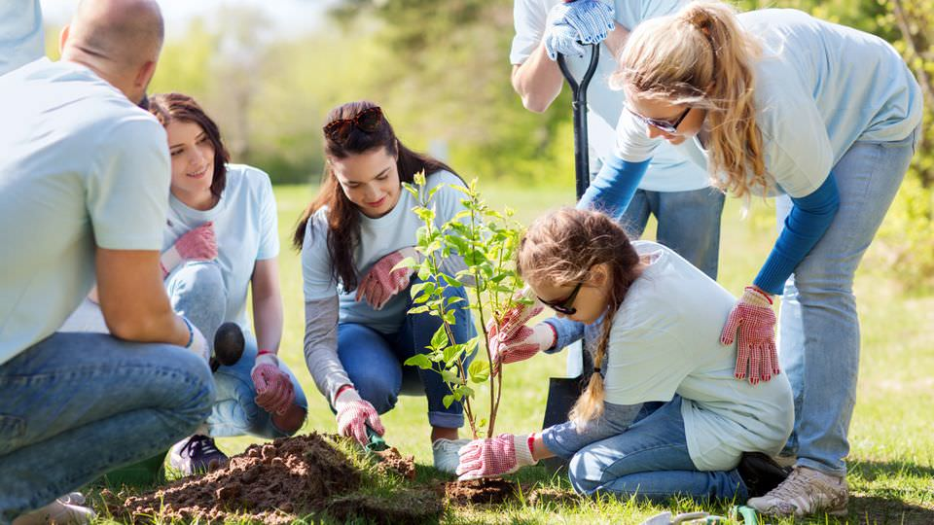
Unit
4
1
Unit
FAMILY LIFE
FOR A BETTER COMMUNITY
LESSON 2
LANGUAGE

Slide 3

Unit
1
1
FAMILY LIFE
Family Life
Unit
OBJECTIVES
By the end of this lesson, Ss will be able to:
Use the lexical items related to the topic For a better community;
Pronounce correctly stress in two-syllable words with the same spelling;
Understand the past simple vs. the past continuous.

Slide 4
LESSON 2
LANGUAGE
Unit
WARM-UP
Name volunteering activities
PRONUNCIATION
Task 1: Listen and circle.
Task 2: Listen and practise saying.
Task 1: Match the words with their meanings.
Task 2: Complete the sentences.
Task 3: Choose the correct word.
VOCABULARY
GRAMMAR
Task 1: Choose the correct verb form.
Task 2: Combine the two sentences.
EXTRA ACTIVITY
Game: Who is faster?
CONSOLIDATION
Wrap-up
Homework

Slide 5
LESSON 2
LANGUAGE
Unit
WARM-UP
Name volunteering activities

Slide 6
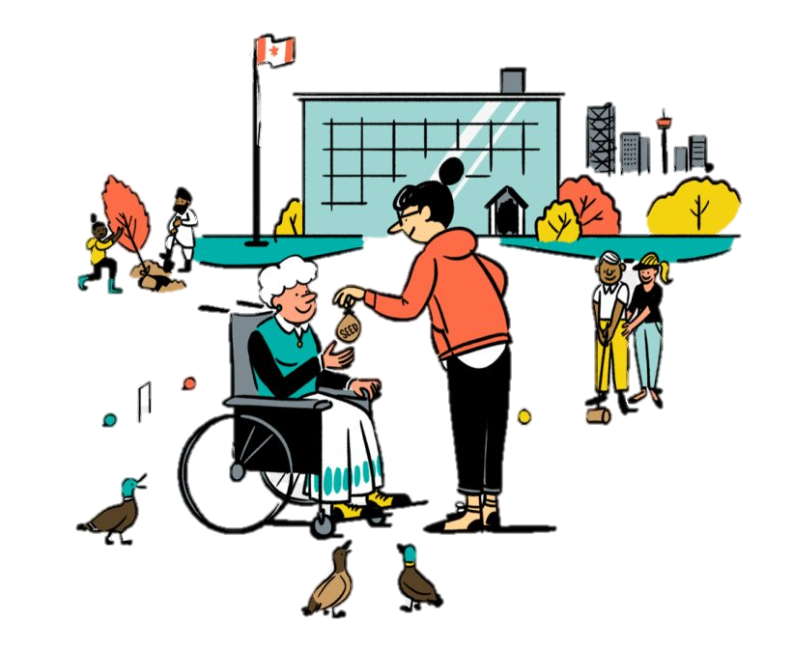
WARM-UP
Name volunteering activities
2 teams
Take turns to name an activity you can do to help the community
The team with more correct answers will be the winner

Slide 7
LESSON 2
LANGUAGE
Unit
WARM-UP
Name volunteering activities
PRONUNCIATION
Task 1: Listen and circle.
Task 2: Listen and practise saying.

Slide 8
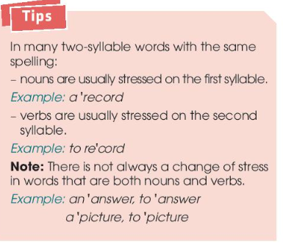
PRONUNCIATION: Stress in two-syllable words with the same spelling
Ex 1: I will present you a present.
I will preSENT (v) you a PREsent (n)
Ex 2: i am going to record some music
She ran so fast she broke the world record.
I am going to reCORDsome music. (v)
She ran so fast she broke the world REcord. (n)
For example:
an ‘IN crease vs. to in ‘CREASE
a ‘DE crease vs. to de ‘CREASE
a ‘PROject vs. to pro‘JECT
a ‘CONtract & to con’TRACT
…..

Slide 9

PRONUNCIATION: Stress in two-syllable words with the same spelling
1
Listen to the sentences and circle the word with the stress you hear.
1. The centre keeps a record of all donations.
a. ‘record b. re’cord
2. We will record the charity live show for those who can’t watch it live.
a. ‘record b. re’cord
3. There was an increase in house prices last year.
a. ’increase b. in’crease
4. We want to increase students’ interest in volunteering at the community centre.
a. ’increase b. in’crease
5. I got this present from a visitor to our centre.
a. ’present b. pre’sent
6. We need to help local businesses to export their products.
a. ’export b. ex’port

Slide 10
PRONUNCIATION
2
Listen again and practise saying the sentences in 1.
1. The centre keeps a record of all donations.
2. We will record the charity live show for those who can’t watch it live.
3. There was an increase in house prices last year.
4. We want to increase students’ interest in volunteering at the community centre.
5. I got this present from a visitor to our centre.
6. We need to help local businesses to export their products.

Slide 11
LESSON 2
LANGUAGE
Unit
WARM-UP
Name volunteering activities
PRONUNCIATION
Task 1: Listen and circle.
Task 2: Listen and practise saying.
Task 1: Match the words with their meanings.
Task 2: Complete the sentences.
Task 3: Choose the correct word.
VOCABULARY

Slide 12
VOCABULARY
1
Match the words with their meanings.
a. giving or willing to give freely
1. donate (v)
b. far away from places where people live
2. volunteer (n)
c. to give money, food, clothes, etc. to a charity
3. generous (adj)
d. to give a better position because of something, to be useful to somebody.
4. remote (adj)
5. benefit (n)
e. a person who does a job without being paid for it

Slide 13
VOCABULARY
2
Complete the following sentences using the correct forms of the words in 1.
1. He is very ___________. He is always willing to give a lot of money to charity.
2. The school is difficult to get to because it is located in a _________ area.
3. If you don’t have time to volunteer, you can ________ money and food.
4. This clean water project will ________ the people in the village.
5. Our club needs more ___________ to clean up the park at the weekend.
generous
remote
donate
benefit
volunteers

Slide 14
VOCABULARY
3
Choose the correct word to complete each of the following sentences.
1. We need to be careful / careless when we record the donations.
2. I am interested / interesting in community development activities.
3. There are excited / exciting volunteering opportunities in our community.
4. Last year, I was hopeful / hopeless at maths. I couldn’t even do simple addition in my head.

Slide 15
LESSON 2
LANGUAGE
Unit
WARM-UP
Name volunteering activities
PRONUNCIATION
Task 1: Listen and circle.
Task 2: Listen and practise saying.
Task 1: Match the words with their meanings.
Task 2: Complete the sentences.
Task 3: Choose the correct word.
VOCABULARY
GRAMMAR
Task 1: Choose the correct verb form.
Task 2: Combine the two sentences.

Slide 16
GRAMMAR
1
Choose the correct verb form in each of the following sentences.
1. While Lan was working / worked as a volunteer in the countryside, she met an old friend.
2. I was revising for civics class when my dad was telling / told me about the volunteer job.
3. We saw many unhappy children while we were helping / helped people in remote areas.
4. He was sorting donations when he was realising / realised how generous people were.

Slide 17
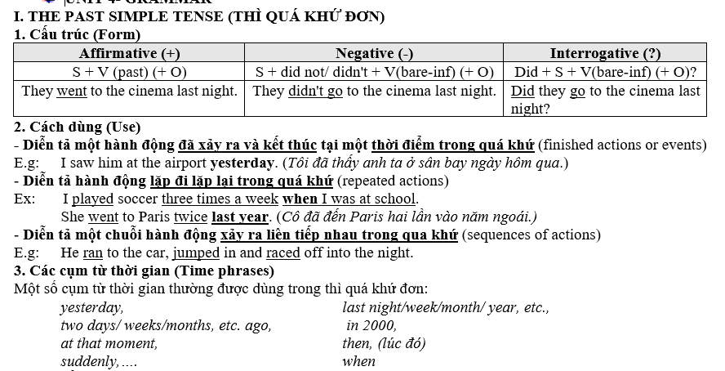

Slide 18
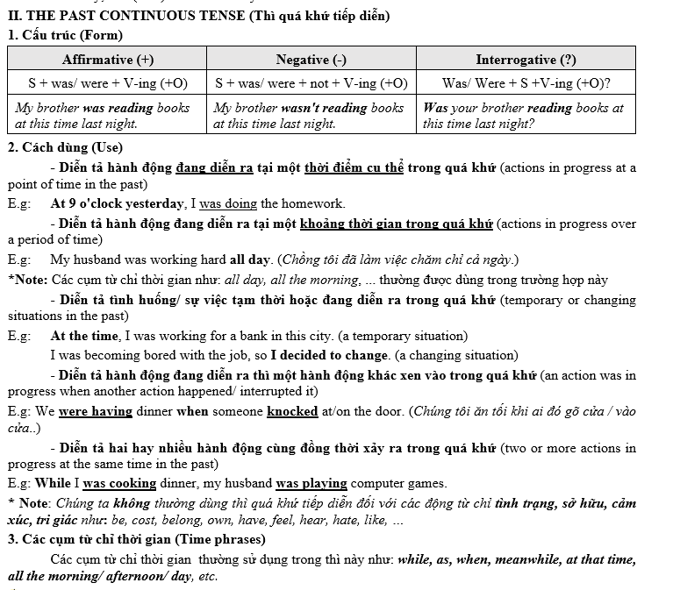

Slide 19
PRACTICE
GRAMMAR
2
Combine the two sentences using when or while where appropriate.
1. They were cleaning the streets. It started to rain.
2. I was watching TV. I saw the floods and landslides in the area.
-> While they were cleaning the streets, it started to rain. / They were cleaning the streets when it started to rain.
-> While I was watching TV, I saw the floods and landslides in the area. /I was watching TV when I saw the floods and landslides in the area.

Slide 20
PRACTICE
GRAMMAR
2
Combine the two sentences using when or while where appropriate.
3. Tim was searching for employment opportunities. He found a job advert from a non-governmental organisation.
4. They decided to help build a community centre for young people. They were visiting some poor villages.
-> While Tim was searching for employment opportunities, he found a job advert from a non-governmental organisation. / Tim was searching for employment opportunities when he found a job advert from a non-governmental organisation.
-> They decided to help build a community centre for young people while they were visiting some poor villages. / They were visiting some poor villages when they decided to help build a community centre for young people.

Slide 21
LOOKING BACK/ VOCABULARY
Fill in the gaps with the correct forms of the words in brackets.
1. There are (end) __________ opportunities for teenagers to volunteer these days.
2. We were very (excite) __________ to help children organise afterschool activities.
3. The local people were really (help) __________. They supported us all the time we stayed there.
4. We need more (volunteer) __________ for our community projects.
5. Our charity groups received generous (donate) __________ from the local people.
endless
excited
helpful
volunteers
donations

Slide 22
LOOKING BACK/ GRAMMAR
Complete the sentences using the correct forms of the verbs in brackets. Use the past simple or past continuous.
1. I first (meet) __________ Lan while we (work) _____________ as volunteers.
2. While we (walk) ______________ home, we (see) __________ a girl crying near a bus stop.
3. Kim (notice) __________ the poverty of the area while she (deliver) _____________ free meals to old people.
4. When I (arrive) __________ at the community centre, a guest speaker (give) __________ a speech.
met
were working
were walking,
saw
noticed
was delivering
arrived
was giving

Slide 23
LESSON 2
LANGUAGE
Unit
WARM-UP
Name volunteering activities
PRONUNCIATION
Task 1: Listen and circle.
Task 2: Listen and practise saying.
Task 1: Match the words with their meanings.
Task 2: Complete the sentences.
Task 3: Choose the correct word.
VOCABULARY
GRAMMAR
Task 1: Choose the correct verb form.
Task 2: Combine the two sentences.
EXTRA ACTIVITY
Game: Who is faster?

Slide 24

EXTRA ACTIVITY
Game: Who is faster?
Write sentences including 3 features:
two-syllable words with the same spelling but different stress mentioned in Task 1, Pronunciation
when/while
the past simple/the past continuous
e.g. When I was wrapping the present, my mom knocked the door.

Slide 25
LESSON 2
LANGUAGE
Unit
WARM-UP
Name volunteering activities
PRONUNCIATION
Task 1: Listen and circle.
Task 2: Listen and practise saying.
Task 1: Match the words with their meanings.
Task 2: Complete the sentences.
Task 3: Choose the correct word.
VOCABULARY
GRAMMAR
Task 1: Choose the correct verb form.
Task 2: Combine the two sentences.
EXTRA ACTIVITY
Game: Who is faster?
CONSOLIDATION
Wrap-up
Homework

Slide 26
CONSOLIDATION
1
Wrap-up
Use the lexical items related to the topic For a better community;
Pronounce correctly stress in two-syllable words with the same spelling;
Understand the past simple vs. the past continuous.

Slide 27
CONSOLIDATION
2
Homework
1. Prepare for the next lesson: Unit 4_Reading
2. Do exercises in the workbook

Slide 28

Website: sachmem.vn
Fanpage: facebook.com/sachmem.vn/

