Slide 2
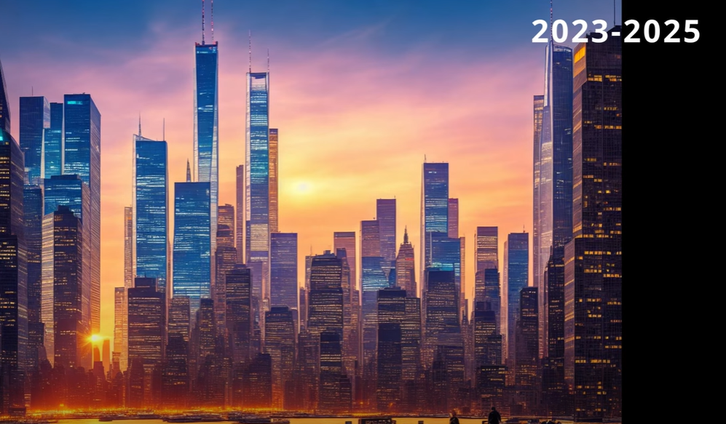
NEW YORK CITY, America

Slide 3
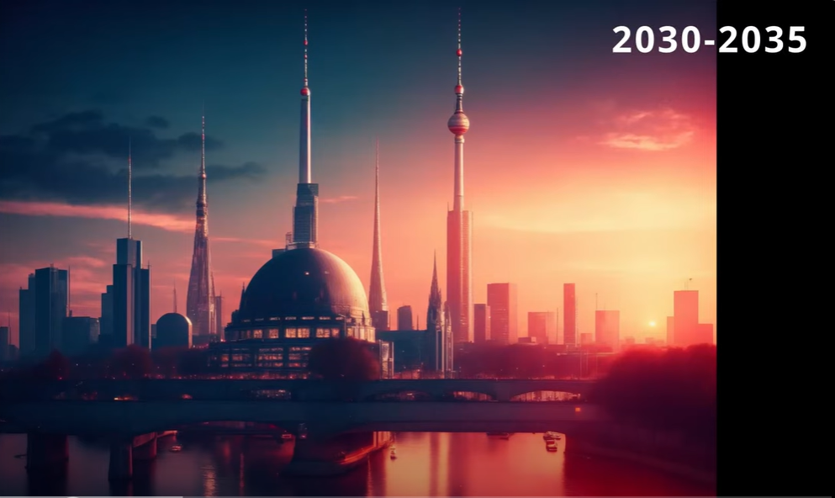
BERLIN, Germany

Slide 4
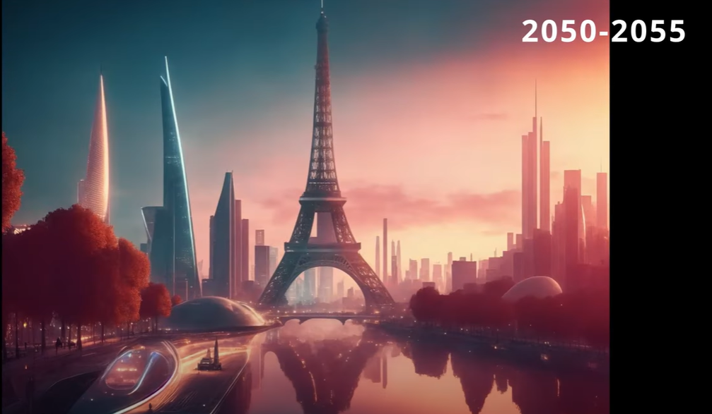
PARIS, France

Slide 5
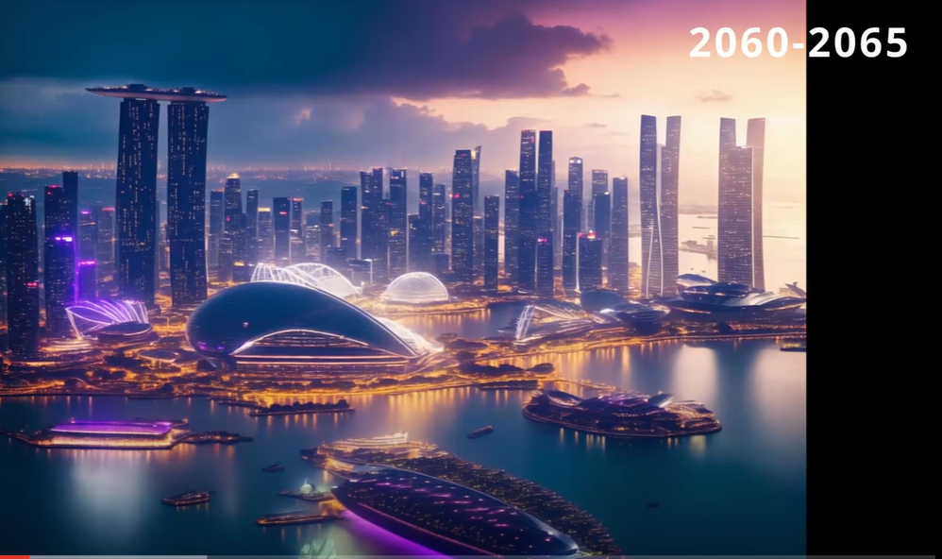
SINGAPORE

Slide 6
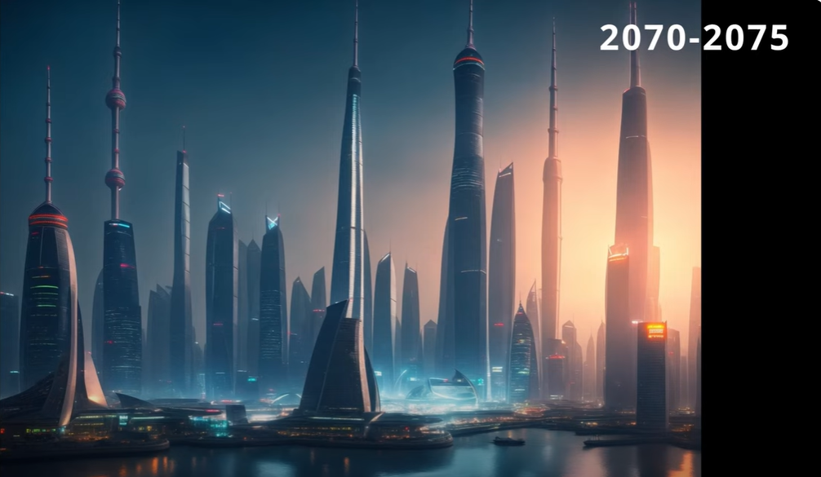
SHANGHAI, China

Slide 7
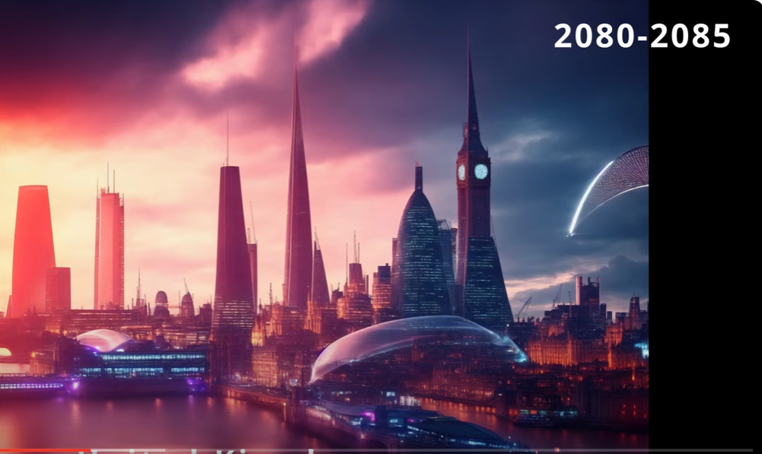
LONDON, England

Slide 8
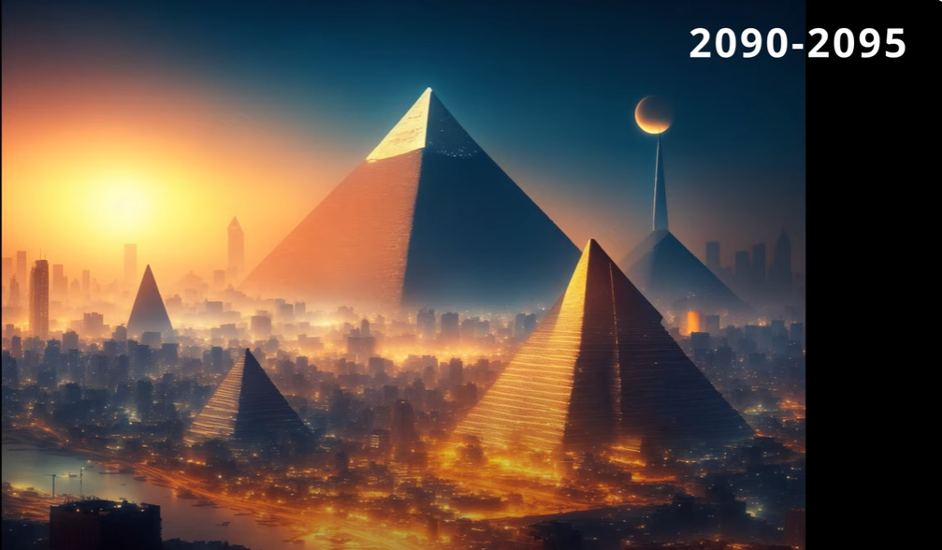
CAIRO, Egypt

Slide 9
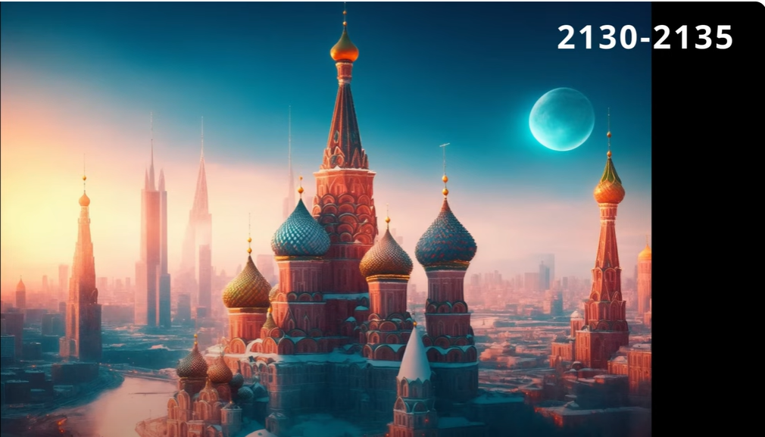
MOSCOW, Russia

Slide 10
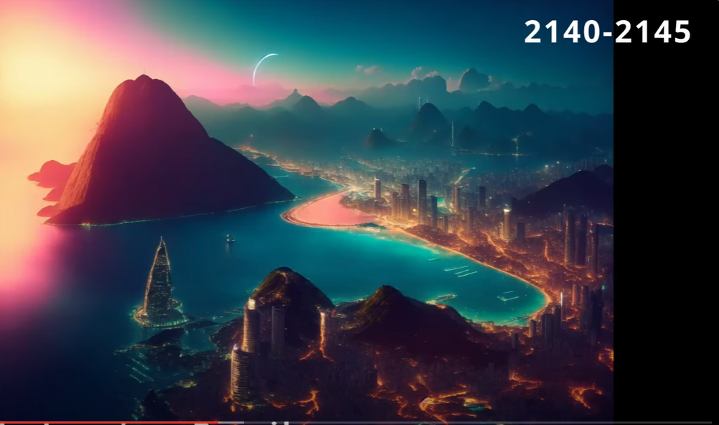
RIO DE JANEIRO, Brazil

Slide 11
TOKYO, Japan

Slide 12
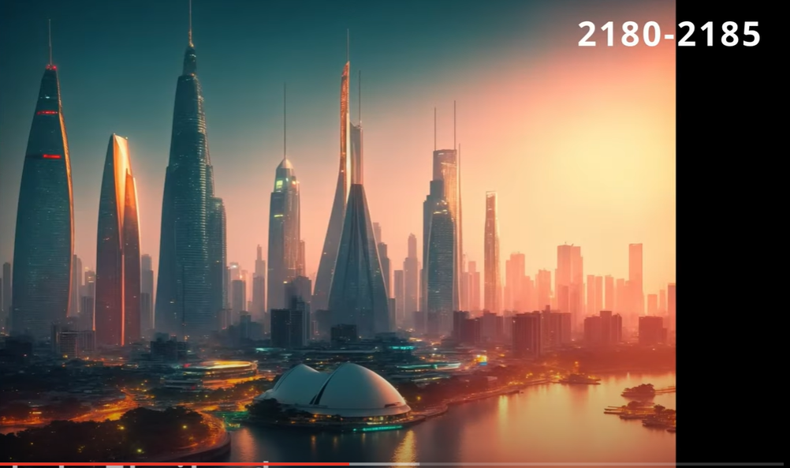
BANGKOK, Thailand

Slide 13
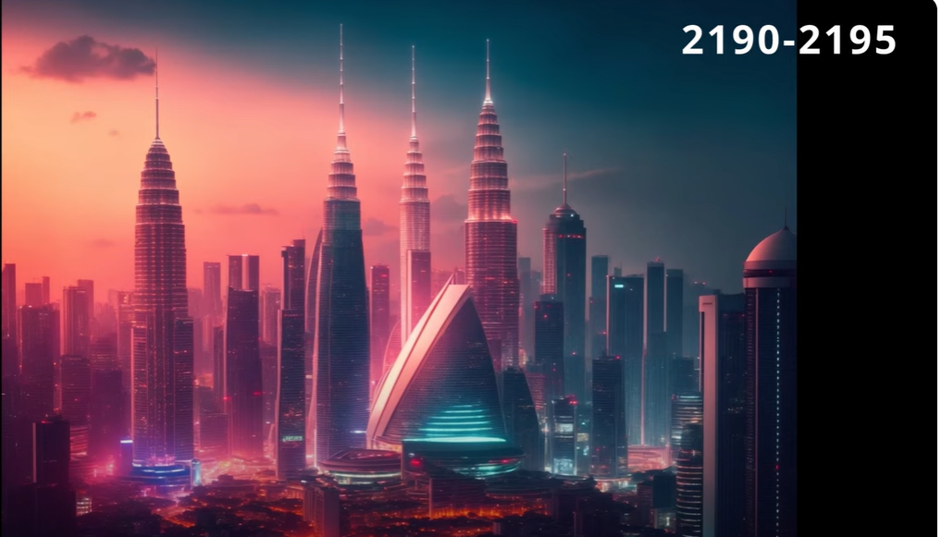
KUALA LUMPUR, Malaysia

Slide 14
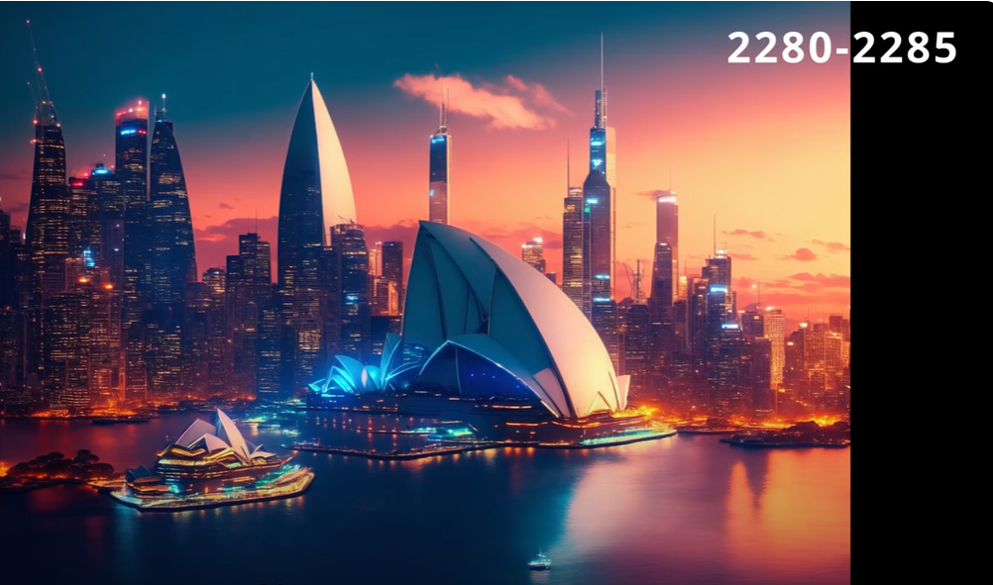
SYDNEY, Australia

Slide 15
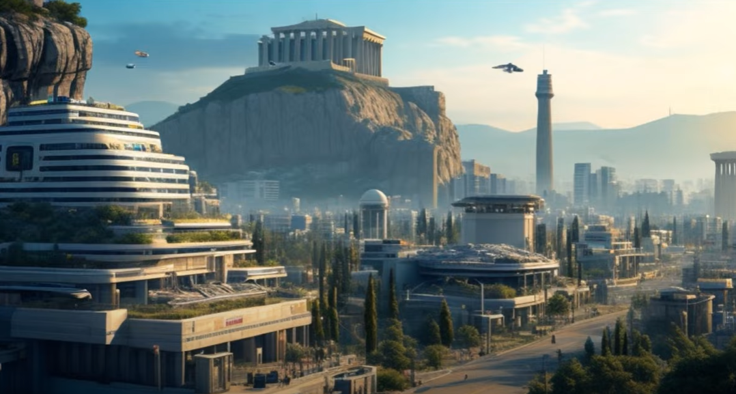
ATHENS, Greece

Slide 16
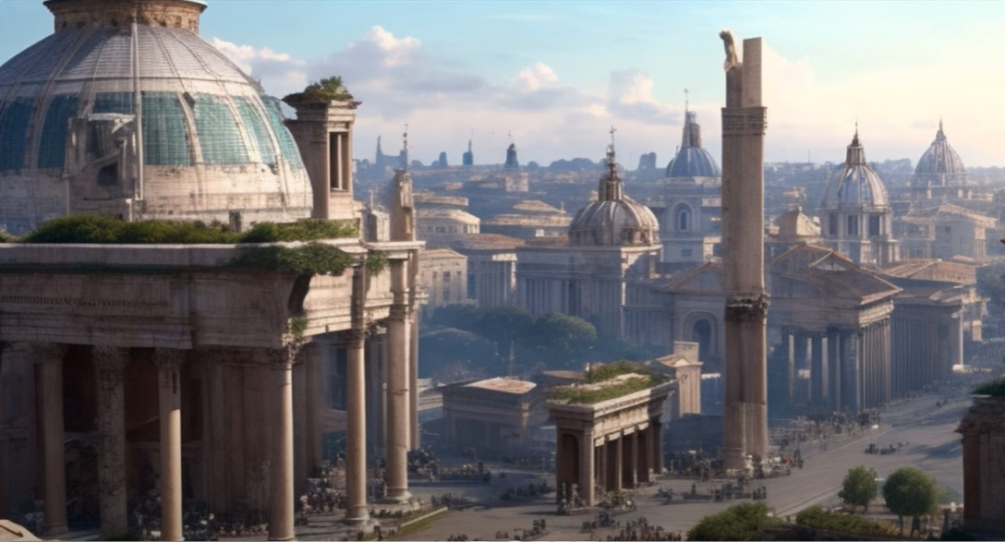
ROME, Italy

Slide 17
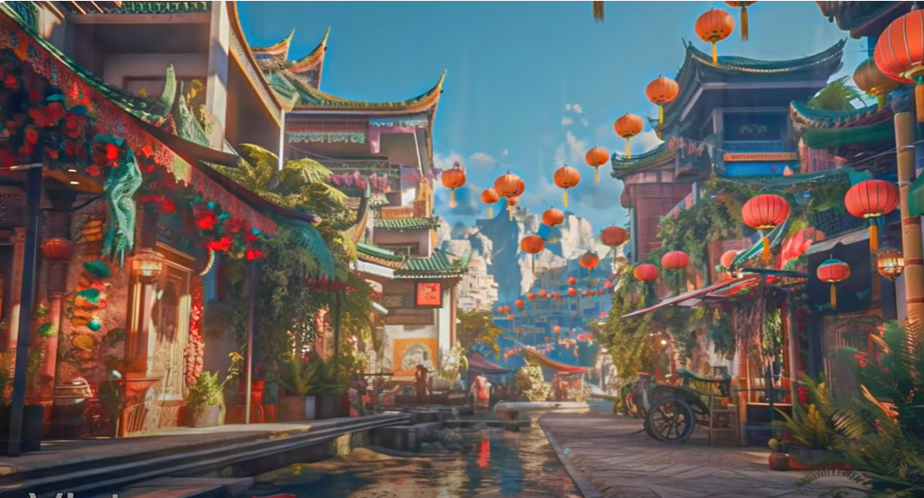
VIETNAM

Slide 18
Unit
3
CITIES OF THE FUTURE
Unit
FAMILY LIFE
LESSON 4
SPEAKING
Discussing cities of the future

Slide 19
LESSON 4
SPEAKING
WARM-UP
Watch a video
Task 1: Complete the diagram.
Task 2: Match the questions with the answers.
CONTROLLED PRACTICE
LESS CONTROLLED PRACTICE
Task 3: Ask and answer questions.
FREE PRACTICE
Task 4: Discussion
Further practice
CONSOLIDATION
Wrap-up
Homework

Slide 20
WARM-UP
WATCH A VIDEO
Notes:
https://youtube.com/watch?v=m1z1rAC7nBs&feature=share

Slide 21
Form | Pronunciation | Meaning
1. environment (n) | /ɪnˈvaɪrənmənt/ | the natural world in which people, animals and plants live
2. private vehicle (n) | /ˈpraɪvət ˈviːəkl/ | any vehicle that is used primarily for the private purpose of the person who owns it
3. public transport (n) | /ˌpʌblɪk ˈtrænspɔːt/ | the system of buses, trains, etc. provided by the government or by companies, which people use to travel from one place to another
4. infrastructure (n) | /ˈɪnfrəstrʌktʃə(r)/ | the basic systems and services that are necessary for a country or an organization to run smoothly, for example buildings, transport and water and power supplies
5. eco-friendly (adj) | /ˌiːkəʊ ˈfrendli/ | not harmful to the environment
6. sensor technology (n) | /ˈsensə(r) tekˈnɒlədʒi/ | a technology that uses sensors to acquire information by detecting the physical, chemical, or biological property quantities and convert them into readable signal

Slide 22
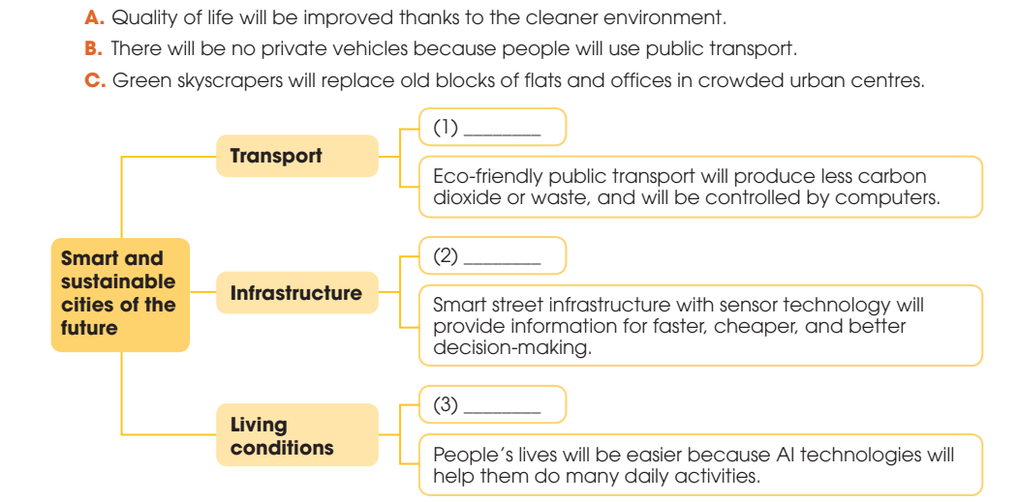
CONTROLLED PRACTICE
1
Work in pairs. Complete the diagram with the ideas below .
B
B
C
C
A
A

Slide 23
CONTROLLED PRACTICE
2
Match the questions with the answers to make a conversation. Then practise it in pairs.
What do you think transport will be like in the cities of the future?
So, how will people travel in the city?
Really? Why do you think public transport will be popular with city dwellers?
They will use public transport instead of their own vehicles.
because technology will make public transport faster, more convenient, and more eco friendly
Well, I think there will be no private vehicles in the cities.

Slide 24
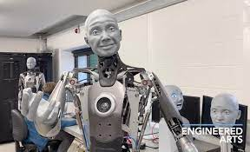
LESS CONTROLLED PRACTICE
3
Work in pairs. Ask and answer questions about one of the features of future cities in 1. Use the model and the tips in 2 to help you.
Example: A: How will city dwellers’ life be like in the future? B: Well, I think people’s lives will be easier because AI technologies will help them do many daily activities. A: So, what kinds of activities can be done by AI technologies? B: Robots can help people do household chores and smart sensors can inform people of possible congestion in the street. It really saves people time and money. A: That’s great.

Slide 25
FREE PRACTICE
4
Work in groups.
Discuss what the cities of the future will be like and present your groups’ ideas to the whole class.

Slide 26
FURTHER PRACTICE
Work in pairs and talk about the feature that they like most about the future cities.

Slide 27
CONSOLIDATION
1
Wrap-up
What have you learnt today?
Discuss cities of the future

Slide 28
CONSOLIDATION
2
Homework
Do exercises in the workbook.
Prepare for Lesson 5 - Unit 3.

Slide 29
Website: hoclieu.vn
Fanpage: facebook.com/www.tienganhglobalsuccess.vn

