Slide 2
LESSON I
GETTING STARTED
WARM-UP
Categorizing game
PRESENTATION
Vocabulary
Task 1: Listen and read.
Task 2: Decide who has the skills.
Task 3: Find words or a phrase.
Task 4: Match the two halves to make sentences.
PRACTICE
PRODUCTION
Role-play
CONSOLIDATION
Wrap-up
Homework

Slide 3
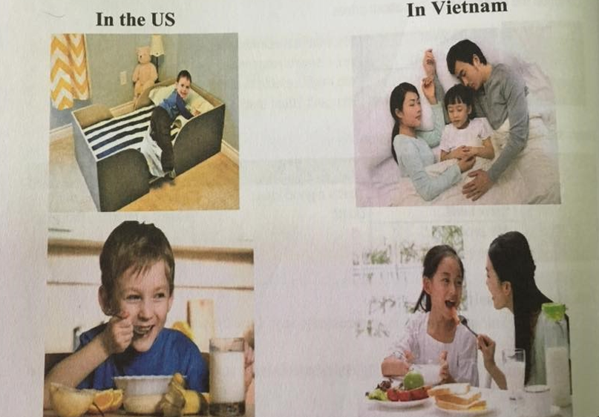
INDEPENDENT
DEPENDENT

Slide 4
CATEGORIZING GAME
- Work in 4 groups.
- Each group is given pieces of paper about dependent and independent lifestyles.
- Classify them to correct columns.
- The first team to complete the task correctly is the winner.
- Go to the board and show the answers.

Slide 5
Independent lifestyle
Dependent lifestyle
+ Cook for yourself
+ Keep asking parents for money
+ Wait for parents to cook
+ Have good time management
+ Need mother to drop you off at school
+ Communicate badly with people
+ Know how to keep house
+ Keep your body clean
+ Think twice before deciding
+ Eat instant noodles all the time
+ Get enough good sleep
+ Not do your homework

Slide 6
Independent lifestyle
Dependent lifestyle
+ Cook for yourself
+ Have good time management
+ Know how to keep house
+ Keep your body clean
+ Think twice before deciding
+ Get enough good sleep
+ Keep asking parents for money
+ Wait for parents to cook
+ Not do your homework
+ Need mother to drop you off at school
+ Communicate badly with people
+ Eat instant noodles all the time

Slide 7
Unit
8
BECOMING INDEPENDENT
Unit
FAMILY LIFE
LESSON I
GETTING STARTED
Earning your parents’ trust

Slide 8
PRESENTATION
independent (adj)
/ˌɪndɪˈpendənt/
confident and free to do things without needing help from other people

Slide 9
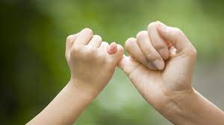
PRESENTATION
trust (n)
/trʌst/
the belief that sb/sth is good, sincere, honest, etc.

Slide 10
PRESENTATION
convince (v)
/kənˈvɪns/
to make someone feel certain that something is true

Slide 11
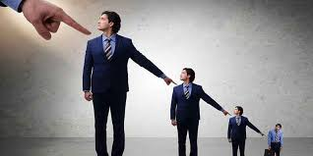
PRESENTATION
responsible (adj)
/rɪˈspɔnsɪbəl/
having the job or duty of doing sth or taking care of sb/sth

Slide 12
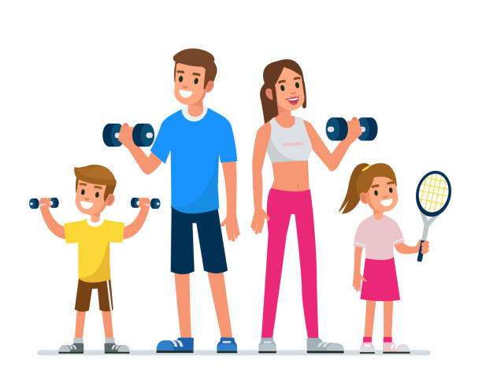
PRESENTATION
encourage (v)
/ɪnˈkʌr.ɪdʒ/
to give sb support, courage or hope

Slide 13
Form | Pronunciation | Meaning
independent (adj) | /ˌɪndɪˈpend^{ə}nt/ | confident and free to do things without needing help
trust (n) | /trʌst/ | the belief that sb/sth is good, sincere, honest, etc.
convince (v) | /kənˈvɪns/ | to make someone feel certain that something is true
responsible (adj) | /rɪˈspɔnsɪbəl/ | having the job or duty of doing sth or taking care of sb/sth
encourage (v) | /ɪnˈkʌrɪdʒ/ | to give sb support, courage or hope

Slide 14
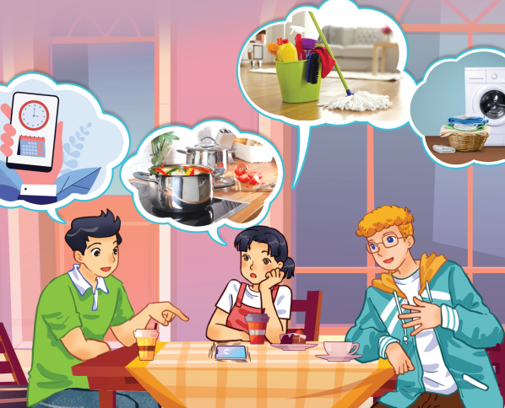
PRESENTATION
1
Listen and read.

Slide 15
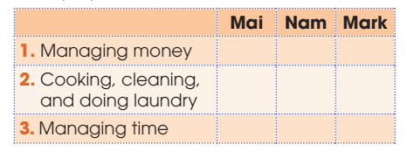
PRACTICE
2
Read the conversation again and decide who has these skills. Put a tick ( ) in the correct column.
✓
✓
✓
✓

Slide 16
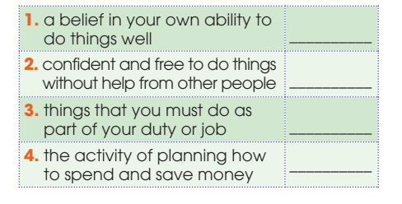
PRACTICE
3
Find words and a phrase in 1 that have the following meanings.
confidence
independent
responsibilities
money-management

Slide 17
PRACTICE
4
Match the two halves to make sentences used in 1.
It’s my mum | that took a long time
2. It was earning my parents’ trust | b. who still think I don’t have the skills to be independent.
3. It’s my parents | c. that taught me how to be responsible with money.
4. It’s the app | d. who is calling me again.
1. d 2. a 3. b 4. c

Slide 18
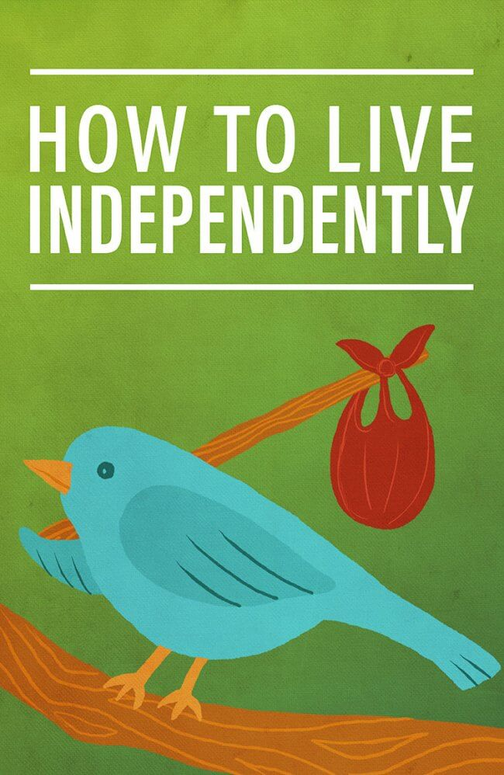
PRODUCTION
Role-play
- Ss work in groups of 4.
- In each group, one student plays the role of a student. Others are advisors. Advisors are giving advice on how to live independently.
- 3 minutes to prepare for the role-play.
- 2 minutes for a performance.

Slide 19
CONSOLIDATION
1
Wrap-up
What have you learnt today?
Some lexical items about becoming independent
Reading for specific information
Cleft sentence with “it is/was … who/ that…”

Slide 20
CONSOLIDATION
2
Homework
Do exercises in the workbook.
Prepare for Lesson 2 - Unit 8.
Prepare materials for the project in lesson 8

Slide 21
Website: hoclieu.vn
Fanpage: facebook.com/www.tienganhglobalsuccess.vn

