Slide 1

Unit 4: Community Services
Lesson 1.1: Vocabulary & Reading
Page 28

Slide 2



LESSSON OUTLINE
Consolidation

Slide 3

By the end of this lesson, students will be able to…
- talk about charity events.
- practice reading and understanding general and specific information about charity events.

Slide 4
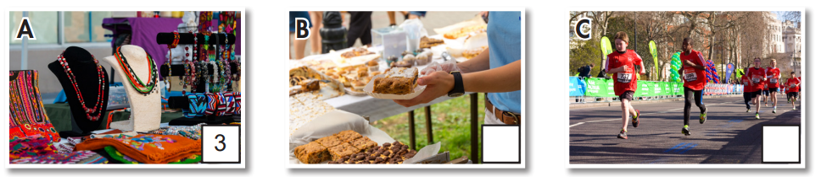
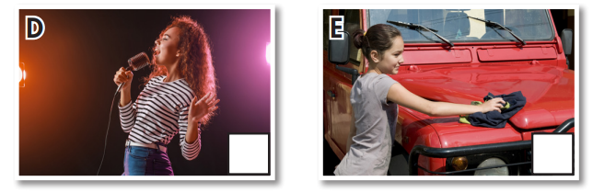
New words
car wash
bake sale
craft fair
talent show
fun run

Slide 5

Lesson 1
WARM UP

Slide 6

Work in pairs
1 Do you ever do charity work?
2 Who do charity events usually help?
3 What activities can you take part in?

Slide 7



Slide 8
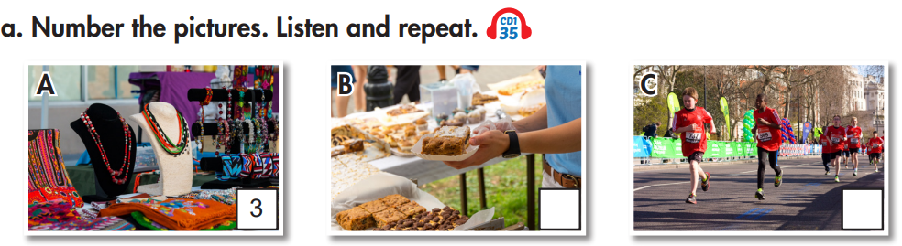
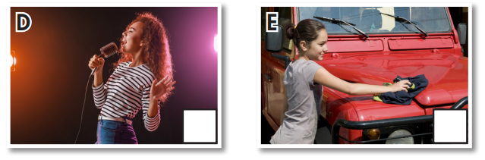
Work in pairs. What can you see in each picture?

Slide 9
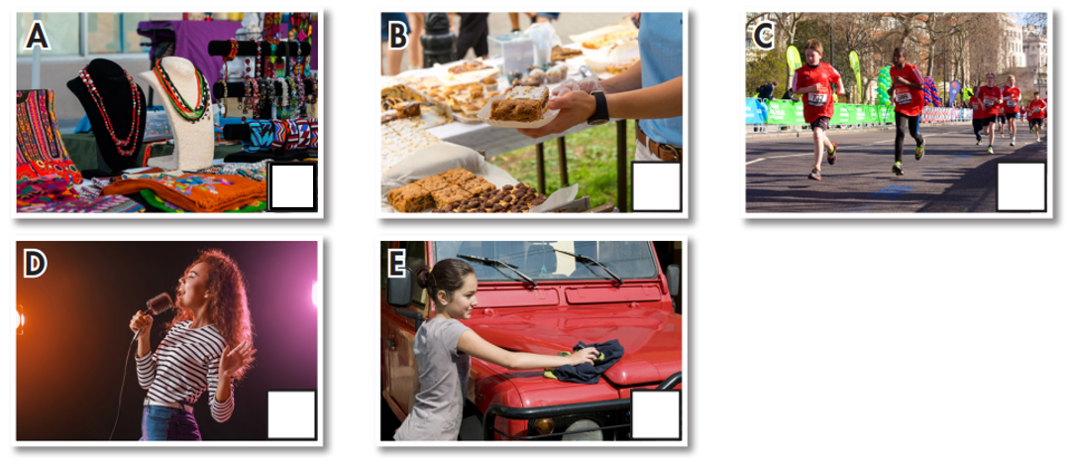
Work in pairs. a. Match each phrase to each picture.
1. car wash
2. bake sale
3. craft fair
4. talent show
5. fun run
3
2
5
4
1

Slide 10

Listen and repeat. (Click each word to hear the sound)
car wash (n phr) /kɑːr wɑːʃ/ rửa xe
bake sale (n phr) /beɪk seɪl/ bán bánh
craft fair (n phr) /kræft fer/ hội chợ hàng thủ công
talent show (n phr) /ˈtælənt ʃoʊ/ biểu diễn tài năng
fun run (n phr) /fʌn rʌn / thi chạy bộ
Notes:
GV click vào từng cụm nghe âm thanh

Slide 11
Work in pairs. b. Circle the correct definition for the underlined word or phrase.
1. My brother is a volunteer at his school. He helps teach young children after school.
A. someone who helps for free B. an activity to help people for free
2. Let's organize a charity event to support poor students in our town.
A. an outdoor activity B. an activity to help people in need
3. All children have the right to go to school. We must do everything we can to help them go to school.
A. a rule about what a person should have
B. a rule about what a person can't do

Slide 12
Listen and repeat.
(click each word to hear the sound)
volunteer (n) /ˌvɑːlənˈtɪr/ tình nguyện viên
charity event (n phr) /ˈtʃerəti ɪˈvent/ sự kiện từ thiện
right (n) /raɪt/ quyền lợi
Notes:
GV click vào từng cụm nghe âm thanh

Slide 13
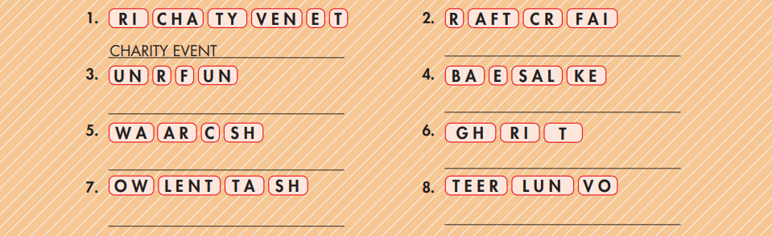
Extra Practice
WB, page 20
Unscramble the groups of letters to make phrases.
CRAFT FAIR
FUN RUN
BAKE SALE
CAR WASH
RIGHT
TALENT SHOW
VOLUNTEER

Slide 14
Fill in the blanks using the words in the previous slide.
charity event
1. We will organize a ______________ to give school books to children.
2. My dad works in a bakery in our hometown. He always helps when there's a ______________.
3. Every summer vacation, we have a ______________, where we run to raise money to help families in need.
4. All children have the ______________ to be happy and healthy.
bake sale
fun run
right

Slide 15
5. People can make things like bracelets or stuffed animals, and sell them at a ______________.
6. My brother is working as a ______________ in Sudan. He helps build schools and teach young kids there.
7. Every summer, the library organizes a ______________ next to a busy road to raise money.
8. If you like singing, dancing, or playing an instrument, you can join a ______________.
craft fair
volunteer
charity event
talent show

Slide 16


Work in pairs.
c. Please add 3 charity events. What do you think about them?

Slide 17

It’s reading time….

Slide 18
Pre - reading
Read the instruction quickly. Underline the key words. What are we going to do?
Read the article and choose the best headline.
Read the article and choose the best headline.
1. Help Us Bring Happiness to Children!
2. Charity Event Ideas to Raise Money.

Slide 19
Look at the article. Quickly read the information.
What events can you see? Who will the money be used to help? What’s the text about?
The United Nations says that all children under 18 have the right to live, be healthy and happy, and much more*, but some poor children don't have these rights. They don't have enough food, and can't go to school. So, please join us in helping poor children. We are going to do these activities next month to raise money:
• Craft Fair (May 15th – 16th). Many talented artists will be there! You’ll find lots of cool things like cute stuffed animals and pretty paintings. There will also be arts and crafts workshops in the afternoons.
• Bake Sale (May 22nd – 23rd). Come buy cookies, cupcakes, pies, and more! Don't miss the cupcake decorating competition on May 23rd!
We’ll use the money from these events to buy clothes, books, and toys for children. We also need volunteers to help organize the events. Please contact brendajohnson@foreverychild.org for more information.

Slide 20


Skim the text. Underline the key words. Choose the best headline.
The United Nations says that all children under 18 have the right to live, be healthy and happy, and much more*, but some poor children don't have these rights. They don't have enough food, and can't go to school. So, please join us in helping poor children. We are going to do these activities next month to raise money:
• Craft Fair (May 15th – 16th). Many talented artists will be there! You’ll find lots of cool things like cute stuffed animals and pretty paintings. There will also be arts and crafts workshops in the afternoons.
• Bake Sale (May 22nd – 23rd). Come buy cookies, cupcakes, pies, and more! Don't miss the cupcake decorating competition on May 23rd!
We’ll use the money from these events to buy clothes, books, and toys for children. We also need volunteers to help organize the events. Please contact brendajohnson@foreverychild.org for more information.

Slide 21
Pre - reading
Read the instruction quickly. What are we going to do?
Read and write Yes, No, or Doesn’t say.

Slide 22

1. Every child has the same 18 rights. ______________
2. The charity events will happen this month. ______________
3. You can join arts and crafts workshops in the morning on May 15th. ______________
4. You can also decorate cupcakes at the bake sale. ______________
5. Volunteers will help organize both the craft fair and bake sale. ______________

Slide 23
While - reading
Scan the text. Write Yes, No, or Doesn’t say.
Doesn’t say
The United Nations says that all children under 18 have the right to live, be healthy and happy, and much more*, but some poor children don't have these rights. They don't have enough food, and can't go to school. So, please join us in helping poor children. We are going to do these activities next month to raise money:
• Craft Fair (May 15th – 16th). Many talented artists will be there! You’ll find lots of cool things like cute stuffed animals and pretty paintings. There will also be arts and crafts workshops in the afternoons.
• Bake Sale (May 22nd – 23rd). Come buy cookies, cupcakes, pies, and more! Don't miss the cupcake decorating competition on May 23rd!
We’ll use the money from these events to buy clothes, books, and toys for children. We also need volunteers to help organize the events. Please contact brendajohnson@foreverychild.org for more information

Slide 24
While - reading
Scan the text. Circle the answer.
No
The United Nations says that all children under 18 have the right to live, be healthy and happy, and much more*, but some poor children don't have these rights. They don't have enough food, and can't go to school. So, please join us in helping poor children. We are going to do these activities next month to raise money:
• Craft Fair (May 15th – 16th). Many talented artists will be there! You’ll find lots of cool things like cute stuffed animals and pretty paintings. There will also be arts and crafts workshops in the afternoons.
• Bake Sale (May 22nd – 23rd). Come buy cookies, cupcakes, pies, and more! Don't miss the cupcake decorating competition on May 23rd!
We’ll use the money from these events to buy clothes, books, and toys for children. We also need volunteers to help organize the events. Please contact brendajohnson@foreverychild.org for more information

Slide 25
While - reading
Scan the text. Circle the answer.
No
The United Nations says that all children under 18 have the right to live, be healthy and happy, and much more*, but some poor children don't have these rights. They don't have enough food, and can't go to school. So, please join us in helping poor children. We are going to do these activities next month to raise money:
• Craft Fair (May 15th – 16th). Many talented artists will be there! You’ll find lots of cool things like cute stuffed animals and pretty paintings. There will also be arts and crafts workshops in the afternoons.
• Bake Sale (May 22nd – 23rd). Come buy cookies, cupcakes, pies, and more! Don't miss the cupcake decorating competition on May 23rd!
We’ll use the money from these events to buy clothes, books, and toys for children. We also need volunteers to help organize the events. Please contact brendajohnson@foreverychild.org for more information

Slide 26
While - reading
Scan the text. Circle the answer.
Yes
The United Nations says that all children under 18 have the right to live, be healthy and happy, and much more*, but some poor children don't have these rights. They don't have enough food, and can't go to school. So, please join us in helping poor children. We are going to do these activities next month to raise money:
• Craft Fair (May 15th – 16th). Many talented artists will be there! You’ll find lots of cool things like cute stuffed animals and pretty paintings. There will also be arts and crafts workshops in the afternoons.
• Bake Sale (May 22nd – 23rd). Come buy cookies, cupcakes, pies, and more! Don't miss the cupcake decorating competition on May 23rd!
We’ll use the money from these events to buy clothes, books, and toys for children. We also need volunteers to help organize the events. Please contact brendajohnson@foreverychild.org for more information

Slide 27
While - reading
Scan the text. Circle the answer.
Yes
The United Nations says that all children under 18 have the right to live, be healthy and happy, and much more*, but some poor children don't have these rights. They don't have enough food, and can't go to school. So, please join us in helping poor children. We are going to do these activities next month to raise money:
• Craft Fair (May 15th – 16th). Many talented artists will be there! You’ll find lots of cool things like cute stuffed animals and pretty paintings. There will also be arts and crafts workshops in the afternoons.
• Bake Sale (May 22nd – 23rd). Come buy cookies, cupcakes, pies, and more! Don't miss the cupcake decorating competition on May 23rd!
We’ll use the money from these events to buy clothes, books, and toys for children. We also need volunteers to help organize the events. Please contact brendajohnson@foreverychild.org for more information

Slide 28
Post - reading
I’d like to take part in the bake sale because I like decorating cakes.
Work in pairs
Which of the two events would you like to take part in?
I’d prefer the craft fair because I enjoy painting.

Slide 29

CONSOLIDATION

Slide 30
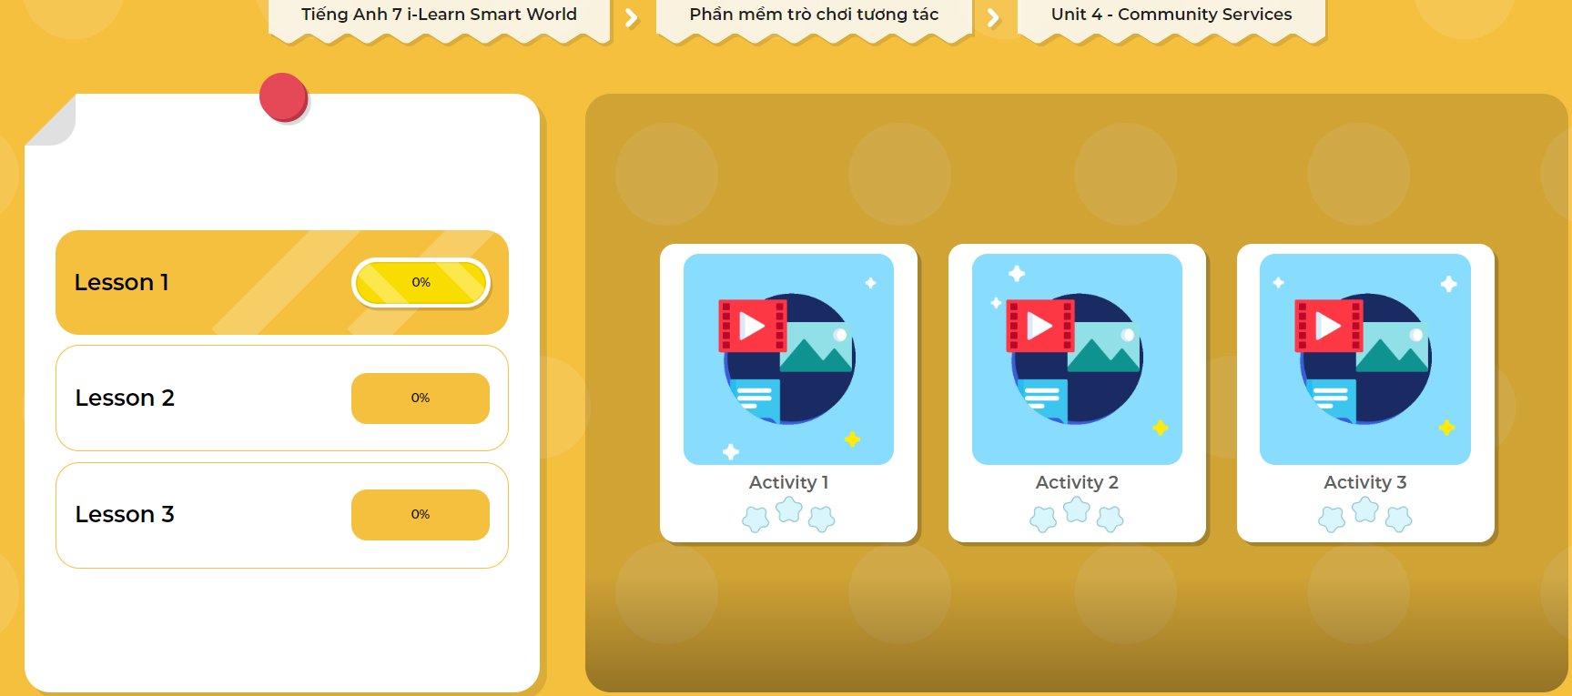
LET’S PLAY!
Click here to play the games

Slide 31
Work in groups of three, discussing the charity events you can organize to help the victims of the storm in the center of Vietnam. Use the words you study today. (7 minutes)

Slide 32

WRAP-UP

Slide 33
Today’s lesson
Vocabularies
Car wash
Bake sale
Craft fair
Fun run
Talent show
Volunteer
Charity event
Right

Slide 34
Lesson 3
Today’s lesson
Reading:
- Understanding instructions.
Skimming and scanning for general and specific information.
Speaking:
- Talking about charity events.

Slide 35
Lesson 3
Homework
Learn by hearts vocabularies and make sentences using them.
Do the exercises on page 20 WB
Do the exercise in Tiếng Anh 7 i-Learn Smart World Notebook (page 22)
Prepare the next lesson (page 29 SB)
Play the consolidation games in Tiếng Anh 7 i-Learn Smart World DHA App on www.eduhome.com.vn

Slide 36

Lesson 3
Stay positive and have a nice day!

