Slide 1
WELCOME TO OUR CLASS
TEACHER:
Phan Thị Trường Ngân
Binh Tan Junior High School

Slide 2
? Whether do you know any names of the sports in the video?
rock climbing, skydiving, hang gliding, skiing, surfing, skateboarding, …

Slide 3
Unit 1: Free Time
Period 8.
Lesson 3.1: Listening & Reading

Slide 5
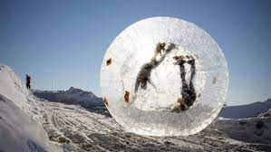
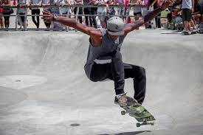
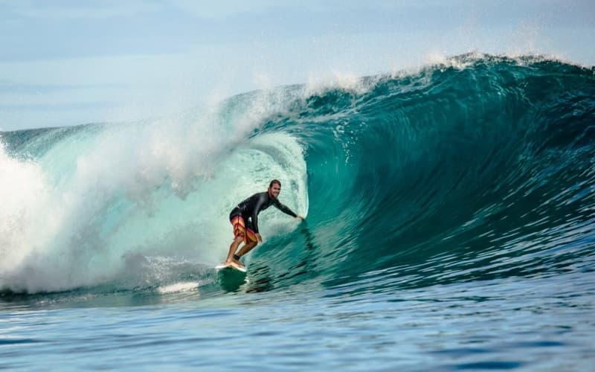
skateboarding (n) /ˈskeɪtˌbɔrdɪŋ/
trò trượt ván
surfing (n) /ˈsɜrfɪŋ/ :
trò lướt sóng :
rock climbing (n)
/rɑk ˈklaɪmɪŋ/
trò leo núi đá (hoặc leo tường có gắn đá)
zorbing (n) /ˈzɔːrbɪŋ/
trò lăn xuống dốc hoặc lăn trên mặt nước trong một quả cầu nhựa trong suốt
extreme sports (n)
/ɛkˈstrim spɔrt/
thể thao mạo hiểm
safety equipment (n)
/ˈseɪfti ɪˈkwɪpmənt/
thiết bị an toàn
Notes:
GV click vào từng cụm nghe âm thanh

Slide 6
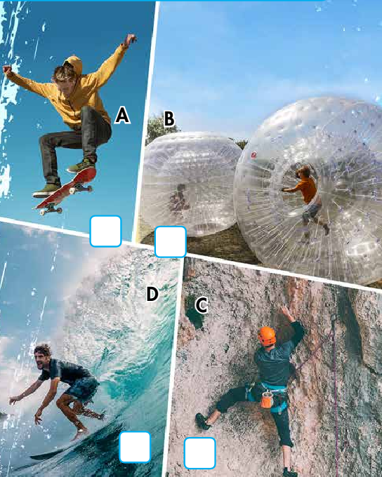
Match the extreme sports to the pictures.
1
4
2
3

Slide 7
It’s listening time….

Slide 9
a. Listen to a talk about extreme sports. How does the speaker feel about them?
1
1. She loves them. 2. She thinks they're very difficult.
“Of course, everything was OK and I loved it.” → She loves them .

Slide 10
b. Now, listen and circle.
1. The speaker used to play soccer/basketball.
2. She tried skateboarding/rock climbing first.
3. She learned at an indoor center/on a mountain.
4. She thought zorbing sounded dangerous/exciting.
5. The first time she went zorbing, she was scared/excited.

Slide 11
Now, listen and circle.
1. The speaker used to play soccer/basketball.
2. She tried skateboarding/rock climbing first.
3. She learned at an indoor center/on a mountain.
4. She thought zorbing sounded dangerous / exciting.
5. The first time she went zorbing, she was scared/ excited.

Slide 12
Audio script:
I used to spend a lot of time playing soccer. Then, one day, a friend introduced me to extreme sports. These are sports that are very dangerous and exciting, for example, skateboarding and surfing. The first extreme sport I tried was rock climbing. I learned how to do it at an indoor rock climbing center, but I was soon climbing mountains. After that, I was ready for a new challenge. I heard about zorbing and thought it sounded really exciting. Zorbing is when you get inside a big, soft ball, and roll down a hill. The first time I went zorbing, I was pretty scared. I thought the ball would break! Of course, everything was OK and I loved it.

Slide 13
It’s reading time….

Slide 14
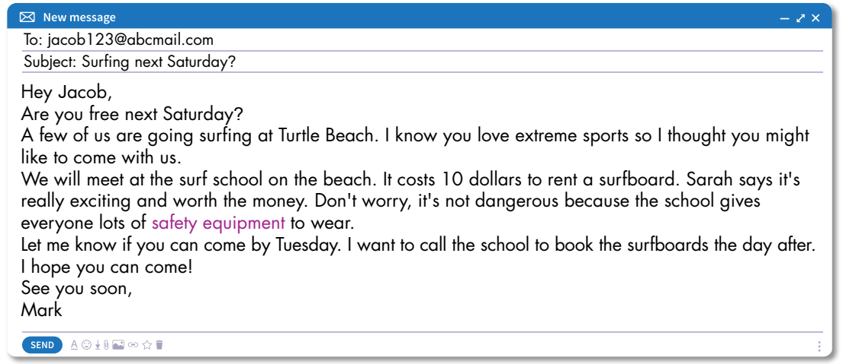
trying a new activity 2. doing an activity again

Slide 15
The email is about
1. trying a new activity
? What email is about?

Slide 16
b. Now, read and answer the questions.
1. What extreme sport does Mark invite Jacob to do?
2. Where is the school?
3. What does Sarah say?
4. What does the school give everyone to wear?
5. When will Mark book the surfboards?

Slide 17
LUCKY NUMBER
1
2
3
4
5
6

Slide 18
What extreme sport does Mark invite Jacob to do?
Surfing.

Slide 19
Lucky Number
Lucky Number

Slide 20
Where is the school?
On the beach.

Slide 21
What does Sarah say?
It’s really exciting and worth the money.

Slide 22
What does the school give everyone to wear?
Safety equipment.

Slide 23
When will Mark book the surfboards?
(on) Wednesday.

Slide 24
b. Now, read and answer the questions.
1. What extreme sport does Mark invite Jacob to do?
2. Where is the school?
3. What does Sarah say?
4. What does the school give everyone to wear?
5. When will Mark book the surfboards?
Surfing.
On the beach.
It’s really exciting and worth the money.
Safety equipment.
Wednesday.

Slide 25
c. In pairs.
Which extreme sport would you like to try?
→ I would like to try skateboarding.
Why?
→ Because it’s really interesting and it makes me feel excited.

Slide 26
HOMEWORK
Learn by heart the new vocabularies.
Practice talking about the extreme sport you like.
Do exercises in Workbook: Lesson 3 – Listening and Reading (page 6).
Practice the vocabulary in Tiếng Anh 7 i-Learn Smart World Notebook (page 8).
Prepare: Lesson 3 – Writing and Speaking (page 11 – SB).

Slide 27
Thank you for
Your attention!

Slide 28
The bye bye song
Bye, bye.
See you tomorrow.
Bye, bye.
See you tomorrow.
Bye, bye.
See you tomorrow.
Bye, bye. Bye, bye.
The bye bye
song
Notes:
28
28

